Slide 1
GEO Group
Budget Comparison
Overhead Expenses
Financial Data

Slide 2
Report to the Jail Oversight Board
Questions were raised during the JOB meeting of April 13th about how Delaware could manage the GWH facility at lower costs than GEO’s current contract. The following presentation provides:
  - comparisons to Montgomery and Chester prison budgets;
  - details of GEO’s overhead costs that are passed on to Delaware County taxpayers; and
  - details about GEO’s financials which raise concerns about its financial health.

Slide 3
Organization | Budget | Capacity (Beds) | Per Diem | Average Correctional Officer Pay
GEO Group | $52.8 M | 1,883 | $76.83 / Day | $16.45 / Hour
Montgomery County | $41 M | 2,020 | $55.61 / Day | $22.30 / Hour
Chester County | $32 M | 1,135 | $77.24 / Day | $21.00 / Hour

Slide 4
Findings from Visits to Montgomery and Chester Prisons
Higher wage level for Correctional Officers results in better morale, better quality applicants and lower staff turnover rates. College graduates are applying for CO jobs.
Central booking unit is housed and staffed at the Montgomery County prison, helps reduce prison population and allows district police to focus on policing.
Alternative Courts (health, drug, veterans) are held at Montgomery County prison which improves services and reduces prison population.
Significant community engagement with residents of the prison which assists with re-entry programs.

Slide 5
Total Compensation of GEO’s “Top 5 Executive Officers”
Total Compensation (2017-2020) = $57.6 M
2017
$19.6 M
2018
$14.3M
2019
$13.6 M
2020
$10 M

Slide 6
Total Compensation of GEO’s “Top 5 Executive Officers”
Total Compensation (2017-2020) = $57.6 M
▸Annual average compensation Total = $14.4 M
▸Annual average compensation per Officer = $2.9 M

Slide 7
GEO Board of Director Compensation
Total Compensation (2017-2020) = $7.4 M
Annual Average = $1.8 M
2017
$2.2 M
2018
$1.2 M
2019
$1.7 M
2020
$1.6 M

Slide 8
GEO Domestic Income Taxes Paid
Domestic Income Taxes Paid (2017-2020) = $69.2 M
Annual Average = $17.3 M
2017
$18 M
2018
$14.1 M
2019
$16.7 M
2020
$20.5 M

Slide 9
GEO Political Contributions
Total Contributions (2017-2019) = $8.4 M*
2017
$2.4 M
2018
$3.3 M
2019
$2.8 M
*This total figure does not include GEO’s political contributions in 2020.

Slide 10
GEO Federal Lobbying Expenses
Total Expenses (2017-2020) = $13.2 M
2017
$3.2 M
2018
$4.3 M
2019
$4.3 M
2020
$1.4 M*
*The GEO Political Activity and Lobbying Report for 2020 is not yet available; figure reflected for 2020 covers only GEO federal lobbying expenditures in 2020 as reported on OpenSecrets.org. According to OpenSecrets.org, during 2020, GEO ranked 337 out of 5,561 organizations tracked in lobbying expenditures.

Slide 11
GEO Overhead Expenses (2017-2020)
$57.6 M
GEO “Top 5 Executive Officers” Total Compensation (2017-2020)
$7.4 M
GEO Board of Directors Compensation (2017-2020)
$69.2 M
GEO Domestic Income Taxes Paid (2017-2020)
$8.4 M
GEO Political Contributions (2017-2019)
$13.2 M
GEO Federal Lobbying Expenses (2017-2020)
$156 M
Total
Information from March 19, 2021 GEO SEC Proxy Statement:
https://sec.report/Document/0001193125-21-087535/d112096ddef14a.htm#toc112096_8

Slide 12
GEO Earnings
Total Expenses (2017-2020) = $13.2 M
2017
$146 M
2018
$145 M
2019
$167 M
2020
$113 M*
*Earnings data from Consolidated Statements submitted to the Securities and Exchange Commission ( https://www.sec.gov/Archives/edgar/data)

Slide 13
Total GEO Exec Comp, Other Expenses and Earnings for 2019
$13.6 M – Executive Compensation
$1.7 M - Board Compensation
$2.8 M - Political Contributions
$4.3 M – Lobbying Expenses
$16.7 M – Income Taxes
$168 M – Earnings
$206.1 M - Total

Slide 14
Calculation of Extra Overhead Costs Due to Exec Comp, Political, Lobbying, Taxes and Earnings - 2019
Total Number of Beds Managed by GEO = 93,000 Beds
Total Exec Comp and Other Costs = $206.1 M
Exec Comp, Earnings and Other Costs per Bed = $2,216 per year
Total Number of Beds at GWH = 1,883 Beds
$2,216 X 1,883 = $4,172,971 Estimate of Extra Overhead Costs Allocated to GEO Contract with Delaware County

Slide 15
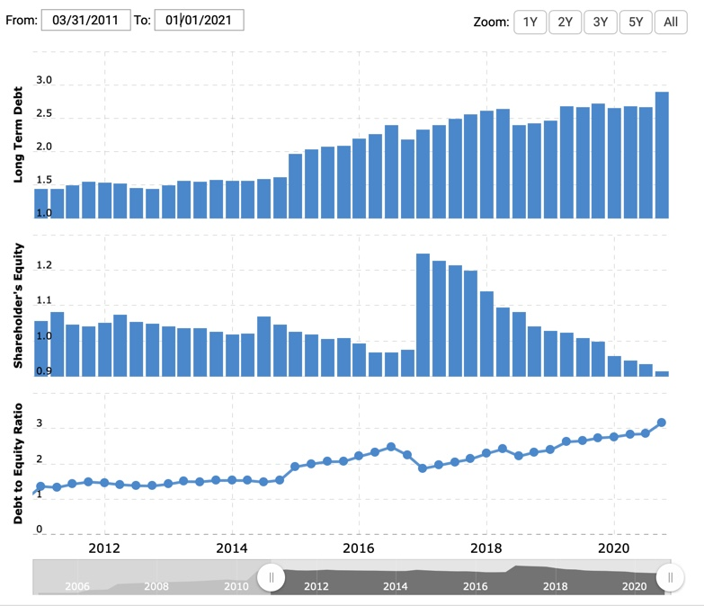
GEO’s Financial Health
Debt: GEO’s debt has increased from $2.5 billion to over $3 billion in the past four years, while shareholder’s equity has declined.
(From Macrotrends)

Slide 16
GEO’s Debt Problem
GEO recently borrowed $230M for a short 5-year term at 6.5% (a very high rate in today’s market).
The Biden Administration decided in 2021 not to renew its govt service contracts. GEO stands to lose substantive revenue from expiration of Federal Prison Contracts.
In March 2021, both S&P and Moody’s downgraded GEO’s debt to less than investment grade (Junk Bond Status)
Source: https://www.bloomberg.com/news/articles/2021-03-24/private-prison-operators-hit-by-downgrades-after-biden-order

Slide 17
GEO Cuts Dividend on April 8th, 2021
GEO announced on April 8th, 2021, it was suspending its dividend and would maximize the use of cash flows to repay debt, deleverage, and internally fund growth.
GEO’s stock was primarily owned by income investors who coveted the predictable dividend stream and presumable safe government counterparties.
Not surprising, the stock has dropped precipitously.

Slide 18
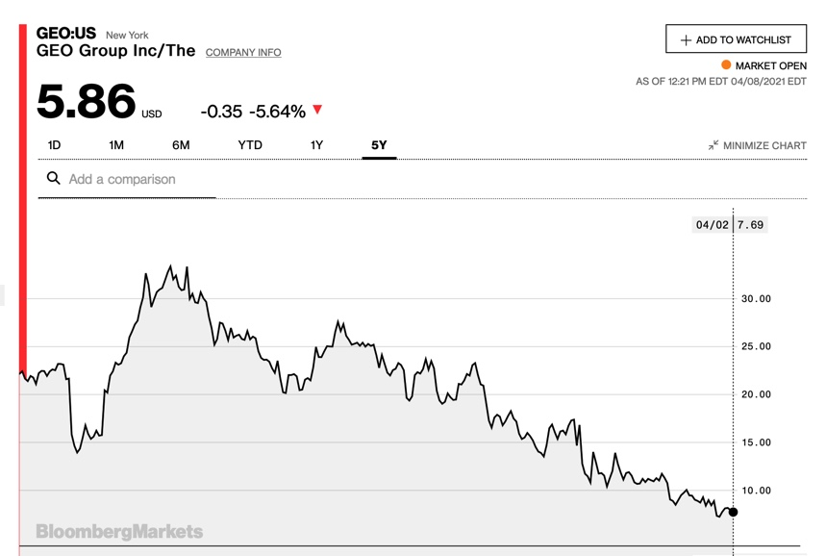
GEO stock price has dropped from $33 per share to less than $6 per share in the past four years — a substantial drop in value of 82%. Whereas the S&P has appreciated more than 75% during this same time period.
(Source: Bloomberg)

Slide 19
GEO’s Market Value (Given its share price and shares outstanding):
2017
$4 Billion
May 2021
$729 Million

