Slide 1
Personal Health Division
Maternal and Child Health Programs Overview
November 21, 2024

Slide 2
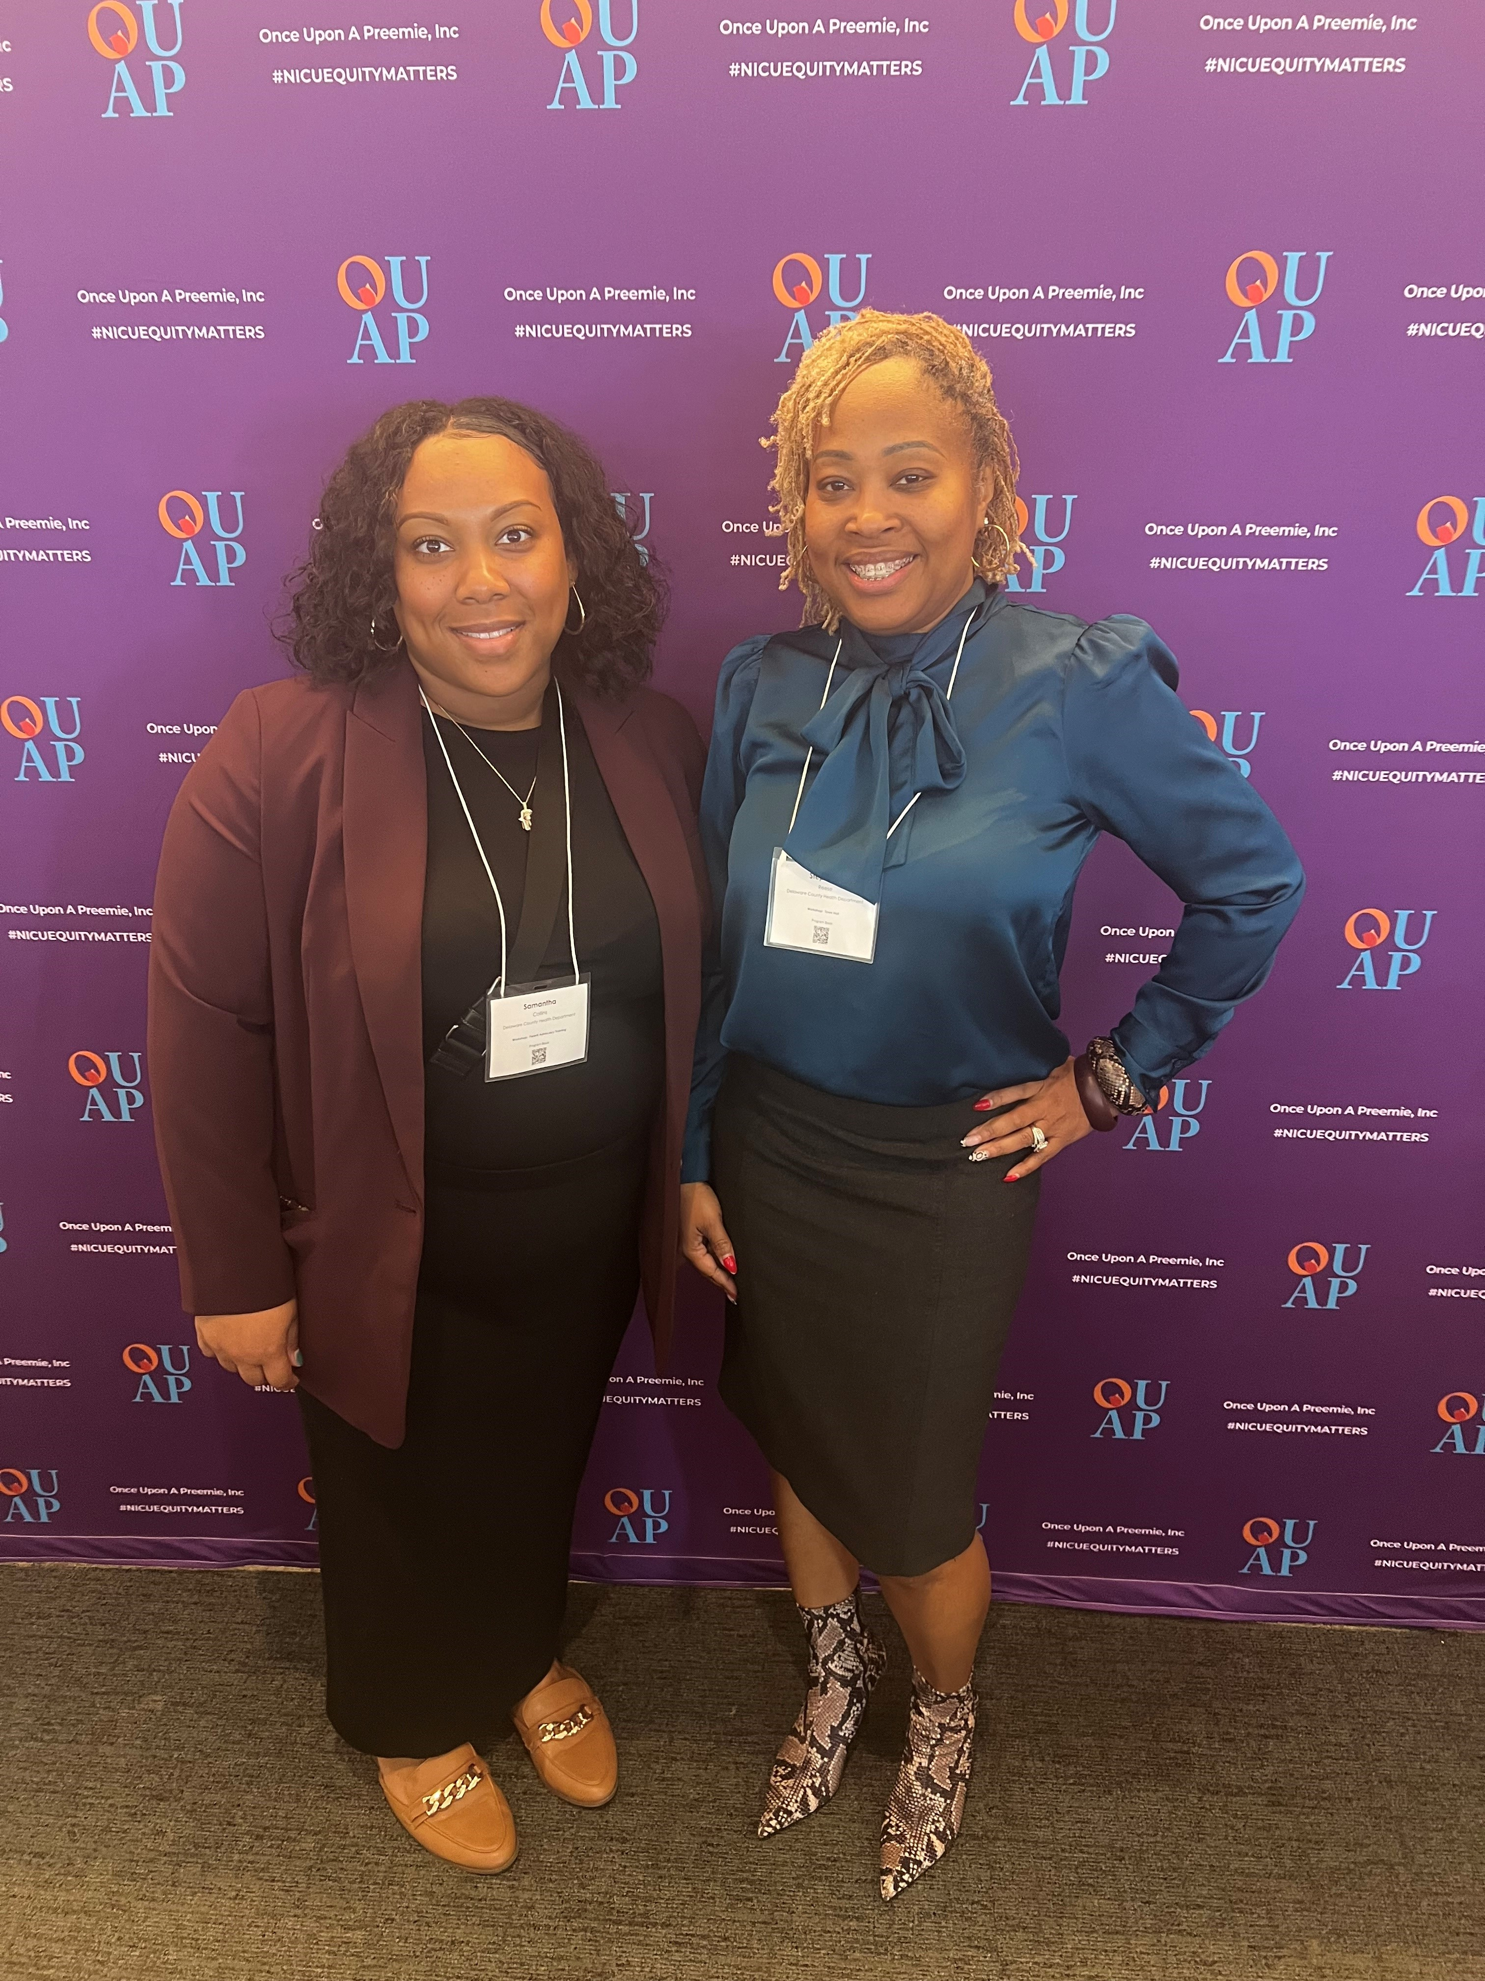
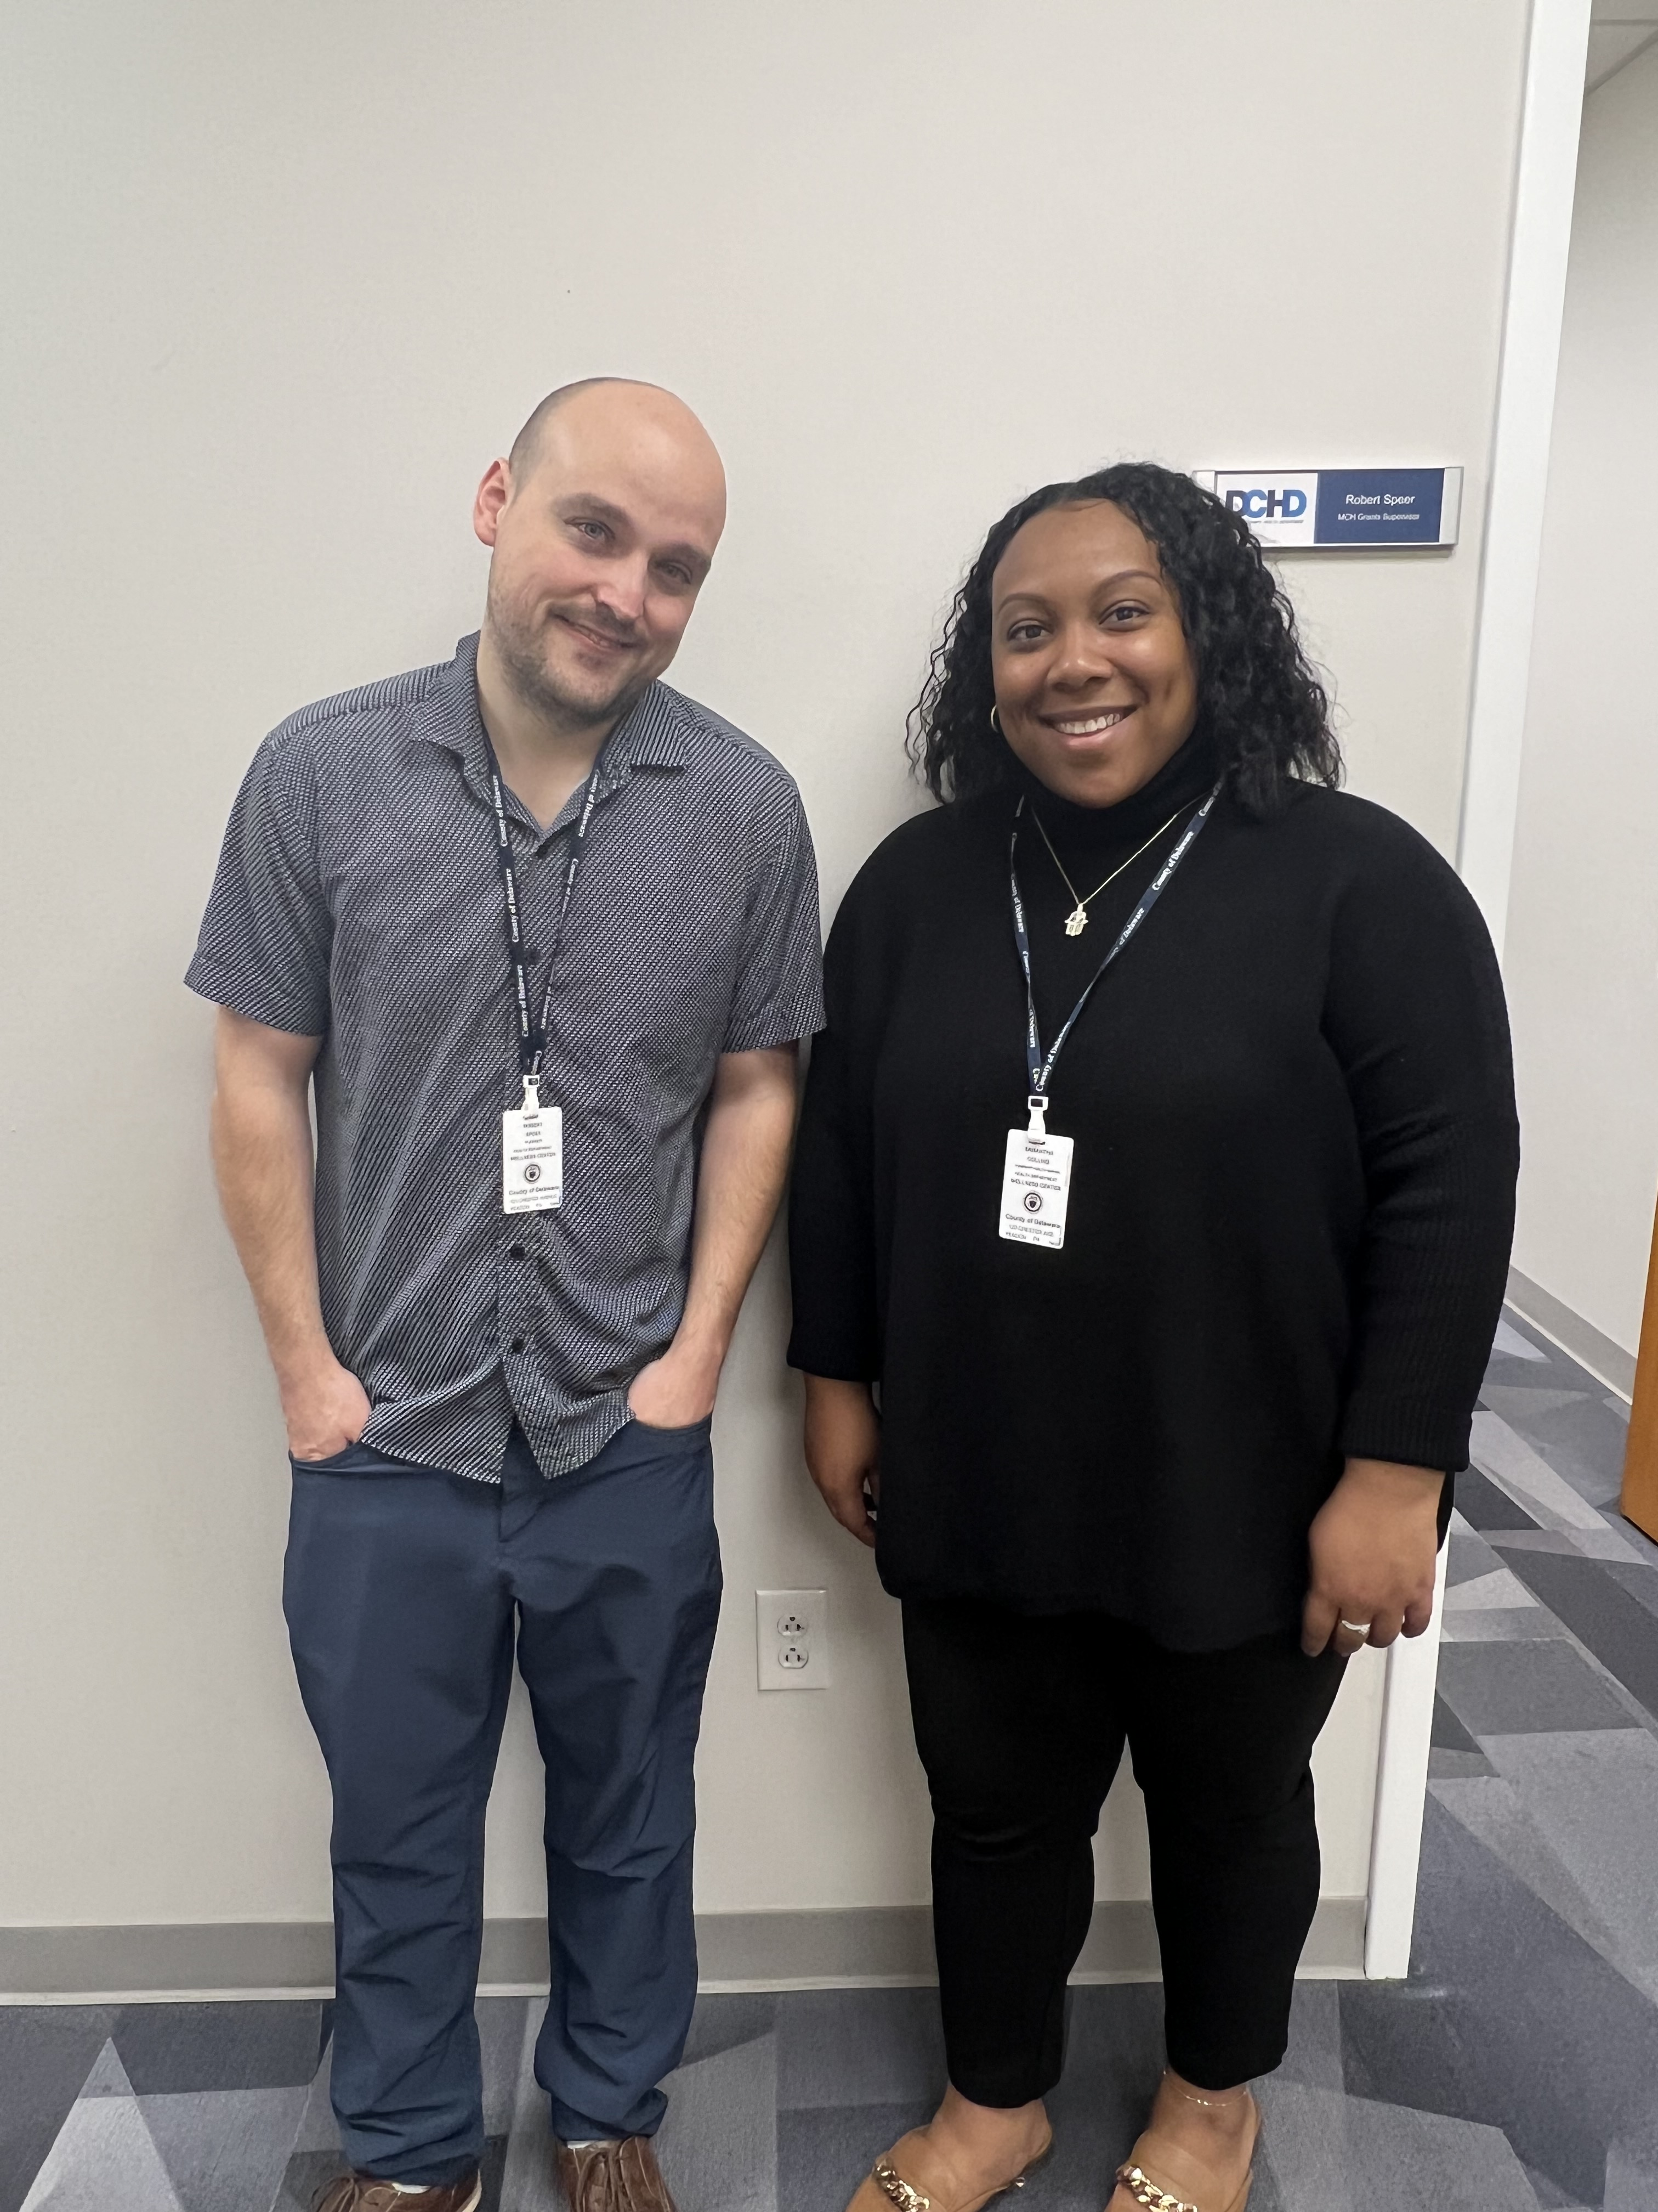
Stephanie Reese, MBA, BSN, RN (Administrator of Personal Health Division)
Robert Speer, BSPH (MCH Program Supervisor)
Samantha Collins, MPH (Community Health Worker)
November 21, 2024

Slide 3
TITLE V PROGRAM FY 23 - 24
DCHD partnered with four community partners to advance doula services offered in Delaware County and improve access to assistive technologies for children with special healthcare needs.
Partners included:
Maternity Care Coalition
The Foundation for Delaware County
Pettaway Pursuit Foundation
Delaware County Intermediate Unit
Services provided using Title V dollars included:
Free training to aspiring doulas
Free prenatal and postpartum visits by doulas to Delaware County residents
Free birth attendance by doulas to Delaware County residents
Funding for DCIU to expand its assistive technology library.

Slide 4
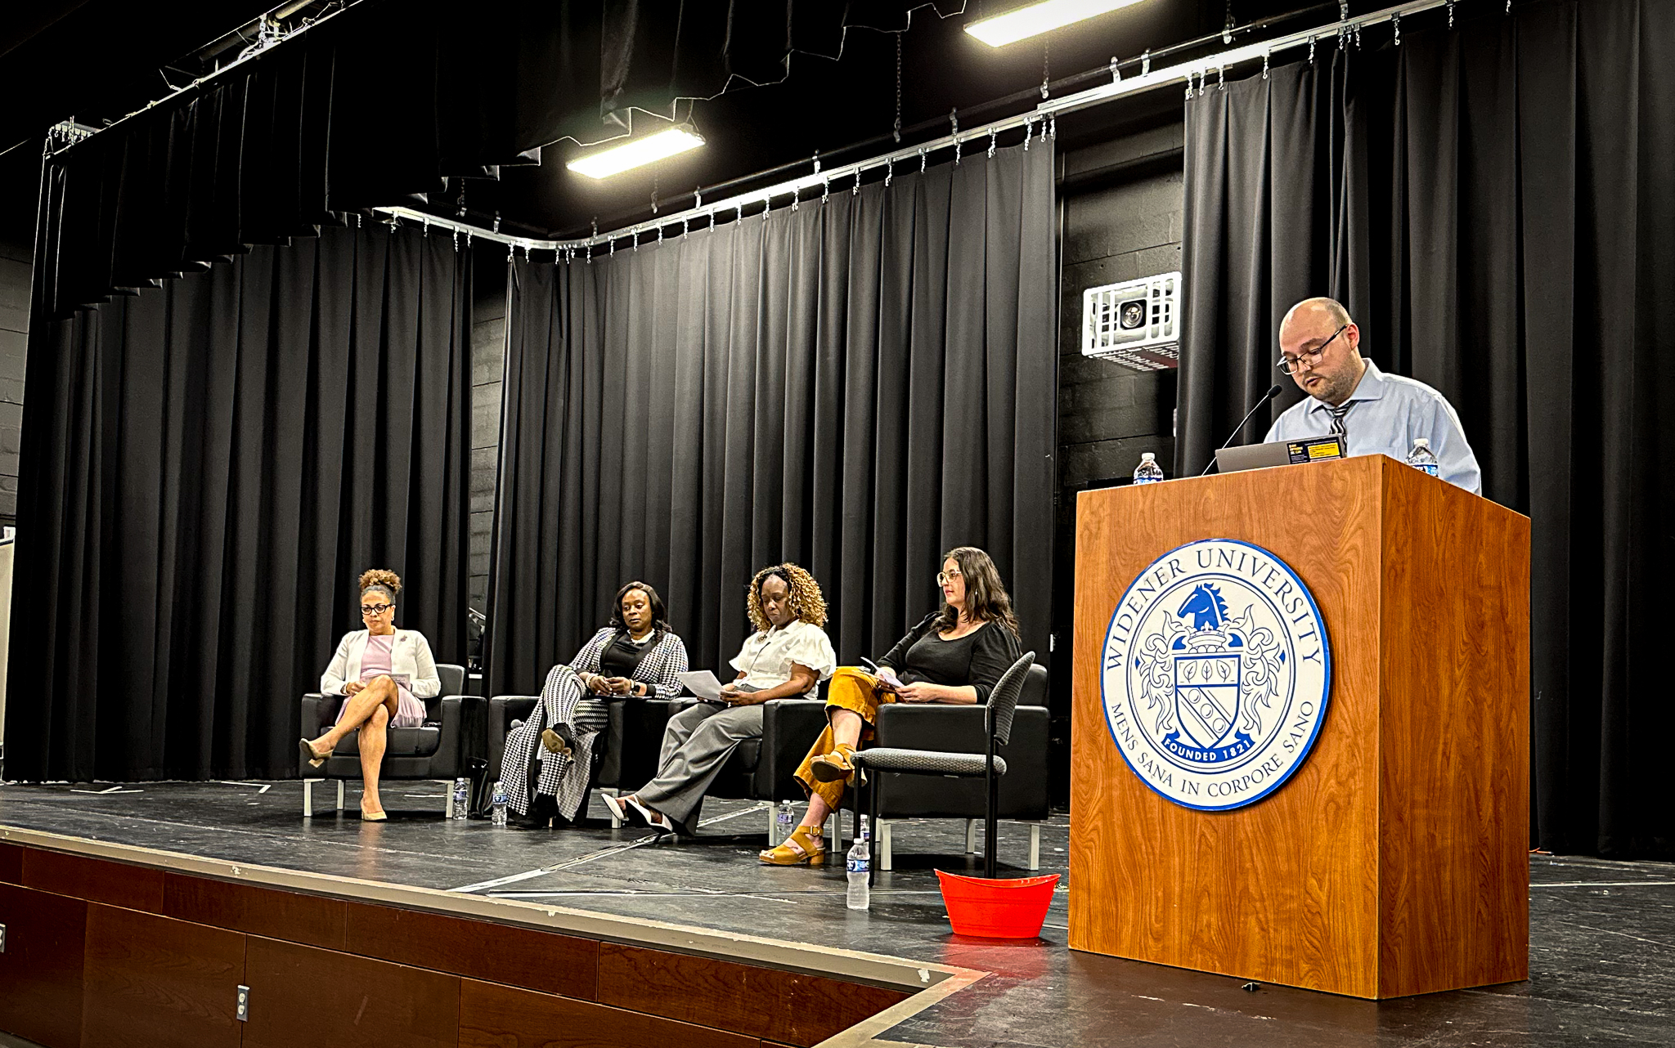
TITLE V PROGRAM FY 23 - 24
Outcomes included:
    Pettaway Pursuit Foundation providing 23 prenatal visits, 18 postpartum visits, and 8 birth attendances to a total of 10 clients (8 of whom were black or African American)
    Maternity Care Coalition training 16 new doulas to serve Delaware County residents (including 2 doulas that can speak Spanish and 10 doulas who are Black or African American)
    Foundation for Delaware County training 4 new doulas and providing 40 prenatal visits, 18 postpartum visits, and 11 birth attendances to a total of 23 clients (19 of whom were black or African American)
  Delaware County Intermediate Unit (DCIU) purchased Assistive Technology devices -$84,000
    We will be purchasing additional assistive technology in addition to the needs assessment aspect.

Slide 5
TITLE V PROGRAM FY 24 - 25
In FY 2024 – 2025 DCHD has partnered with four community partners to continue advancing Doula services in Delaware County and improving access to assistive technologies.
CocoLife Foundation
The Foundation for Delaware County
Pettaway Pursuit Foundation
Delaware County Intermediate Unit
Services to be provided include:
Pettaway Pursuit Foundation training 4 doulas to provide up to 4 prenatal visits, 2 postpartum visits, and birth attendance to 8 Delaware County residents. (signed 9/5/2024)
CocoLife Foundation providing 2-3 doula-resident engagement events, expanding their remote doula support services to provide free prenatal/postpartum doula and mental health support groups and dial-a-doula text service, providing postpartum transition consultations, and supporting the MOMA campaign (signed 9/7/2024)
Foundation For Delaware County training 4 doulas to provide up to 2 prenatal visits, 2 postpartum visits, and birth attendance to 12 Delaware County residents. (signed 9/7/2024)
Delaware County Intermediate Unit running a needs assessment across 3 of their administered programs to evaluate each student's specific assistive technology “best fit” and to match students with those “best fits”. The DCIU will use around 1/3 of their budget for contractual services to complete the needs assessment and 2/3 for equipment purchases that are identified as being needed by the assessment. (Approved 11/20/2024)
Partners include:

Slide 6

Department of labor
Perinatal Doula and Birth Companion Program
Development of the application for funding through the DOL grant began in Summer/Fall of 2023 with the initial drafts of the project narrative, abstracts, and RFP’s for partner selection being formulated in consultation with community partners.
Grant application and RFPs development continued through the beginning of 2024 and up until final grant submission to DOL and RFPs release to invited partners.
  Grant was awarded to DCHD on May 30, 2024.
  Selection notification to partners was made on May 31, 2024 .

Slide 7
Department of labor Perinatal Doula and Birth Companion Program
Growing and Diversifying the Doula Workforce Program
Developing a Birth Companion Program
Developing a Centralized Intake System
Selected Partner:
  Foundation for Delaware County
Award Amount: $600,000
Goals:
  Reimburse Doulas for services through Medicaid billing.
  Mentor new Doulas
  Develop Doula Registry
Selected Partner:
  Temple University
Award Amount: $200,000
Goal:
  Develop a birth companion training course for nursing students that incorporates both simulated and real-life experiential learning
Selected Partner:
  DCHD
Award Amount: $54,000
Goal:
  Develop the pilot for a centralized intake system for maternal and child health services in Delaware County

Slide 8
Department of labor Perinatal Doula and Birth Companion Program
Growing and Diversifying the Doula Workforce Program
Developing a Birth Companion Program
Developing a Centralized Intake System
Progress so far:
  Initial development of Delco Community Doula Collaborative website (containing registry)
  Creation of project required job descriptions with anticipation to fill by end of 2024
  Began outreach to local doula organizations and doulas
Progress so far:
  Extended an offer to hire a doula trainer.
  Began curriculum development with simulation scenario drafts for week one and 3 of the didactic lectures completed.
  2 clinical sites secured for students to observe labor and postpartum experiences.
  Draft of IRB application is complete
Progress so far:
  Convened centralized intake working group.
  Developed business requirements for centralized intake.
  Scheduling partner tour of DCHD call center that will be directly involved in centralized intake system

Slide 9

HRSA Grant – Once Upon A Preemie
Expanding Black Maternal Health and Neonatal Health Equity Trainings to DELCO Healthcare Professionals
Funding Amount: $150,000
Approved by County Council: May 15th, 2024
Grant Activities:
  Provide free and virtual health equity training courses for up to 100 healthcare professionals serving Delaware County birthing people. Including:
    An Introduction to Health and Racial Equity in the NICU
    Solutions for Addressing Inequities Pre, During, and Post NICU
    Addressing Black Mothers Mental and Emotional Health Pre, During, and Post NICU
    Black Parents as Partners in Delivering Care
  Once Upon A Preemie books will also be shipped to all healthcare providers who successfully complete the courses

Slide 10
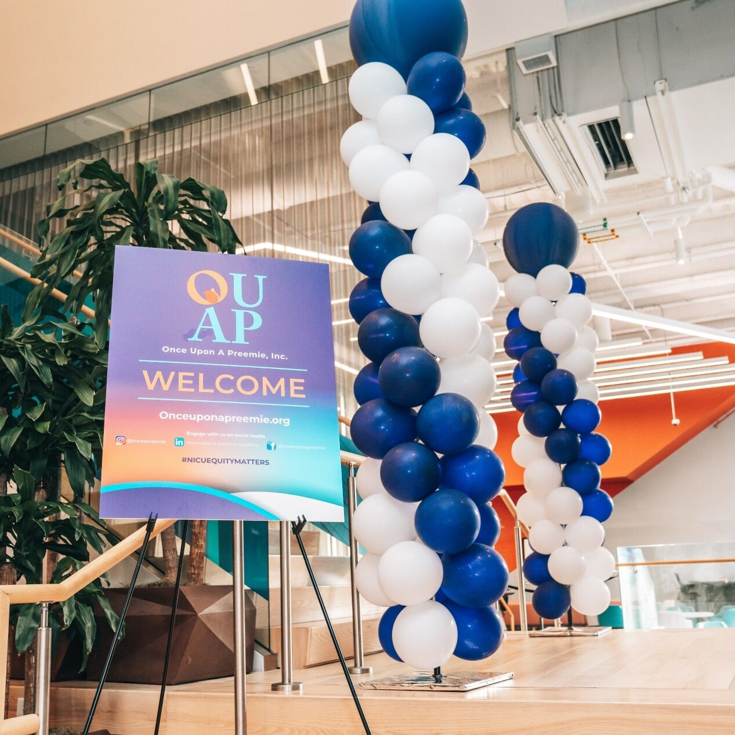
HRSA Grant – Once Upon A Preemie
Expanding Black Maternal Health and Neonatal Health Equity Trainings to DELCO Healthcare Professionals
Progress so far:
  Has begun outreach to healthcare professionals serving Delaware County residents to recruit for course enrollment in January 2025 (60 secured so far)

Slide 11
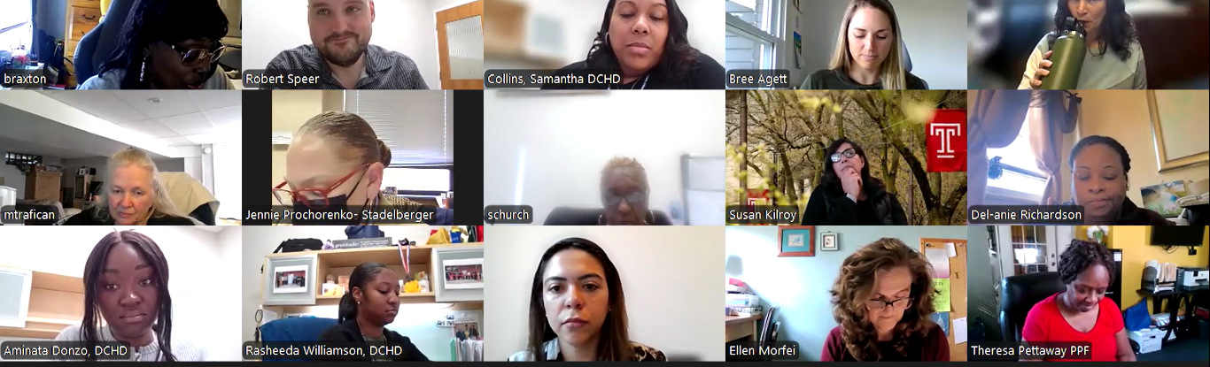
Community Health Improvement Plan Committee
The Maternal, Parental, and Infant Health CHIP Committee has been meeting since March 2023 and has developed various Goals, Strategies, and Objectives to achieve for Delaware County by December 2028
As of October 23, 2024 there have been 7 meetings total with the next meeting scheduled for December 11th, 2024.
CHIP committee consists of 48 members from both the public and private sectors, including various DCHD staff members and community partners working with DCHD on Title V, the Department of Labor Grant, and HRSA Grant.

Slide 12
Community Health Improvement Plan (CHIP)
Committee
Improve
Improve maternal, parental, and infant health outcomes through improved access to and awareness of community and medical services
Decrease
Decrease opioid misuse during pregnancy
Prevent
Prevent infant deaths

Slide 13
Community Health Improvement Plan Committee
Objective 1.1: By December 31, 2028, improve birth outcomes in Delaware County, with a special focus on Black, Hispanic, and Multi-race birthing parents. (Reduce all below outcome) indicators by 5%)

Slide 14
Community Health Improvement Plan Committee
Objective 2.1: By December 31, 2028, decrease the rate of neonatal abstinence syndrome among babies born to Delaware County parents.

Slide 15
Community Health Improvement Plan Committee
Objective 3.1: By December 31, 2028, decrease the rate of infant mortality in Delaware County.

Slide 16
Questions?

