Slide 1
Director Epi Update
March 27, 2025

Slide 2
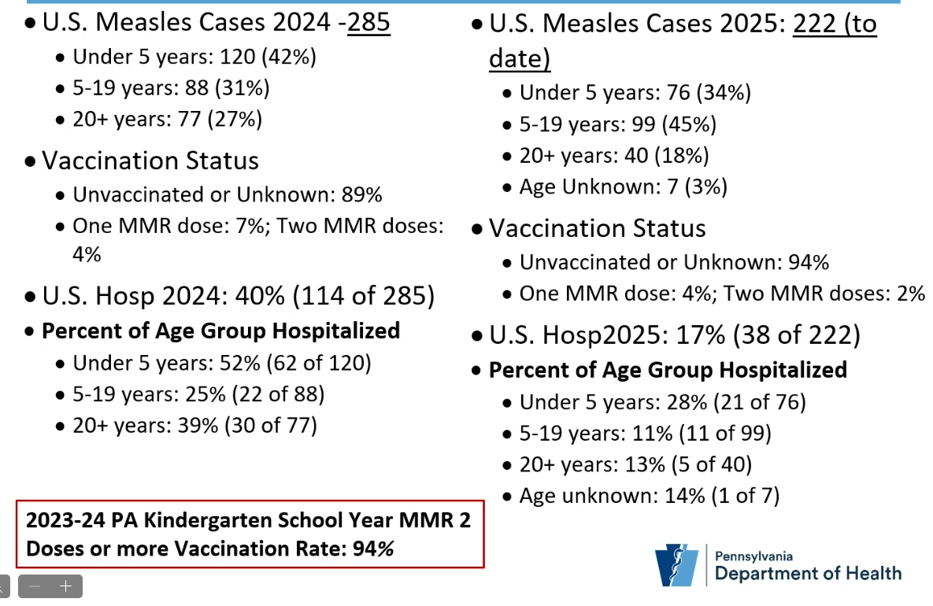

National Measles Summary
That was from 2 weeks ago - as of 3/20/25, 378 confirmed cases in 18 jurisdictions
Notes:
Regarding sex, about the same for females and males @ 130s each

Slide 3
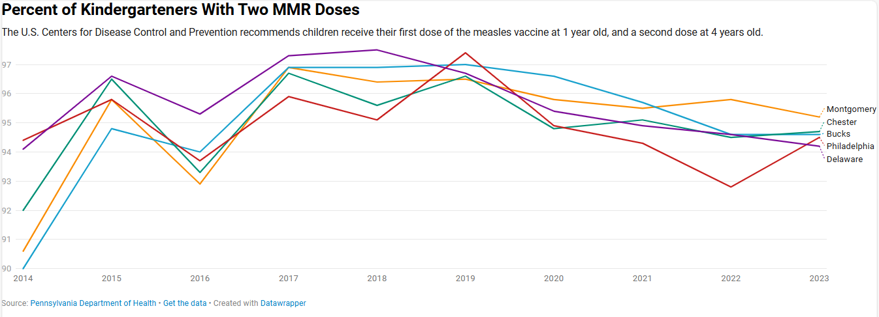
Measles Vaccination in Kindergartners in SE PA

Slide 4
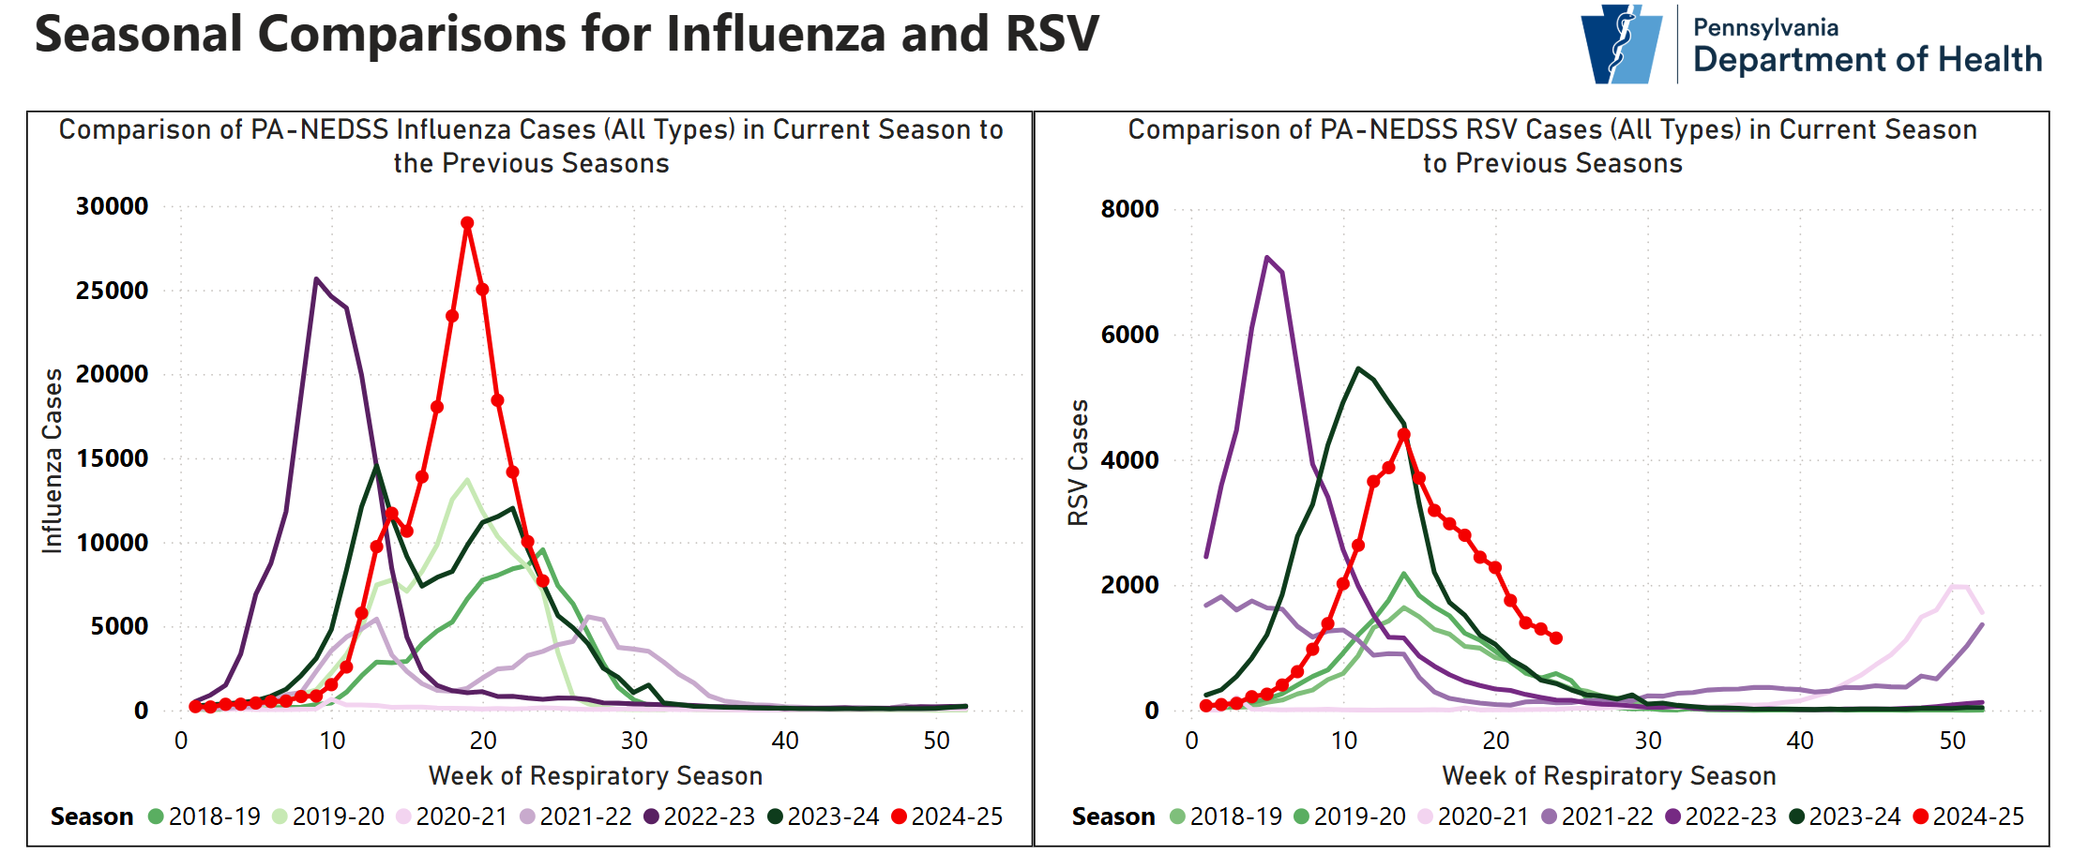
PA Respiratory Illness Dashboard
https://www.pa.gov/agencies/health/diseases-conditions/infectious-disease/respiratory-viruses/respiratory-virus-dashboard.html

Slide 5
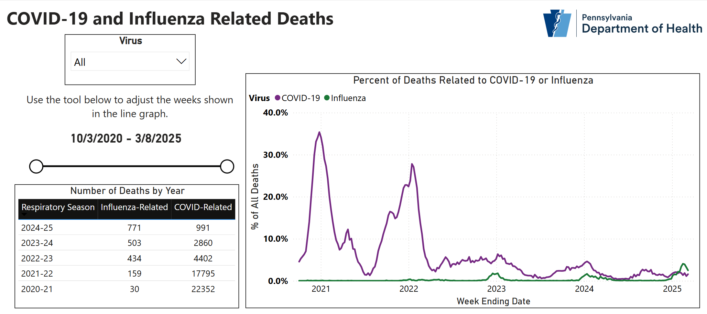
PA Respiratory Illness Dashboard
https://www.pa.gov/agencies/health/diseases-conditions/infectious-disease/respiratory-viruses/respiratory-virus-dashboard.html

Slide 6
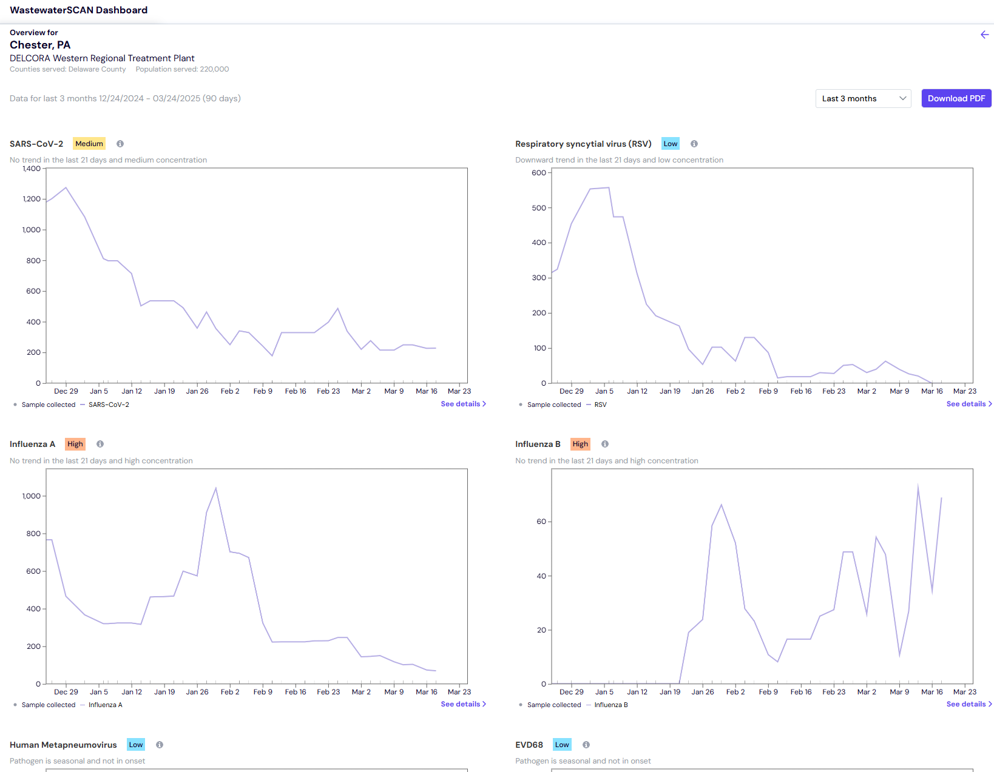
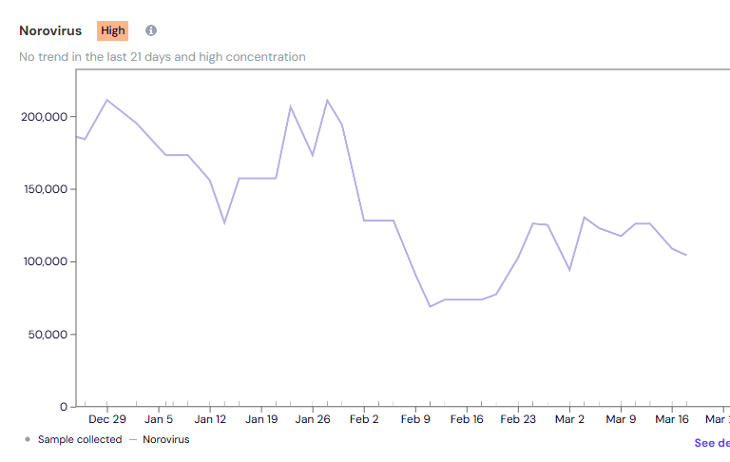
Delaware County Wastewater (12/24/24-3/24/25)
https://www.wastewaterscan.org/en

Slide 7


