Slide 1


Delaware County’s
Path to Zero Waste

Slide 2



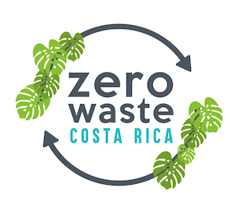

Slide 3
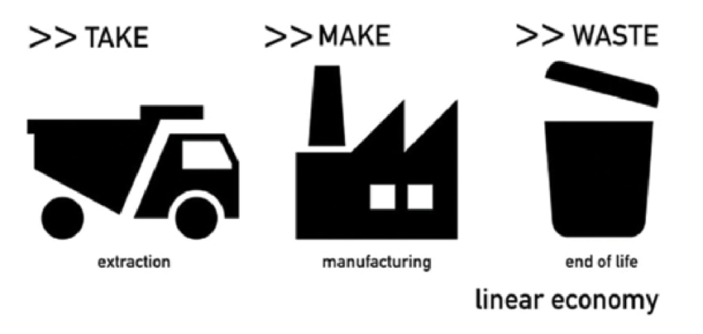
Linear Economy

Slide 4
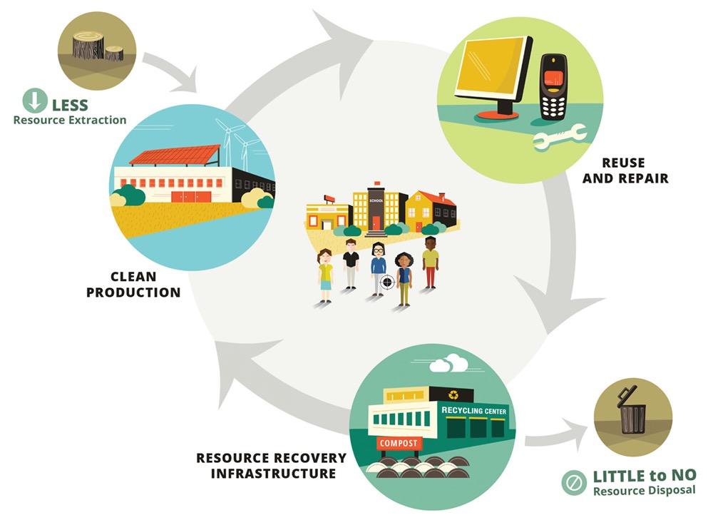
Zero Waste Economy
Source: biocycle.net courtesy of EcoCycle Solutions

Slide 5
Zero Waste Definition
Internationally peer-reviewed definition:
The conservation of all resources by means of responsible production, consumption, reuse, and recovery of products, packaging, and materials without burning and with no discharges to land, water, or air that threaten the environment or human health.

Slide 6
Zero Waste Hierarchy
Notes:
https://zwia.org/zwh/

Slide 7
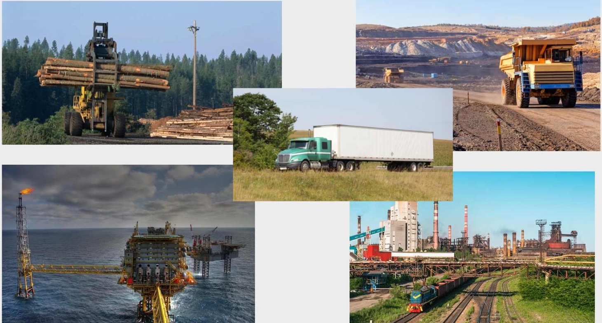
Zero Waste Focuses on
Upstream Redesign and Waste Reduction

Slide 8

Wasteberg
71:1

Slide 9
Zero Waste is one of the fastest, most efficient, and lowest cost ways to reduce greenhouse gas emissions.
Source: ILSR Stop Trashing the Climate

Slide 10

Zero Waste Saves Energy
Energy Saved Recycled vs Virgin Material
 | 95% Aluminum
 | 88% Plastic
 | 75% Copper
 | 60% Paper
 | 60% Steel
 | 34% Glass
Source: EcoCycle - ISRI Facts & Figures 2018
Notes:
Recycling saves energy

Slide 11
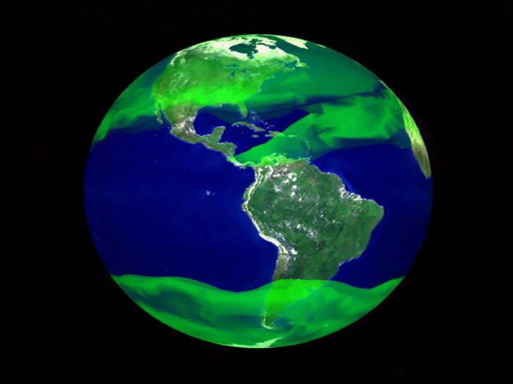
Methane
23x
CO²
Photo: Nasa

Slide 12


Zero Waste Around the World
San Fernando City, Philippines
Capannori, Italy
Alameda, California, USA
Thiruvananthapuram, India
Kamikatsu, Japan

Slide 13
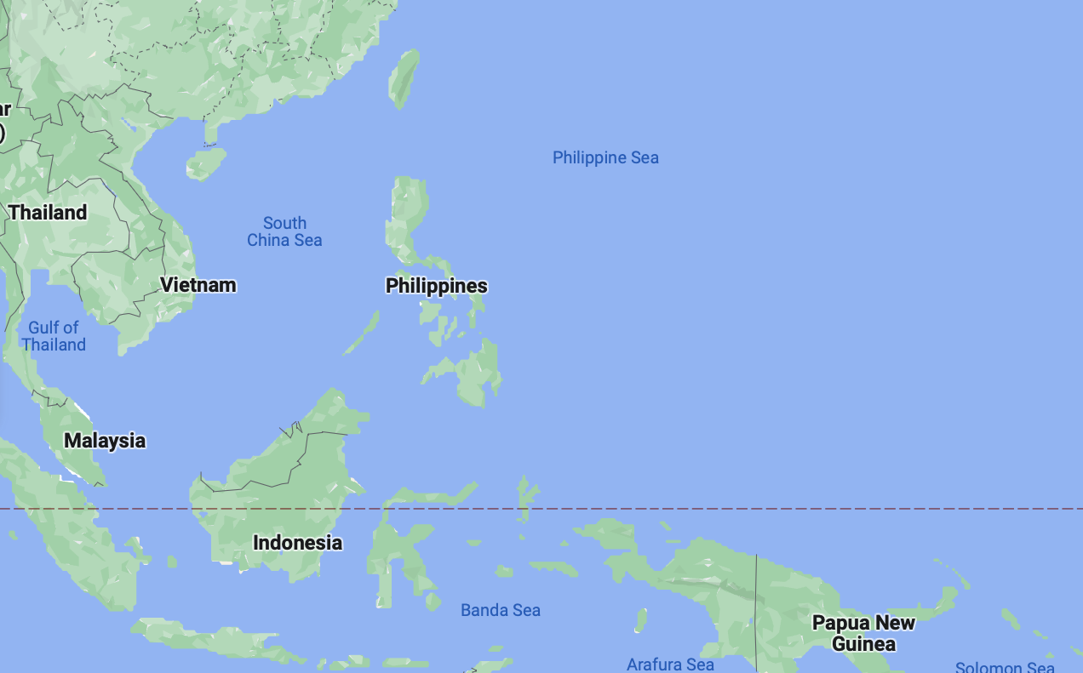
The Philippines
7,107 islands
95 million population
National ban on incineration

Slide 14
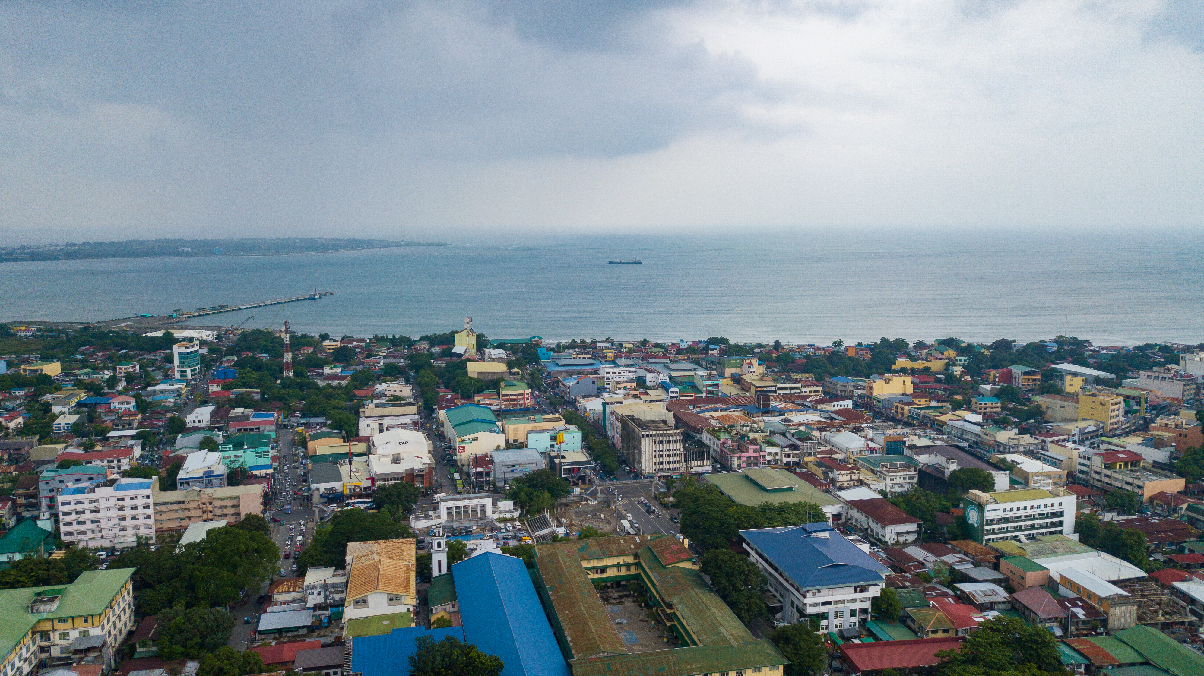
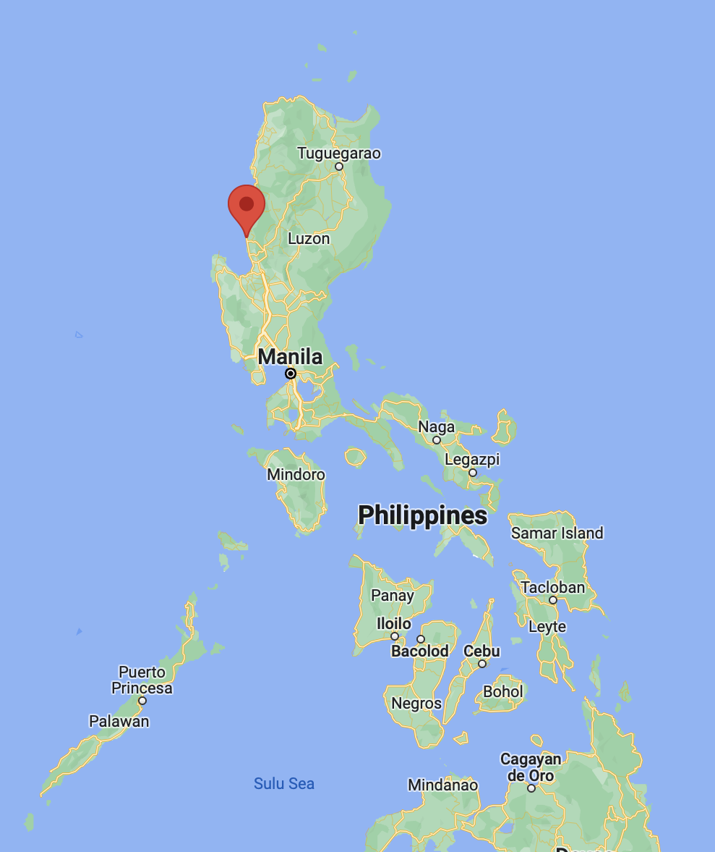
San Fernando City, Philippines
115,000 population
Divided into 59 barangays
Notes:
115,000 population
Divided into 59 barangays - the smallest administrative division in the Philippines

Slide 15
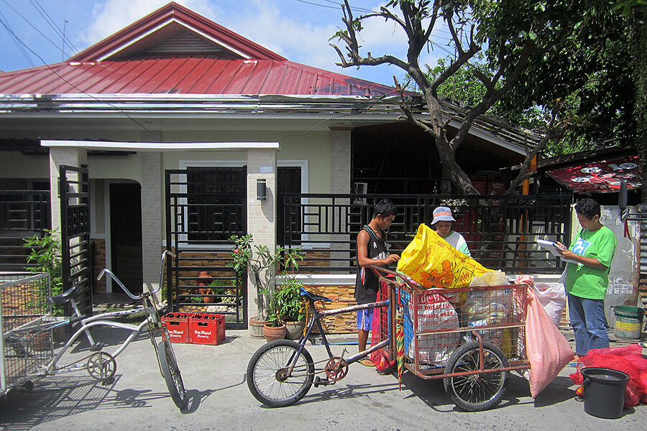
Working Toward Zero Waste
Achieved 80% in 2018
Notes:
Adopted Zero Waste as a Principle
Set targets for 2013 (60%), 2015 (70%), 2018 (75%), 2020 (80%), 2025 (90%)
Achieved 78% by 2017 up from 12% in 2012
Model for Decentralized Waste Management – MRFs in 33 of 35 villages

Slide 16
Model for Decentralized Collection
Notes:
Model for Decentralized Waste Management – MRFs in 33 of 35 villages

Slide 17
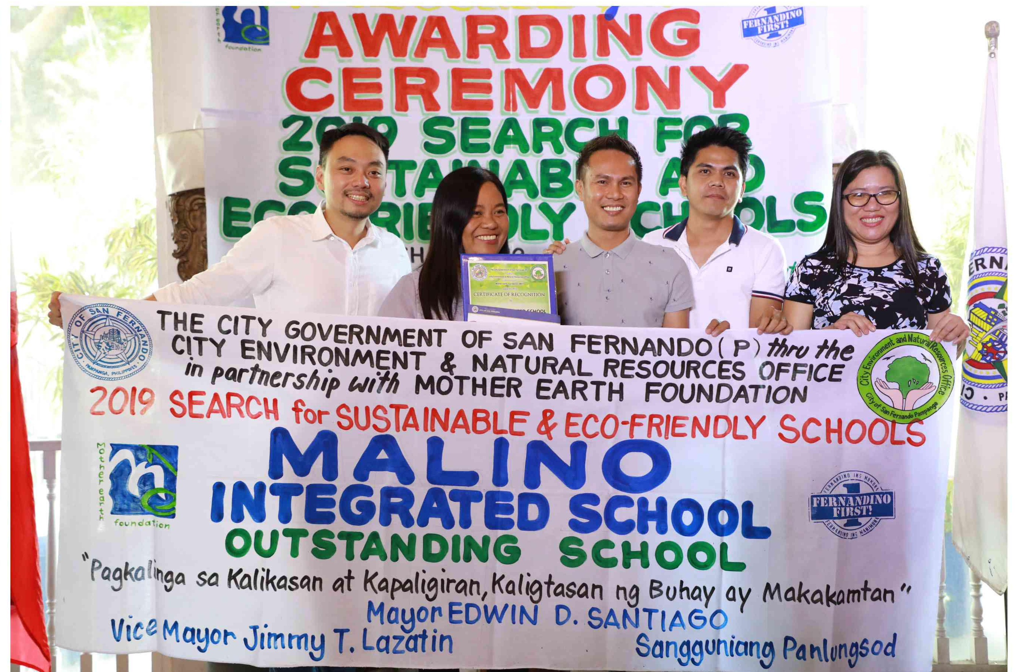
Eco Friendly Schools
Notes:
Eco Friendly Schools
Curriculum Integration
Mother Earth Kids Club
Zero Waste Monday
Mother Earth Kids Time
Trash for Points System

Slide 18
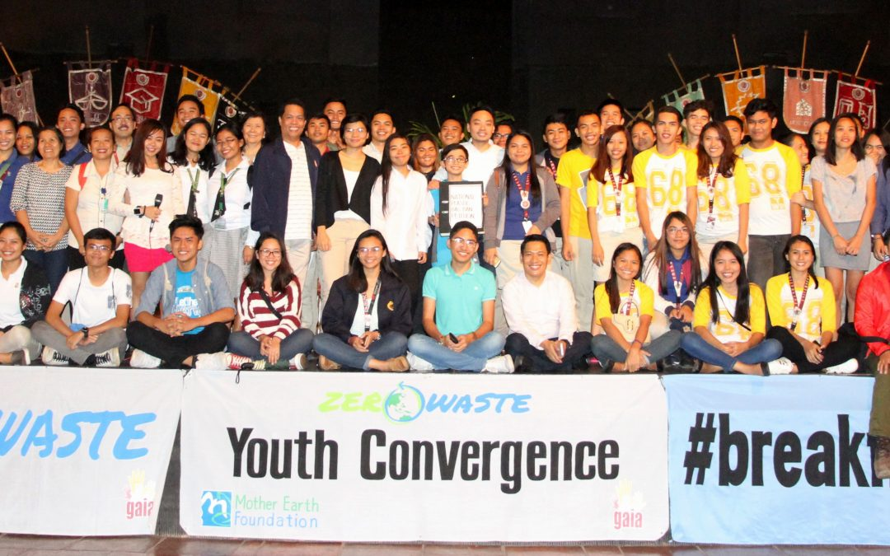
Zero Waste Youth
.
Notes:
Zero Waste Youth Festival
Month-long Celebration
Held in 4 cities, attended by more than 5,000 youth leaders
Seminars, forums, concert, parade, etc

Slide 19
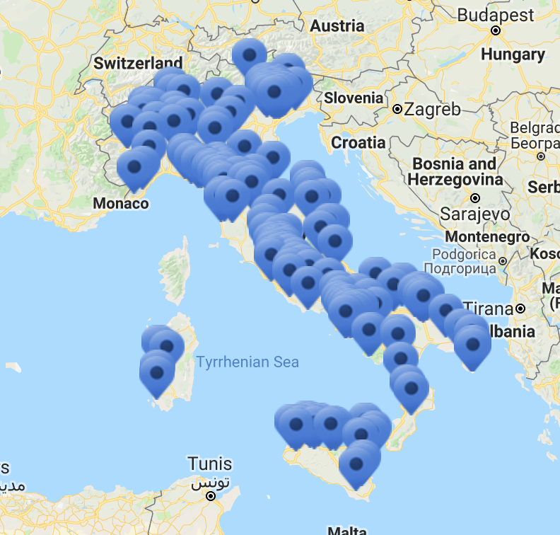
Zero Waste Italy
300 municipalities in Italy—over six million inhabitants—are working toward Zero Waste

Slide 20
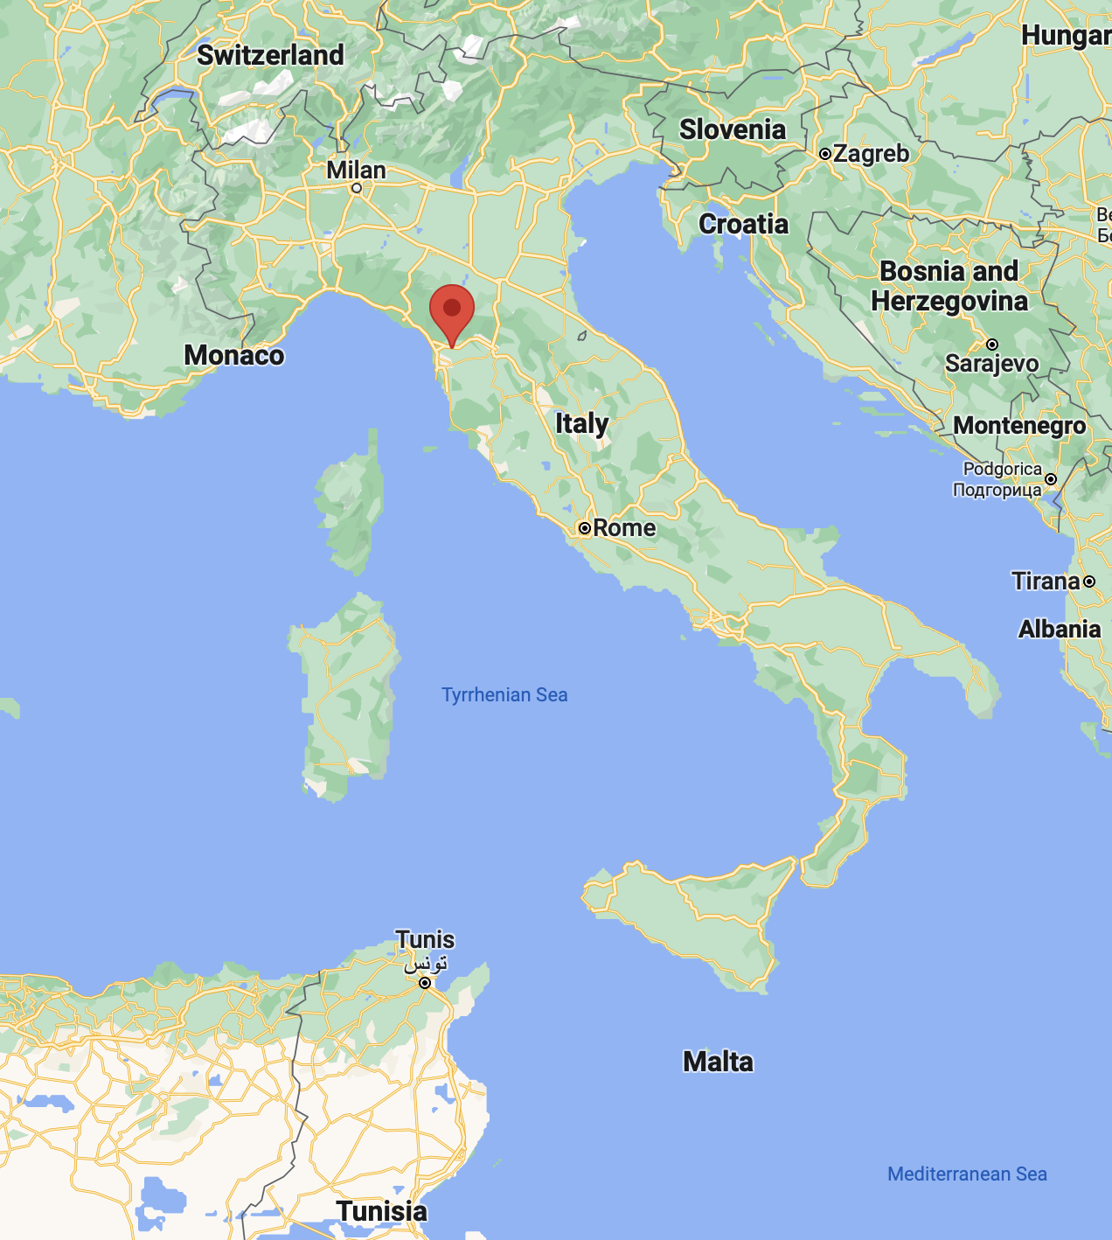
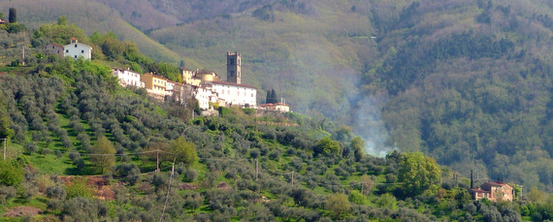
Capannori, Italy
46,000 population
Province of Lucca in the Region of Tuscany

Slide 21
First City in Europe to Declare Zero Waste
Achieved 85% diversion in 2014
Notes:
First municipality in Europe to adopt Zero Waste as a goal (in 2007)
75% by 2015 and Zero Waste by 2020
Achieved 85% in 2014
Focusing on the last 15%

Slide 22
Zero Waste Research Centre
Notes:
Formed Zero Waste Research Centre in 2010
Researching composition of residual discards
Proposing changes to the design of badly designed products
Asking companies to redesign products to make them more sustainable

Slide 23
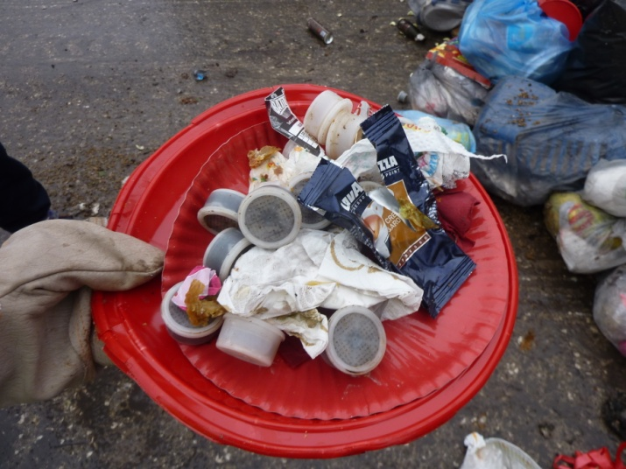
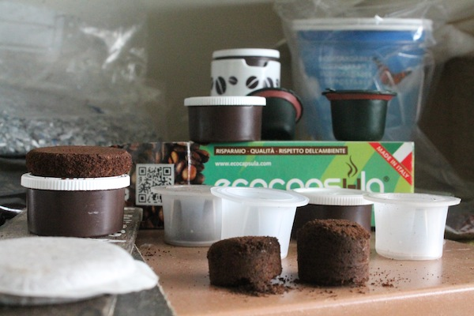
Companies Respond to Capannori

Slide 24
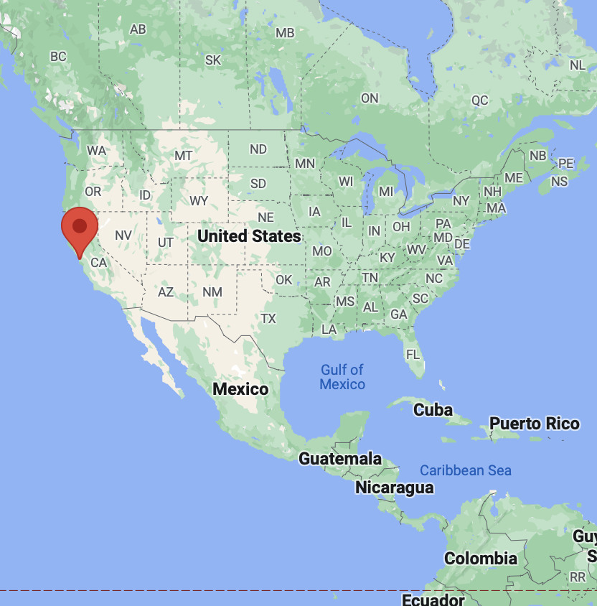
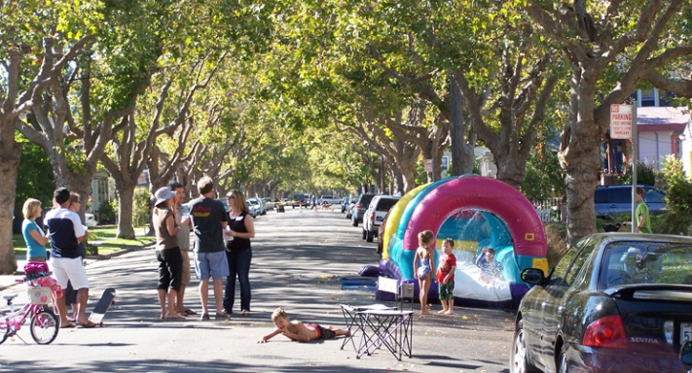
Alameda, California, USA
75,000 population
“The Island City” on the coast of Oakland across the Bay from
San Francisco

Slide 25
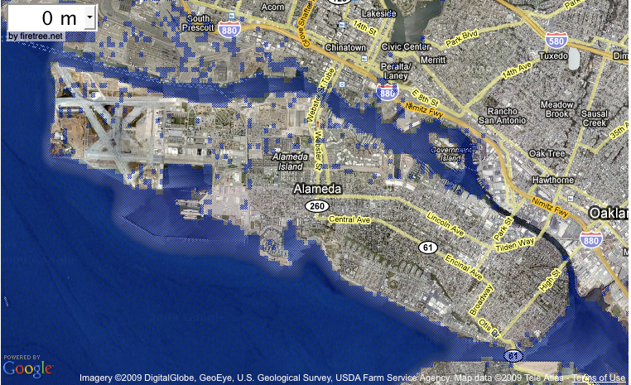
Possible Climate Change Impacts
Alameda Today

Slide 26
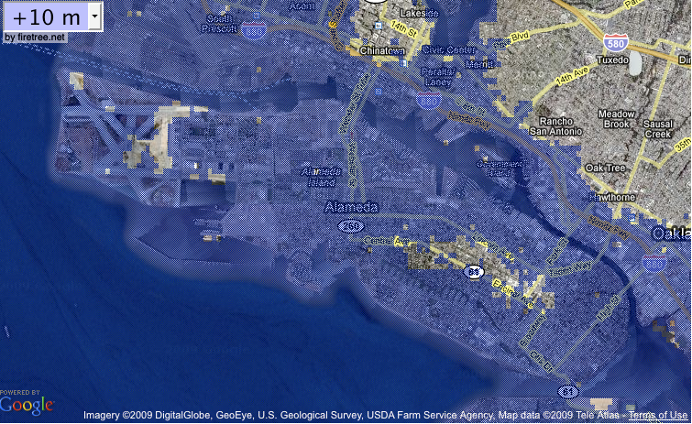

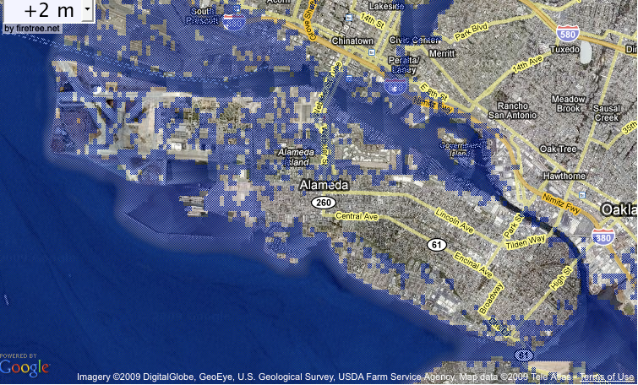
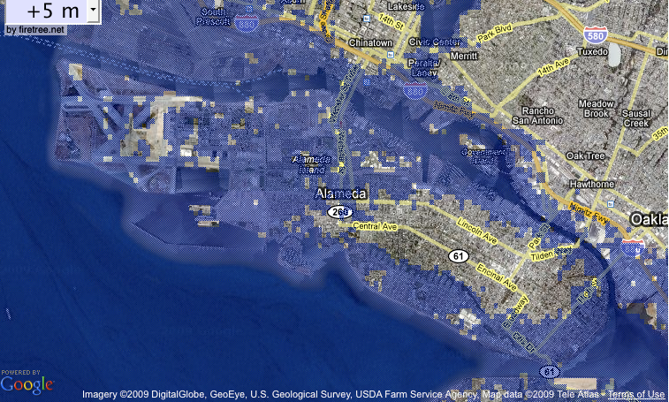
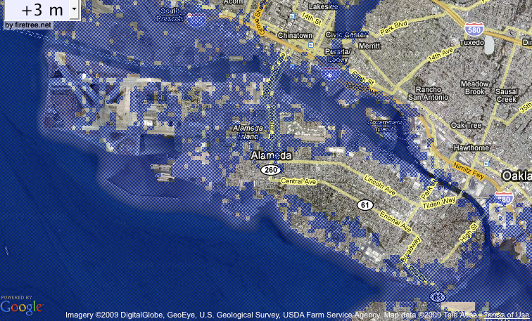
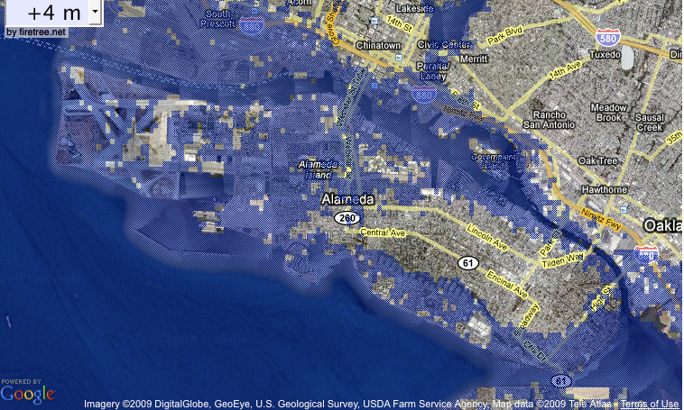
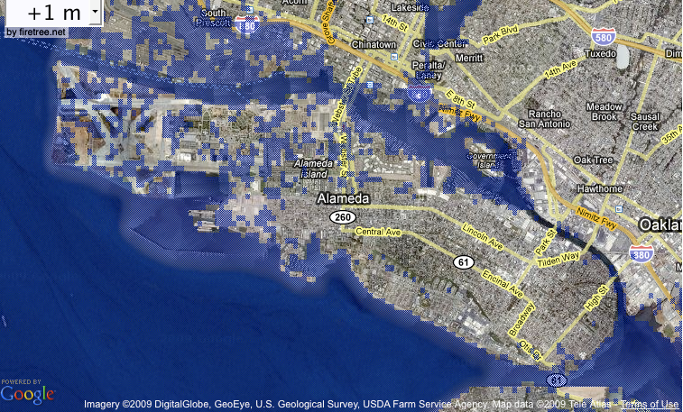
Rising Sea Level Impacts
1 Meter
2 Meter
5 Meter
3 Meter
0 Meter
4 Meter
10 Meter
Courtesy DL Morrison

Slide 27
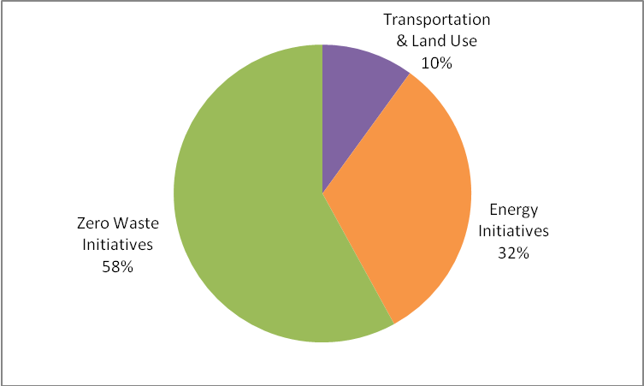
Alameda Greenhouse Gas Reduction Potential by Initiative

Slide 28
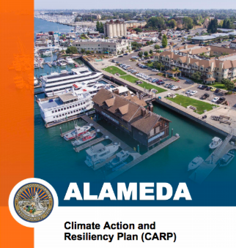

Community Based Approaches to
Climate Action & Resiliency

Slide 29
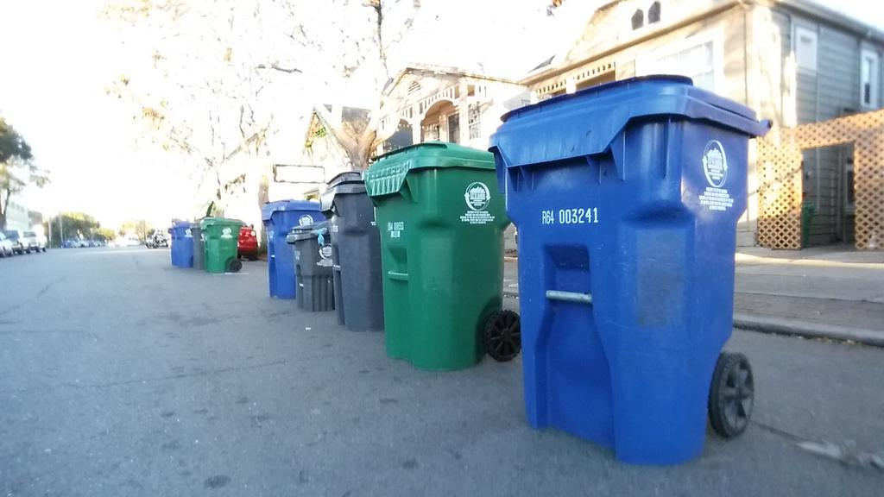
Door-to-Door Separation
Achieved 78% diversion 2019
Notes:
Door-to-door cart collection program 1997
Food scrap diversion 2002
Comprehensive construction and demolition recycling requirements 2002
Climate Protection Local Action Plan 2008
Ban on polystyrene to-go containers 2008
Zero Waste Implementation Plan 2010
Ban on single-use plastic bags 2012
Ban on single-use plastic foodware 2018
48% diversion 1995
65% diversion 2000
68% diversion 2005
72% diversion 2010
75% diversion 2012
79% diversion 2017

Slide 30
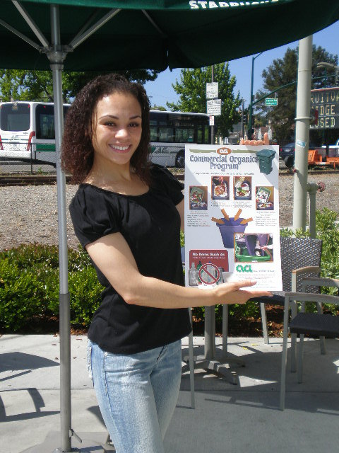
Miss Alameda Says “Compost!”
Notes:
Targeting restaurants and faith-based organizations
Increasing participation in the food scrap program to 75 percent within one year
Collaborating with Sierra Student Coalition, City of Alameda, ACI, Stopwaste and Miss Alameda
Diverting 1,000 tons from landfills an reducing greenhouse gas emissions by 1,300 metric tons per year

Slide 31
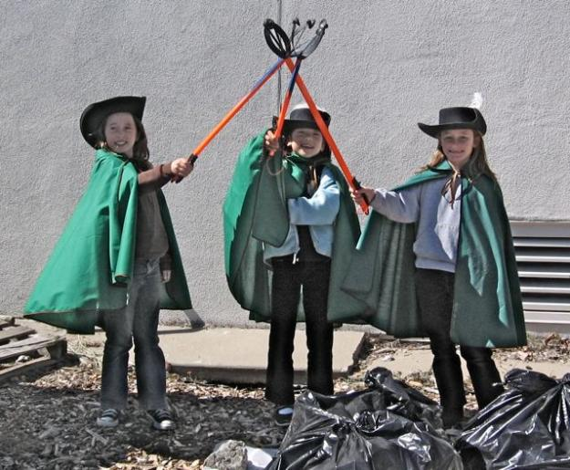
Alameda Green Schools Challenge
“Tree Musketeers”
Notes:
Goals
Increase diversion from 41% to 75% in 3 years
Uniform recycling and composting programs at all schools and district facilities
Reduce greenhouse gas emissions
Create zero waste cultural change
Current Status
75% in 2017
Reducing greenhouse gas emissions by 3,000 metric tons per year
Comprehensive recycling and composting at all public schools

Slide 32
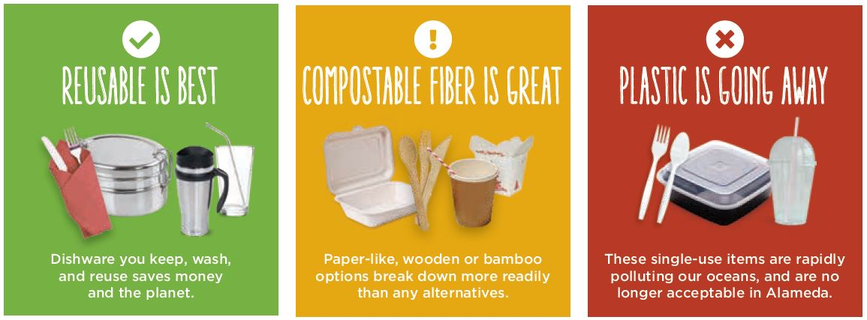
Alameda Single-Use Plastic Foodware Ban

Slide 33
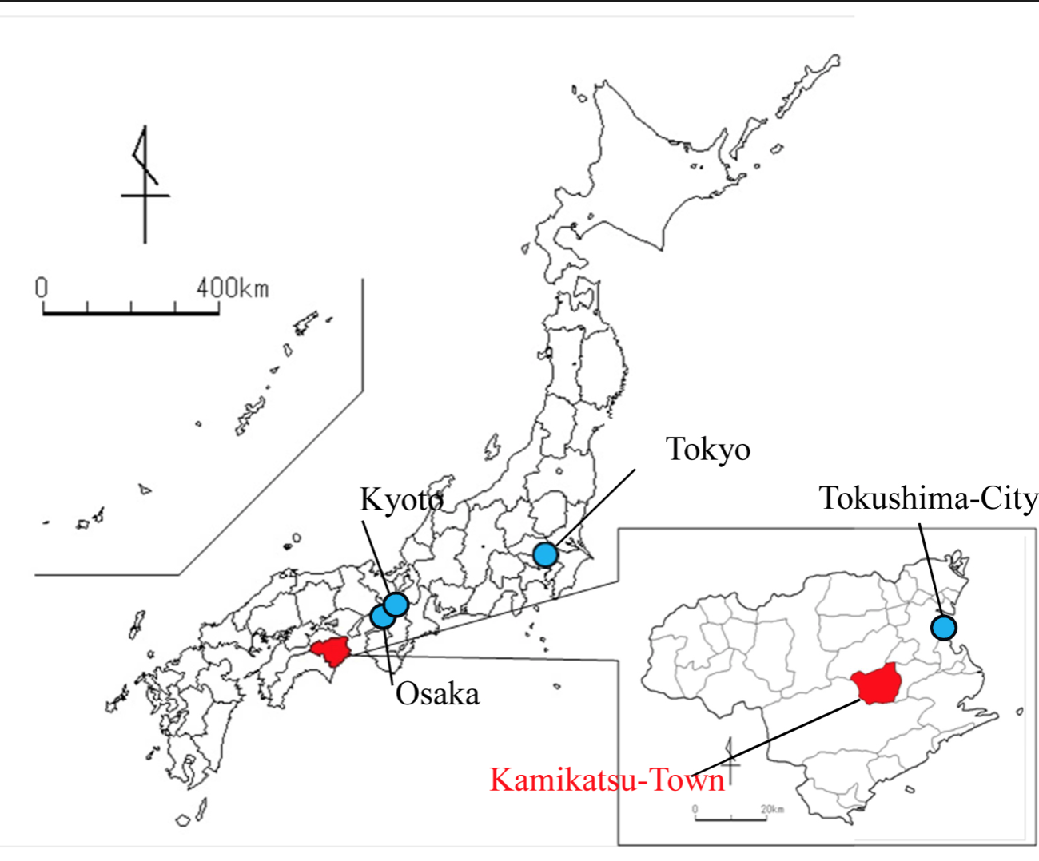
Kamikatsu, Tokushima, Japan
Small rural town
Declared a goal of
Zero Waste in 2003
Currently at 80% diversion from landfills and incinerators

Slide 34
Residents sort materials into 45 categories

Slide 35
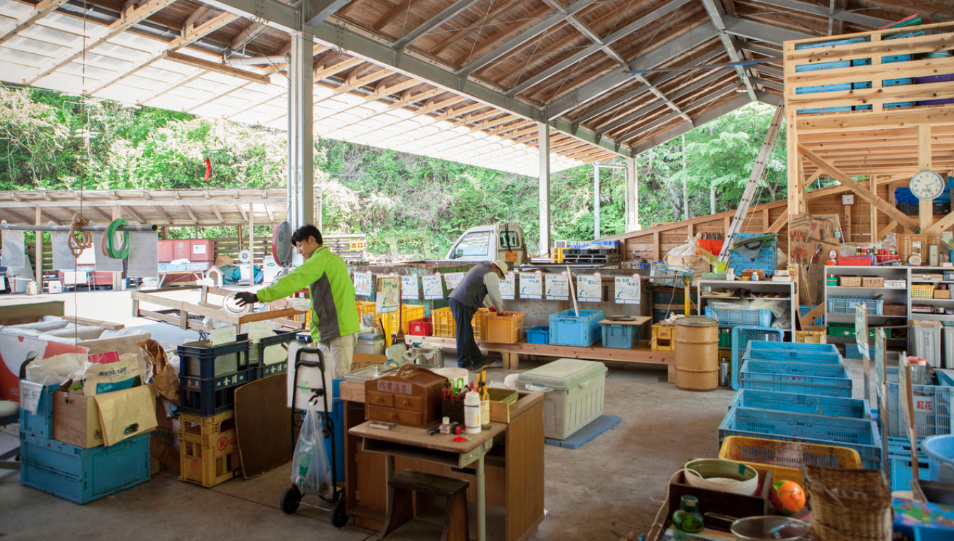
Residents sort materials into 45 categories

Slide 36
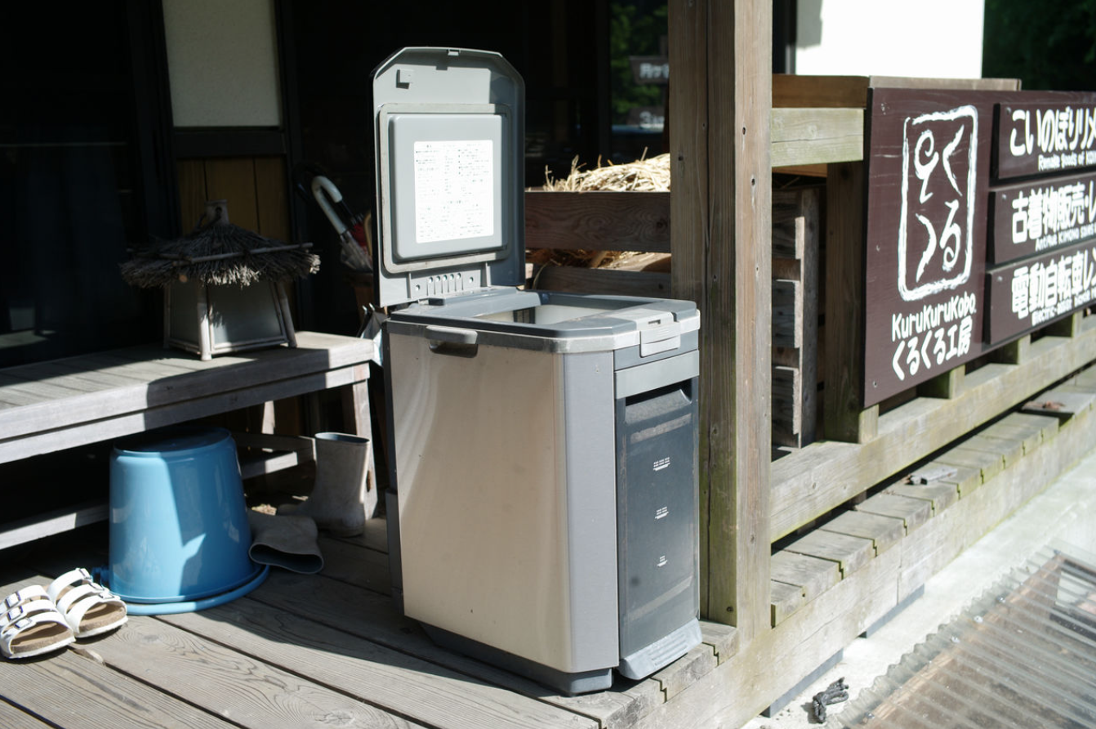
Organics are processed in household digesters

Slide 37
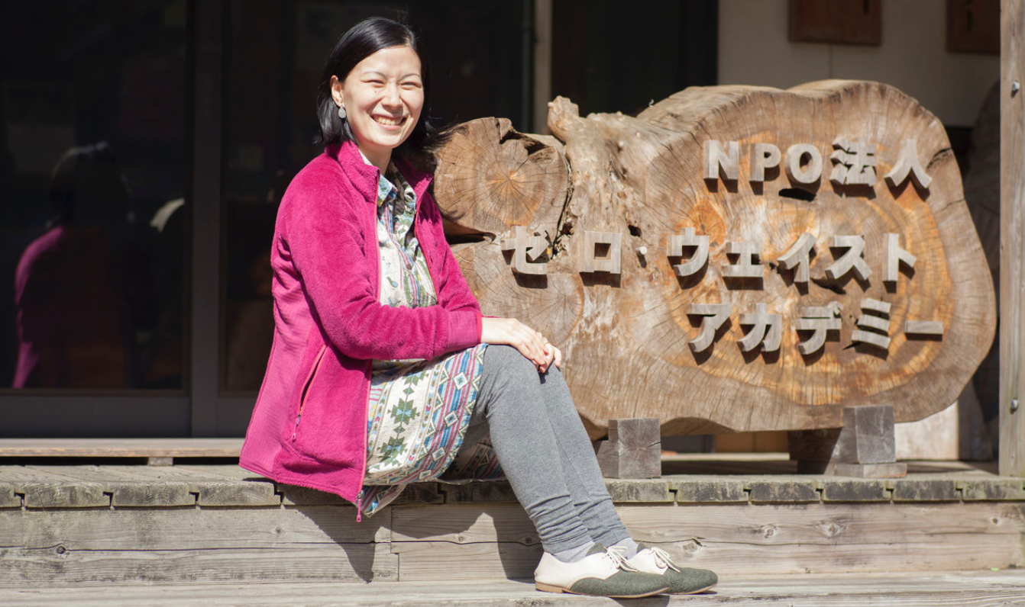
Akira Sakano runs the Zero Waste Academy

Slide 38
Swachh Bharat Mission 2014 to 2019

Slide 39
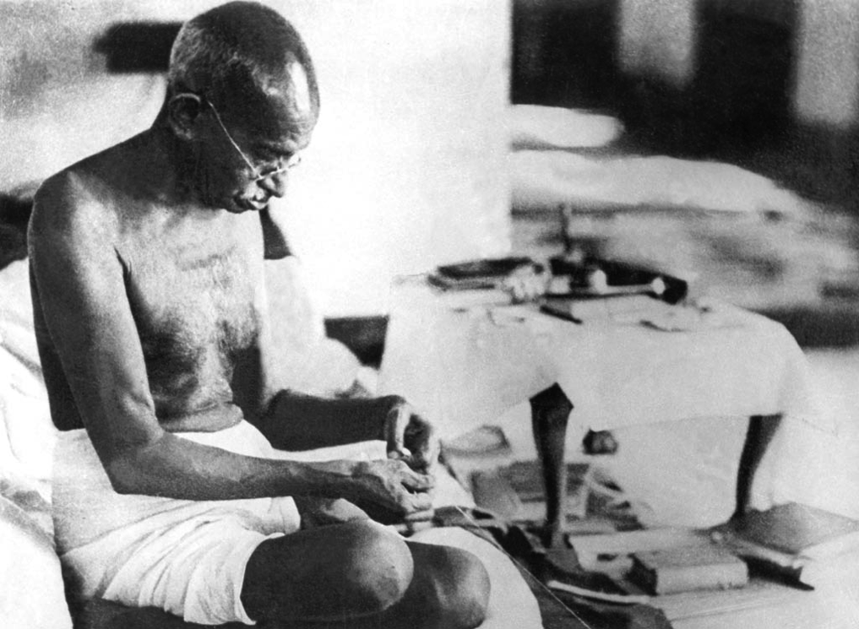

Slide 41
The Kerala Zero Waste Model
Thiruvananthapuram
Capital of Kerala
1M Population
250,000 households
50,000 households manage organics on-site

Slide 42
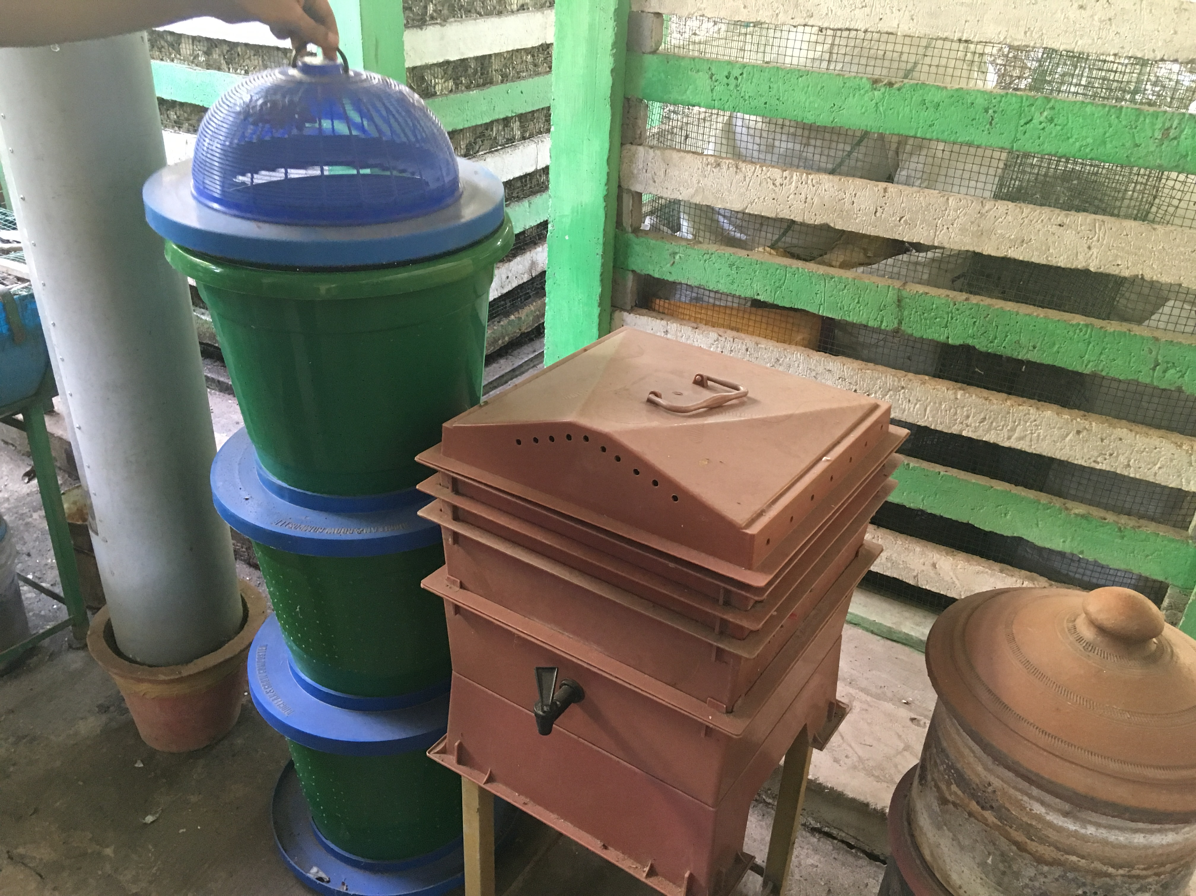

Slide 43
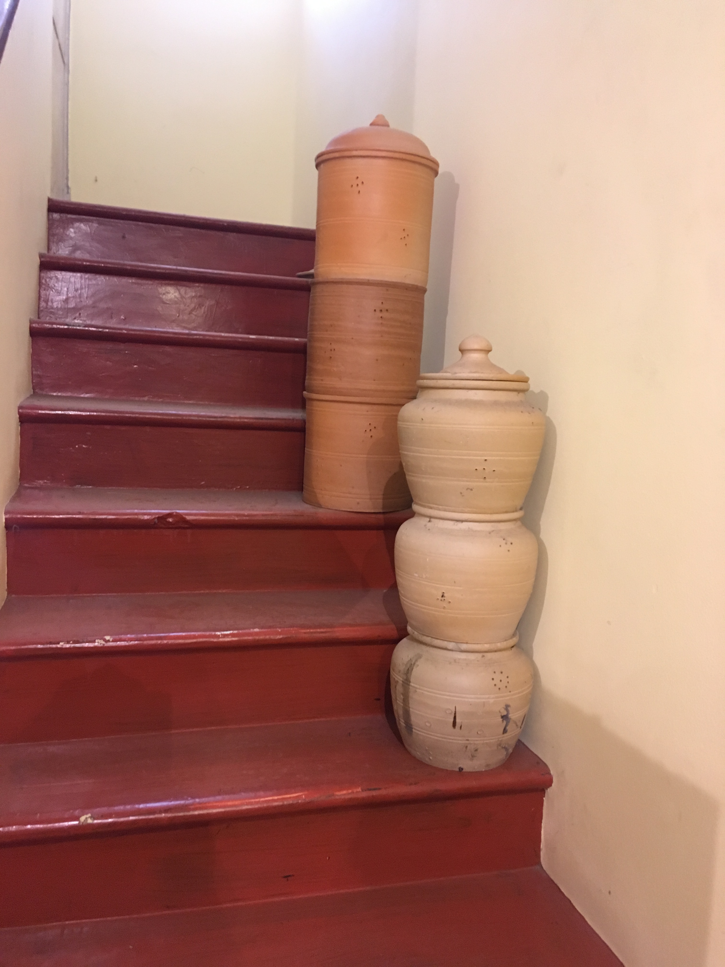
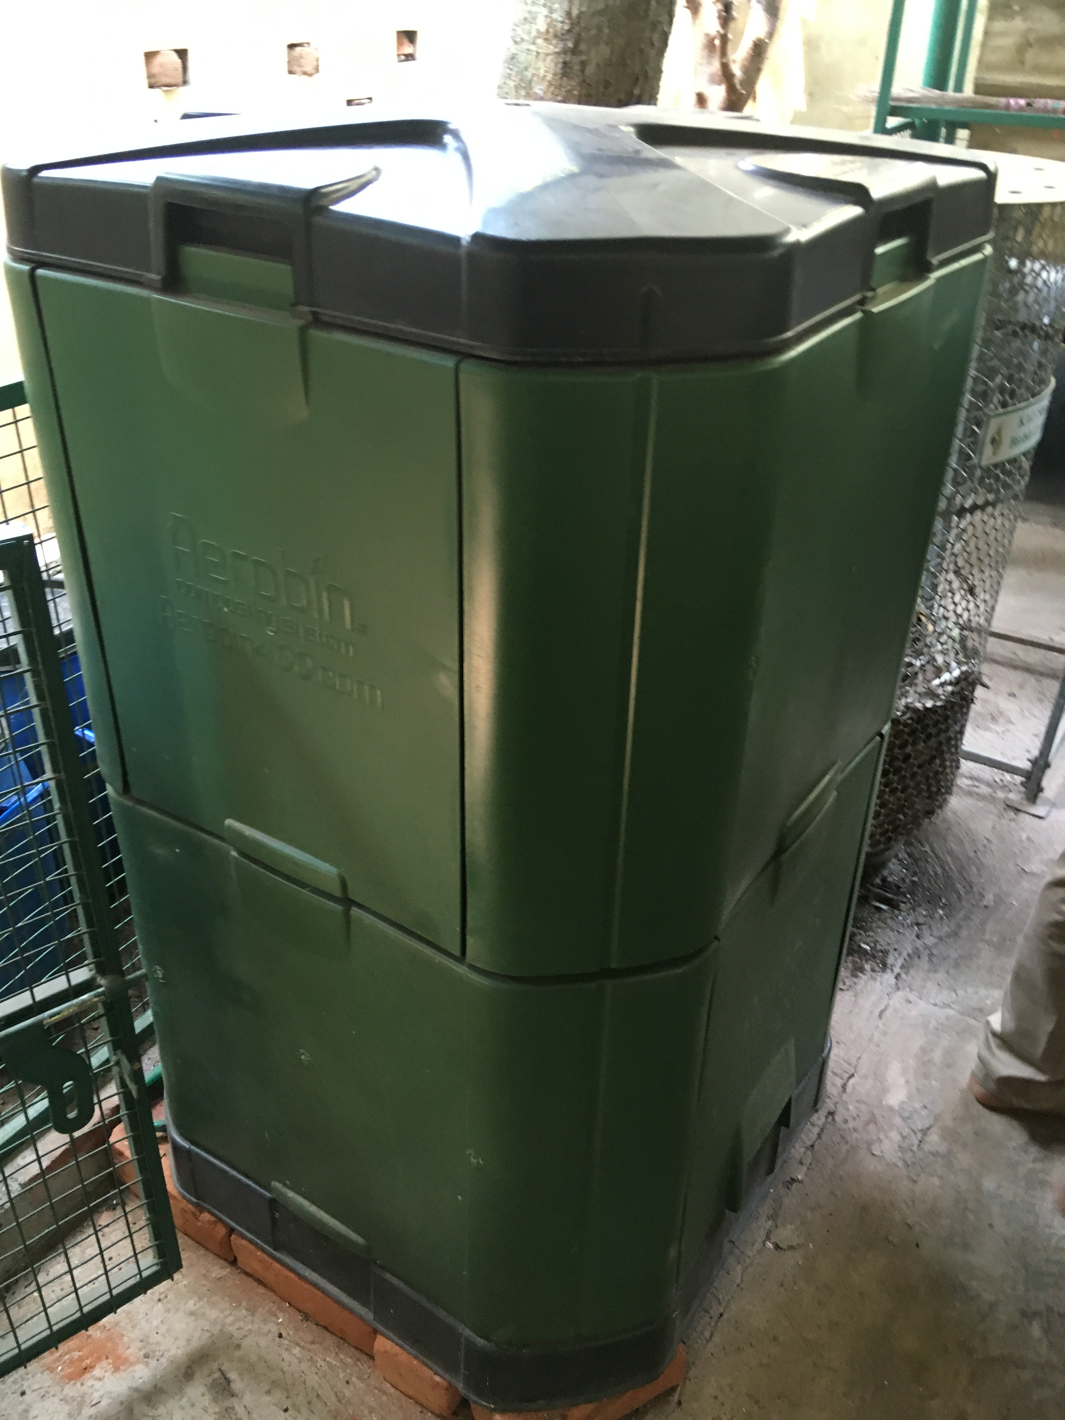

Slide 44
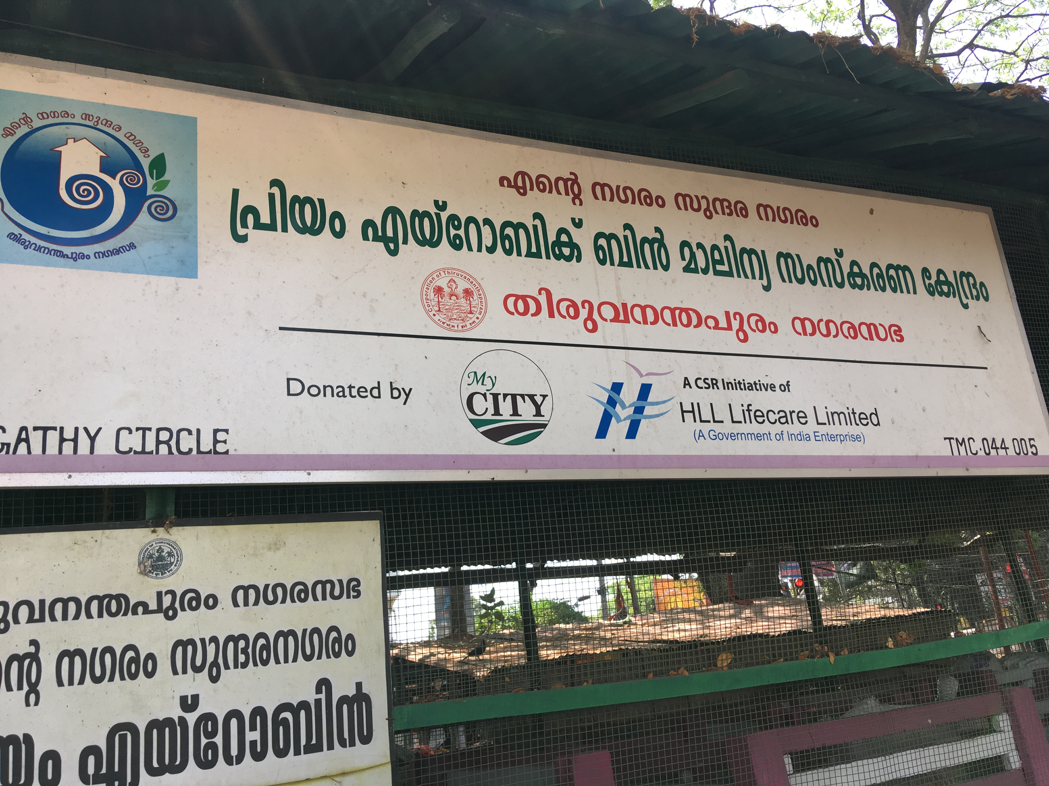

Slide 45
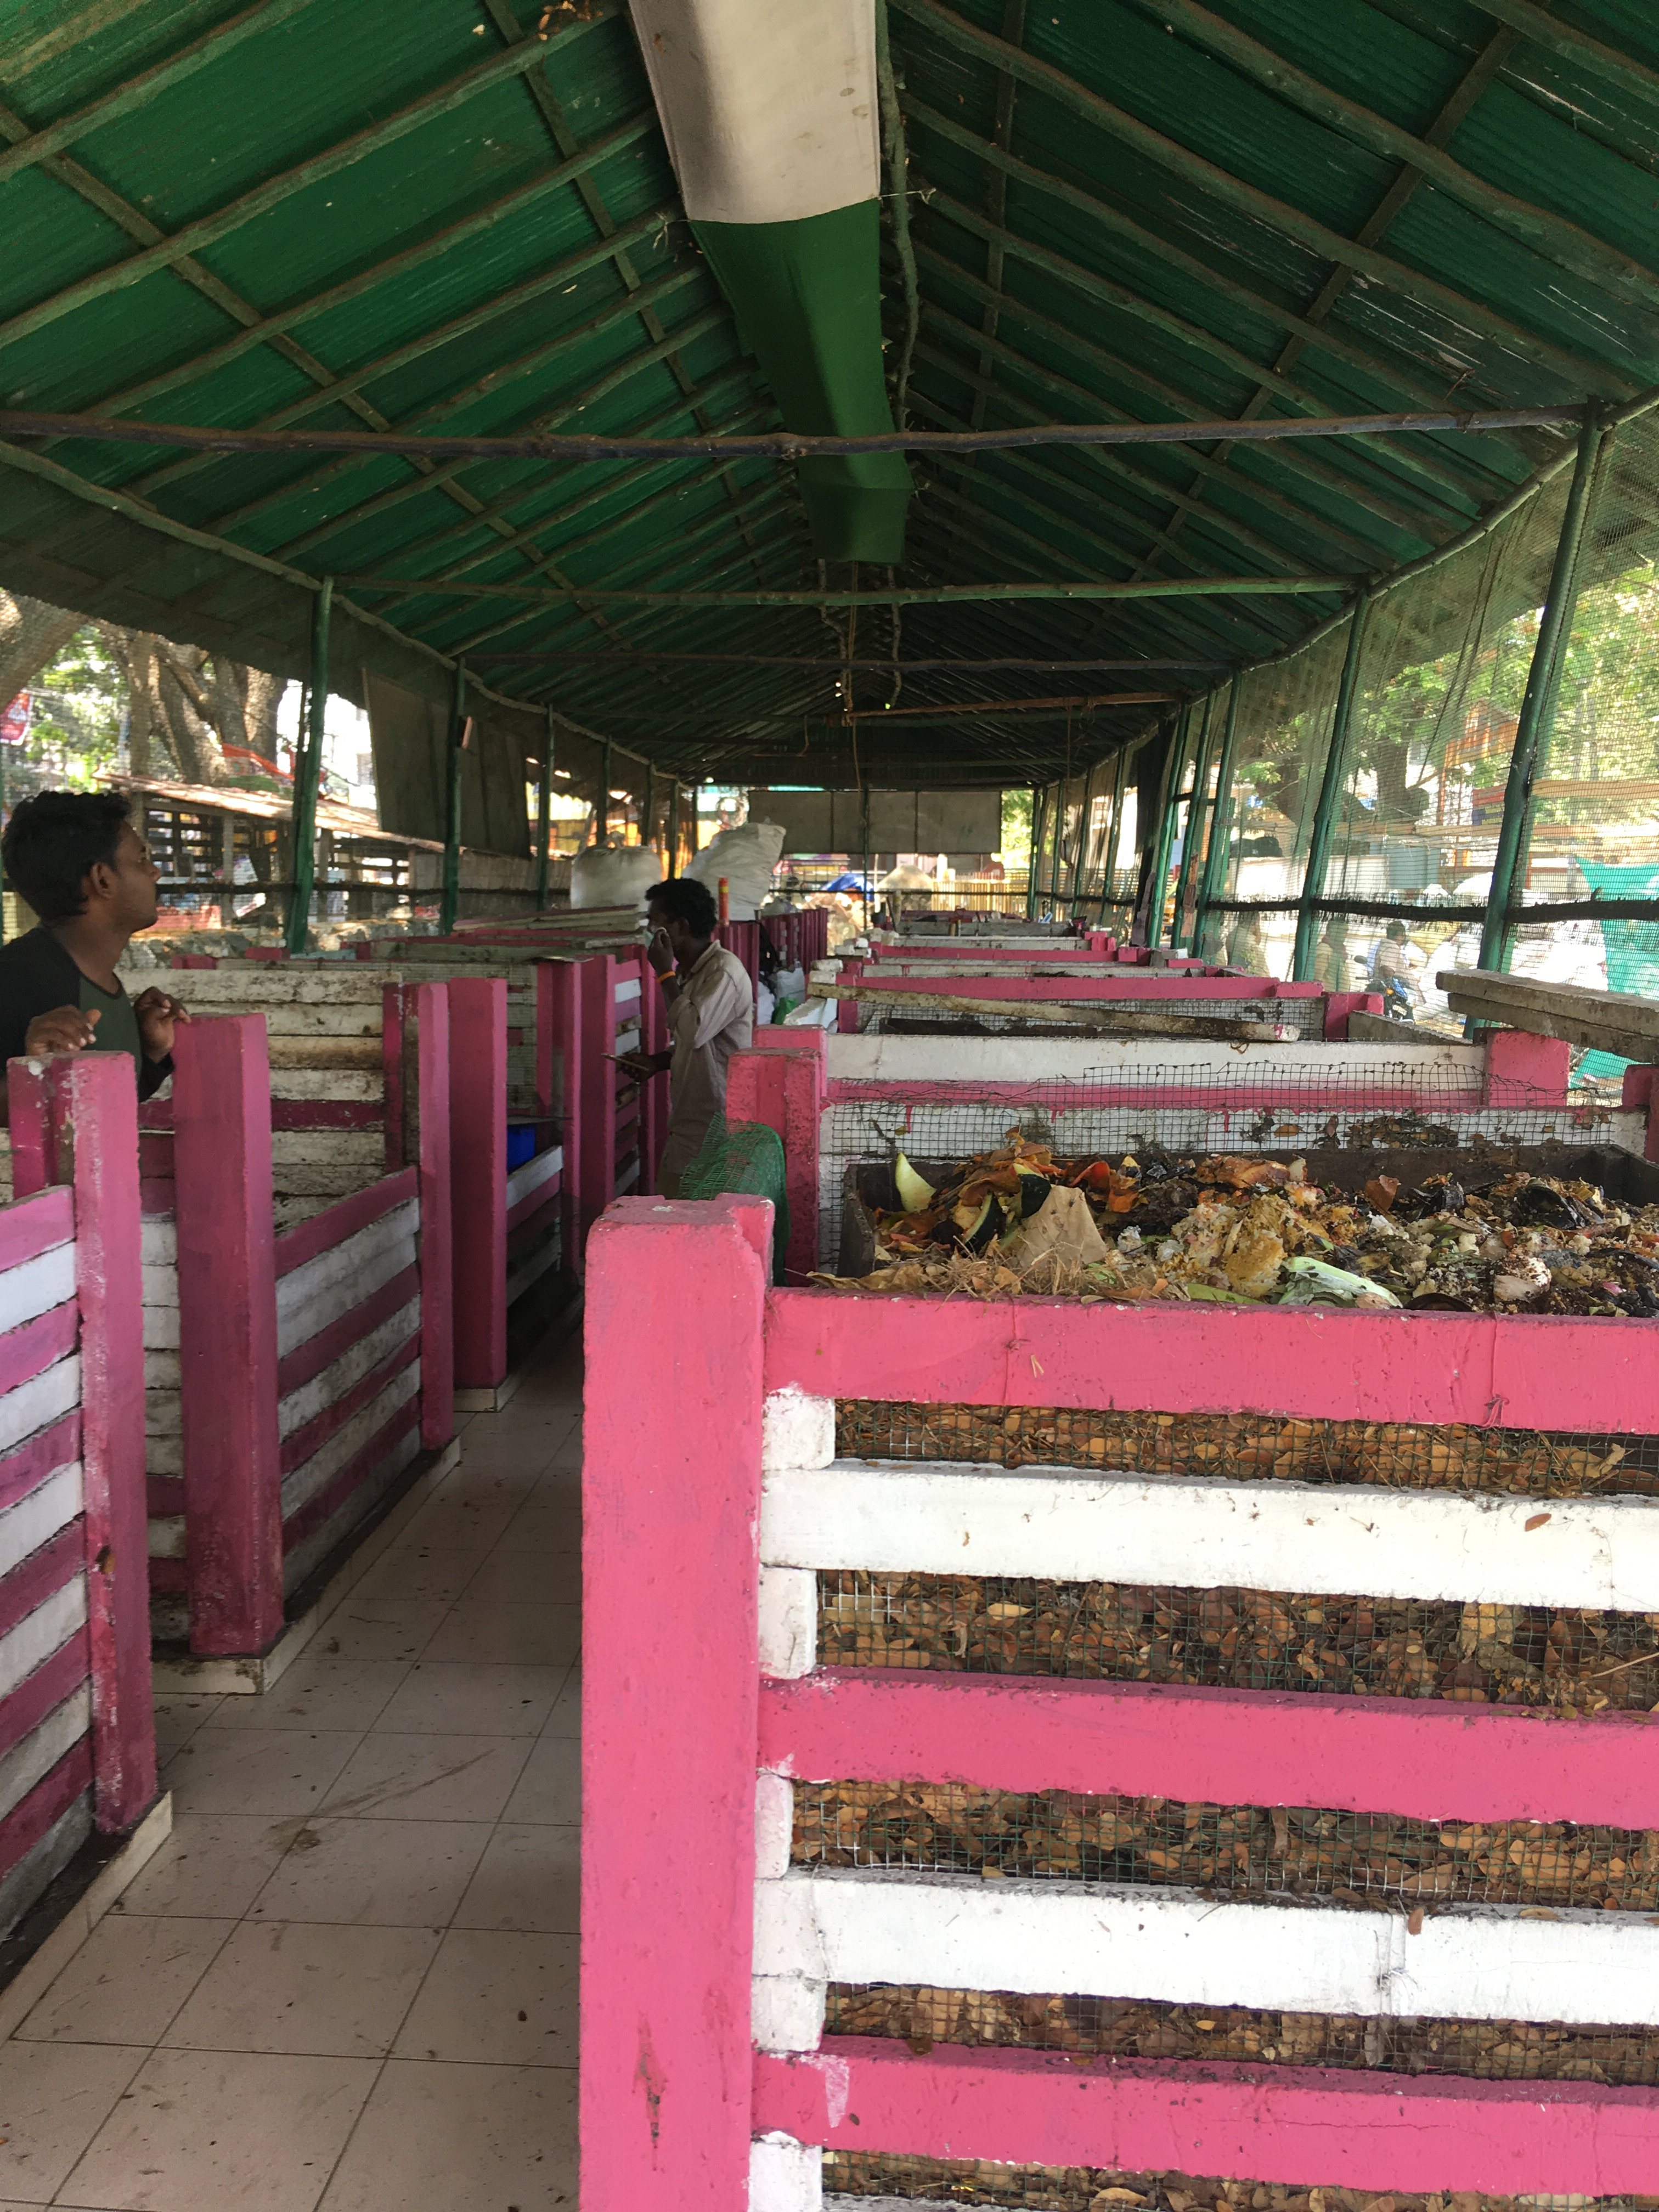
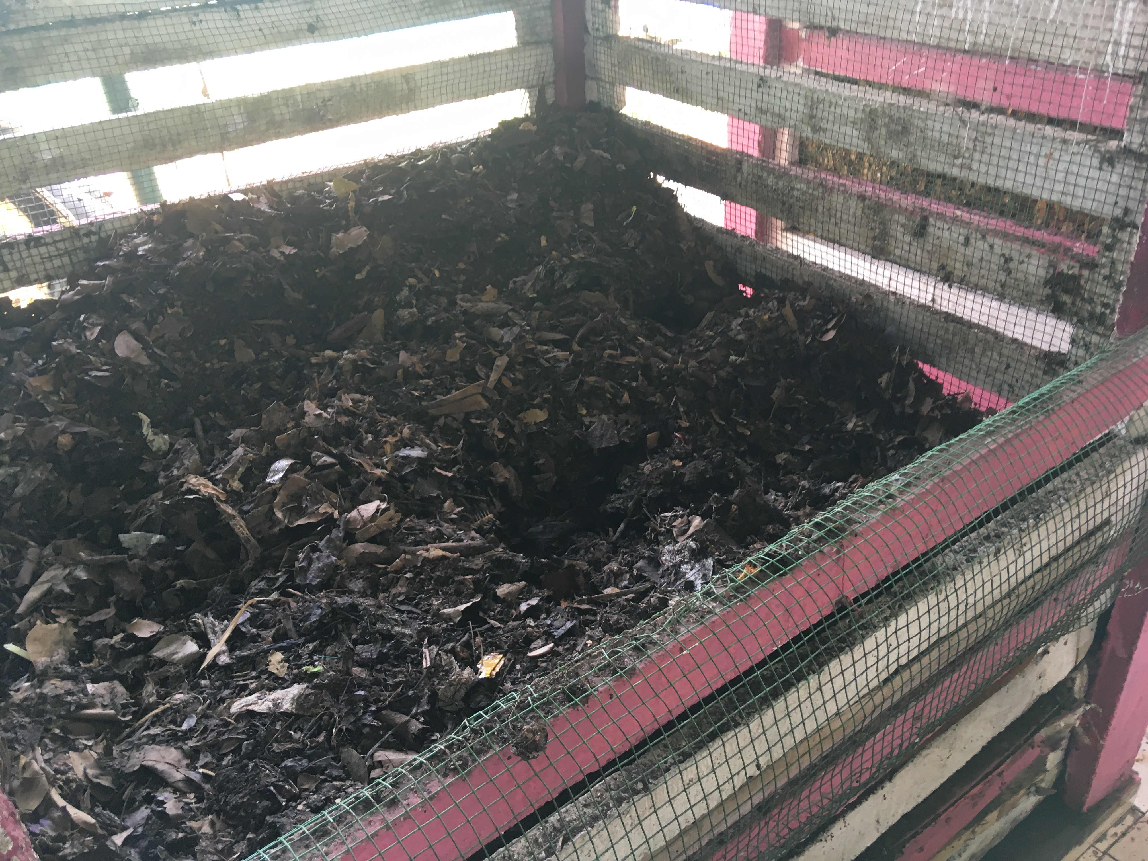

Slide 46
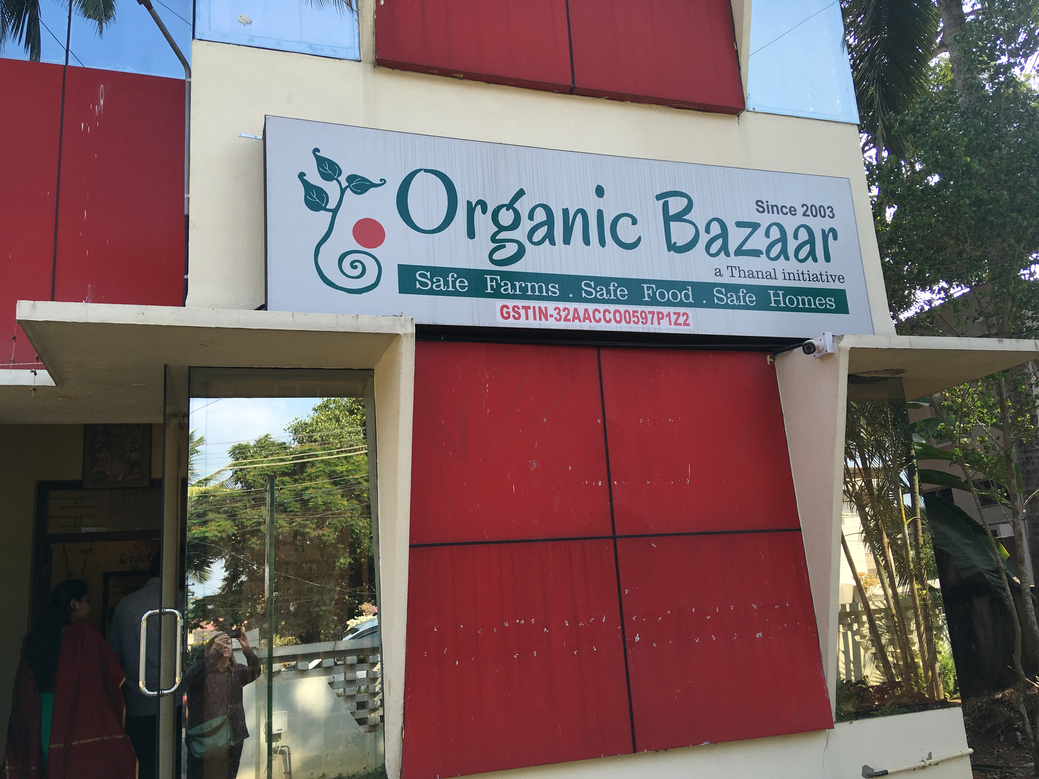
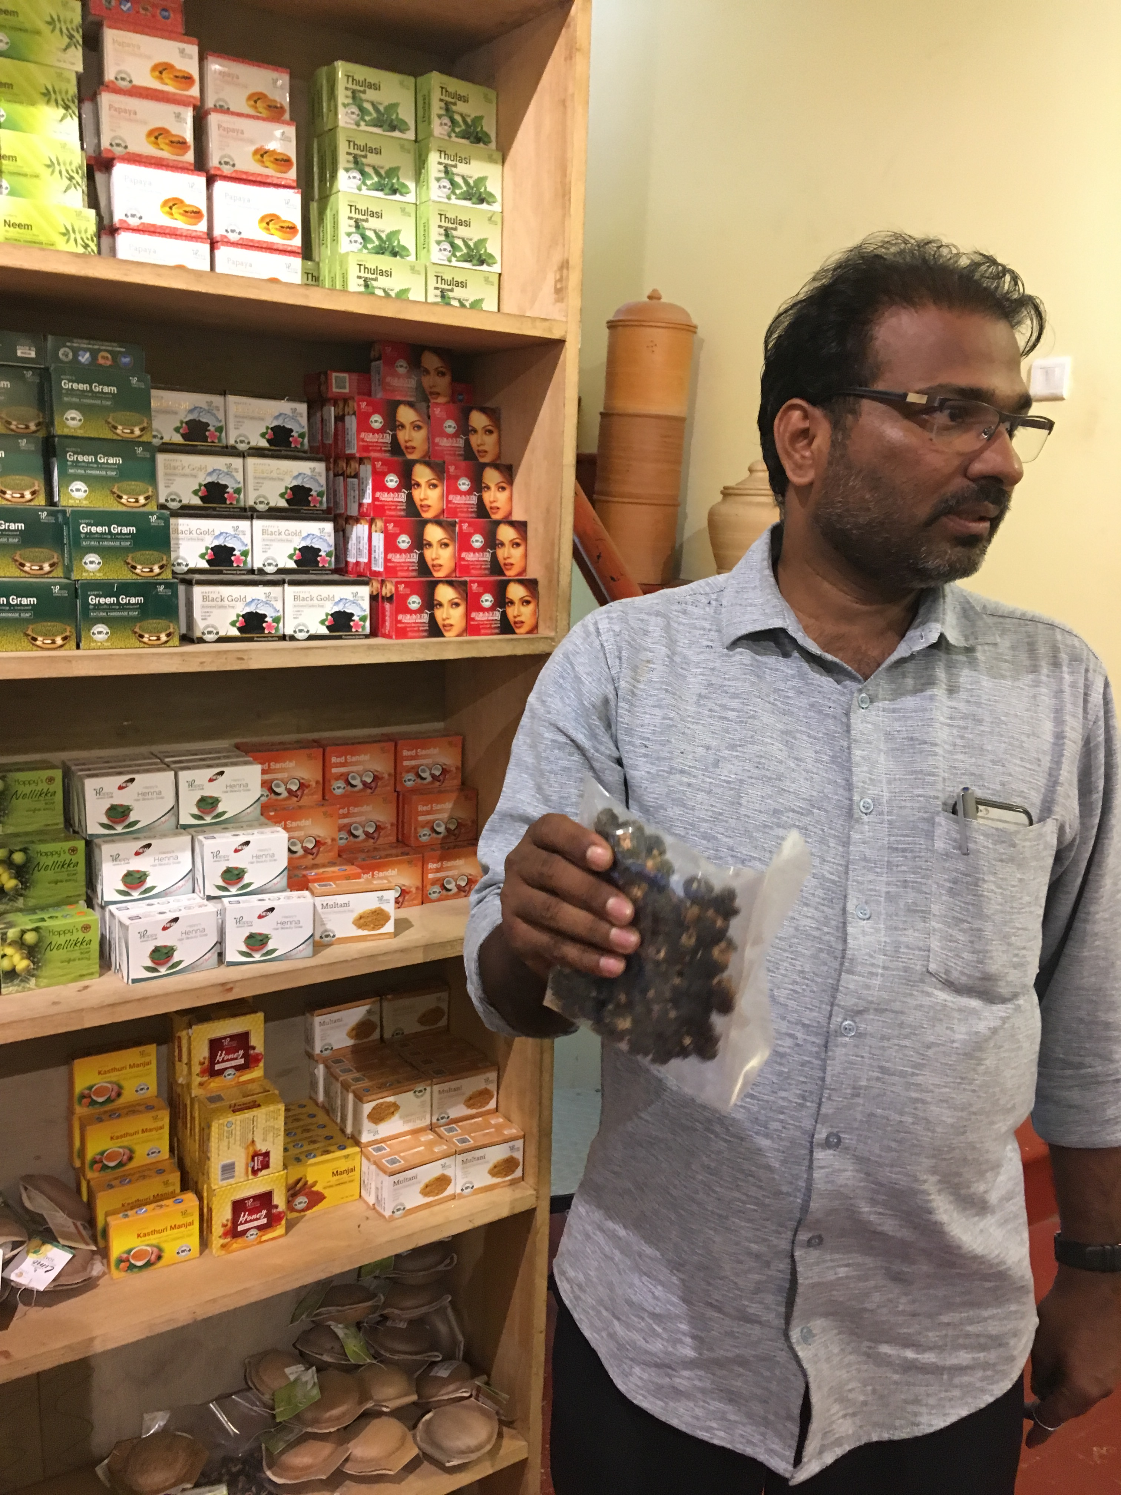

Slide 47
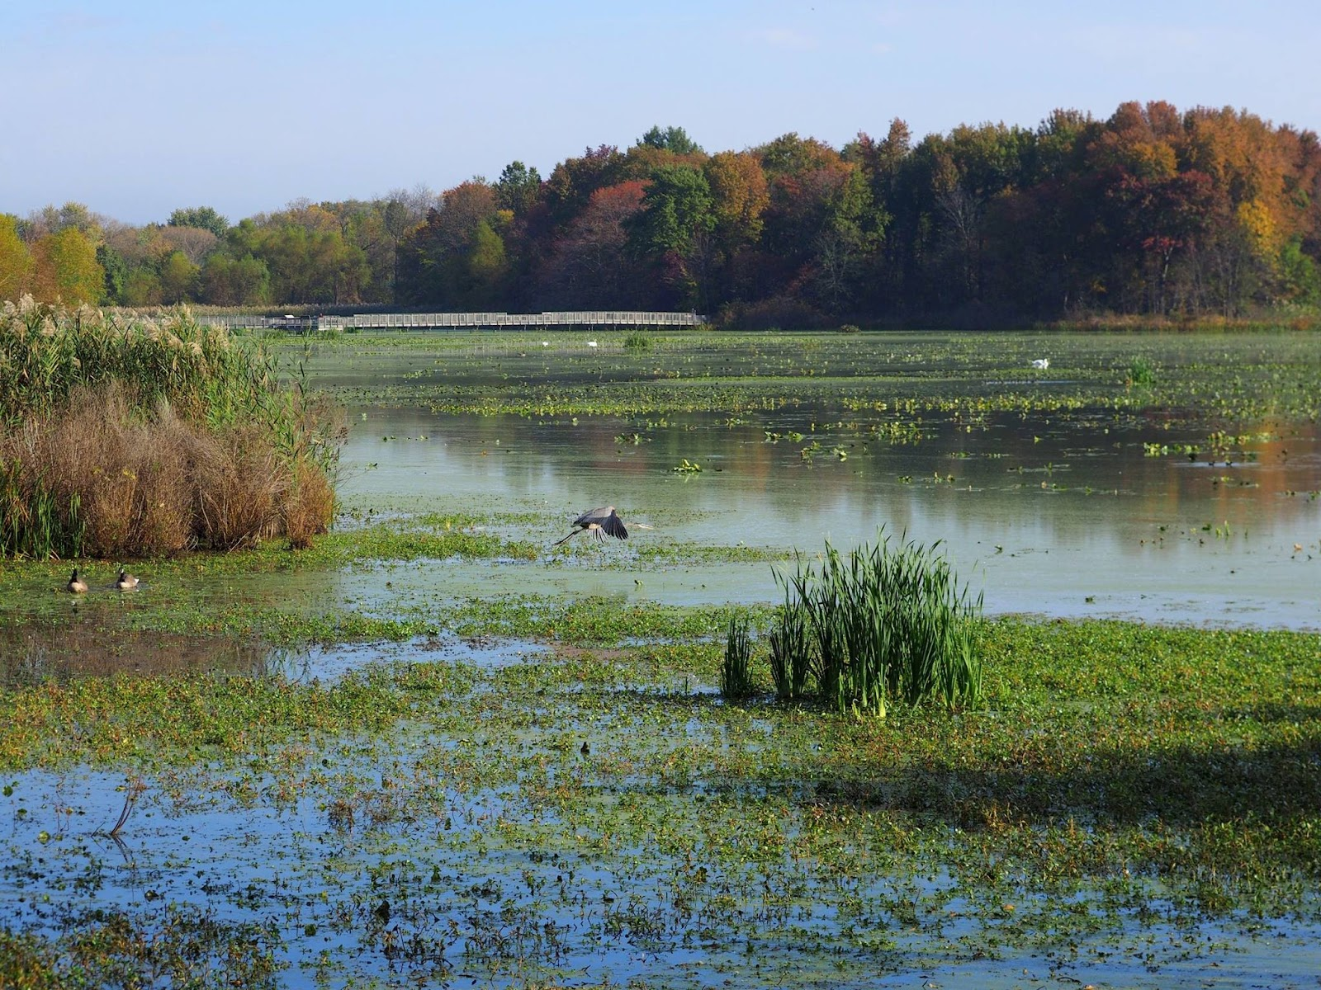
Delaware County’s
Path to Zero Waste

Slide 48
Delaware County has embarked on the planning process to update its 10-Year Municipal Waste Management Plan

Slide 49
The timing coincides with the development of the
Delaware County Sustainability Plan

Slide 50
Outcomes of the Planning Process
Ensure that the County has sufficient processing and disposal capacity for its municipal waste for the next 10 years.
Guide the County’s transition to sustainable methods of materials management using Zero Waste practices, and following the Zero Waste Hierarchy.
Ensure maximum feasible waste reduction of municipal waste and source-separated recyclable material.

Slide 51
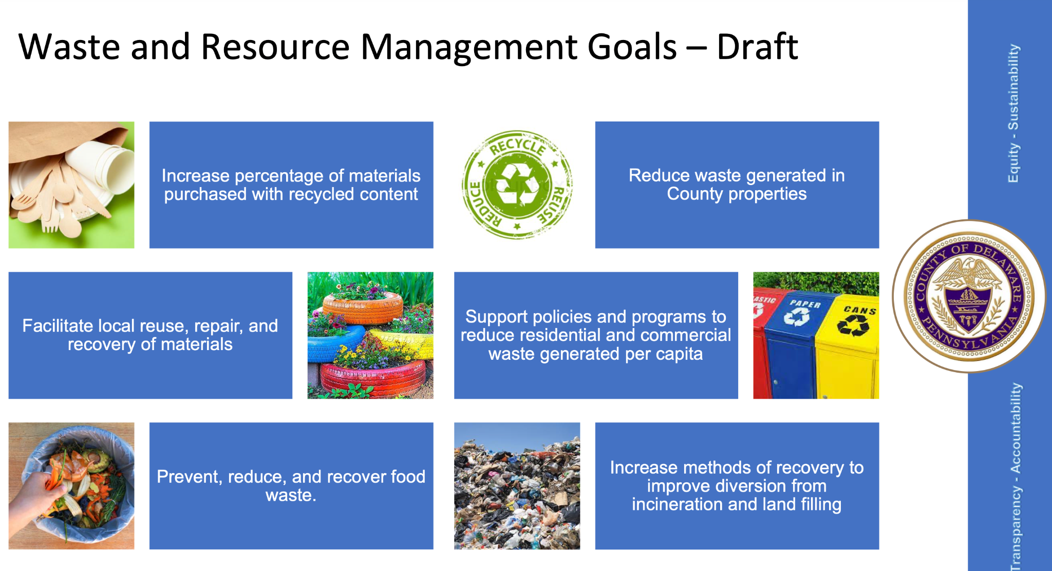
Sustainability Commission Goals

Slide 52
Municipal Waste Plan Work Plan & Schedule
Task | Jan | Feb | Mar | Apr | May | Jun | Jul | Aug | Sep | Oct | Nov | Dec
1 | Long-Term Waste Disposal
 |  | Public Outreach Process
2 | Solid Waste Facility Inventory
3 | Waste Quantities & Composition
 |  | Prepare Life-Cycle Analysis
4 |  | Waste Management Activities Analysis
5 |  |  |  | Strategic Analysis
6 |  |  |  |  | Plan Preparation
7 |  |  |  |  |  |  | Final Draft Plan
8 |  |  |  |  |  |  |  |  | Final Plan

Slide 53
Public Outreach Process
Public Workshops
Last Thursdays at 6 p.m.
April 28 (Goals)
May 26 (Zero Waste Strategies)
June 30 (Draft Plan Elements)
Public Hearing (tentative)
Thursday, August 25 at 6 pm
County Council Meeting (tentative)
Wednesday, October 19 at 6 pm
Assumes 30-day circulation timeframe
Listening Sessions - 20 including:
Municipalities
Service providers
Schools & universities
Environmental & faith groups
Business community
Advisory Committee meetings
First Thursdays at 12 noon
April 7
May 5
June 2
August 4

Slide 54
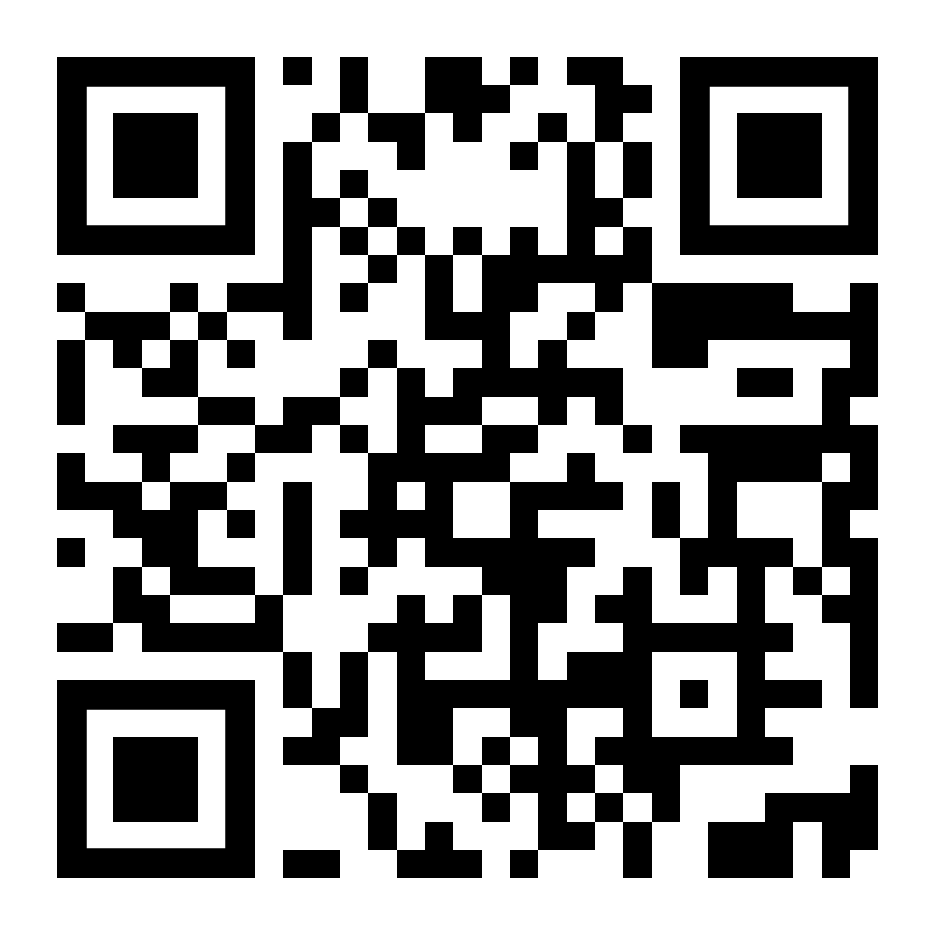
Guiding Principles Survey
What do you think the principles should be that guide the Delaware County Zero Waste Planning Process?
Do you have any thoughts or comments about Zero Waste Principles that should guide policies and planning for Delaware County?

Slide 55
Preliminary Zero Waste Strategies
 | Policies | Programs | Infrastructure
Rethink/ Redesign | Product policies Lead by example | Every-other-week trash collection
Reduce/ Reuse | Deconstruction | Reuse collection Edible food donation Reuse repair (repair fairs, directory, etc.) | Refillable stations Zero packaging stores Building materials reuse yards
Recycle/ Compost | Universal recycling/ composting (model ordinance) Pay-as-you-throw Construction & demolition recycling requirements | Universal recycling/ composting collection | Center for Hard to Recycle Materials Materials recovery facility Organics processing
Materials recovery |  |  | Mixed organics processing
Residuals Management |  | Materials characterization

Slide 56
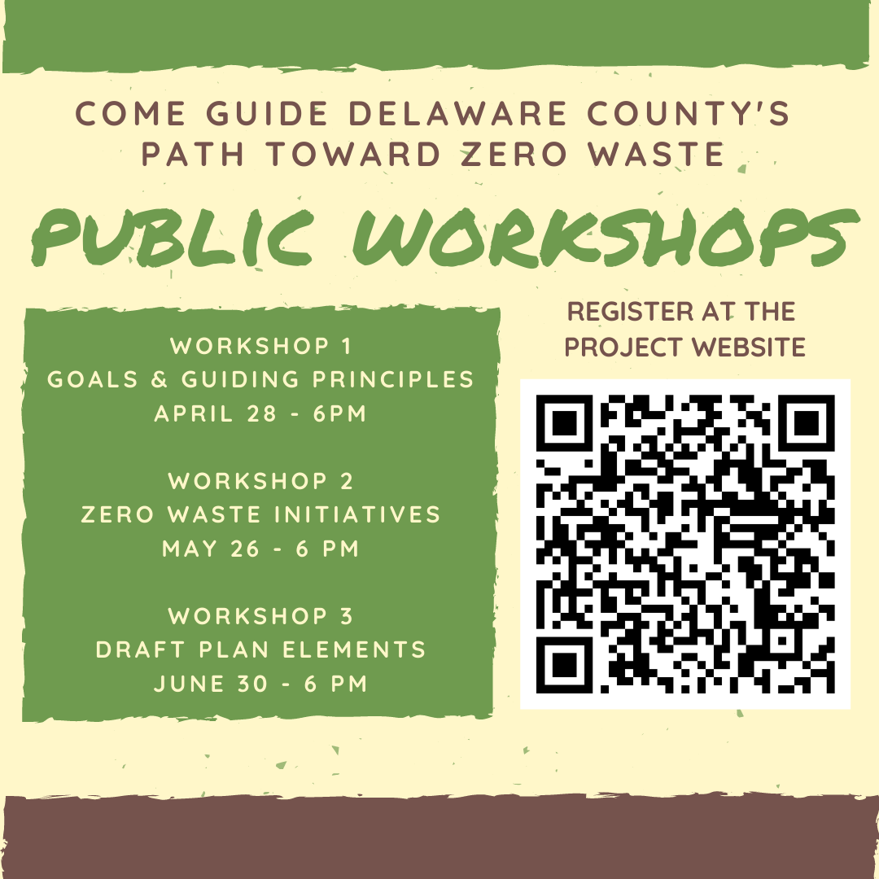
Join us!
delcopa.gov/workshops

Slide 57
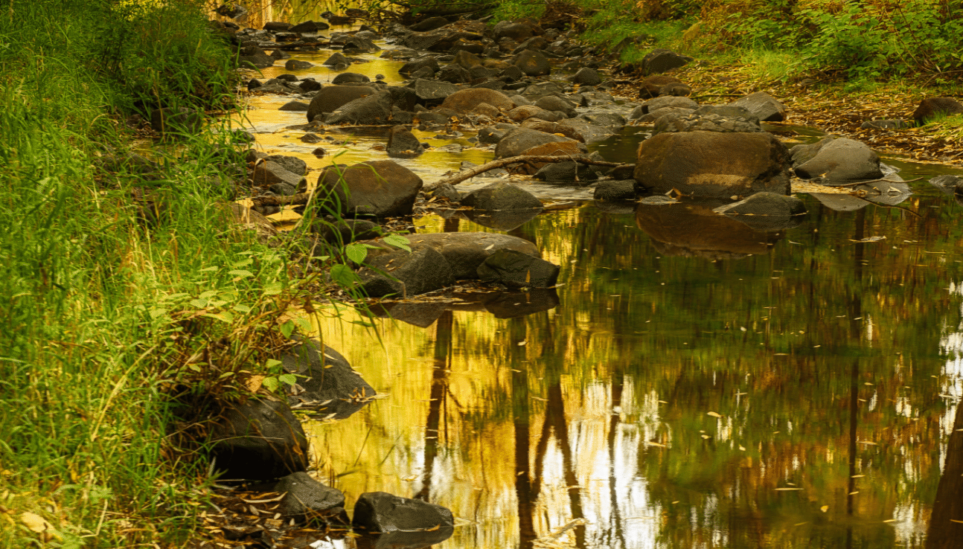
If you’re not for Zero Waste…
How much waste are you for?

