Slide 1

PA C-PACE
Property Assessed Clean Energy
Kelly Sanders, Director of Programs
Sustainable Energy Fund

Slide 2
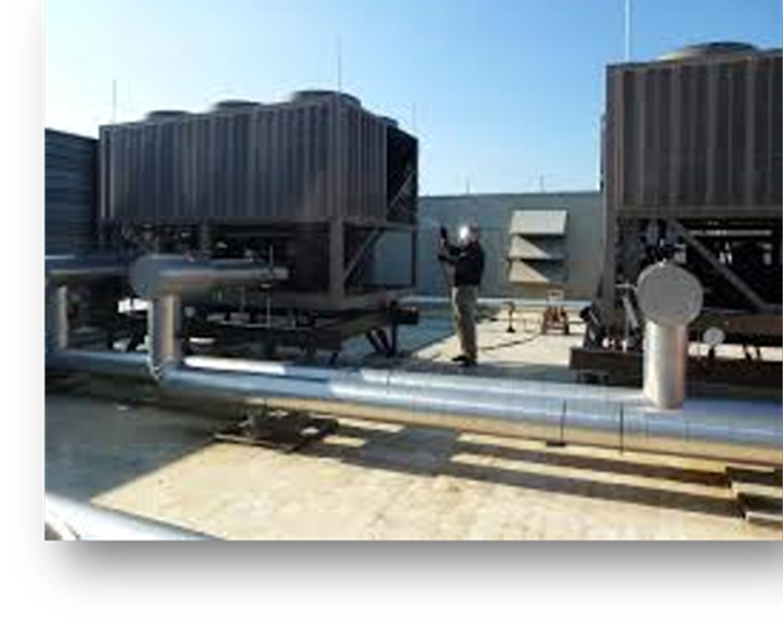
What is C-PACE
Commercial Property Assessed
Clean Energy:
Financing tool: Provides long-term funding
for energy efficiency, renewable energy, and
water conservation projects
Creates measurable savings: Projects
must result in energy savings or reductions
in water usage for commercial properties
Through a special tax assessment:
Collection is through a special payment
similar to a property tax that stays with the
property upon sale or transfer

Slide 3
HOW IS C-PACE USED?
Commercial and agriculture properties:
Office
Industrial
Retail
Farms
Nonprofits
Private Schools
No multi-family
No government owned

Slide 4
ELIGIBLE IMPROVEMENTS
A 20% reduction in energy consumption for the ECM
Utilization of best-in-class equipment.
Prescriptive measures:
  Measures listed in Pennsylvania’s Public Service Commission’s Technical Resource Manual
  Measures listed in the NYSERDA’s Technical Manual
  Measures identified as being eligible for utility incentive
  Energy efficiency products certified by Energy Star that are permanently affixed to the land or building
  Products on the list of Energy Efficient Equipment published by the Consortium for Energy Efficiency, Inc.
  Energy efficiency products certified by the Federal Energy Management Program.

Slide 5
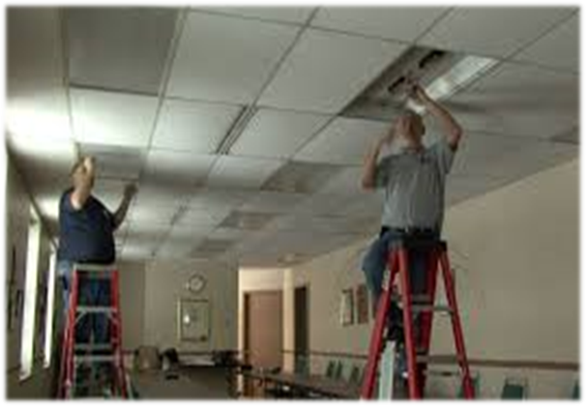
ELIGIBLE IMPROVEMENTS
Energy efficient equipment and installation (HVAC, boilers, lighting, etc.)
Renewable energy systems
Energy storage
Water conservation fixtures
Ancillary costs can also be included
Projects costs – hard & soft

Slide 6
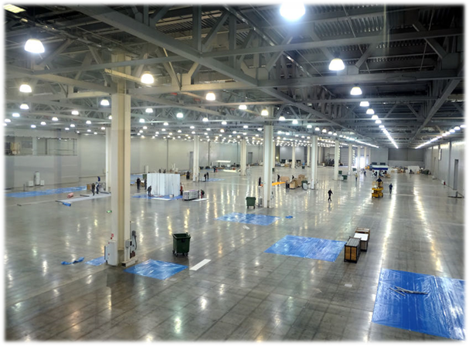
ELIGIBLE IMPROVEMENTS
A 20% reduction in energy consumption for the ECM
Utilization of best-in-class equipment.
Prescriptive measures:
  Measures listed in Pennsylvania’s Public Service Commission’s Technical Resource Manual
  Measures listed in the NYSERDA’s Technical Manual
  Measures identified as being eligible for utility incentive
  Energy efficiency products certified by Energy Star that are permanently affixed to the land or building
  Products on the list of Energy Efficient Equipment published by the Consortium for Energy Efficency, Inc.
  Energy efficiency products certified by the Federal Energy Management Program.

Slide 7
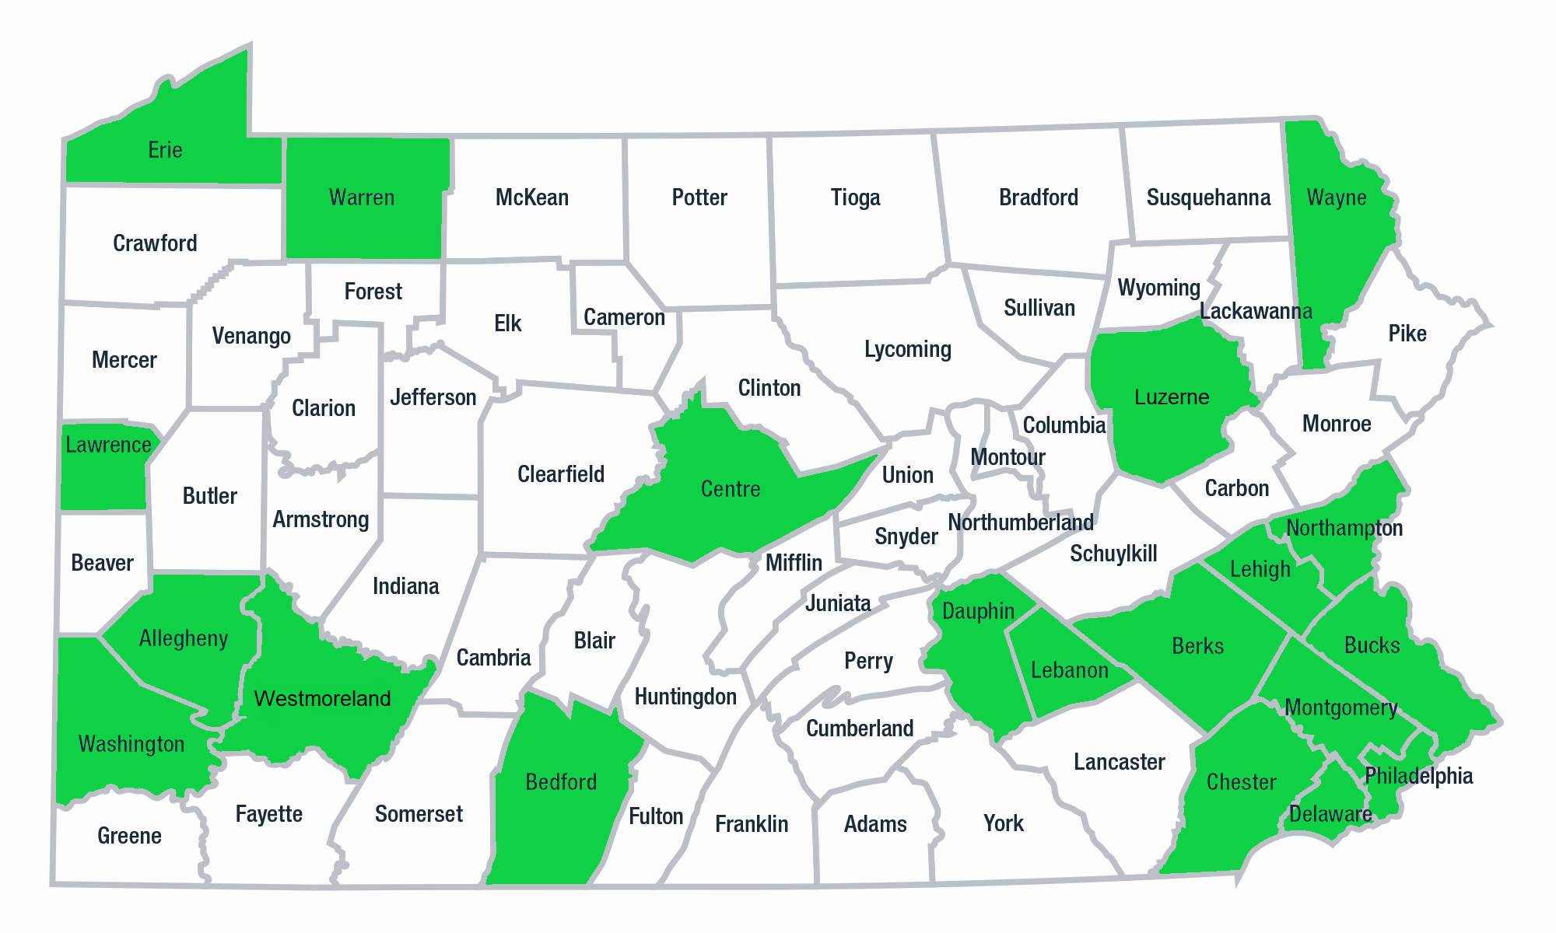
ADOPTION BY COUNTY
Notes:
Benefits to County – Local Investment, Creates Jobs, Good for the Environment, Modernizes Building Stock

Slide 8
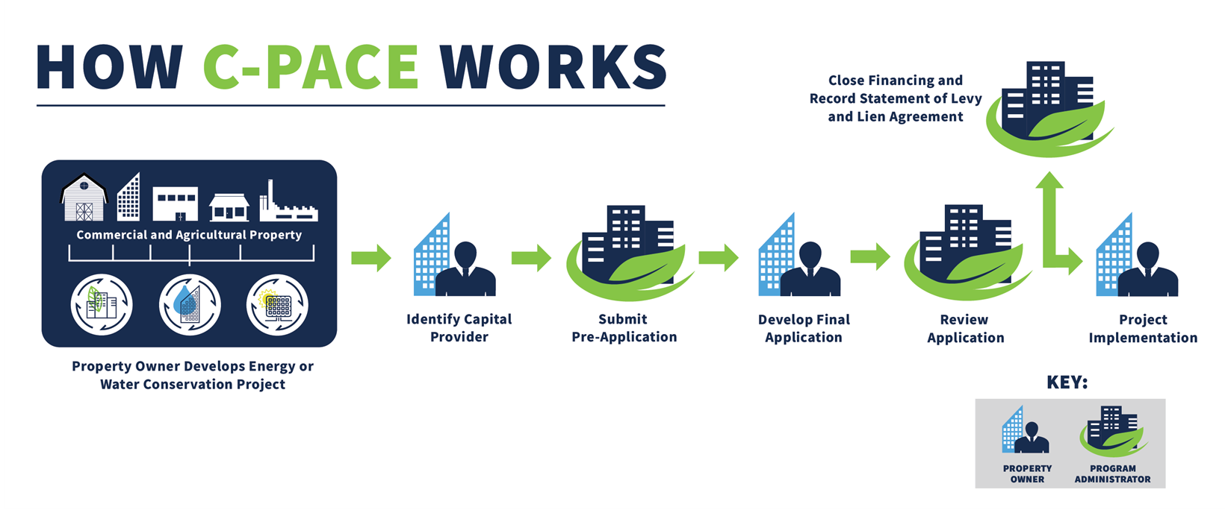

How C-PACE Works

Slide 9

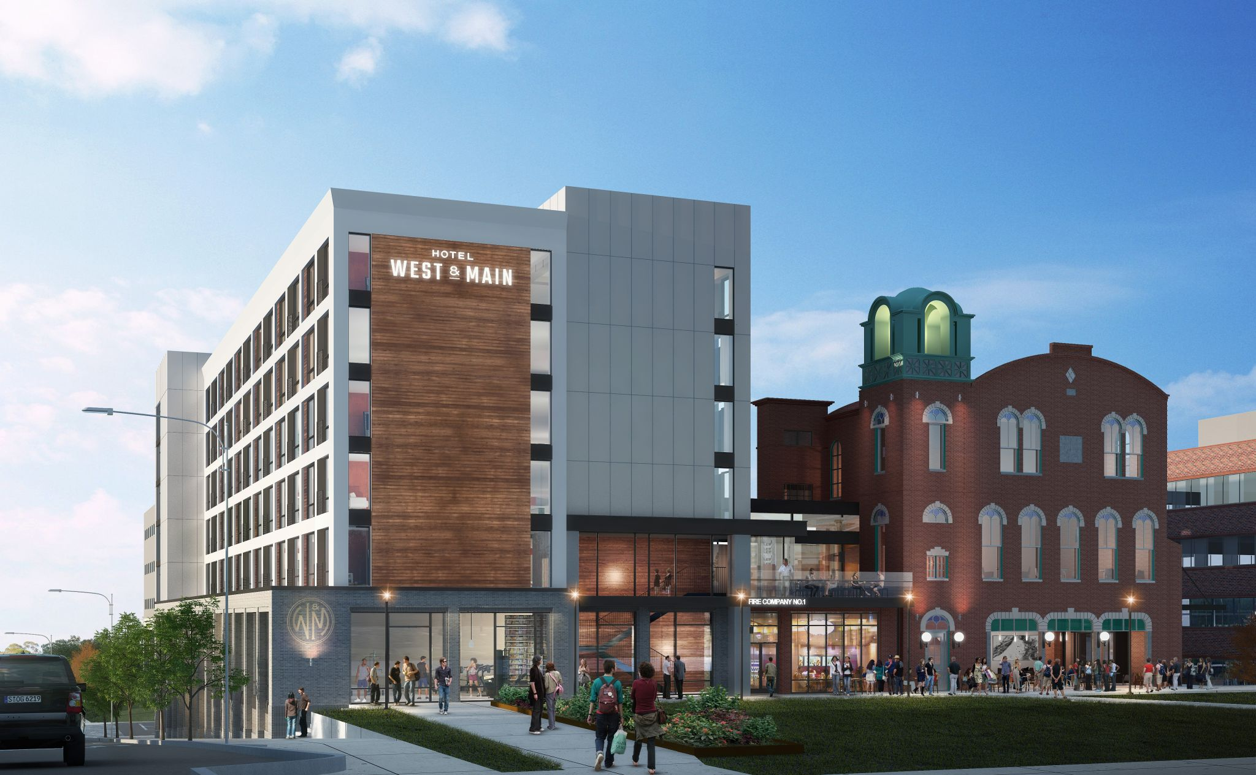
SORA WEST
MONTGOMERY COUNTY
Project Overview
Property Type: New Construction / Rehabilitation
Financing Amount: $9,999,740
Building Measures: Upgrades to building envelope HVAC System LED Lighting Hot Water Heaters
Annual Savings: 349, 644 kWh (~$27,000/year) 4,914 therms of natural gas
Property Owner: Concord Keystone Sora West, LLC
Capital Provider: Greenworks Lending
Image Courtesy of Keystone Property Group.

Slide 10

THE COMMODORE
NORTHAMPTON COUNTY
Project Overview
Property Type: New Construction / Rehabilitation
Financing Amount: $3,454,940.55
Building Measures: High Efficiency heating and cooling systems Upgrades to building envelope Interior/Exterior LED Lighting Plumbing Fixtures
Annual Savings: 132,554 kWh 600 therms of natural gas 137 CCF of water
Property Owner: Optima Durant Group, LLC
Capital Provider: Twain Financial Partners
Image Courtesy of Optima Durant Group.
Notes:
Save $15,111 in electric, $500 for natural gas and $1,000 in water cost savings

Slide 11

Kelly Sanders
Director of Programs
ksanders@thesef.org
610-264-4440
Renee Riley
Relationship Manager
rriley@thesef.org
610-264-4440
Notes:
Webinar Q&A sessions 4th Wednesdays of the month 12:30 pm

