Slide 1

Education for Sustainability
Dr. Victor J. Donnay
vdonnay@brynmawr.edu
Professor of Mathematics, Bryn Mawr College
Director, Philadelphia Regional Institute for STEM Educators (PRISE)

Slide 2
What is the role of schools/school districts in furthering sustainability and addressing the Climate Crisis?

Slide 3
Roles:
1. Educate students about sustainability
2. Give students opportunities to take action that contribute to school and community sustainability
3. Make school operations more sustainable
4. Link operations initiatives to learning

Slide 4
My Background:
Teach courses on Math Modeling and Sustainability
Students apply math knowledge to address a sustainability problem in partnership with community organizations
College’s Sustainability Committee
Philadelphia Regional Institute for STEM Educators (PRISE)
Orient new teachers to Education for Sustainability
Support practicing teachers as they work to link their (STEM) teaching with sustainability and incorporate place-based projects with community partners
Notes:
Math professor at Bryn Mawr College
that contribute to school and community sustainabili
People often wonder what mathematics has to do with sustainability.
What is great about sustainability is that it crosses all boundries; there are connections to it from any field.

Slide 5
Start of Math Class:
Notes:
Making learning relevant;
The goal of our math course is to see how the math we learn can be used to address these issues you have identified.
Theme: Make leaning relevant.

Slide 6
Start of Math Class:
What are some problems facing the nation and world that you are concerned about?
Notes:
Making learning relevant;
The goal of our math course is to see how the math we learn can be used to address these issues you have identified.
Theme: Make leaning relevant.

Slide 7
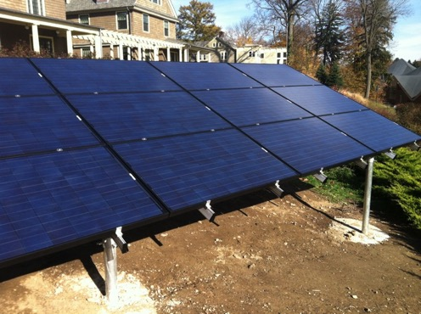
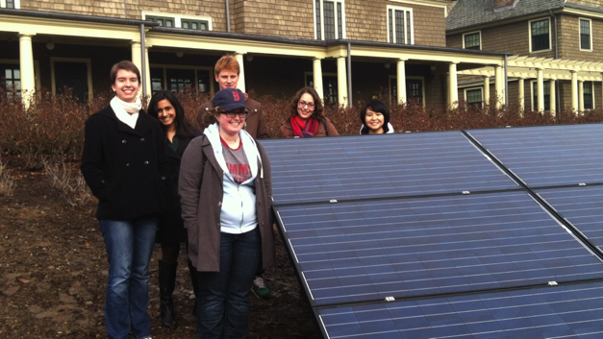
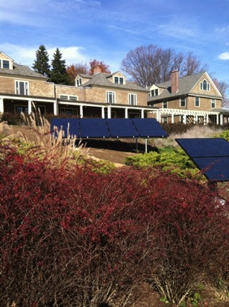
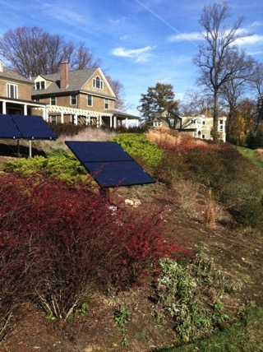
Solar Panel
Field Trip
Notes:
Here is an example of a math unit that links to sustainability.
Field trip

Slide 8
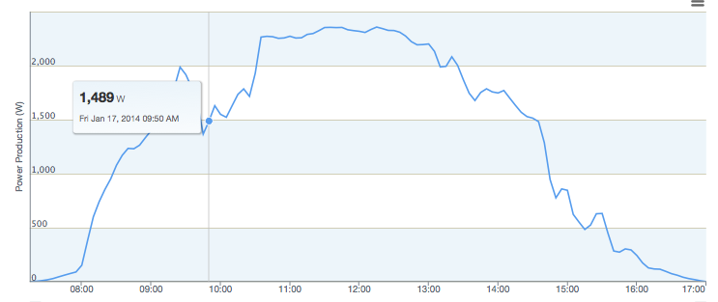
How much energy do the solar panels produce in a day?
Notes:
Data from the Bryn Mawr College website: using real world data in our teaching. Data Analytics – the wave of the future.

Slide 9
How many solar panels would we need to power our school?

Slide 10
What is the pay-back time for buying solar panels?

Slide 11
Should the district buy solar panels?
Notes:
Link with other disciplines: Science – carbon footprint, not just $
biology; health – impacts of fossil fuel pollution asthma

Slide 12
Should the district buy solar panels?
Present your findings to the School Board
Notes:
Link of math with other topics!
Civic Engagement; social studies (how local gov’t work);
Language arts.

Slide 13
Township
Should the district buy solar panels?
Township Board of Commissioners
Present your findings to the School Board
Notes:
Link of math with other topics!
Civic Engagement; social studies (how local gov’t work);

Slide 14
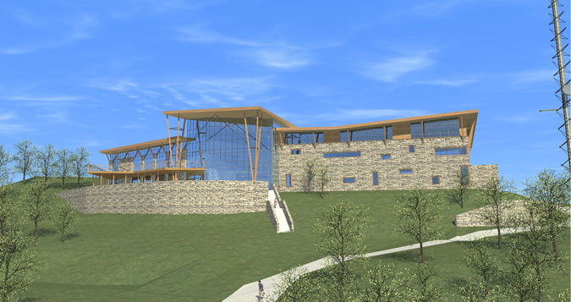
Haverford 2011
Recreation and Environmental Education
Center

Slide 15
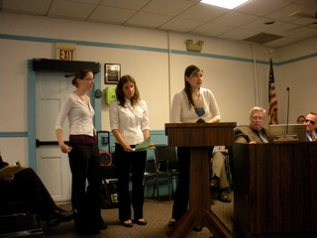
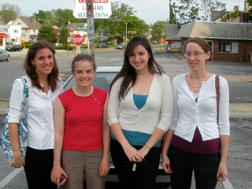
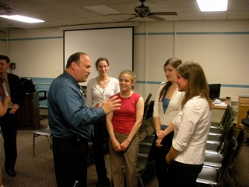
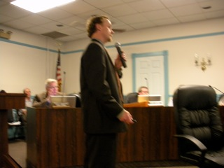
Math and Sustainability:
Cost – Benefit Analysis for Commissioners
Bethany Giblin, Amy Veprauskas, Jenny Sichel, Teresa Palasits

Slide 16
Math and Sustainability:
Cost – Benefit Analysis for Commissioners
Bethany Giblin, Amy Veprauskas, Jenny Sichel, Teresa Palasits

Slide 17
School District of Philadelphia
Green Futures Sustainability Initiative

Slide 18
School District of Philadelphia
Green Futures Sustainability Initiative
For
Education About Sustainability
Equip students, schools, administrators, families, and the community with the skills, knowledge, and habits of mind that will prepare them to create and contribute to a world where economic prosperity, social justice and responsible citizenship are strengthened while restoring our health and that of the living systems upon which our lives depend.

Slide 19
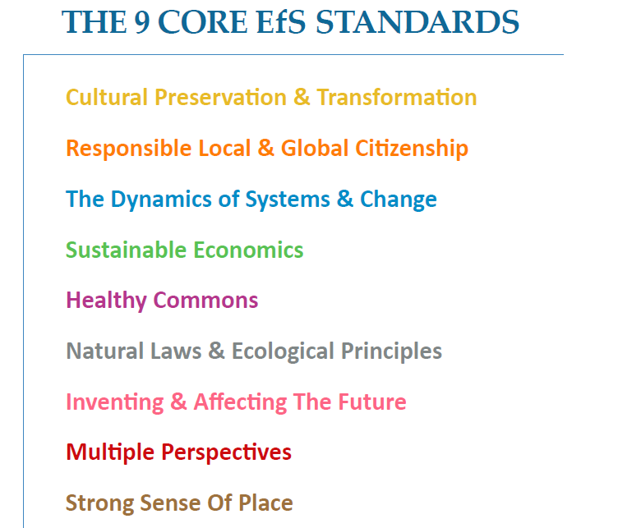
Notes:
three dimensions of sustainable development:
social diversity, equity, inclusion, and justice
economics
the environment

Slide 20
Prepare Students for Green Careers
Bright Solar Futures CTE vocational program
at Frankford High School.
State of the art Solar Training Lab
3-year Solar Energy program to train
students to become Solar Installers (first in the nation!).
Includes paid summer internships in the clean energy field.
Notes:
Equitable access

Slide 21
Eco-Schools USA program
National Wildlife Federation
School based Eco-Team focus on pathways to sustainability
most relevant to the school
Develop an Action Plan
and work towards winning the Green Flag Award
Linked to United Nations Sustainable Development Goals
Notes:
Today over 5,400 schools and more than three million students across all 50 states engage in the National Wildlife Federation’s Eco-Schools USA program.
We are not alone; millions of people all over the world are taking action to bring about the needed change.

Slide 22





Slide 23
Partner with Community Organizations
Science class: student energy audit
New Kensington Community Development Corporation (NKCDC)
Help community residents save money by weatherizing their homes to reduce energy usage
Notes:
PRISE project working with teachers

Slide 24
Partner with Community Organizations
Science class: student energy audit
New Kensington Community Development Corporation (NKCDC)
Help community residents save money by weatherizing their homes to reduce energy usage
NKCDC visits with science class:
real-world application of knowledge and way to reach out to families
Win – Win

Slide 25
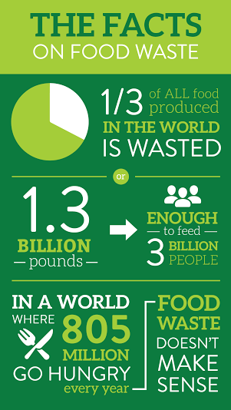

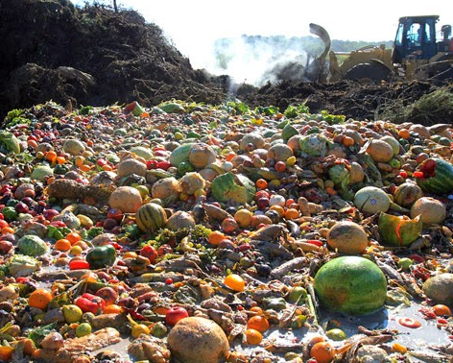
Northeast HS
Amanda Fiegel
Meraki Helps Veterans

Slide 26
School District Operations:
1. Create Climate Action Plan
2. Reduce energy use a. Behavior change b. LED lighting conversion (PECO partnership) c. Energy efficient equipment d. Careful monitoring of heating/cooling systems
Energy Star rating system
3. Get energy from renewable sources

Slide 27
Operations: New Opportunities:
4. Electrify the transportation fleet; electric school buses
5. Install solar panels on school buildings
6. In partnership with other institutions, undertake a Power Purchasing Agreement (PPA) to fund the creation of new large scale solar/wind installations to supply school’s electricity.
Notes:
Solarize delco
Clean Energy Coop

Slide 28
Opportunity for big
savings $$
Cost avoidance of $1.3 million dollars = 35% savings in energy spending
Notes:
Energy management’
Benchmarking; where did we start; then pay attention going forward.

Slide 29
In all these initiatives, link the projects with student learning.
STEM skills: data collection and analysis
Use your school’s data for real-world learning

Slide 30
Resources: https://tinyurl.com/DelCoEarthDay
Organizations that want to partner with schools: contact
Lane Freeze, lfrazee@phennd.org, PHENND Sustainability
Teacher/ School Interest: contact PRISE: kwilson@sju.ed
Upcoming PRISE Events:
Saturday May 7 at Arcadia University: Teacher Showcase on incorporating real-world issues into STEM teaching (USTRIVE).
Saturday June 4, Teacher Showcase on implementing Education for Sustainability projects.

Slide 31
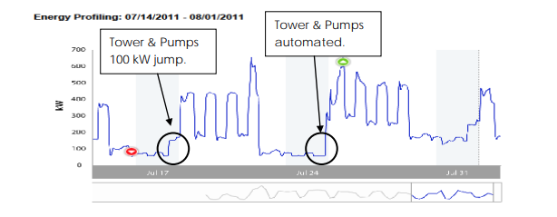
AC chiller system: $1680 savings per year from automating
Thomas Schneider
Manager of Energy and Operational Efficiencies
North Penn School District

