Slide 1
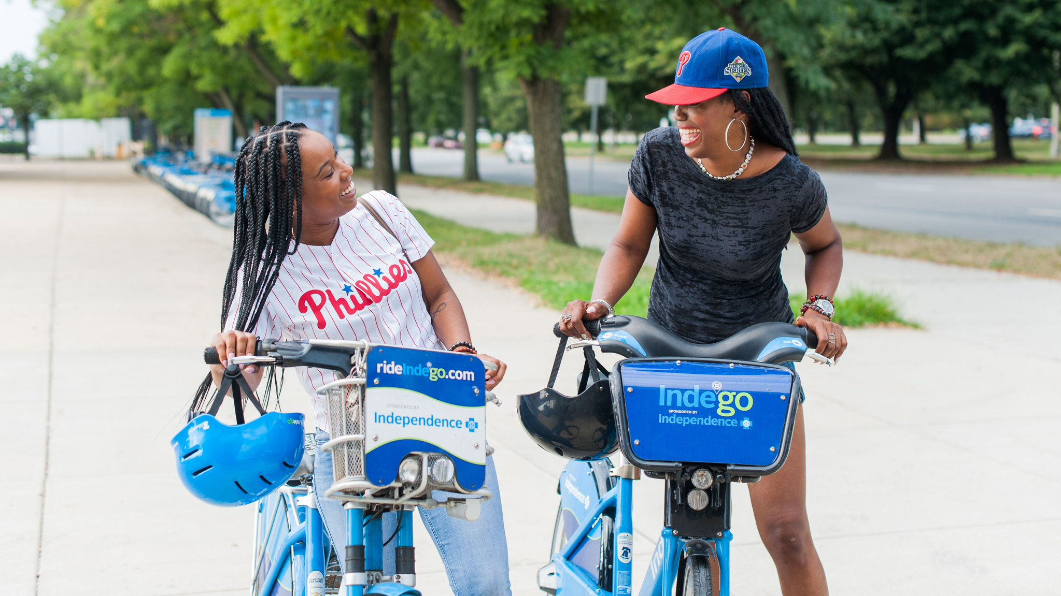

Waffiyyah Murray
Indego Program Manager
Phone: 215-686-5493
Email: Waffiyyah.murray@phila.gov

Slide 2
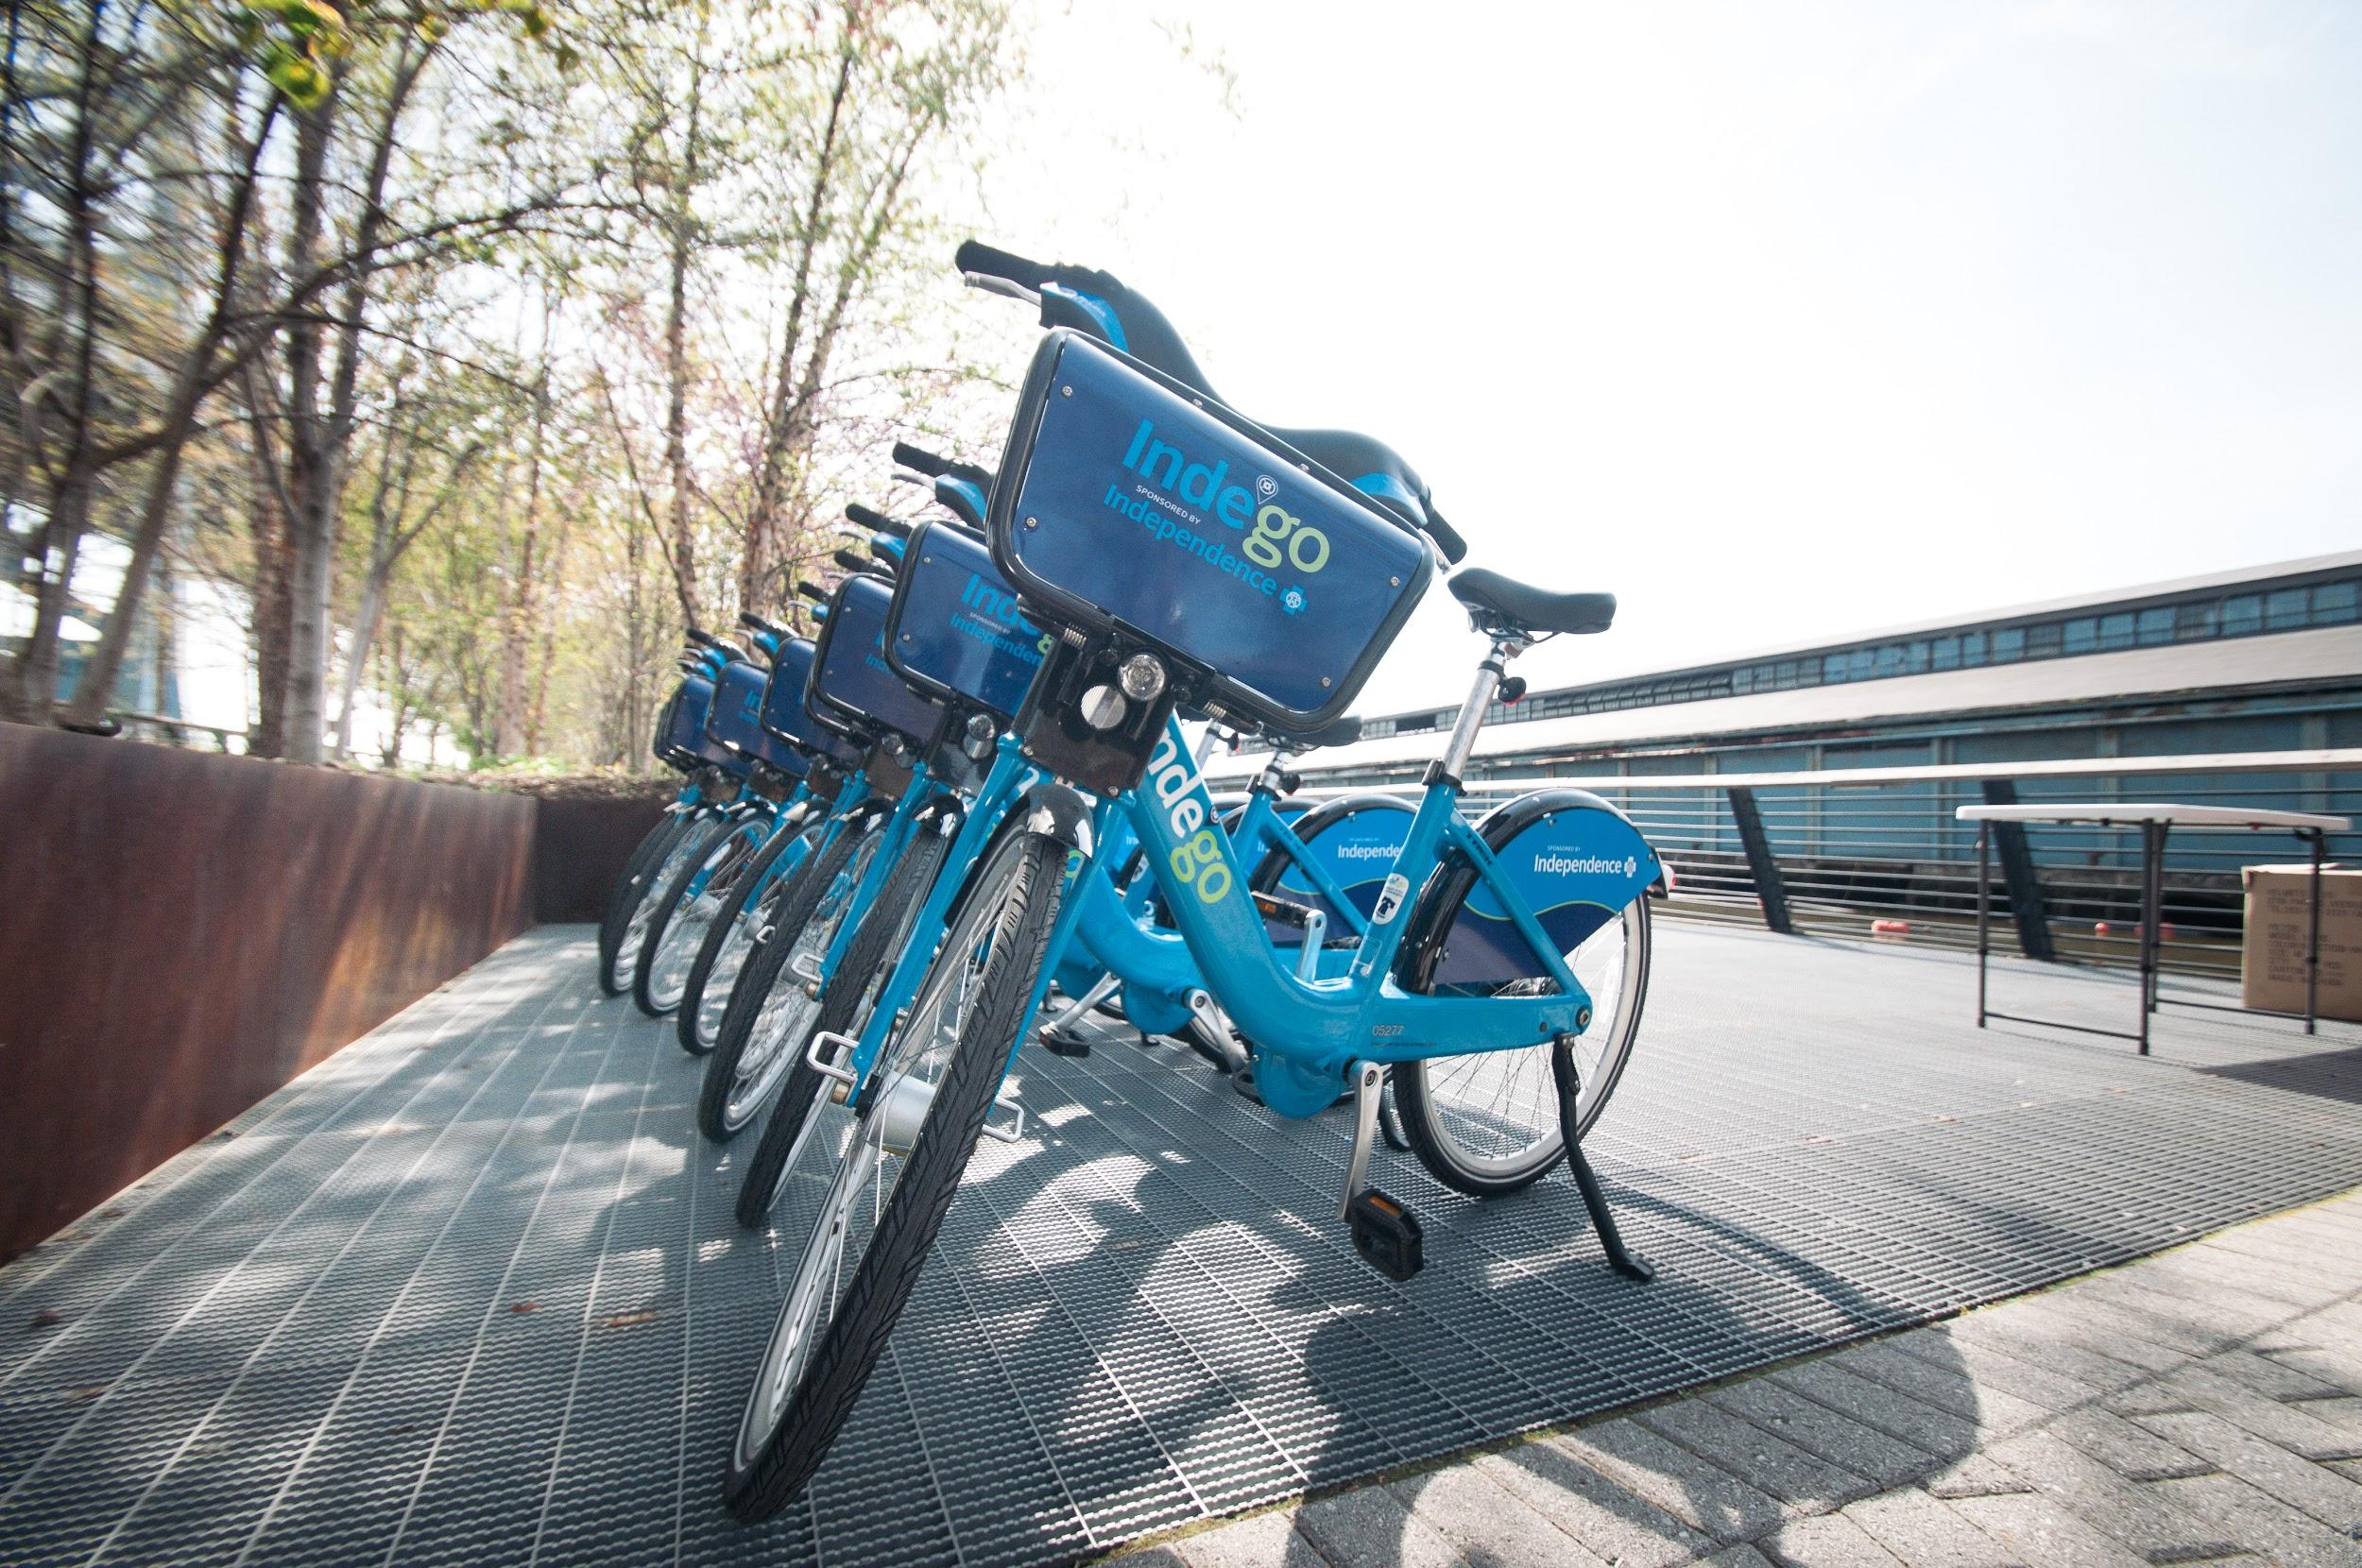
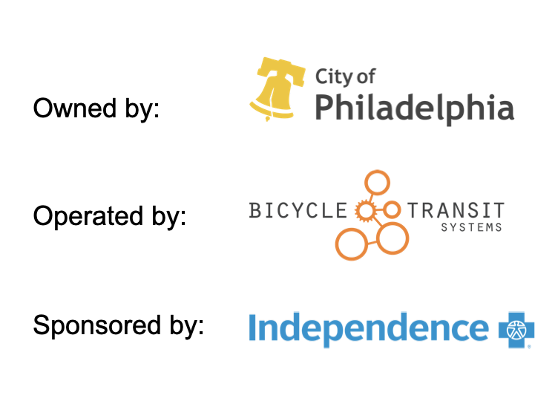
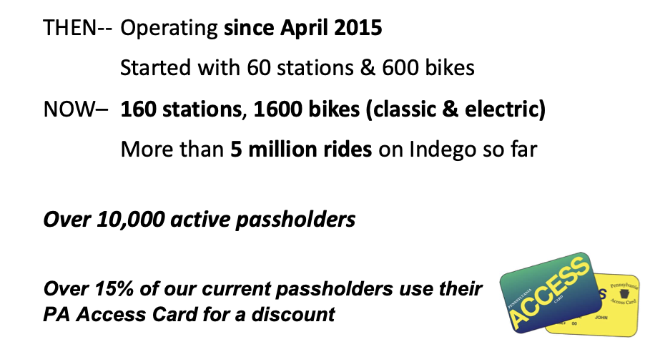

Slide 3
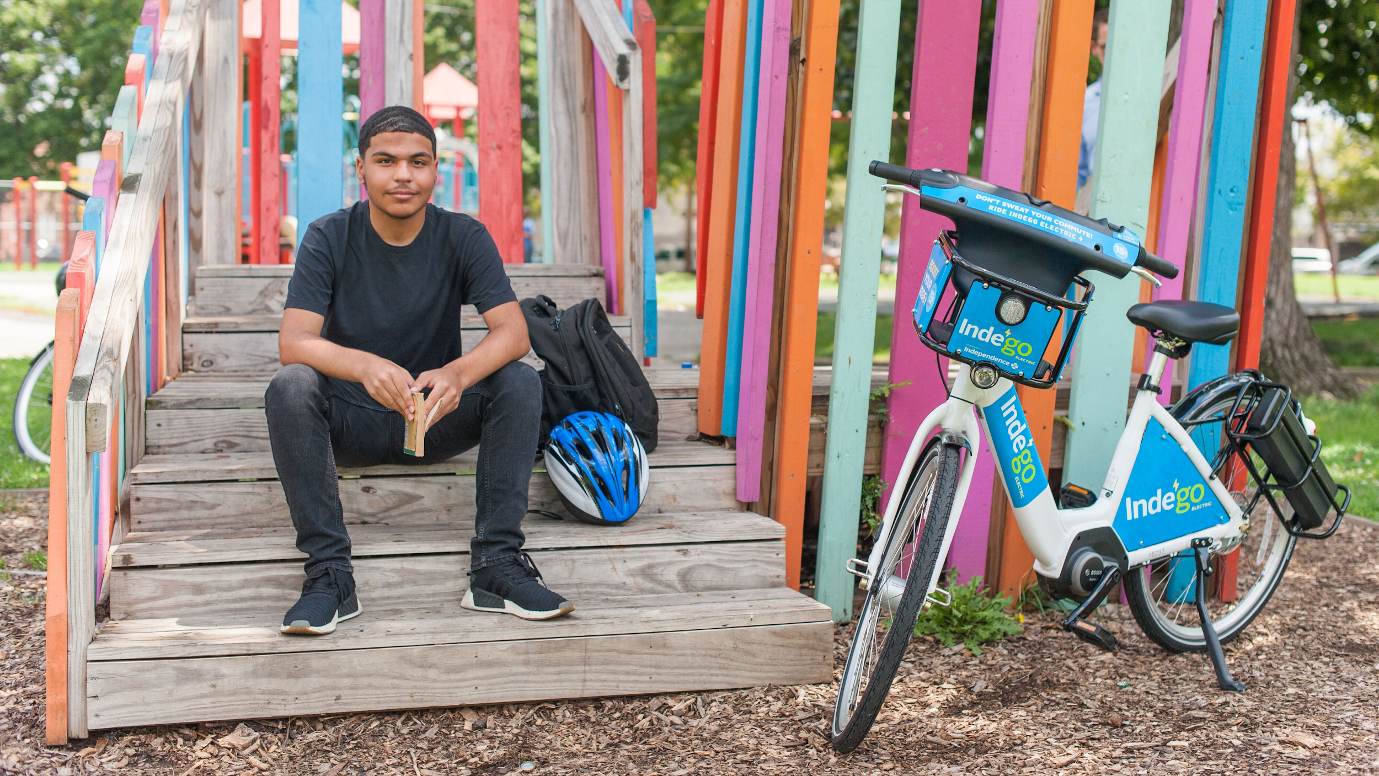



Slide 4

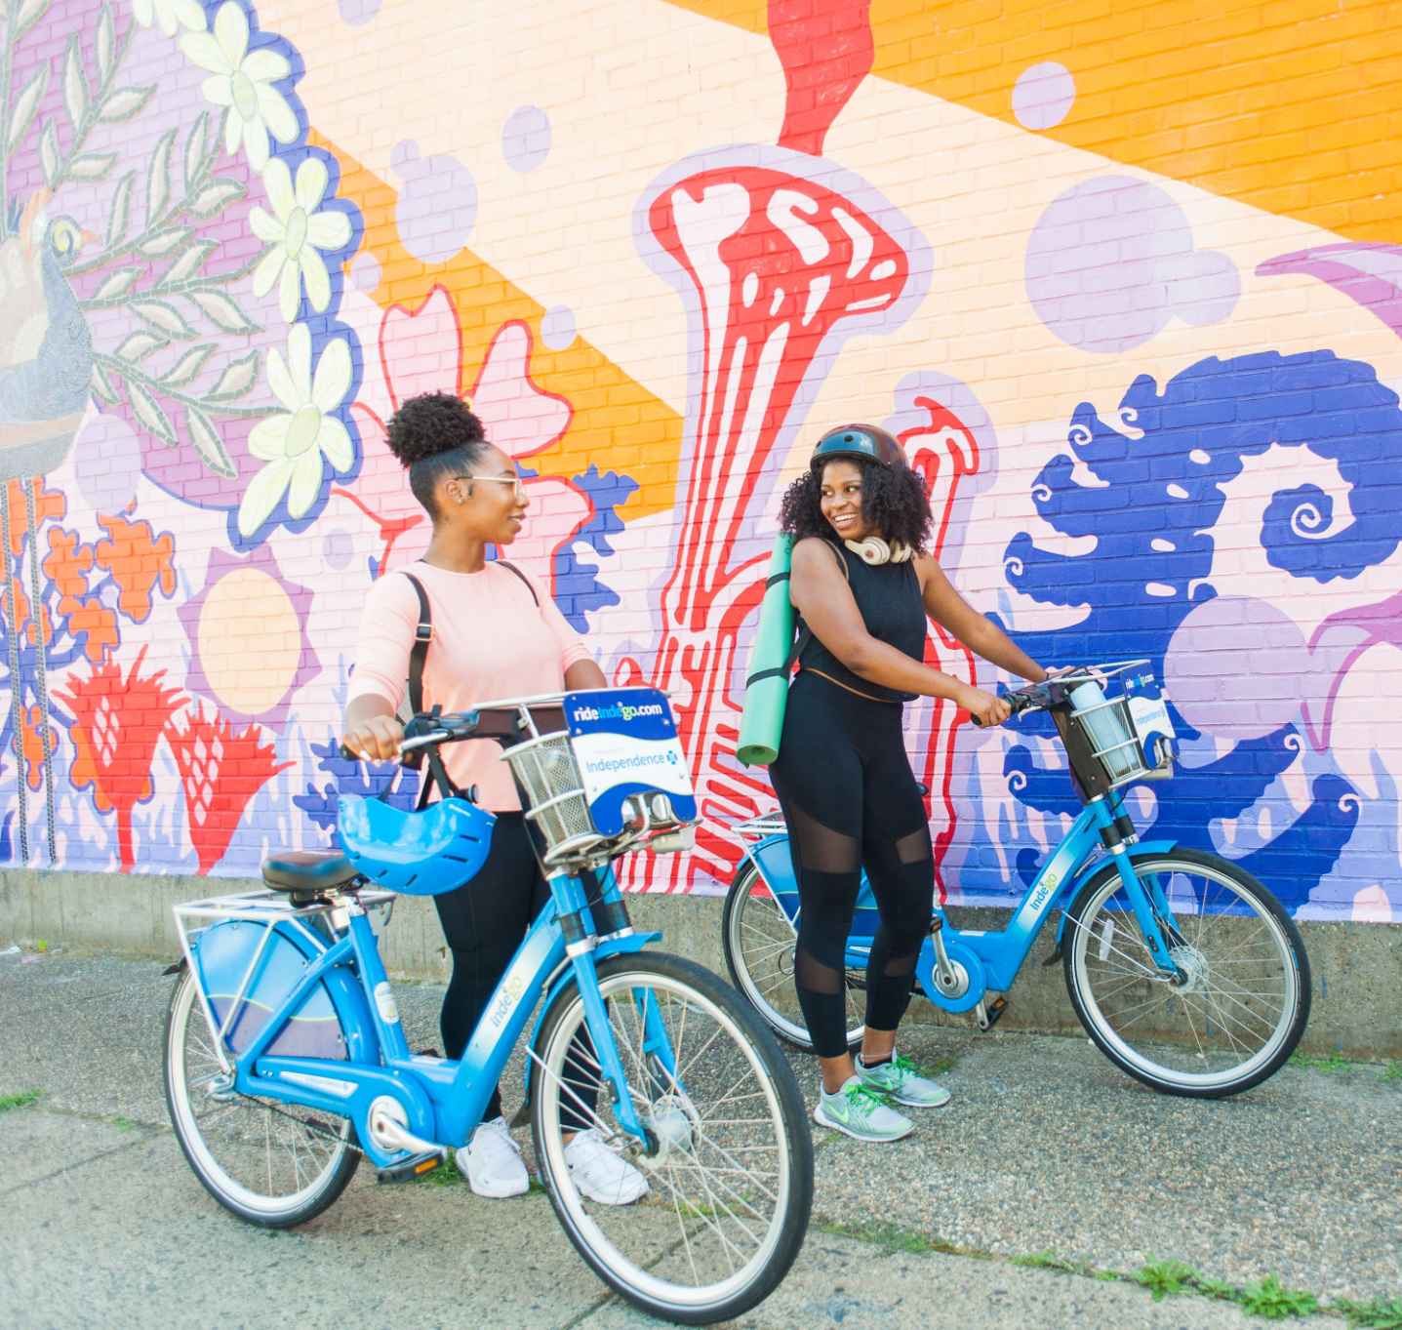
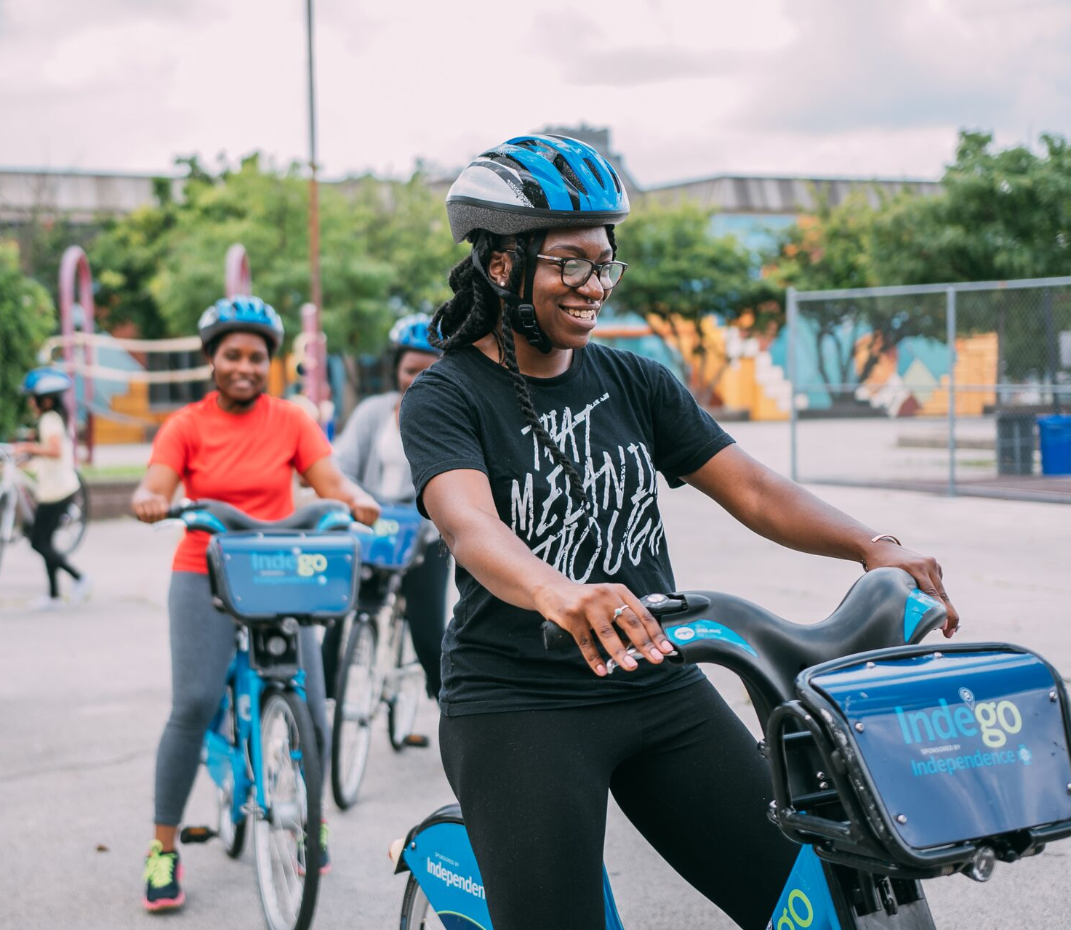
Acknowledging History

Slide 5
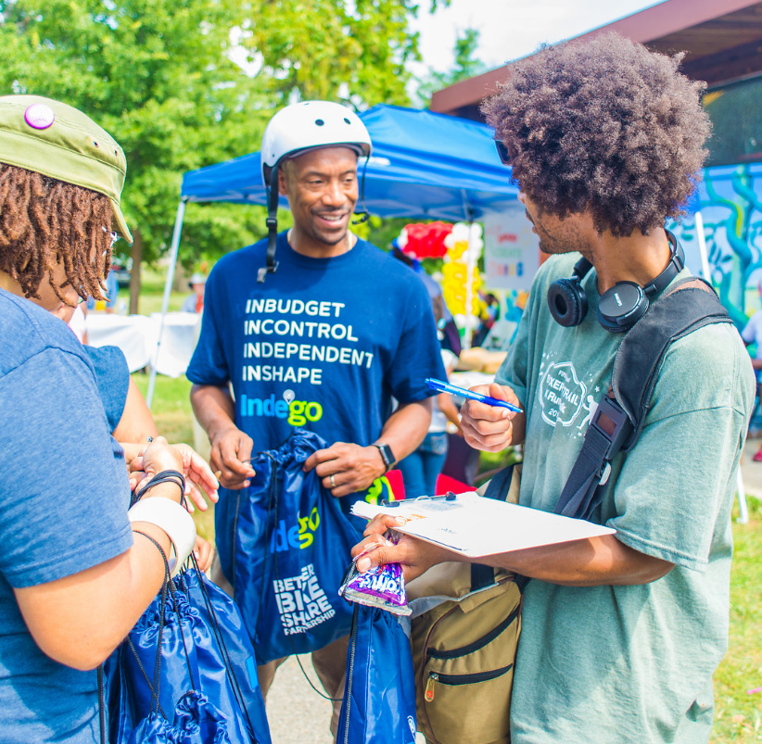
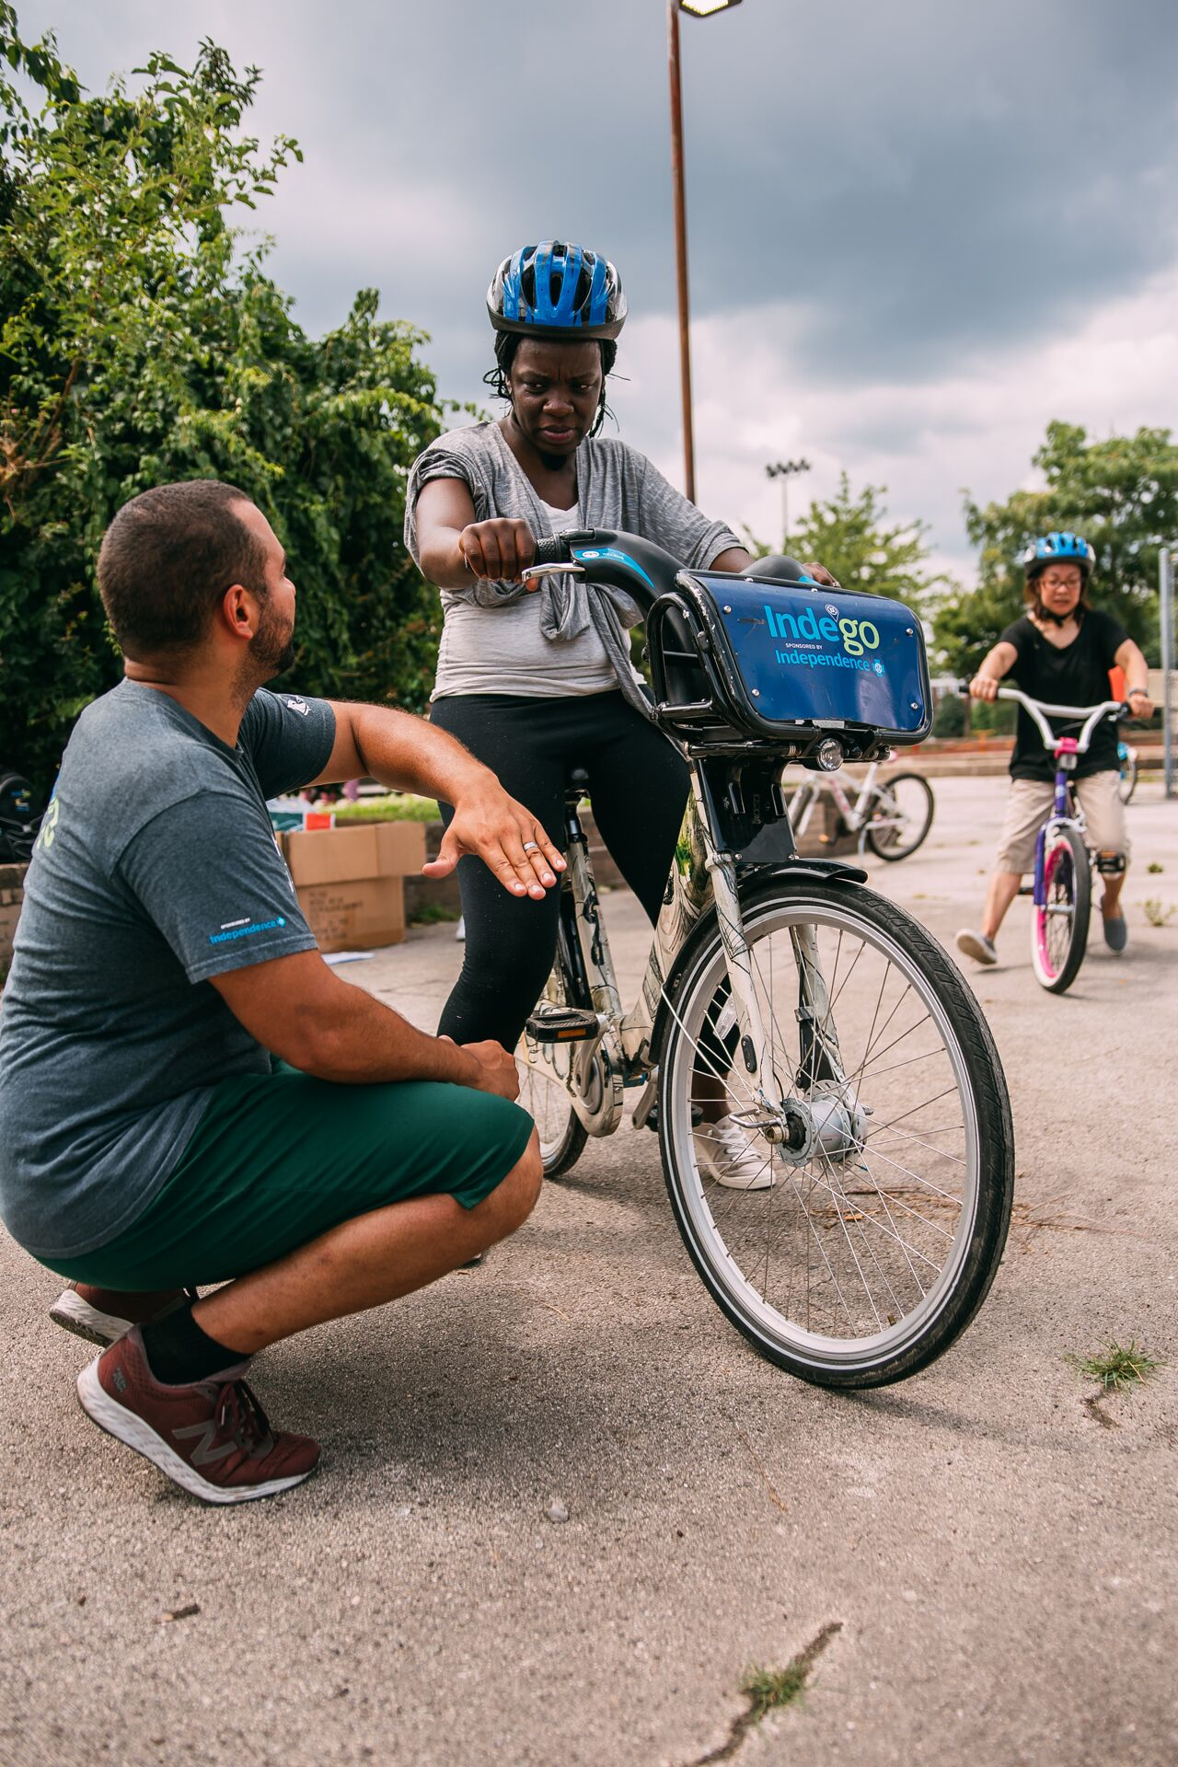
Relationship Building & Trust
Notes:
Not a check the box type of thing
Meet people where they are
Listen and Learn
How can this work fit into people lives in a real and organic way

Slide 6
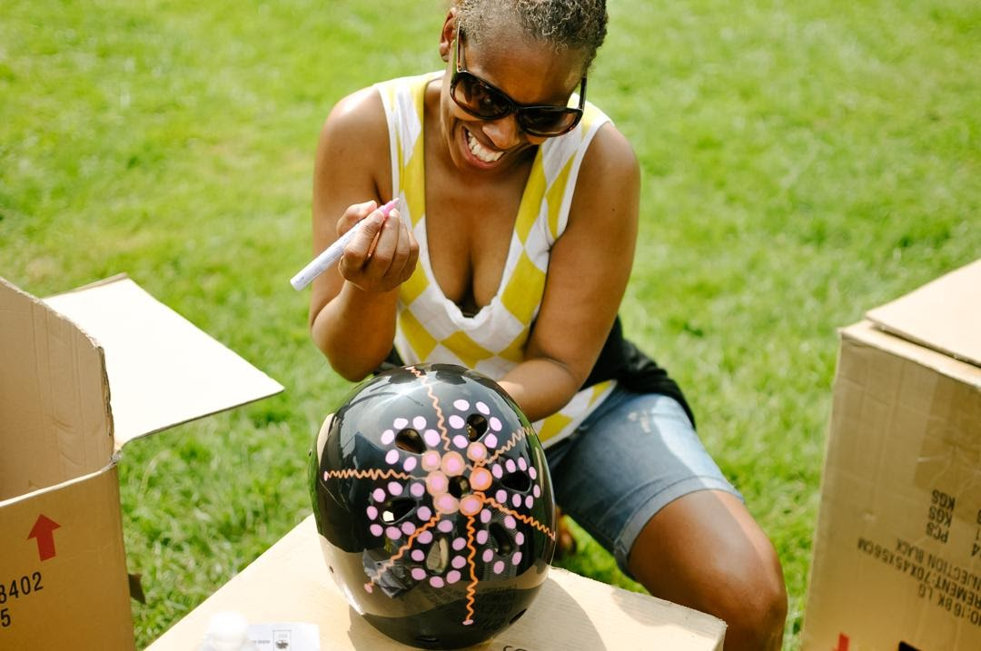
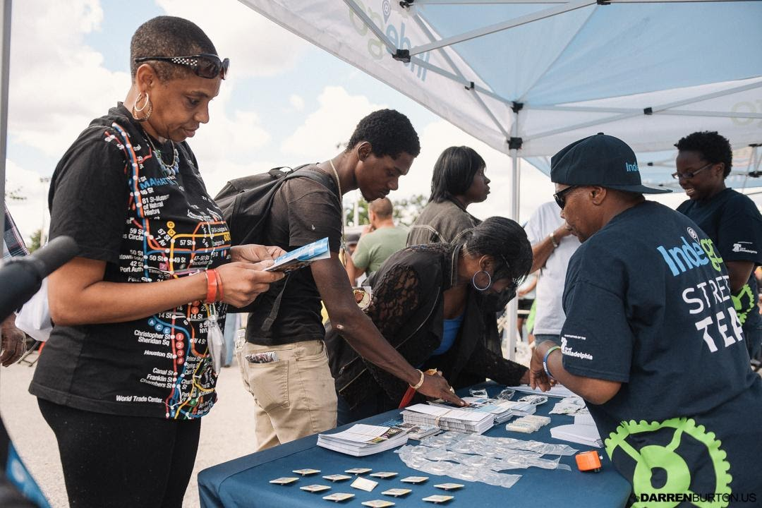
Identify Community Needs
Notes:
Not a check the box type of thing
Meet people where they are
Listen and Learn
How can this work fit into people lives in a real and organic way

Slide 7
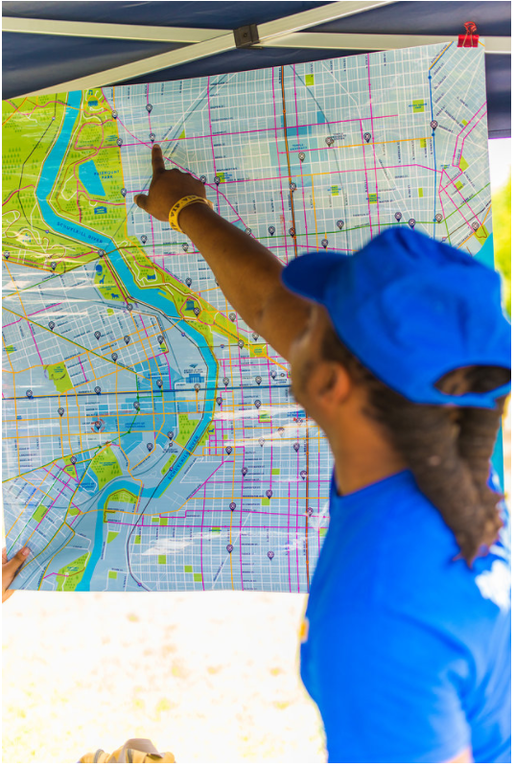

Implement Feedback
Notes:
Do what you say you’re going to do…. follow through on the feedback received. Cash Payment and accessibility; waiting if they say no….

Slide 8
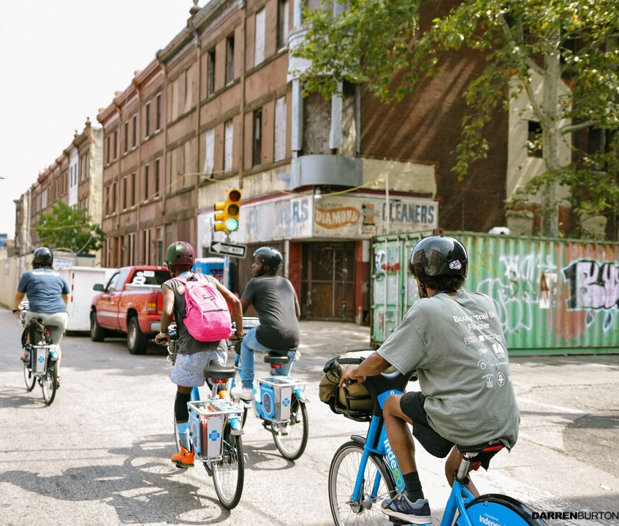
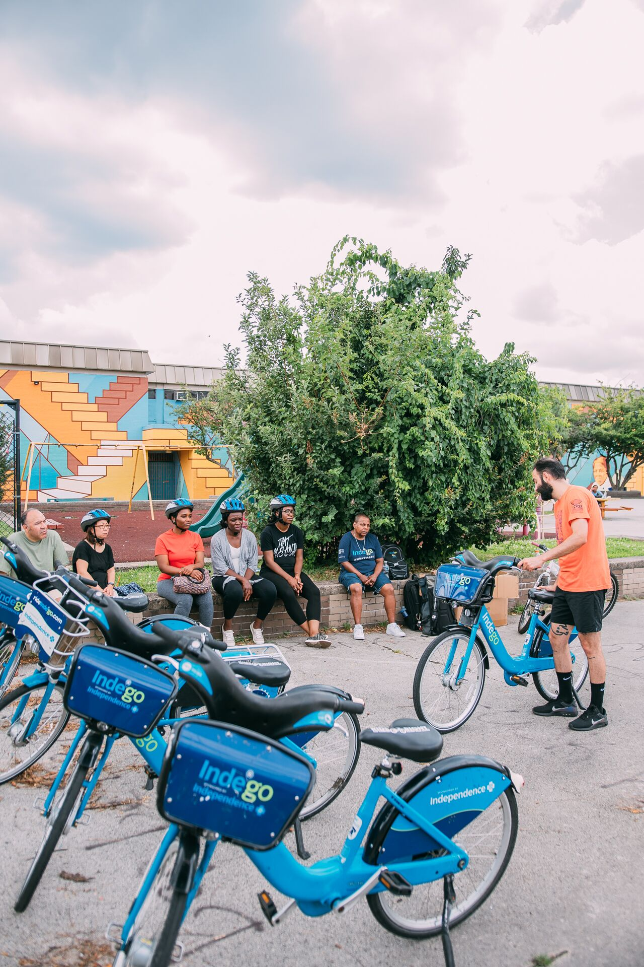
Education & Encouragement
Notes:
For many this is something new; providing education on how they system or new options work; encouragement to help people feel like this is for you!

Slide 9
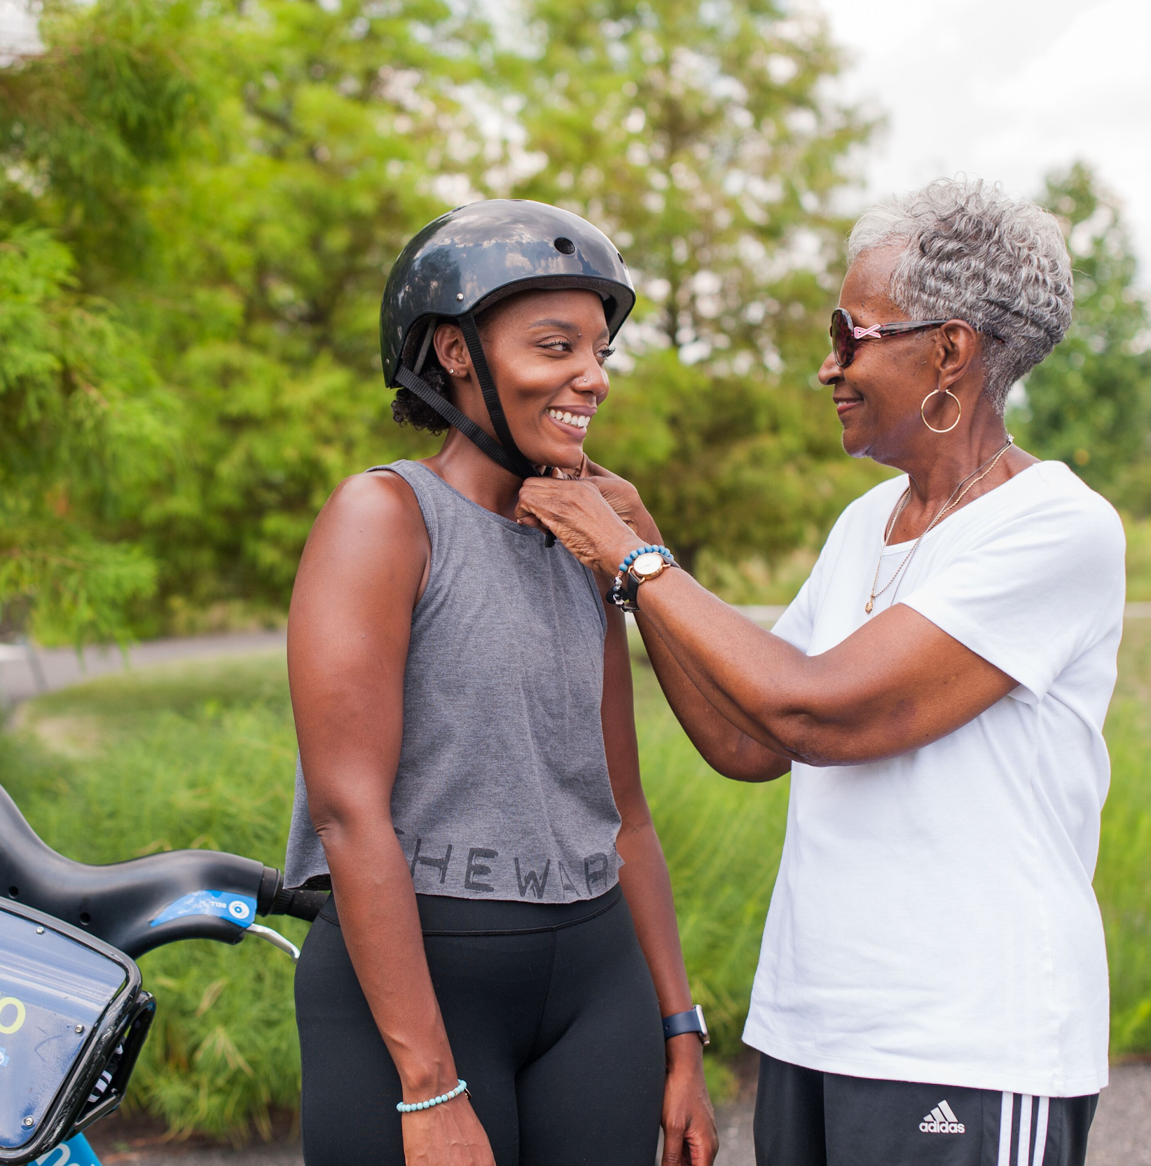
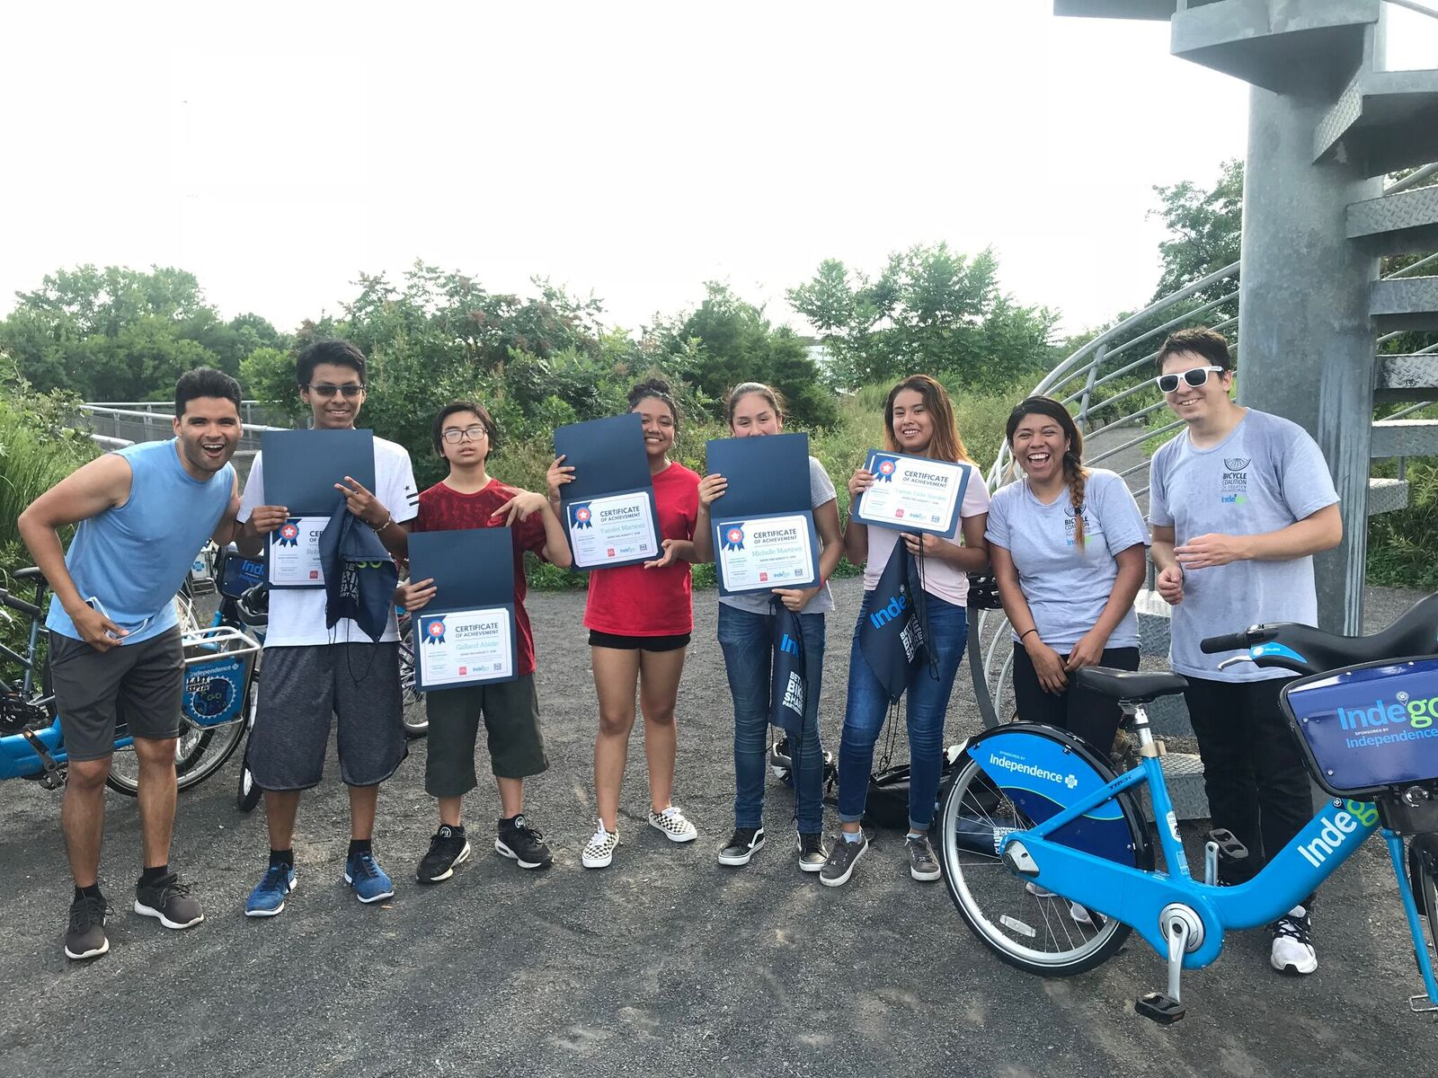
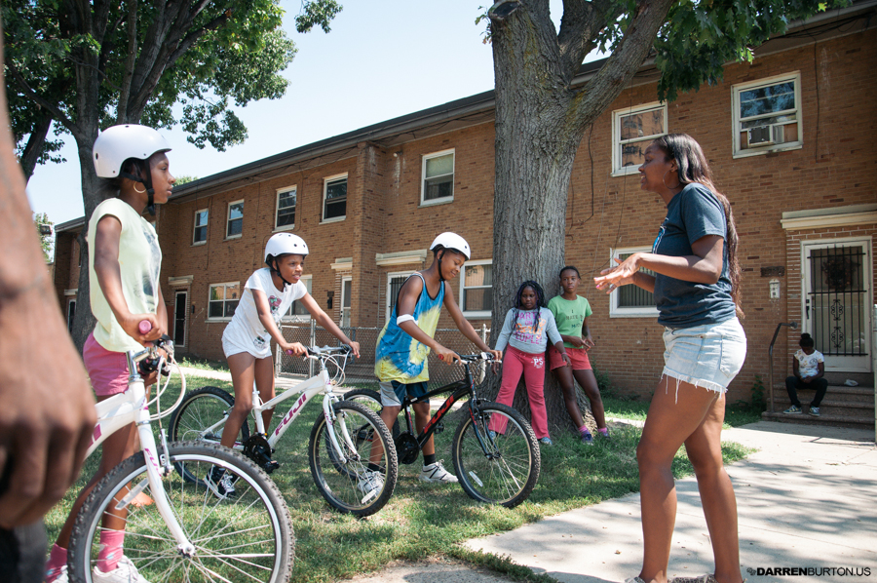
For All Ages
Notes:
People often forget about the importance of engaging youth; they use transit often; they’re also going to be the next generation of advocates. I want to make sure they prepared to take care of me when I’m old

Slide 10
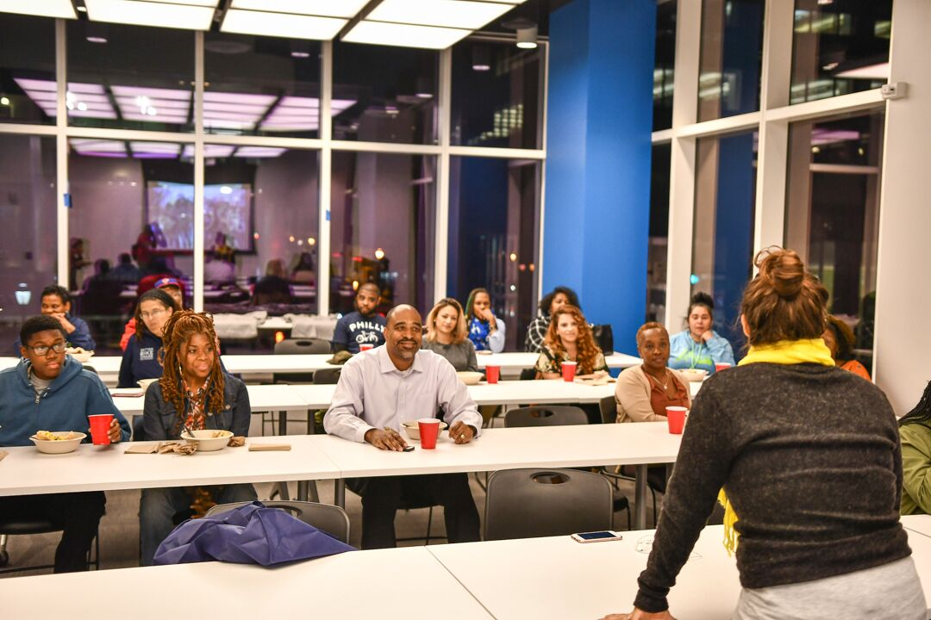
Co-Creation & Co-Development
Notes:
Co-Creation and Co-Development
Inviting diverse co-creators
Co-developing approaches and prototyping

Slide 11
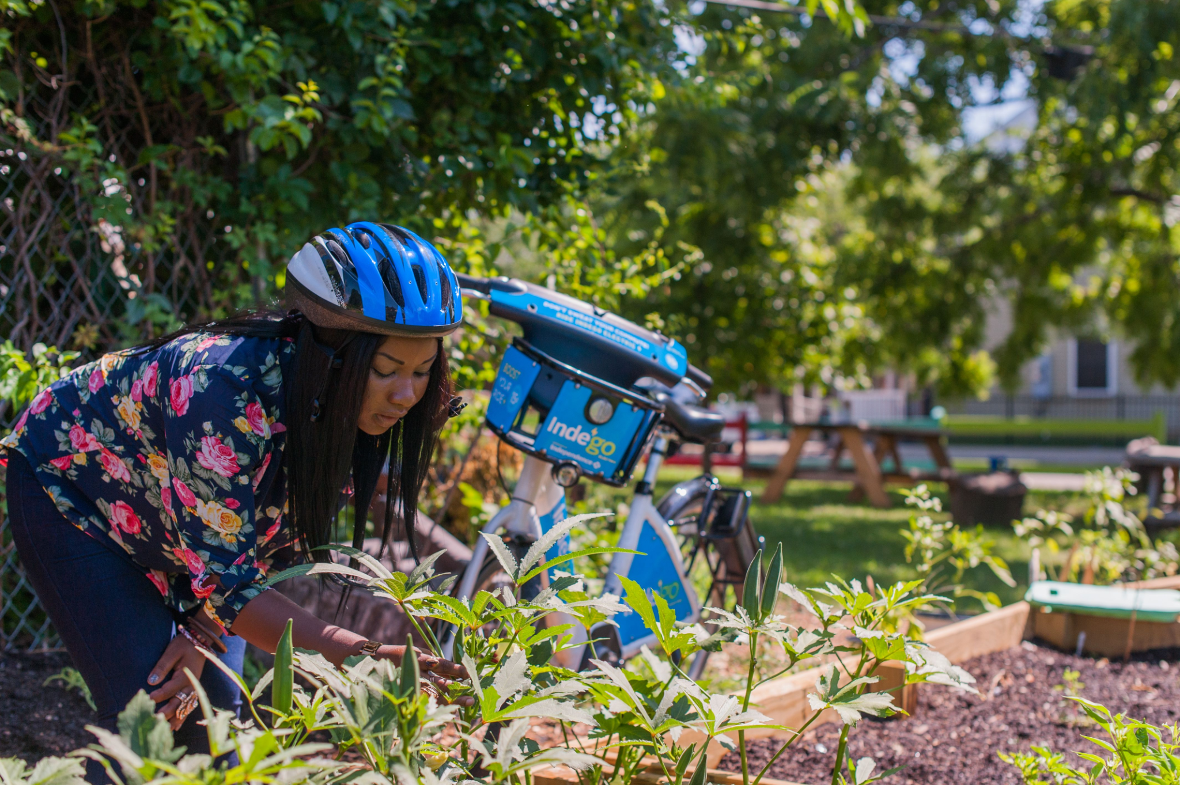
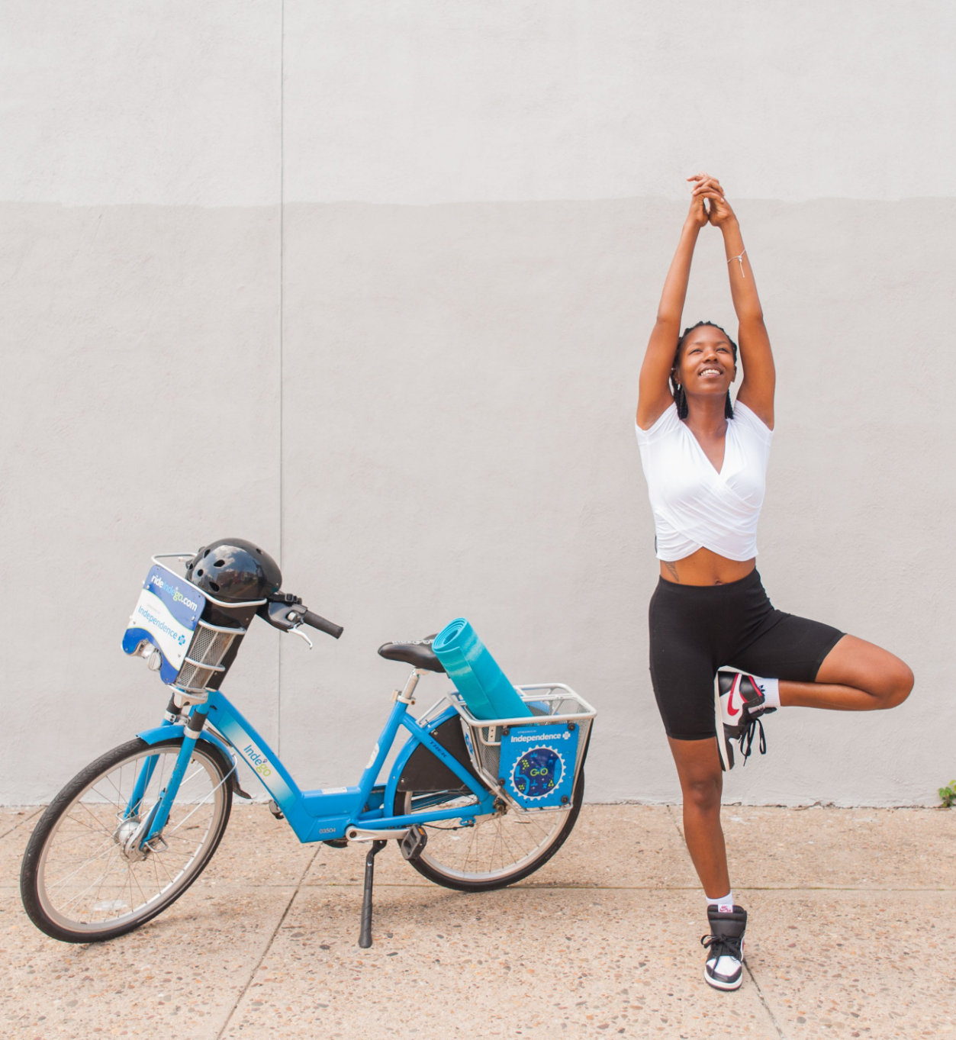
Communities Are Powerful
Notes:
You’re not the expert when it comes to the community’s needs…. I repeat lol
It’s also important to pay them for their time. Any consultants in the room. You would never sit down with a consultant and say hey let me take you out to lunch and while we’re their tell me all your secrets…. while I Pay for lunch. Compensate them for their expertise and time
Communites are powerful, they don’t need to be empowered

Slide 12

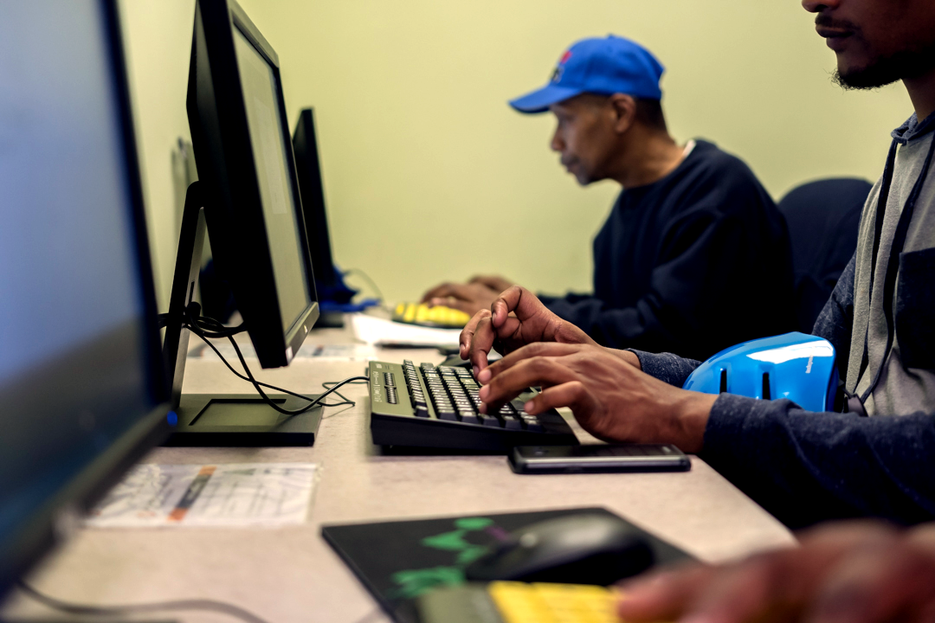
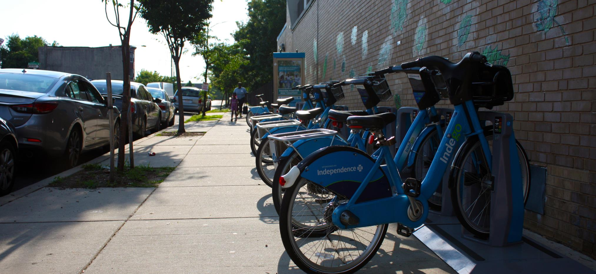
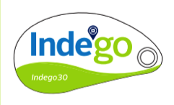
Think Beyond the Bike

Slide 13
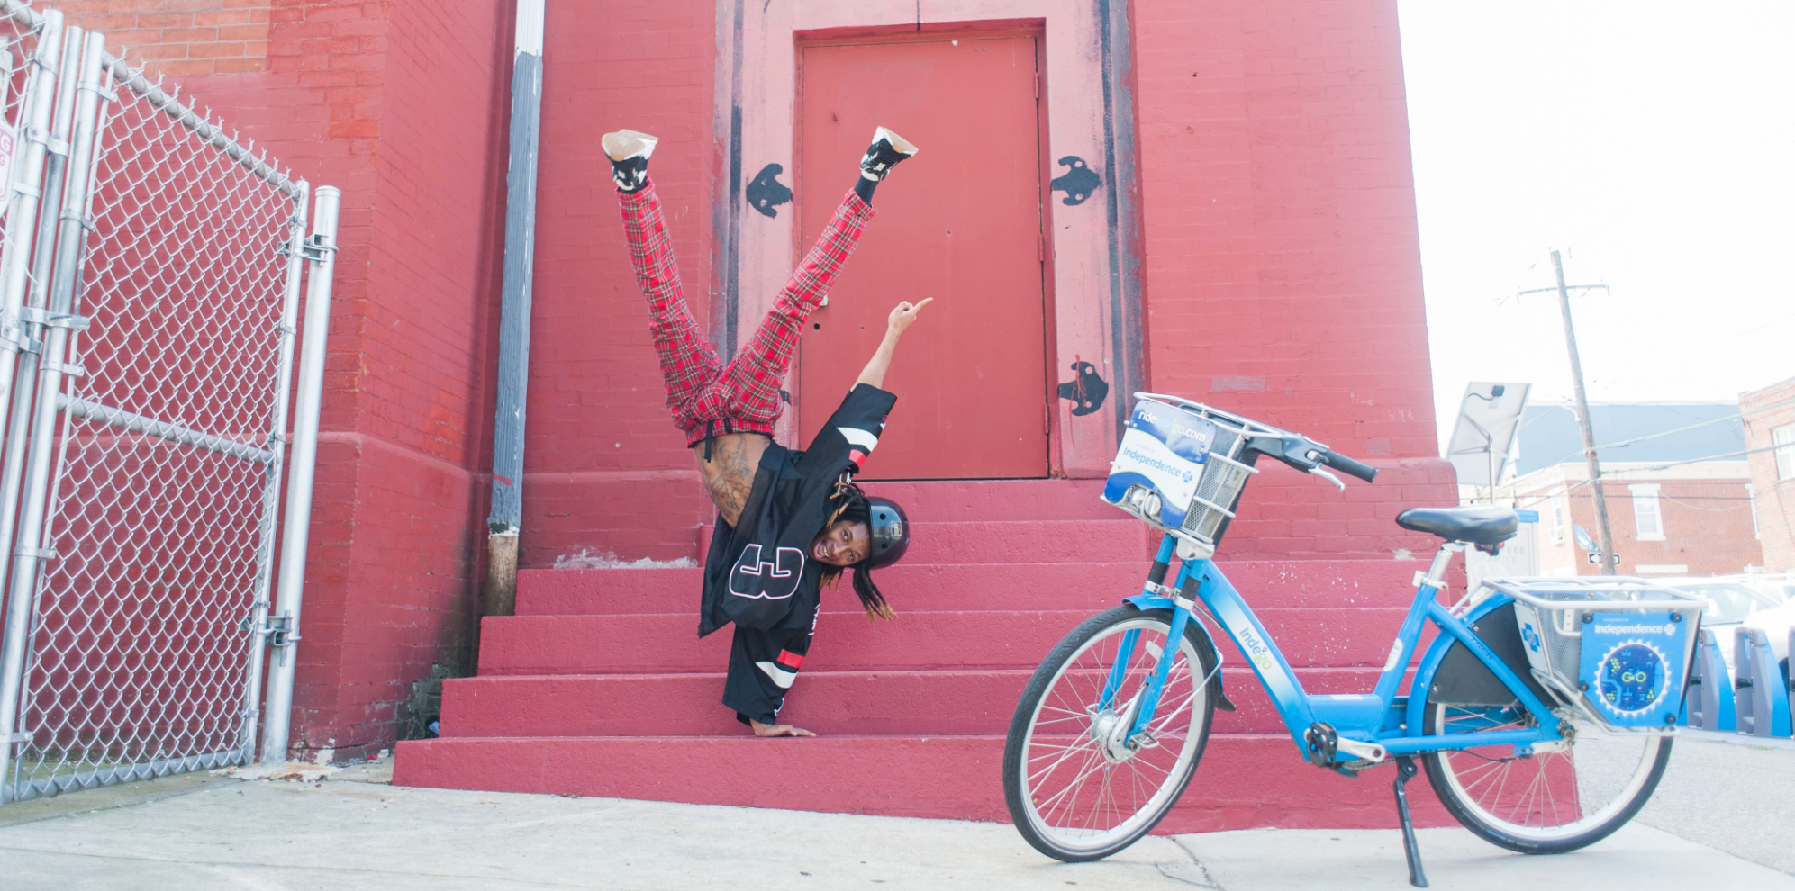
Don’t Be Afraid
Notes:
Get comfortable being uncomfortable

Slide 14


betterbikeshare.org
rideindego.com
Notes:
(

