Slide 1


COMPLETE STREETS
MEETS ELECTRIC VEHICLES
April 21, 2022
Author: Angie Hernandez, AICP
PRESENTED AT: 1st Annual 2022 Delaware County Sustainability Conference
Notes:
Hello Everyone,
I am here today to talk to you about complete streets and electric vehicles. By the end of my presentation, I hope that you will have learned something new and possibly, find something that inspires you to take action to help plan for the growing numbers of electric vehicles in your communities.

Slide 2

ANGIE HERNANDEZ, AICP
Transportation Planner / Project Manager at JMT
Creator of many long-range plans and transportation studies across the Northeast.
Outside Advisory to the DELCO Trails Alliance
Happy to be here today!
Notes:
But first, a little about me.
I am a transportation planning consultant with JMT.
I work on and lead transportation planning projects for multiple government clients across the northeast.
I am an outside advisory to the newly formed DELCO Trails Alliance.
And I am happy to be here today!

Slide 3
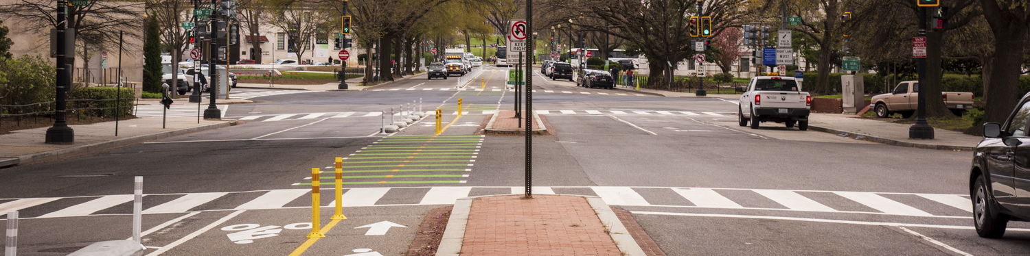
COMPLETE STREETS
A Complete Street is safe, and feels safe, for everyone using the street…[complete streets] “ensure the safe and adequate accommodation of all users of the transportation system, including pedestrians, bicyclists, public transportation users, children, older individuals, individuals with disabilities, motorists, and freight vehicles.”
– March 2022 USDOT Report to Congress / Infrastructure Investment and Jobs Act (IIJA), also known as the Bipartisan Infrastructure Law (BIL)
JMT Project: Virginia Avenue, DC.
Notes:
I want to start by giving a very brief background into what complete streets means.
The idea of complete streets has been around since 2003, so this is nothing new. Many states, counties, cities, and local jurisdictions have set complete streets policies to help transform streets from car-only spaces to multimodal transportation facilities that are safer and more comfortable for all users.
In recent years, the USDOT has been making strides forward to catch up with the ideas behind complete streets and is starting to put funding in place that can really move the needle.
The text here on the screen is how the USDOT has decided to define complete streets in the Infrastructure Investment and Jobs Act (IIJA), also known as the Bipartisan Infrastructure Law (BIL).
This definition was posted in the recently released USDOT Report to Congress in which the USDOT outlines a number of complete streets initiatives it plans to undertake.

Slide 4
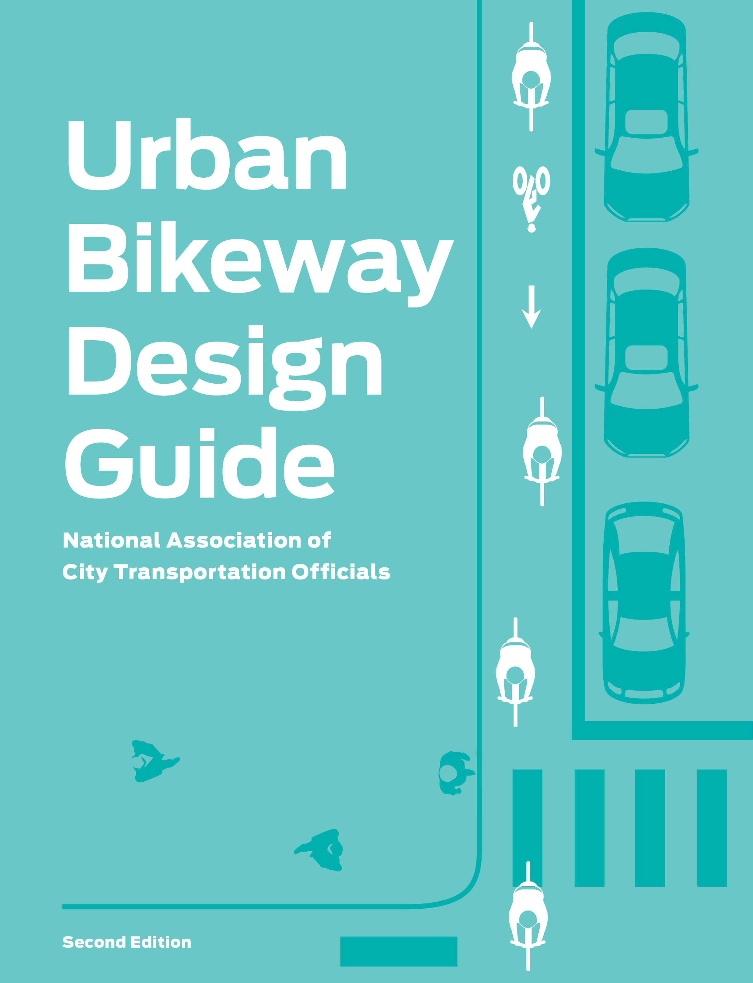
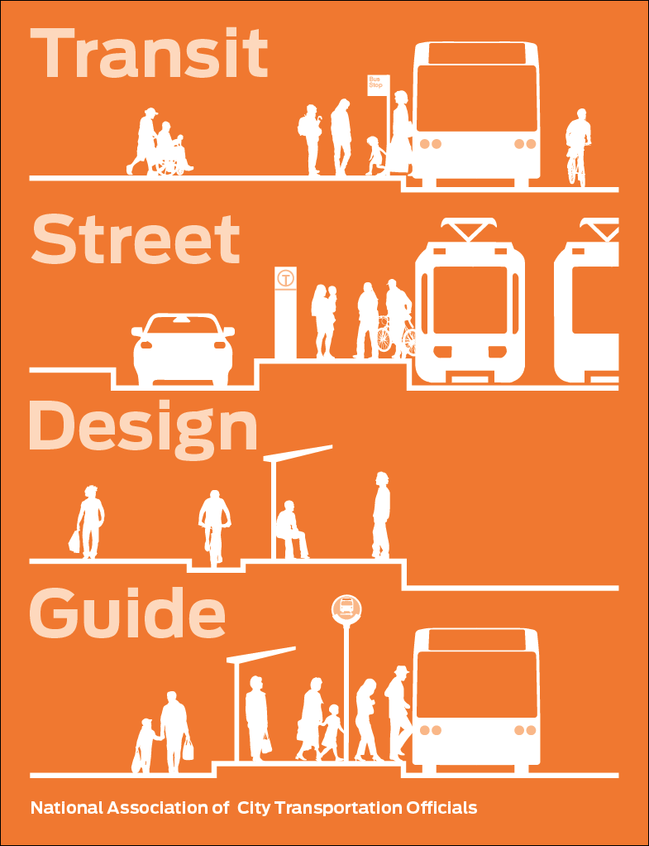
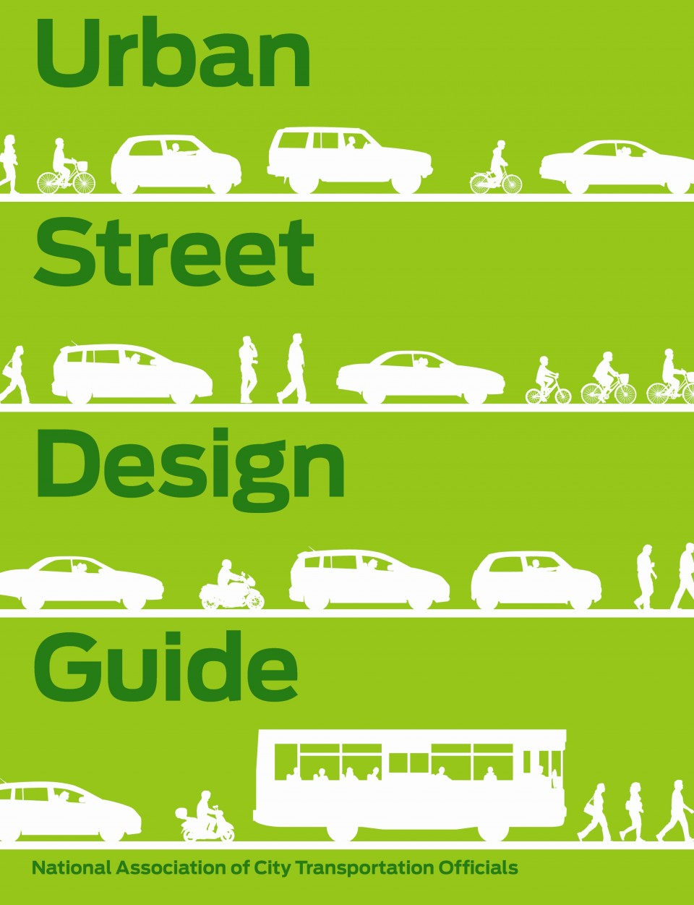
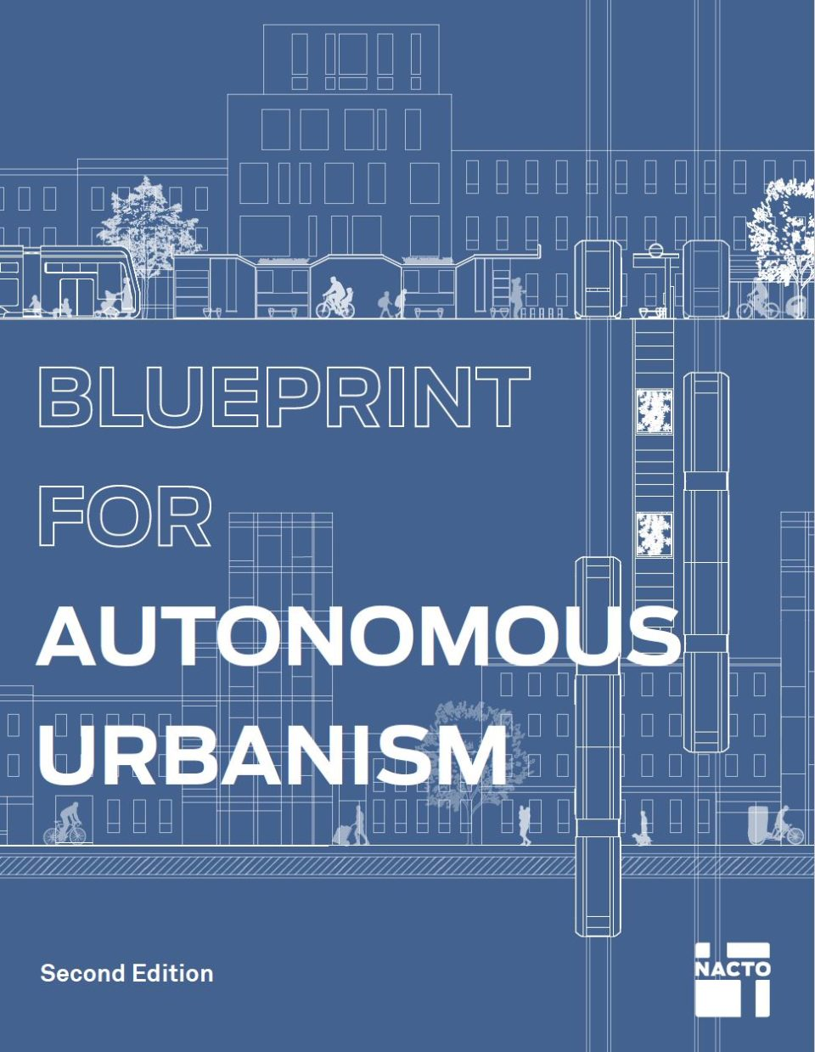
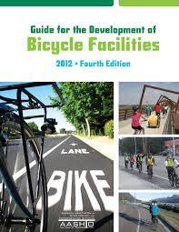
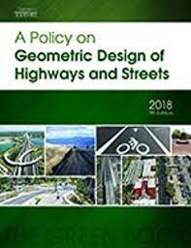
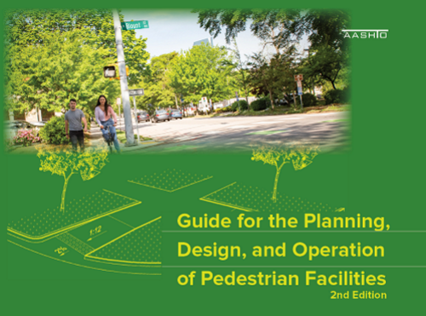

AASHTO GUIDES
LOTS OF DESIGN RESOURCES
NACTO GUIDES
LOCAL GUIDES
Notes:
There are lots of great design guides and planning resources available through AASHTO and NACTO that cover all the aspects of complete streets as they have been defined.
Delaware County even happens to have their own local guide on implementing complete streets that builds off of several of these national resources.
One of the guides I wanted to call your attention to is one of the newest NACTO Guides, it is the Blueprint for Autonomous Urbanism. That dark blue one in the top right corner.

Slide 5
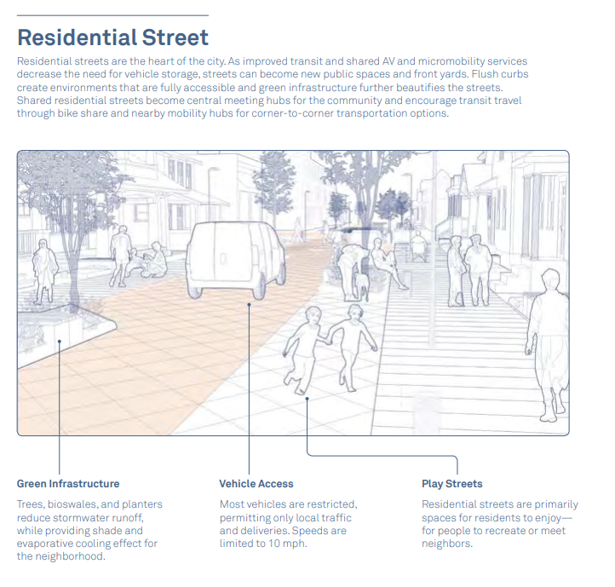
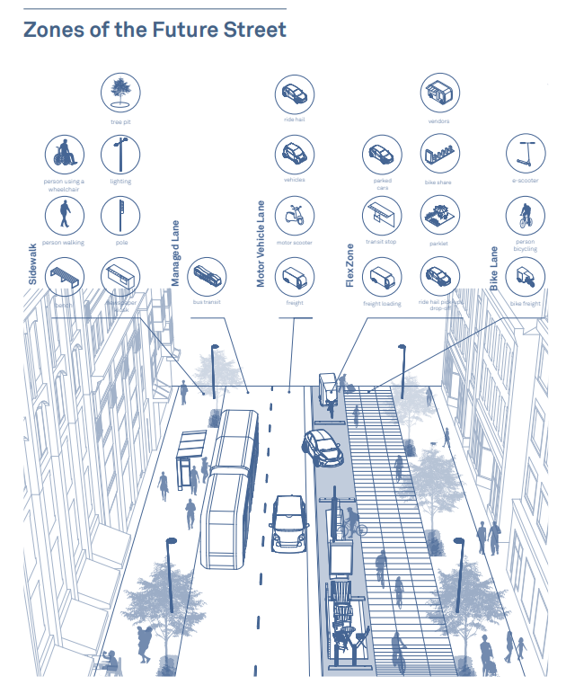
Source: Blueprint for Autonomous Urbanism
Notes:
These are some excerpts from that guide.
Can anyone tell me anything that they find interesting or maybe missing from these visuals? (PAUSE)
What stands out to me is the lack of on street parking and the general lack of vehicles in the streetscape. Some thoughts on this is that in an autonomous vehicle world, we don’t need on street parking anymore. The vehicles will simply let their passengers out and then drive away to park elsewhere. Interesting idea, just not sure how long that will take to happen with our existing infrastructure and land use challenges we already have.
While I do think this is a possibility one day, I feel that this guide is making a huge leap without planning for the transitional change in between now and a fully autonomous world. Namely, electric vehicles. In the absence of a 100% modal share of self driving cars we are likely to still need on-street parking and likely to need EV charging, especially in urban residential areas such as the graphic on the left.
While this guide gives an interesting look into the future I think it falls short of helping us plan our transition between where we are now and getting anywhere close to this future.
I think that’s enough about NACTO.

Slide 6


IIJA/BIL ELECTRIC VEHICLE CHARGING
Joint Office of Energy and Transportation MOE to support the deployment of $7.5 billion from the BIL to build out a national electric vehicle charging network to: build public confidence to EVs
- and - fill gaps in rural, disadvantaged, and hard-to-reach locations
Notes:
Now, I want to talk to you more about what the feds are up to.
As part of the new (IIJA), also known as the Bipartisan Infrastructure Law (BIL), there has been a joint MOE between the Departments of Energy and Transportation to support the deployment of $7.5 billion to build out the nation’s electric vehicle charging network.
They hope to do this by not only providing a bucket of funding but also by building public confidence in EVs and filling in gaps in rural, disadvantaged, and hard-to-reach locations.

Slide 7
WHAT THAT MEANS
DOE and DOT Focus Areas:
investments in zero-emission passenger vehicles, transit and heavy-duty vehicles
Developing guidance and standards for EV charging programs
Providing technical assistance to State and localities to strategically deploy EV charging infrastructure plans.
Focus on the Justice40 Initiative, requires at least 40% of federal climate and clean energy investments go to underserved communities.
In short:
Federal push towards EVs!
Notes:
The Department of Energy and Department of Transportation’s specific focus areas are:
investments in zero-emission vehicles.
Developing guidance and standards for EV charging programs
Providing technical assistance to State and localities to strategically deploy EV charging infrastructure plans and,
Focus on the Justice40 Initiative, which requires at least 40% of federal climate and clean energy investments go to underserved communities.
In short, there is a federal push towards EVs.

Slide 8

BI-PARTISAN INFRASTRUCTURE LAW: EV ELIGIBILITY
National EV infrastructure (NEVI): ($7.5B)
Electric transit buses ($7.5B)
Robust electric grid support ($73B)
Block Grant, ATTIMD eligibility for EV charging and vehicle-to-grid projects ($360M or so)
Carbon reduction program ($1.2B)
Truck Emissions @ Port facilities ($80M)
Notes:
It’s not just a push, they are also putting money into the effort.
As you can see on the screen there are several new funding programs all targeting EV deployment and EV charging infrastructure expansion.

Slide 9
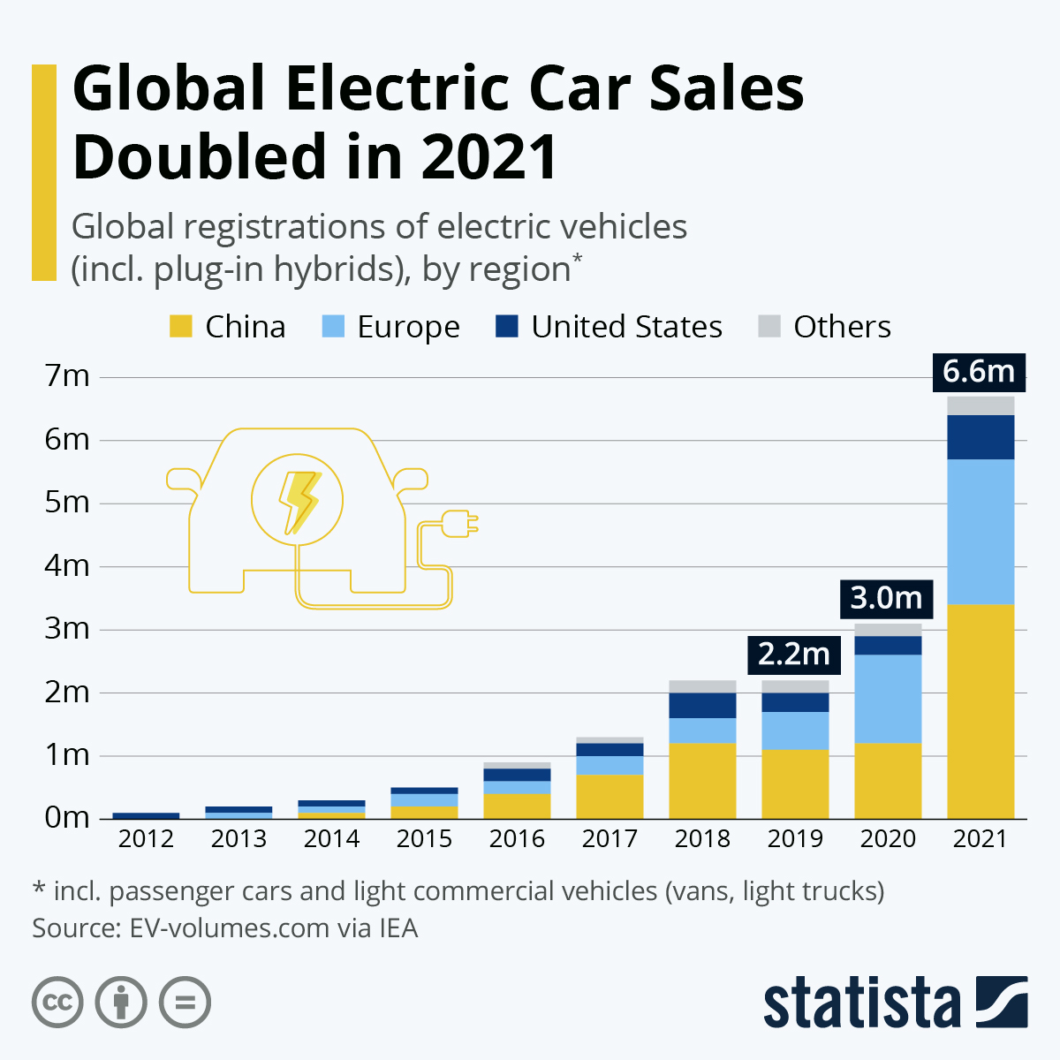
EV SALES ARE GROWING (SLOWLY)
2021 EV sales
  US: 0.5M (6.8% of new car sales)
2021 U.S. Auto Sales Figures by Brand | GCBC (goodcarbadcar.net)
fleet vehicles transitioning to EVs
  Buses
  Government Fleets
  Delivery Vehicles
  Rental Vehicles
US target: 50% sales share by 2030
Notes:
There are likely many reasons as to why the feds are pushing all of this now, but I like to keep things simple. So, in an effort to simplify it, in part this push is coming from market driven factors of what the consumers are already showing they want. We are also seeing many vehicle fleets transitioning to electric.
While the US lags behind other countries in our share of electric vehicles, we are seeing an increasing number of them, as demonstrated in the graph you can see that demand is rising.
The US has set a target that by 2030, 50% of all new vehicle sales will be electric vehicles.

Slide 10
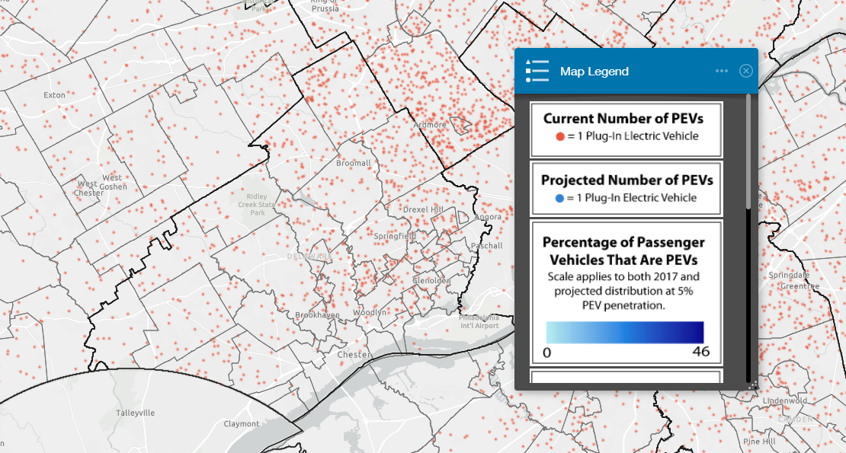
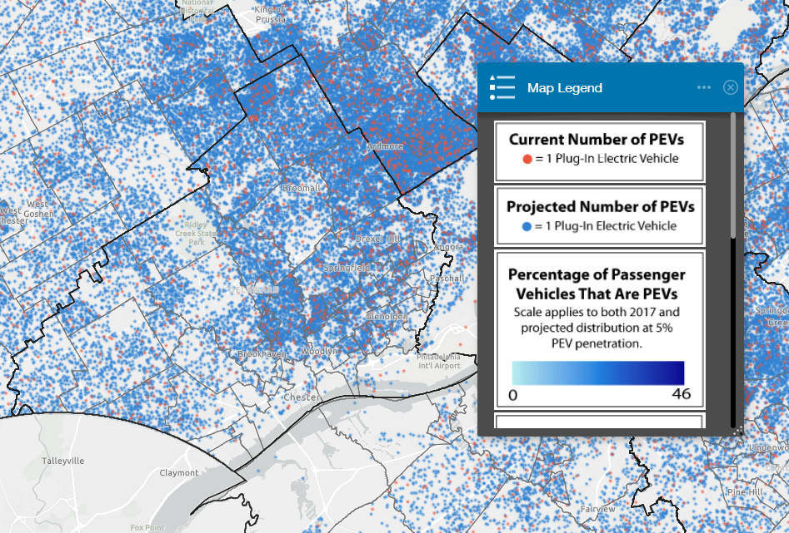
EVs ARE GROWING IN DELAWARE COUNTY TOO
  Plug-In EV Distribution anticipated to grow in Delaware County
  April 14, 2022 – Delaware County awarded two Alternative Fuel Incentive Grants totaling $600,000 for EVs and charging stations.
  69 new EVs (29 dedicated to the new Delaware County Health Department
  22 charging stations.
  Bringing the entire County fleet to 84 EVs and 25 charging stations.
  Projection based on (5% penetration)
Map Source: Planning for Electric Vehicles
Mapping Vehicle Distribution and Workplace Charging Demand
DVRPC in collaboration with the PH&EV Research Center at UC Davis
Notes:
While the national numbers are interesting I was more interested in looking at what is happening here in Delaware County.
Lucky for me, the DVRPC has been looking into this as well. As you can see from the top image on the screen, there are already a number of personal electric vehicles in Delaware County. Each of those red dots accounts for an existing electric vehicle.
The image on the bottom shows the projected spread of electric vehicles based on a theoretical 5% penetration rate.
It gets more interesting, just last week Delaware County was awarded two Alternative Fuel Incentive Grants totaling $600,000 for EVs and charging stations.
This will equate to 69 new EV fleet vehicles for the Delaware County of Heath and,
22 new charging stations to be located throughout the County.
This will bring the entire County fleet to 84 EVs and 25 charging stations. This will be a tremendous leap forward. Congratulations to everyone involved in that grant award. It’s a lot of work to develop a grant application of this scale.

Slide 11
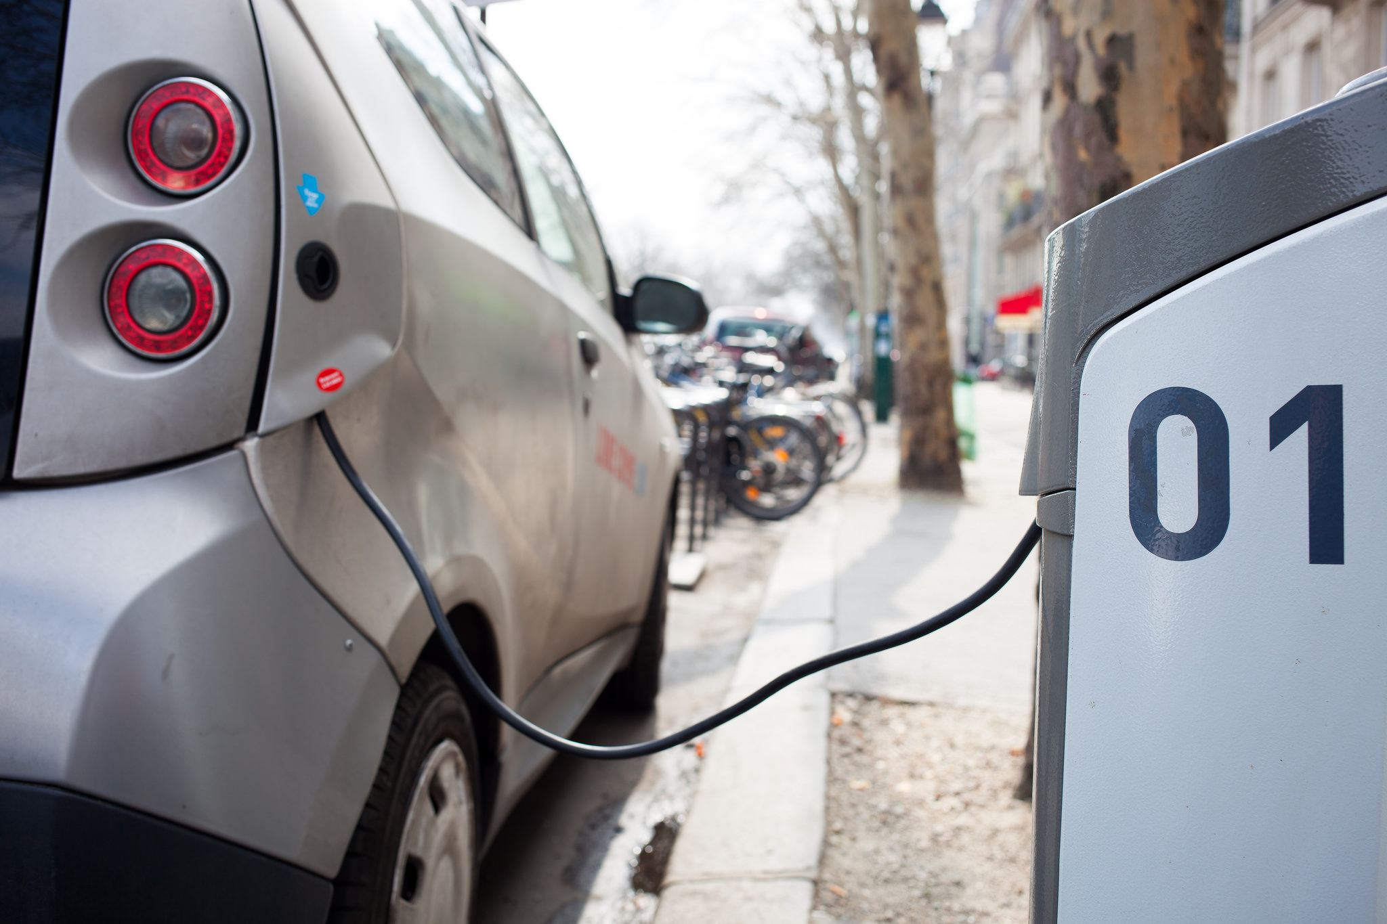

WHAT’S THIS HAVE TO DO WITH COMPLETE STREETS?
Currently 42k public charge stations with 100k ports (not including home charging)
US will need 9.6M charging ports by 2030 (per Edison Electric Institute)
Most sites to date are commercially driven
  Workplaces
  Large box stores
  Service / food locations
  Rest Areas
Notes:
So now that I have caught you all up on what's going on with EVs I think I should make my point about why we need to bring EVs into our complete streets thinking.
It is projected that the US will need 9.6M charging ports by 2030.
Most EV charging sites to date are commercially driven
Workplaces
Large box stores
Service / food locations
Rest Areas
While this will help commuters and long-distance travelers this will not help in many of our residential areas.

Slide 12









LET’S TALK ABOUT URBAN RESIDENTIAL AREAS
It’s mostly assumed that “most people can do overnight charging at home”
  BUT
    What about people without garages or outdoor electrical connections?
    Can this infrastructure fit into our already crowded complete streets?
      What are we willing to sacrifice? How can we do this equitably and sustainably?
What about the electrical grid’s capability to support concurrent charging?
Can it handle all this new demand on power?
Street trees
Bike parking
ADA parking
Street furniture
Signs/parking meters
Light posts
Planter boxes
Outdoor dining
Stormwater management
Notes:
It’s mostly assumed that “most people” can do overnight charging at home.
The flaw in this thinking is that it excludes those without garages or outdoor electrical connections.
What about all the people living in urban residential areas that rely on onstreet parking. How can they charge their electric vehicles?
Is it practical to add EV chargers into the already crowded complete streets? Where will they go?
The logical place to put them would be within the furniture zone, which is roughly the area between on street parking and the pedestrian access route within the sidewalk zone. The problem with this is that that area is already crowded with lots of other stuff like: street trees, bike parking, space for accessible parking access, street furniture, light posts, raingardens, the list goes on.
I think the question needs to be what are we willing to sacrifice and how can we make the things we can’t sacrifice all work together.
While it’s not a focus of this presentation I also would be remised not to mention the overall electrical grid’s capacity to handle the new demand of electrical vehicles charging simultaneously within condensed areas. This is another area that we need to spend some time understanding and then making infrastructure upgrades so that we don’t set ourselves up for failure.

Slide 13
HOW CAN COMMUNITIES DRIVE EV PLANS
Parking Codes
EV charging space requirements (quantity and location).
May need different requirements based on land use.
Building Codes
Need to make sure new development plans for EV charging.
Land Use Controls
What will larger-scale “EV charging businesses” look like? They probably won’t function like gas stations.
Where do we want them?
Can communities capitalize on them?
If we don’t plan for EVs the market will.
Notes:
So, what can we do now?
To start, we can start be examining and possibly updating existing parking codes to account for EV charging space requirements (both quantity and locations).
It is likely that the requirements will change based on the land use and anticipated EV charging needs within each land use type.
We should also start examining existing building codes to make sure that new development accounts for EV charging.
We may even want to explore land use controls to the extent of what a larger scale private EV charging business may look like.
It likely won’t function like a gas station which relies on quick fill ups and quick food and beverage purchases. It may be a totally new business model that we haven’t seen yet as vehicles may need to be plugged in for 15 minutes or more to reach full charge. What will customers do while their vehicle is charging? Is there a way communities could capitalize on this new customer base? Maybe EV charging stations could be paired with parks, trails, or playgrounds to give people a space to recharge themselves while their EV charges. Or maybe they could be placed near downtown business districts or main streets where people can get out and shop around a bit while their vehicle charges. If we don’t put some kind of land use controls its possible that private interests will drive where these types of charging facilities are located and it may not be in the best interest of the local community.

Slide 14

To sum it up:
We need to start planning for EVs now & “stay in the driver's seat” on decisions of how EVs shape our streets and communities.
Notes:
So to sum it all up, we need to start planning for EVs now (and pun intended) “stay in the driver’s seat” on making decisions about how EVs shape our streets and our communities.

Slide 15

QUESTIONS

Slide 16


CONTACT ME ANYTIME:
Angie Hernandez, AICP
814-421-6188
Ahernandez@jmt.com

Slide 17
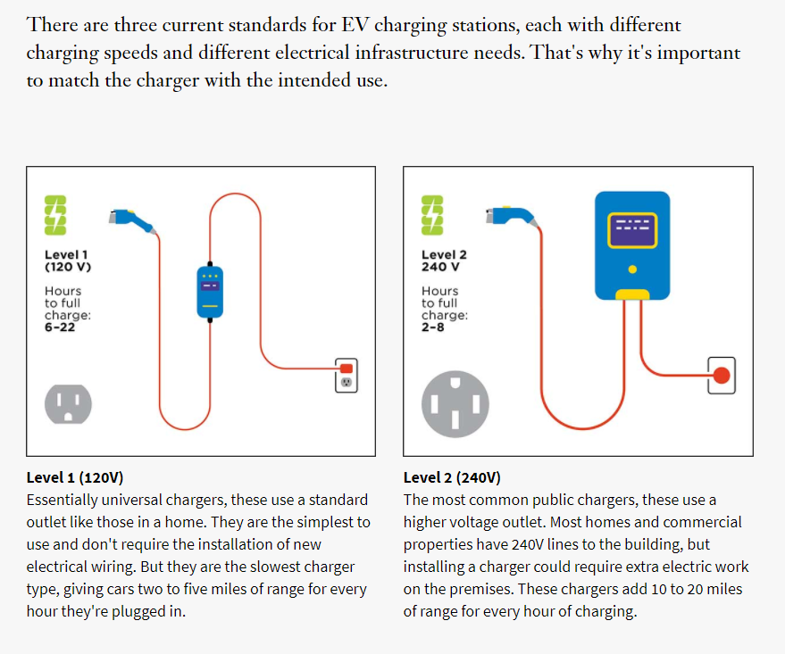
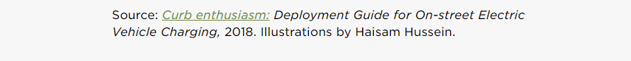
LEVEL 1 & 2: FOCUS ON OVERNIGHT / ALL-DAY CHARGING
<20 kW
20-50 kW
Notes:
Glen

Slide 18
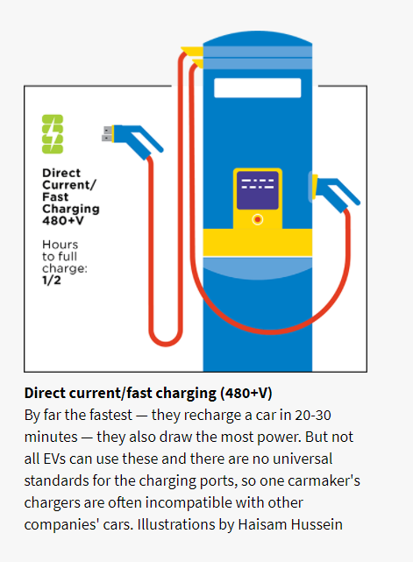
DCFC : FOCUS ON QUICK CHARGING
Direct-Current Fast Charging (DCFC)
Focus is on public charging infrastructure for long distance travel
Don’t try this at home, kids
Notes:
Glen

