Slide 1


Glass Recycling Success
in Southwestern PA
Darren A. Spielman, PhD

Slide 2
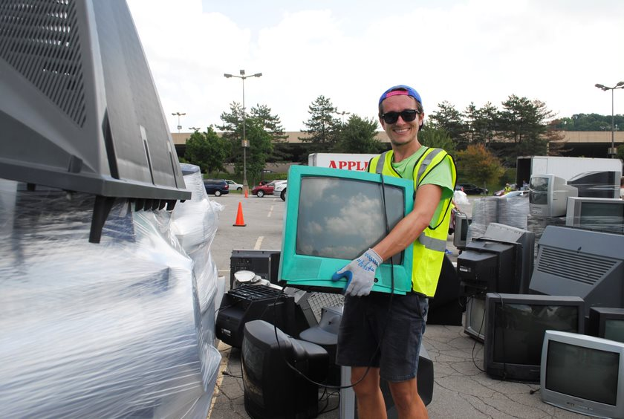
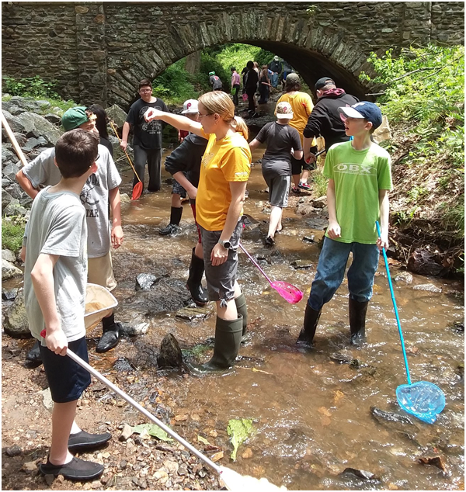

Our Mission
To lead and promote individual and collective action to prevent waste and conserve Pennsylvania’s environmental resources for each generation
Waste
Education
Water

Slide 3
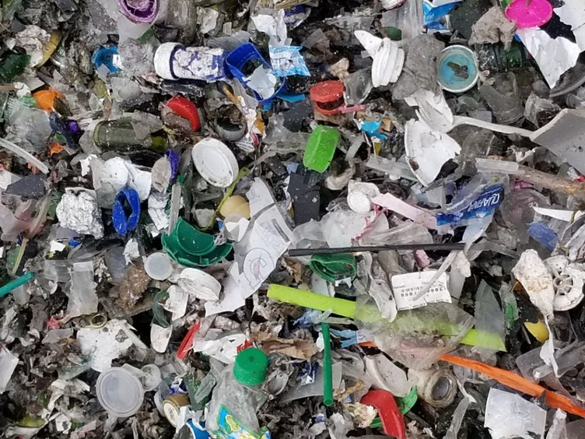
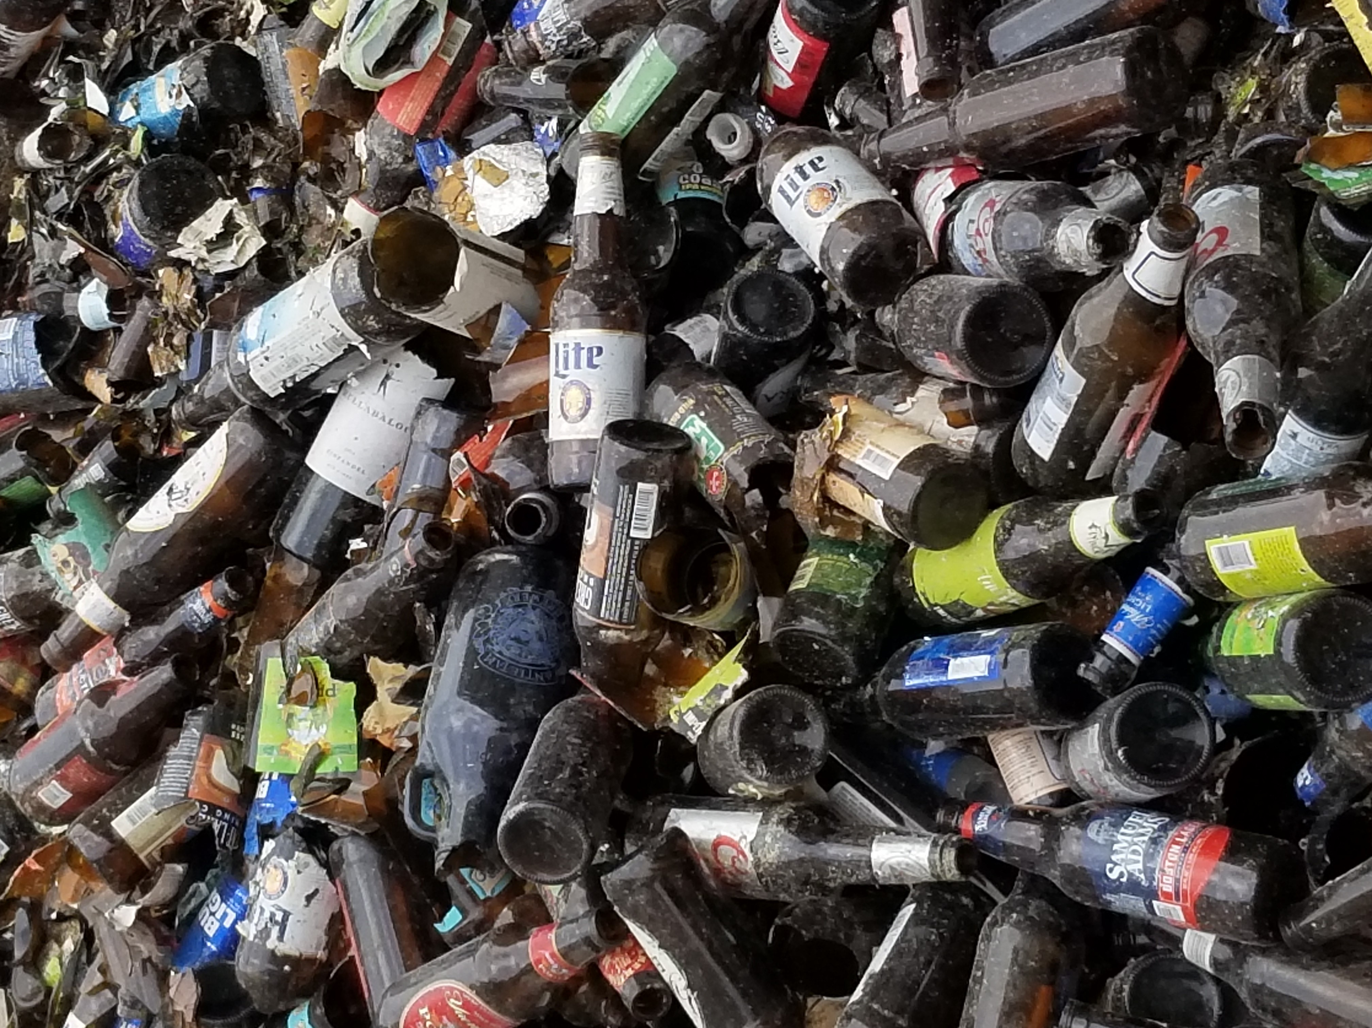
Collection Methods and Quality
PRC is a champion for increasing source-separate recycling options.
“The ‘90s called. They want their recycling back.”
“Removing glass from other material is like unscrambling an egg.”
Single-stream
Source-separated

Slide 4
PRC’s
Glass Recycling Program
Southwestern PA Glass Recycling Collaborative
Traveling Glass Recycling Bin

Slide 5

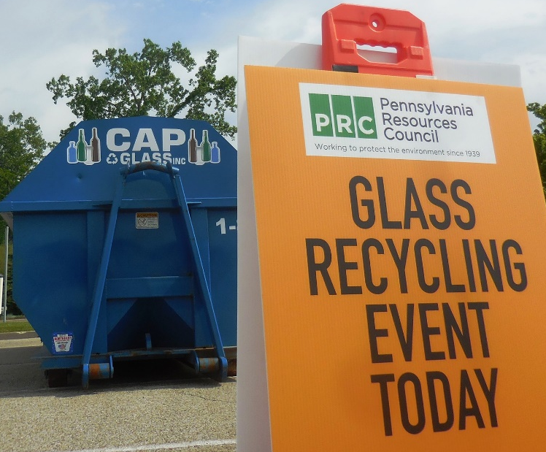
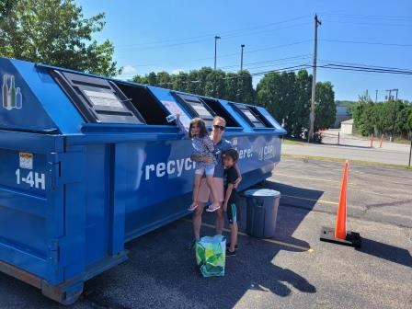
What is it?
Weeklong “rental” with the aspects of permanent sites
Semi-permanent, rotating
Multiple sites, quick turnaround
Outcome of pandemic constraints

Slide 6
Semi-permanent and Permanent Models
Program Development | Education and Outreach
Location siting Equipment procurement Hauling service coordination Reporting Invoicing | Print and digital In-person* On-site signage
Maintenance and Monitoring | Program Pilot
Container upkeep Contamination Regular site servicing | Program evaluation Scaling up Coordinating grant asks

Slide 7
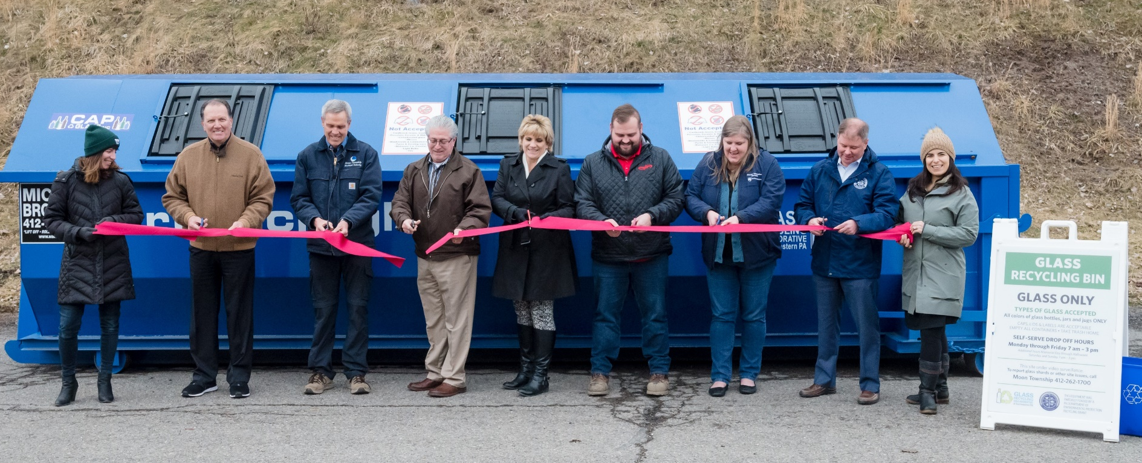
SWPA Glass Collaborative
A growing regional collaborative with local communities
PRC’s growing drop-off network has served more than 30,000 households in the past year and collected 540+ tons of glass for recycling markets.

Slide 8
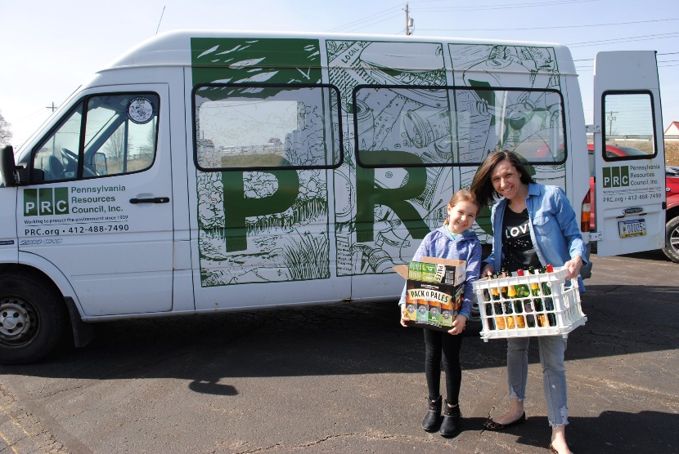
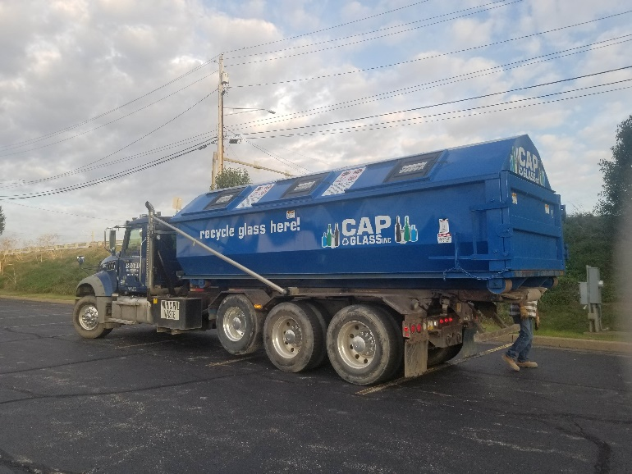
Getting Started
The Easy Stuff
Education, Outreach, & Engagement
Hauling Partner

Slide 9
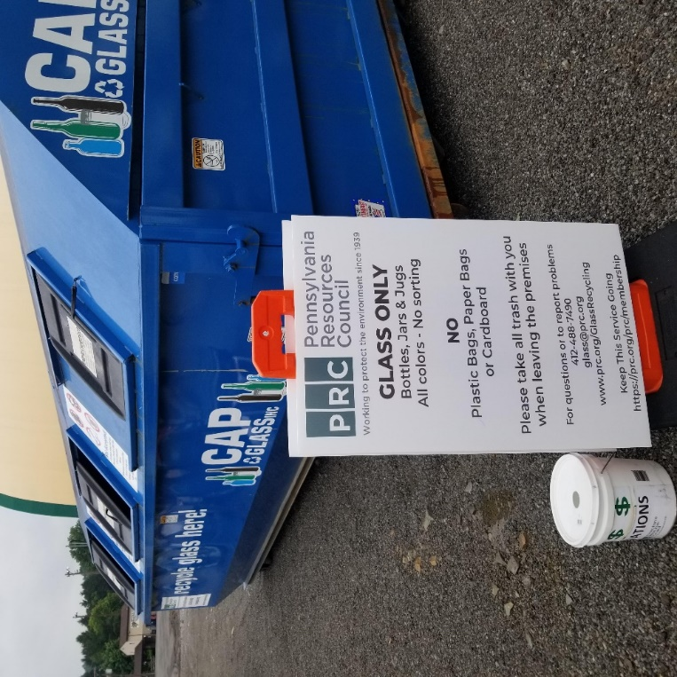
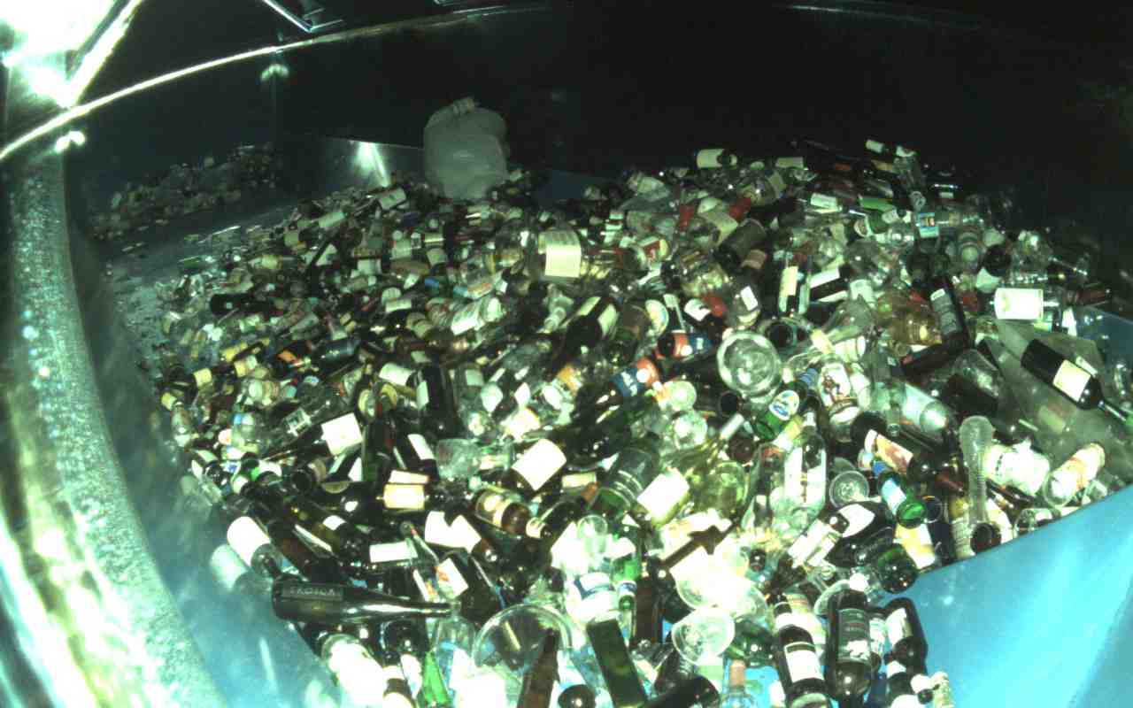
Getting Started
The Trickier Stuff
Capital Equipment
Site Operations

Slide 10
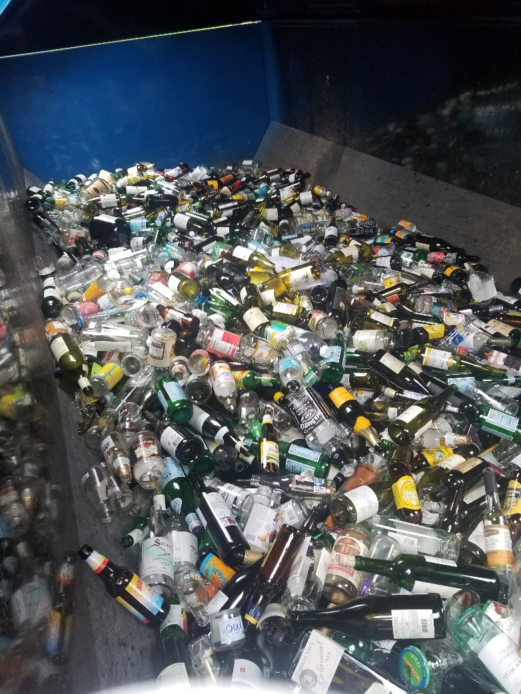
Program Elements
Multi-sector partnerships
Technical assistance and capacity building
Equipment and supplies
Educational and outreach materials and messaging
Turnkey delivery: coordinating logistics

Slide 11
Additional Partnerships
Owens-Illinois Inc.
Carry-All-Products (CAP) Glass
Over 35 Western PA municipalities and other public entities
Michael Brothers Hauling
Boyd Roll-off
Oxford Development Company
KDKA Radio

Slide 12
Additional Resources
Container Recycling Institute: www.container-recycling.org
Glass Packaging Institute: www.gpi.org
Glass Recycling Coalition: www.glassrecycles.org
Institute of Scrap Recycling Industries, Inc.: https://www.isri.org/recycling-commodities/recycled-glass
National Recycling Coalition: www.nrcrecycles.org
Northeast Recycling Council: www.nerc.org

Slide 13


Q & A
Contact
Darren Spielman
darrens@prc.org
www.prc.org
610-353-1555
1671 N. Providence Rd
Media, PA 19063
Ashley DiGregorio
ashleyd@prc.org
www.prc.org
412-488-7490
828 W North Ave
Pittsburgh, PA 15233

