Slide 1

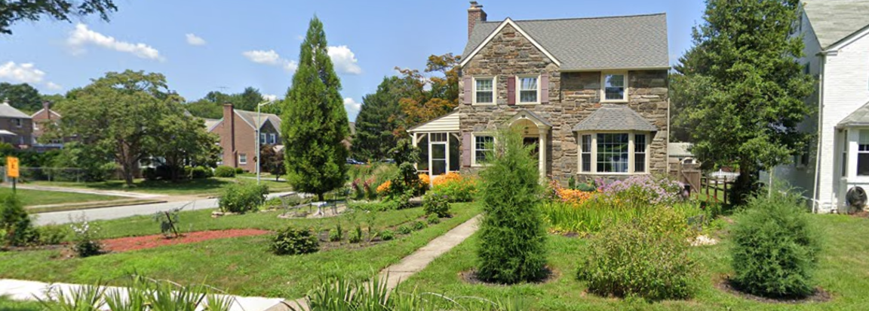

The Darby Cobbs Stormwater Initiative
Diana Andrejczak
Eastern Program Director, Pennsylvania Resources Council
Notes:
My name is Diana Andrejczak, I am Eastern Program Director of PRC.
I am going to tell you about how a partnership of local organizations started an initiative with the goal of getting the average property owner to undertake stormwater management in a watershed that has almost no existing stormwater controls.

Slide 2
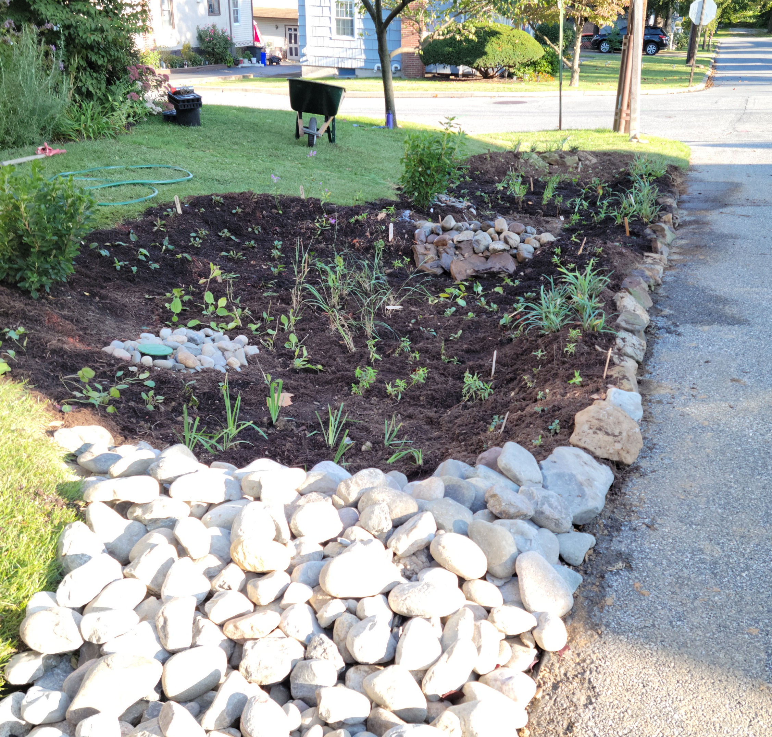

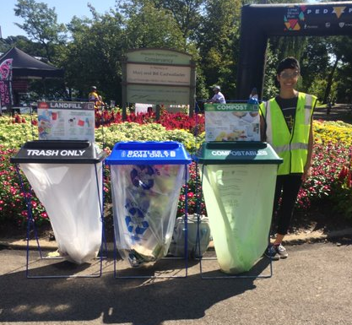
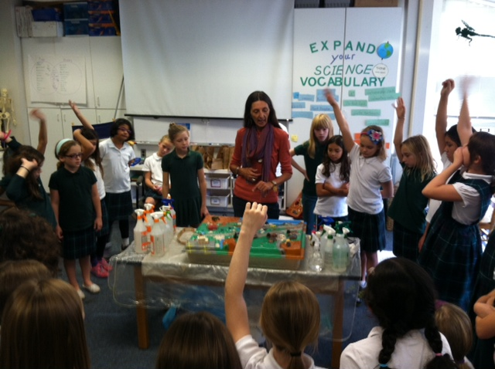
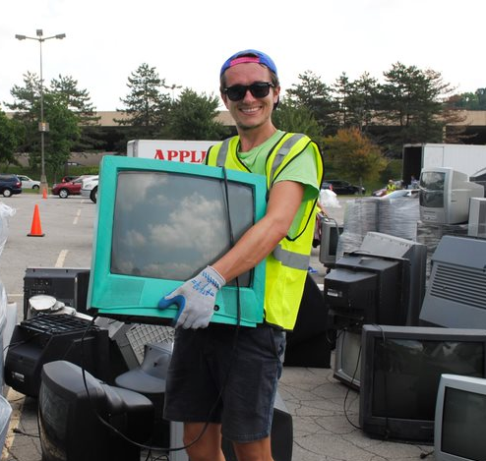
To lead and promote individual and collective action to prevent waste and conserve Pennsylvania’s environmental resources for each generation.
Education & Outreach
Collection Events
Zero Waste Services
Classroom and Outdoor Education
Adult Conservation Workshops
Watershed Protection
Notes:
If you are not familiar with PRC, Pennsylvania Resources Council is an environmental non-profit organization founded in 1939.
Originally focused on litter and roadside beautification, our mission has expanded over the years to focus on waste reduction and resource conservation.
Our current efforts include school & community education programs, e-waste collection events and HHW events, zero waste services and technical assistance, and watershed protection.
We have offices in SE PA in Media and SW PA in Pittsburgh

Slide 3
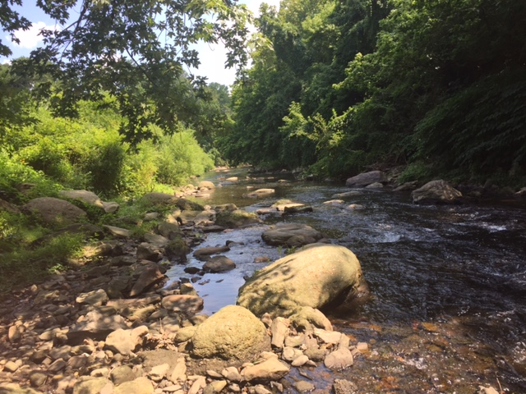
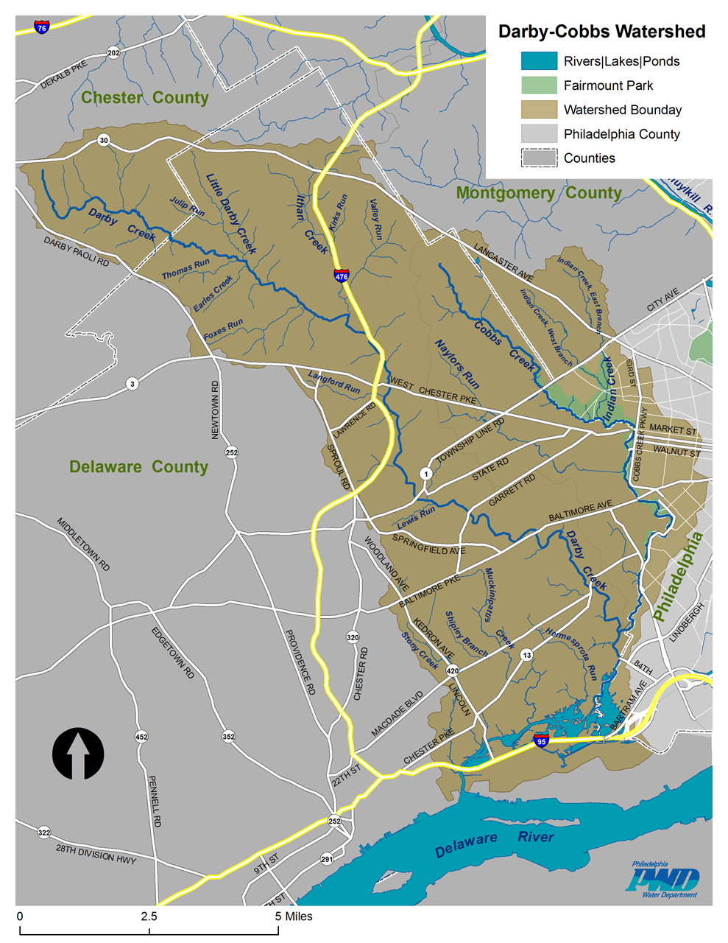
Create Momentum to Effect Change from the Ground Up
Notes:
The watershed is made up of 31 municipalities, encompasses 4 counties and has minimal existing stormwater controls
There are very few large parcels to enable retrofits.
The goal of our programs is to create a paradigm shift in how individuals, both local leaders and average citizen, view stormwater and its relationship to water quality.
And How to integrate real on the ground changes with a shift in behavior of residents and property owners.

Slide 4
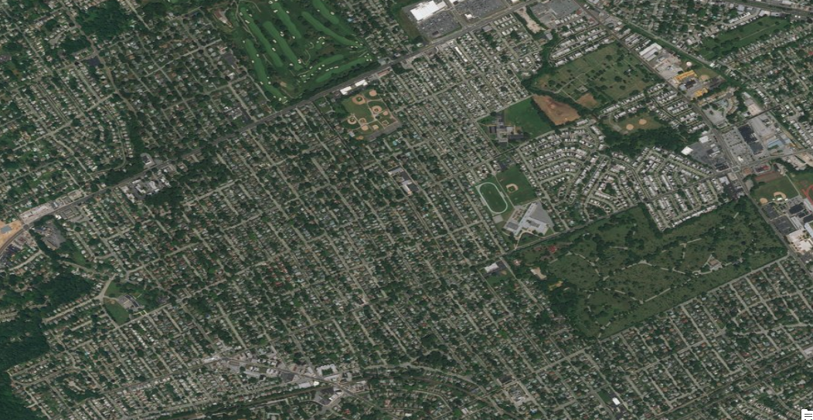
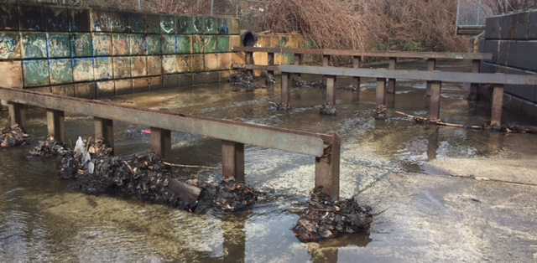
The Challenges
Highly Urbanized
All MS4s
Impaired Streams
Flooding Problems
Notes:
The watershed is heavily developed with most development occurring long before stormwater management was a concern.
The lower portion of the watershed consists of small municipalities creating challenges with coordination and creating change on a watershed wide basis.
The streams in this watershed have been heavily impacted by human development.
Many lack a natural stream channel, are flashy, and flood frequently.
Below is a picture of the main stem of Naylor's run. Large sections have been channelized in the 70s as a flood control measure.
Many of the streams segments in this watershed suffer from similar challenges.

Slide 5
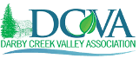
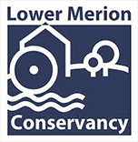

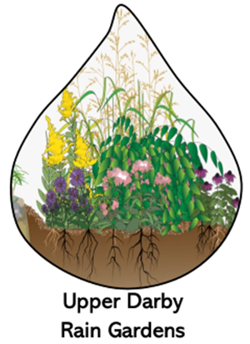
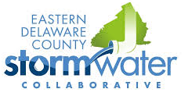

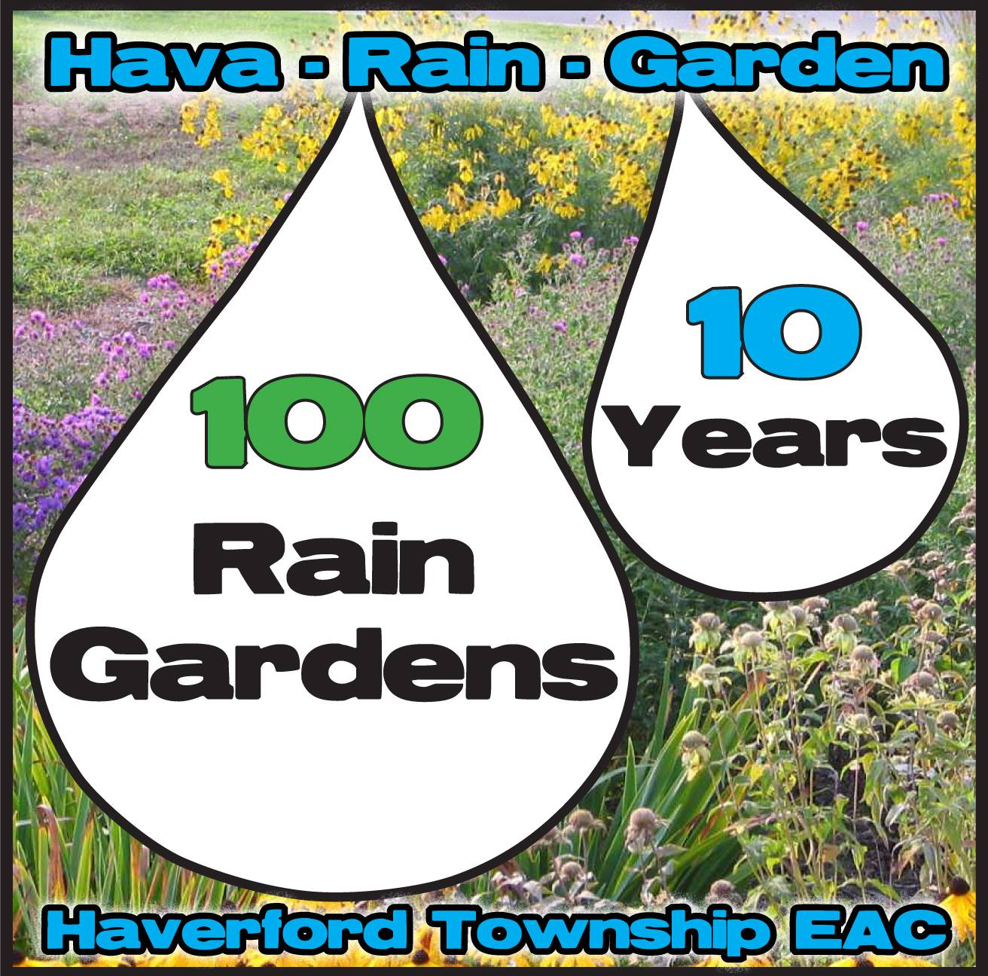

The Importance of Partners
Original Partners
Pennsylvania Resources Council (PRC)
Eastern Delaware County Stormwater Collaborative (EDCSC)
Darby Creek Valley Association (DCVA)
Haverford Township EAC
Additional Partners
Lower Merion Conservancy (LMC)
Upper Darby Rain Gardens
Hav-A-Rain Garden
Friends of Heinz Refuge
Delaware River Watershed Initiative: Upstream Suburban Philadelphia Cluster (DRWI: USP)
Multiple Municipalities
Notes:
Due to these constraints, Collaboration among municipal partners as well as environmental groups is key to affecting positive change.
A cohesive partnership was vital in reaching a wider audience.
The partnership for the pilot program consisted of PRC, EDCSC, DCVA and Haverford EAC.
However, there were also many other organizations in the watershed working towards improving water quality.
We added partners across the region as it grew into a much more comprehensive initiative
PRC is part of the the Delaware River Watershed Initiative
Which is a collaboration of over 65 organizations working together with funding from WPF to protect and restore waterways that are sources of drinking water.
In the Philadelphia cluster, members include
Friends of Poquessing Watershed, PEC, Pennypack Ecological Restoration Trust, Tookany/Tacony-Frankford Watershed Partnership, Wissahickon Valley Watershed Association, Temple University Center for Sustainable Communities, and Villanova University.
- Temple, Villanova, Academy of Natural Sciences – Monitor and assess water quality data

Slide 6
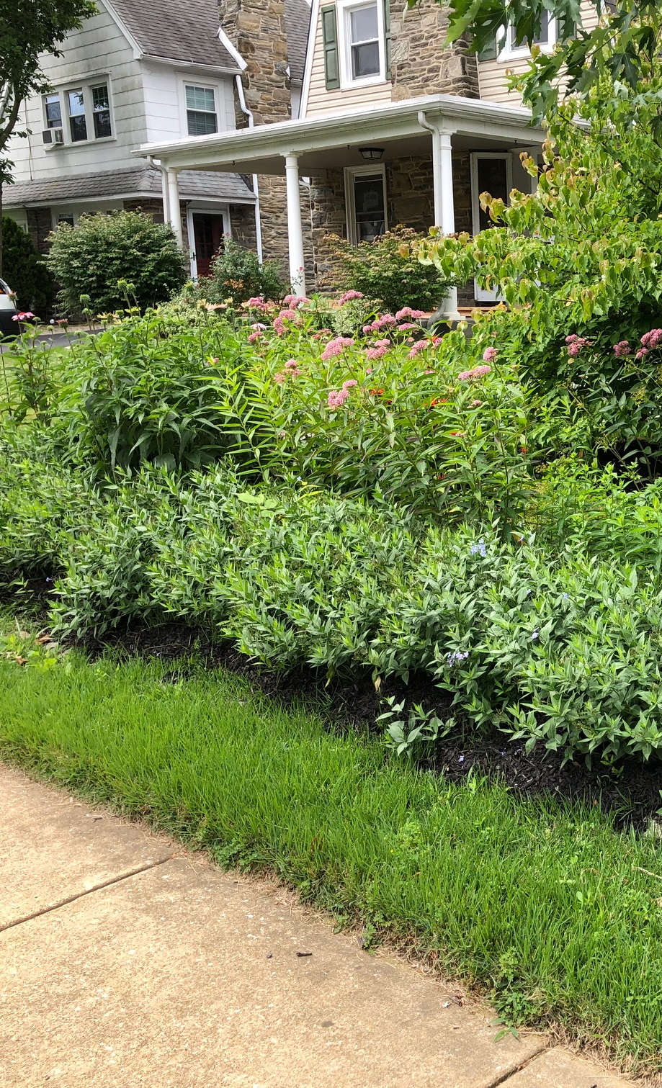
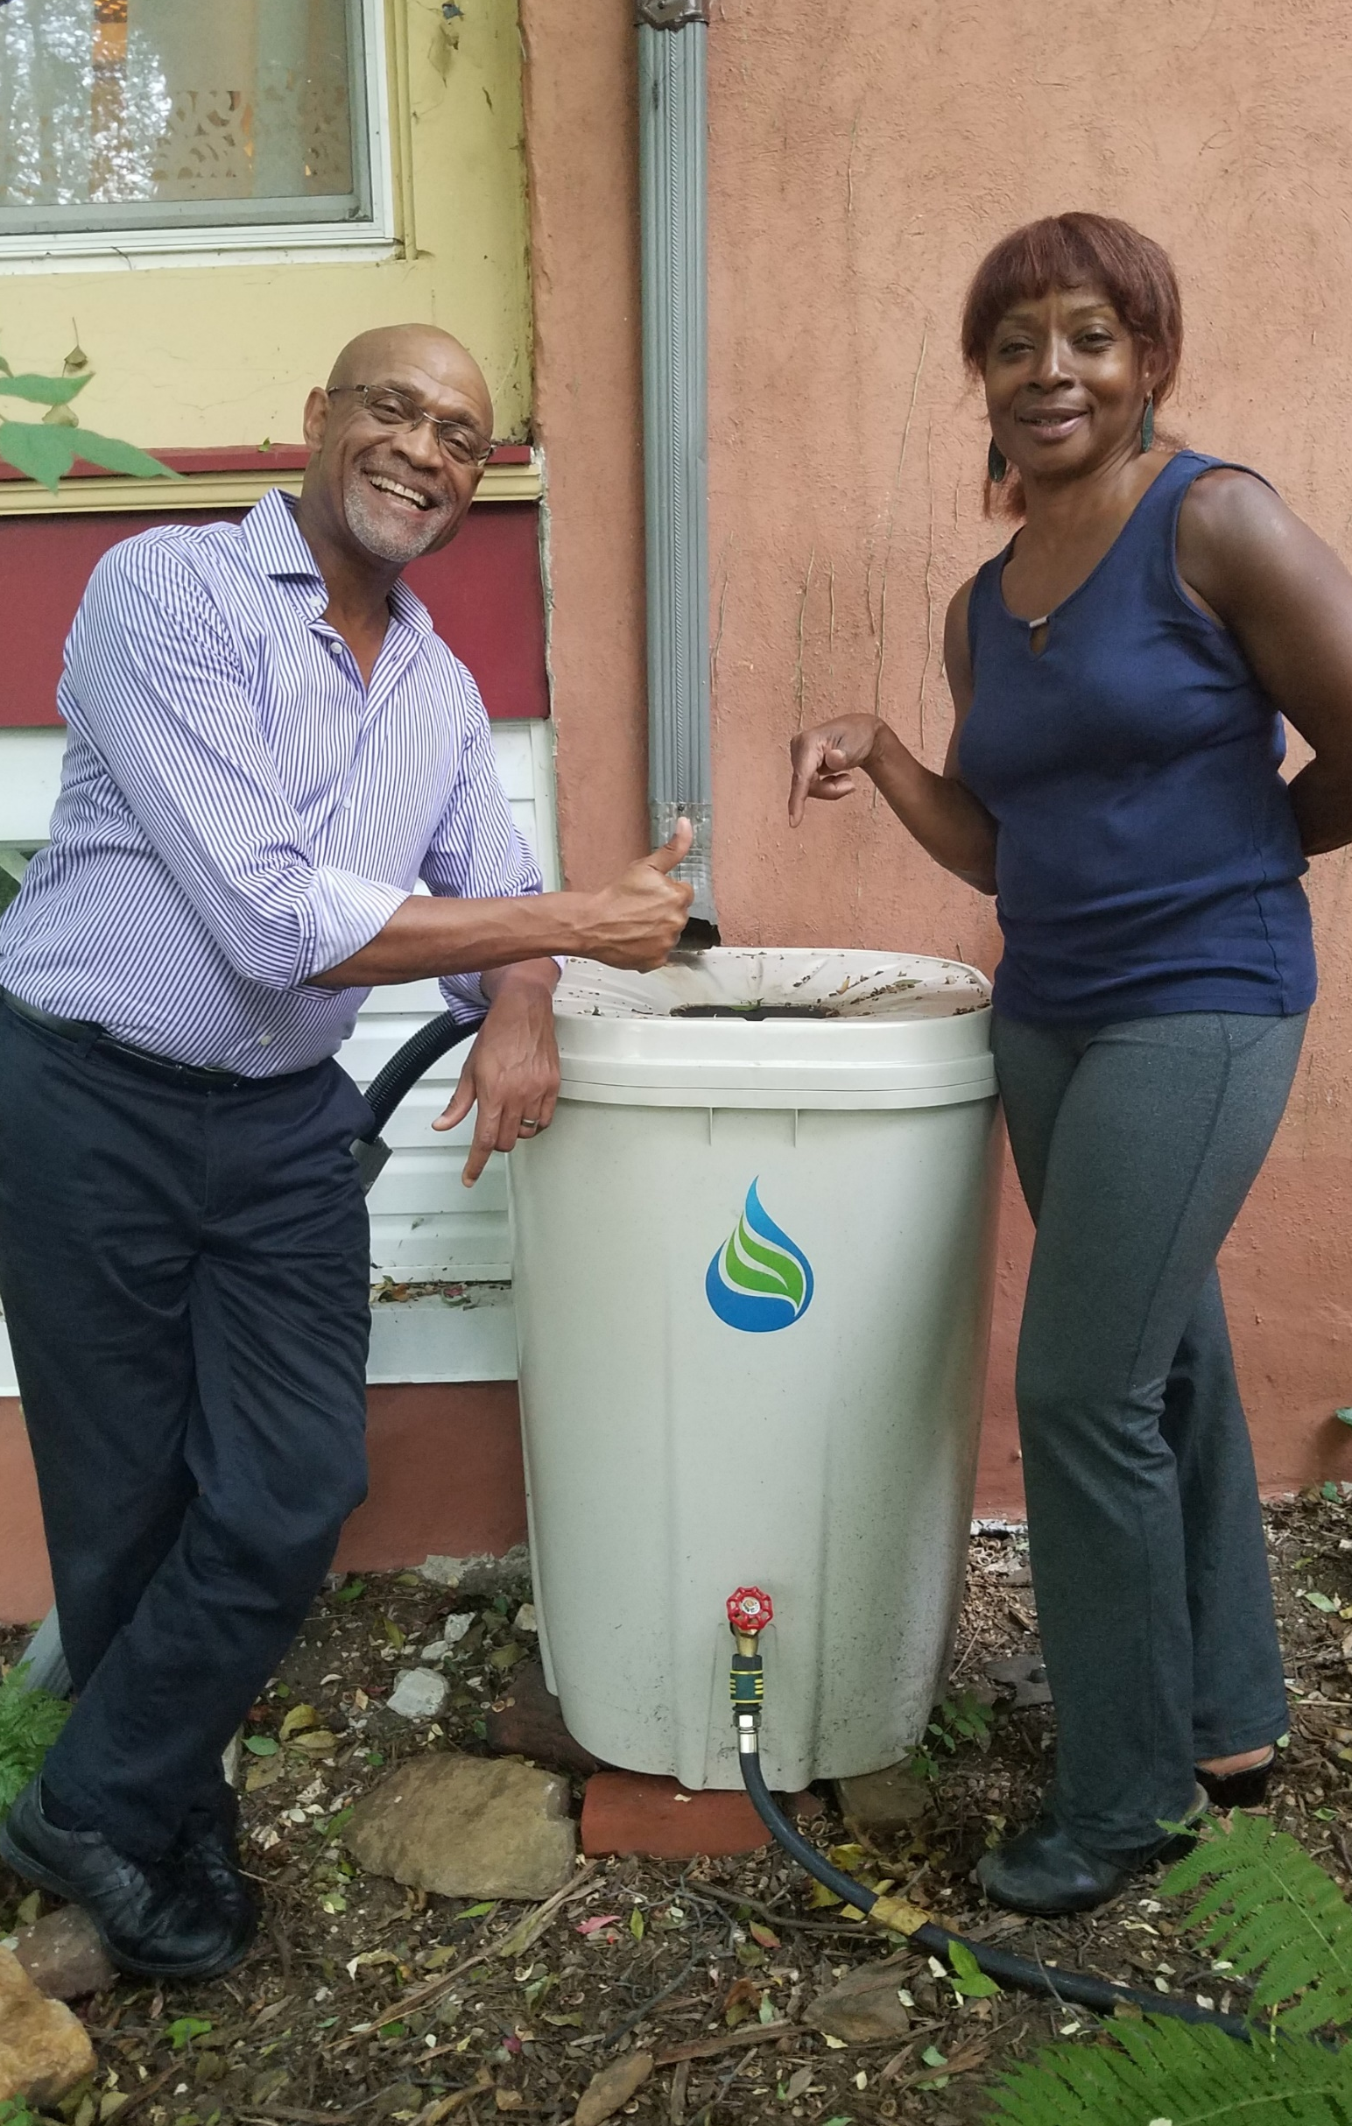
Solutions to the Challenges
Rain Gardens: Public & Private Properties
Property Owner Education & Outreach
Stream Smart Stormwater House Calls
Notes:
Targeting private property owners was deemed a key component to meeting our goals.
Two key programs were developed to achieve this goal.
The first was a rain garden initiative to create on the ground improvements both on private property and public lands
The second was the stream smart stormwater housecalls program to directly engage property owners in education of stormwater on their properties.

Slide 7
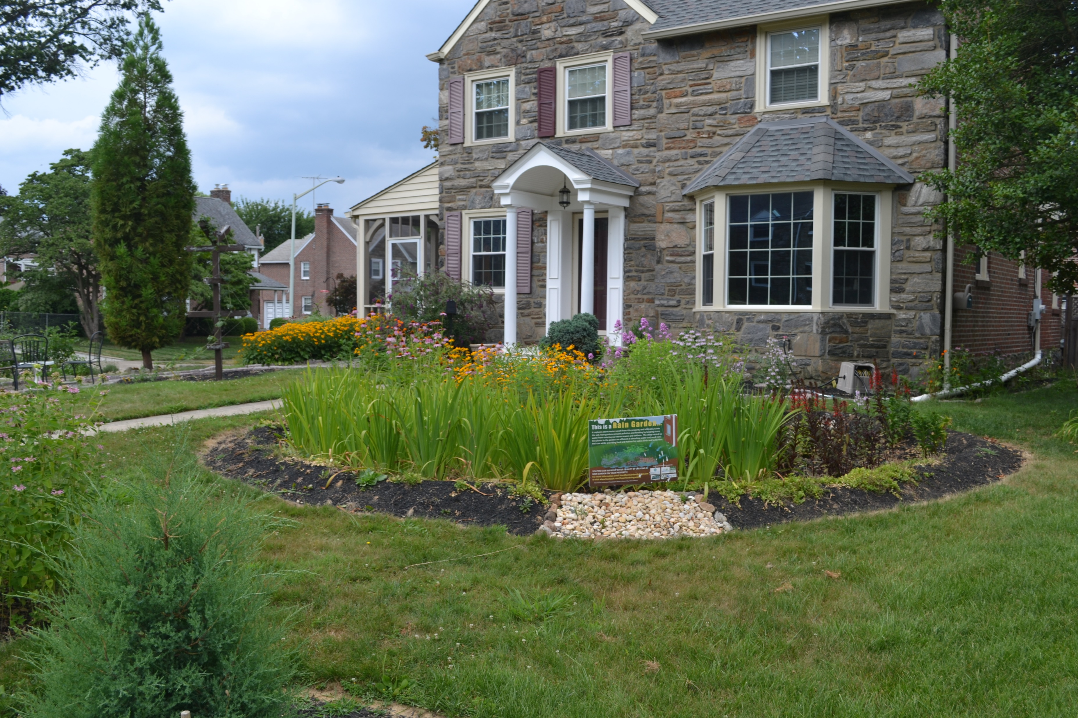
The Darby Cobbs Stormwater Initiative:
Getting to the New Normal
Piloted in 2014
Address water quality and educate the public
Create a framework to engage property owners
Replicate model in other areas
Create a new normal
Notes:
- The rain garden program we piloted in 2014 was the Darby Cobbs Stormwater Initiative: Getting to the New Normal through funding from National Fish and Wildlife Foundation Delaware River Fund Grant
Goal was to a create a framework to engage property owners to install rain gardens on their property – public and private
Develop a replicable model that could be implemented in other areas/watersheds
Generate a long-term shift in the maintenance of public and private properties where GSI become the norm and not the exception in achieving the goals of watershed protection.

Slide 8
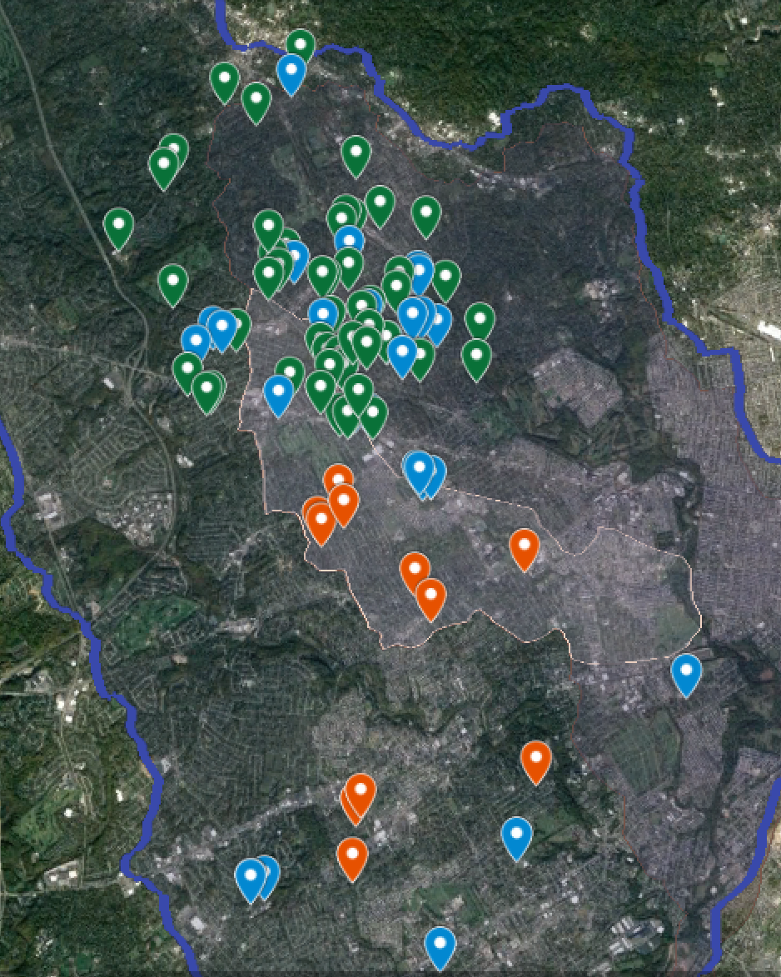
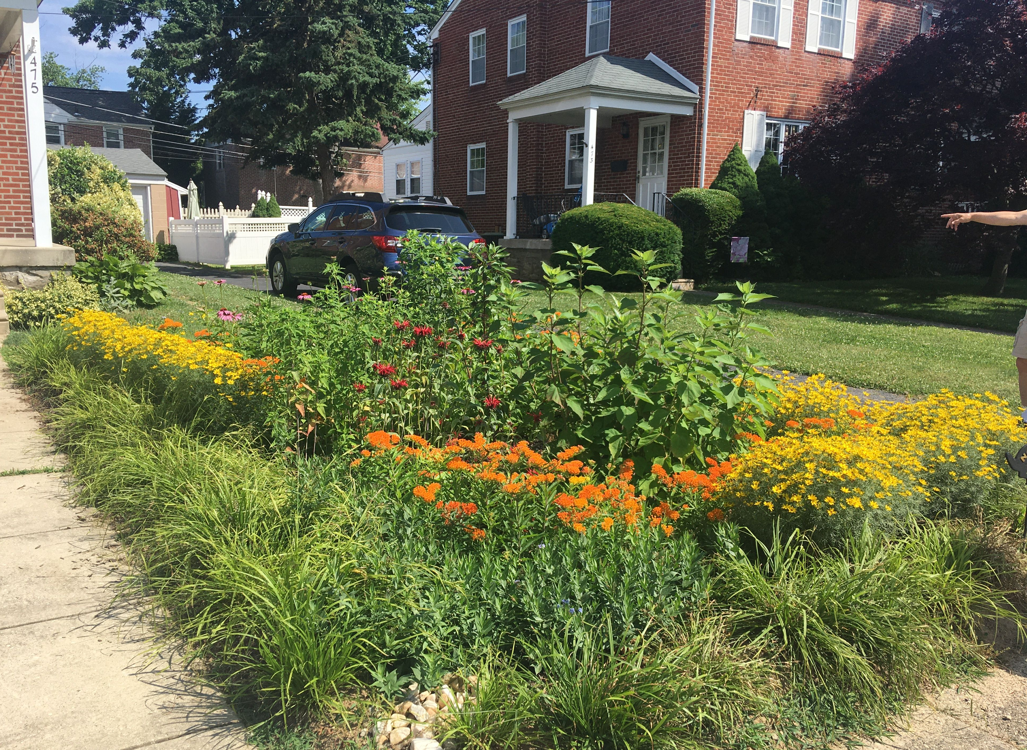
Soaking in the Water
Notes:
The rain garden initiative has two components.
Public demonstration rain gardens
And an initiative spearheaded by the Haverford Township EAC, the Hav A Rain Garden program to install gardens on private properties.
Each component creates change in the landscape, generating conversations for stakeholder about stormwater.
They see the gardens, they ask questions generating interest and allowing for avenues for education.
- The initiative started as 10 residential gardens and 6 Public gardens and we are now up to 98!

Slide 9
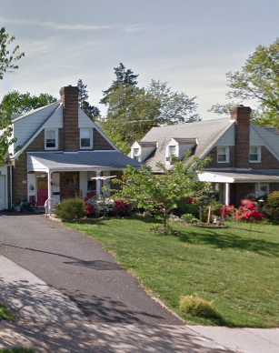
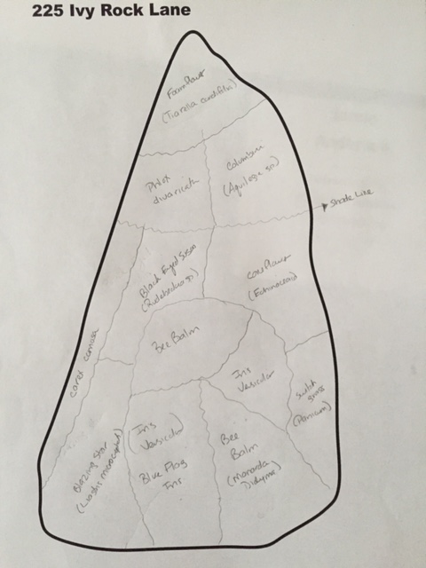
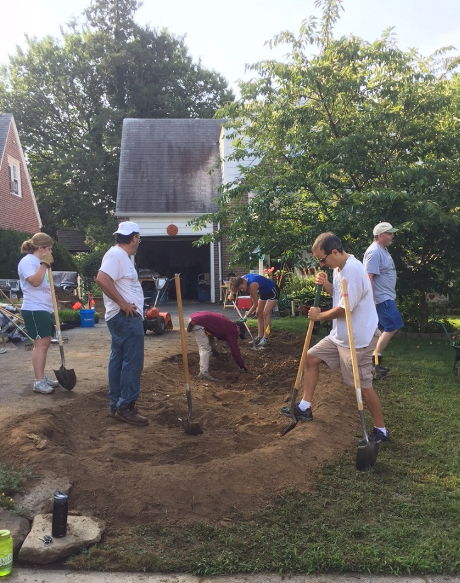
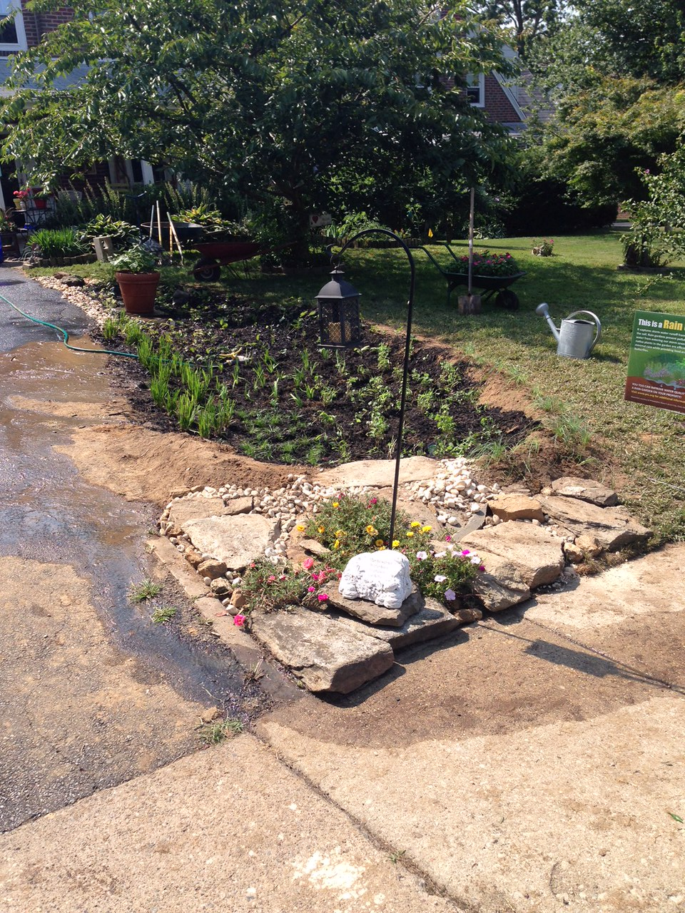
Rain Gardens On Private Properties
Selection
Design
Construction
Success
Notes:
- Gardens, even on public property, are simple in design.
The location must have soil that will adequately infiltrate water,
designs are completed in house by staff or volunteers, landscape plugs are used for ease of transport and cost, and on private property
100% of labor was volunteer in beginning. Now we have funding for contractor to help excavate a percentage of properties. Still planted by volunteers.
Private rain gardens utilize the habitat for humanity model. All residents who receive a garden must volunteer their time to construct others.

Slide 10
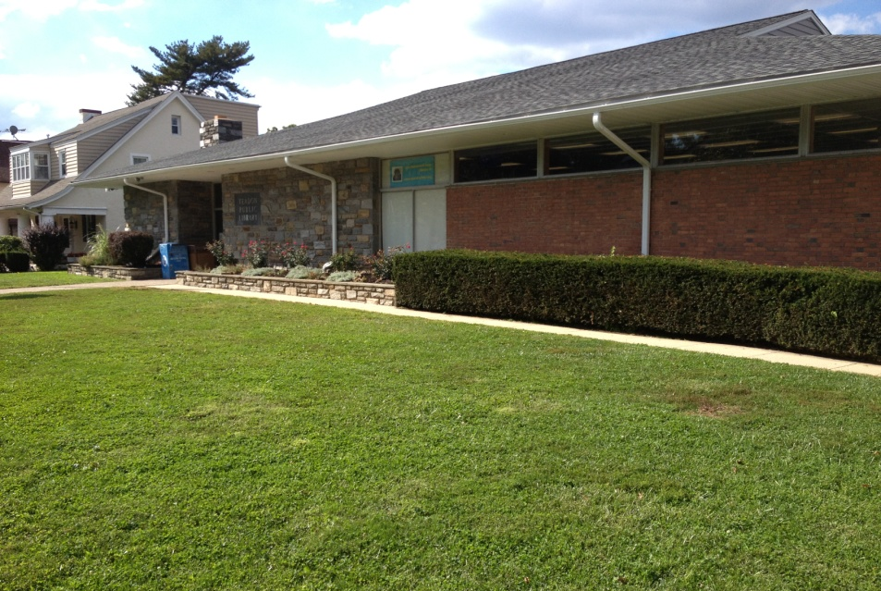
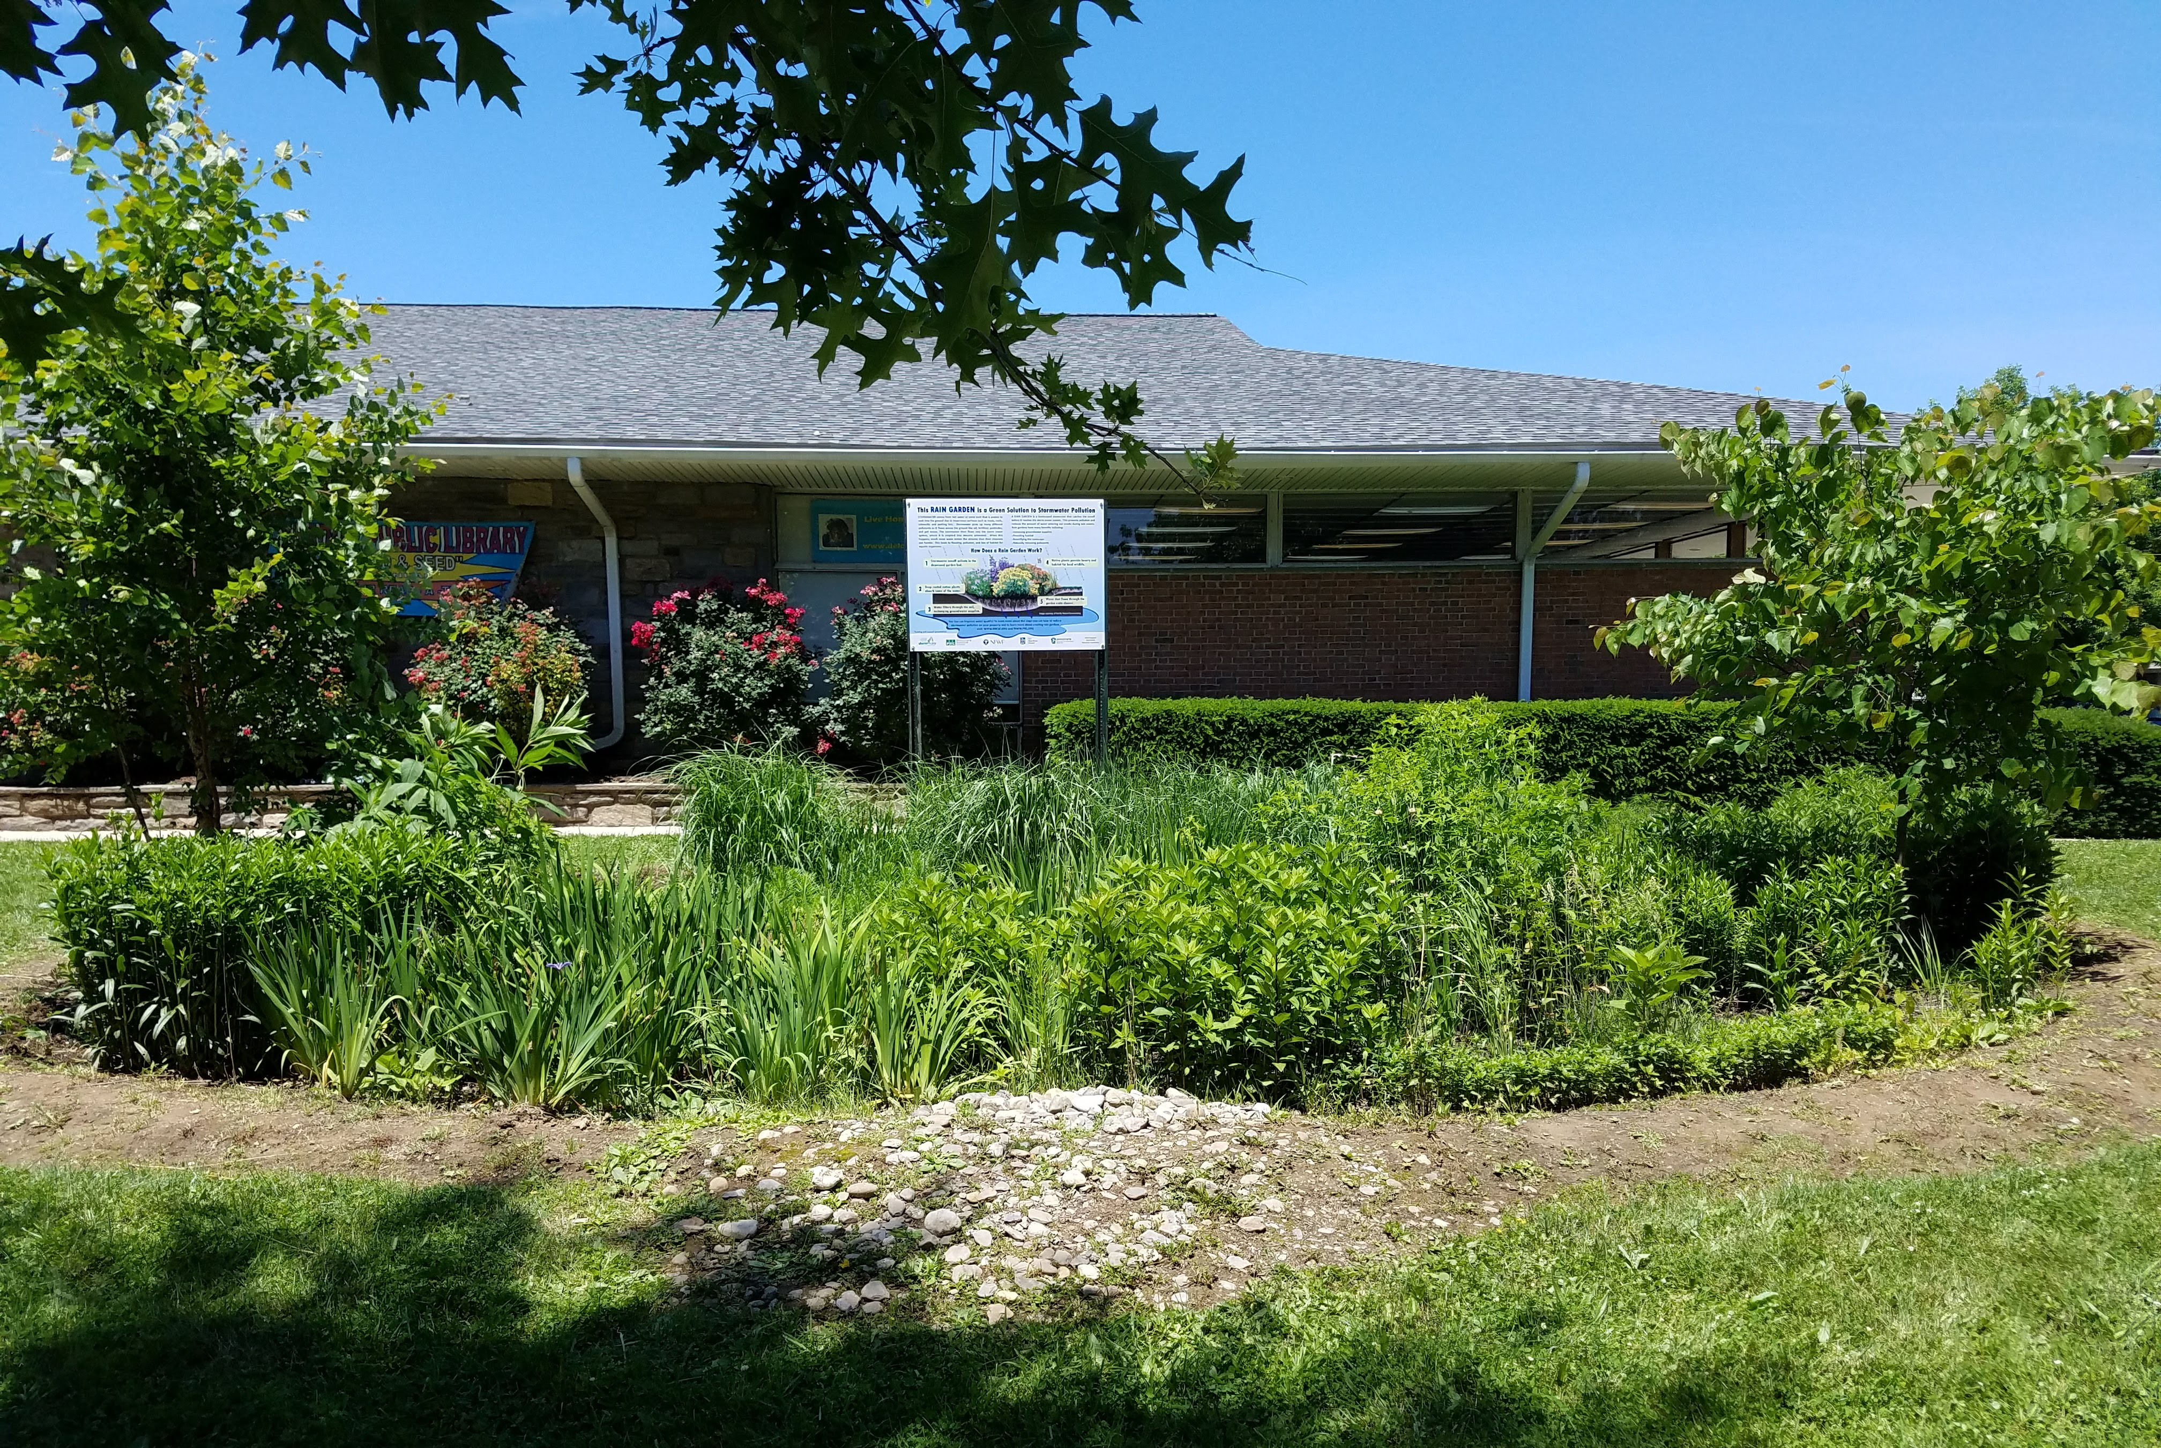
Yeadon Library
Rain Gardens on Public Property
Notes:
Public rain gardens are generally larger than ones constructed at on private properties.
Public works assists with the construction process and helping excavate.
Native soils are used.
Locations are chosen for visibility to create educational opportunities.
There is educational signage at each garden.
All gardens remove water from the stormsewer system.

Slide 11
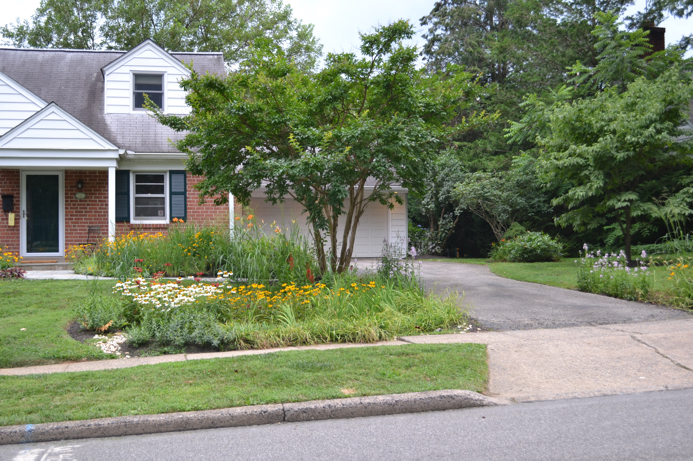
Generating Interest by Increasing Curb Appeal
Notes:
An added benefit property owners find from having rain gardens on their property is curb appeal.
This curb appeal also helps to generate interest in the rain gardens amongst community members.
Others see their beauty, learn of their value, and this generates interest in either building a rain garden on their property or at the very least, encourages them to take steps to improve stormwater management on their property.
Performed nearly 300 assessments to date. Many were because they saw them in the neighborhood!

Slide 12
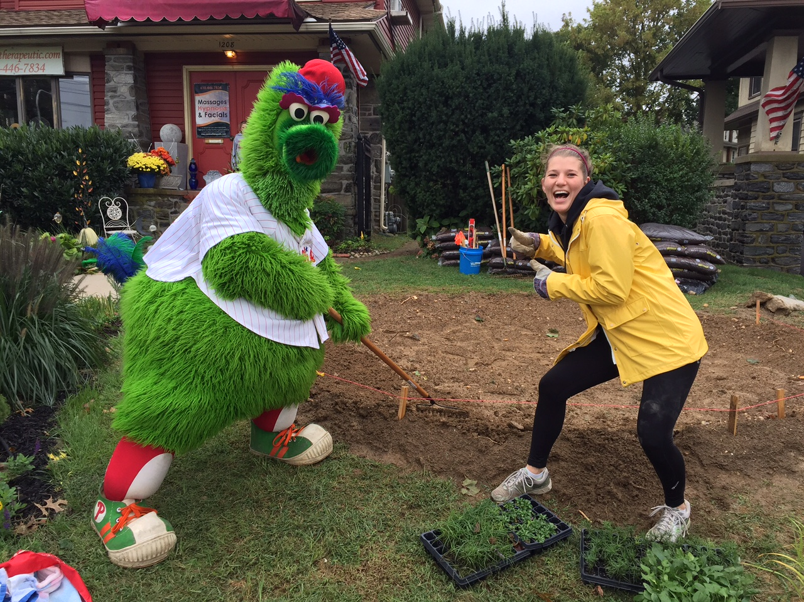
Selected Properties Owner Responsibilities
Property owners sign agreements that outline construction, operation and maintenance
Perform a PA One Call to map out utilities
Cut sod (Rain garden area is marked out by us beforehand)
Pipe water into the garden
Find a place for soil that is removed during excavation
Pledge 4 hours of time to pay It forward
Notes:
- Homeowner Signs Agreements that outline construction, O &M
Perform a One Call for utilities
Rain Garden Team mark out the garden area
Owner is Responsible for cutting sod of area
Find an area to move excess soil that is excavated
Pledge 4 hours of time to help build additional gardens
This this process that we were able to develop a team of trained volunteers and develop a Community Rain Garden Team

Slide 13
Evolution of the Initiative 2014 - 2022
Getting to the New Normal
(NFWF DRRF)
Getting to New Normal Phase 2
(Growing Greener)
Stream Smart
(NFWF DRRF)
Additional Public Gardens (RBC Grant)
Drexel Gardens Park GSI Restoration
(NFWF DWCF)
Every Property Counts
(Growing Greener)
Stream Smart Expansion to USP
(NFWF Cornerstone)
Growing Greener Communities
(Growing Greener)
Backyard Buffers & Rain Barrel Making I & II
(Growing Greener)
Green Streets
Lower Merion Conservancy
Notes:
- The Rain Garden Initiative proved very successful.
Won Governor’s Award for Env. Excellence in 2016
Spurred other programs to continue work of connecting with property owners and addressing water quality issues
As I will discuss later, all these programs will be streamlined into the Growing Greener Communities Umbrella
Not Counting additional grants and programs held by other partners
Match Funds Over $1M
Total Funding: $1,256,000

Slide 14
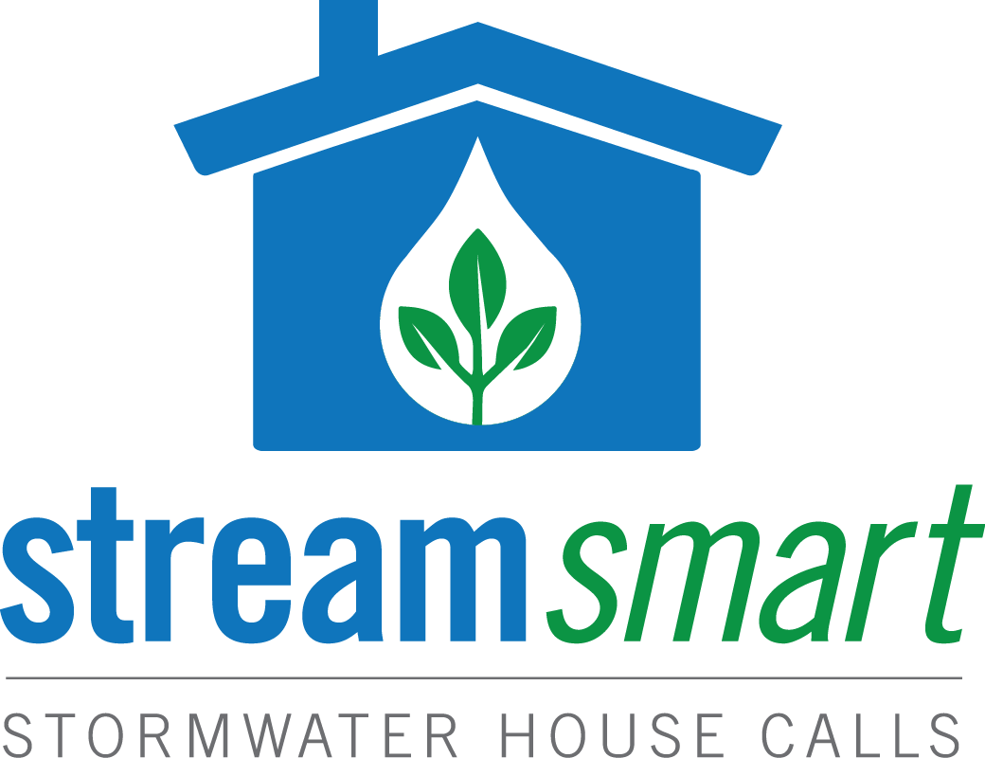
Stream Smart Stormwater House Calls
Rethink Landscaping
Install Rain BarrelS & Flow Through Planters
Plant Trees & Riparian Buffers
Redirect Gutters
Build a Rain Garden
Consider De-paving or Pervious Paving
Notes:
Not all properties are suitable for rain gardens and to reach an even broader audience the streamsmart stormwater housecall audit program was created.
Piloted in 2106 by PRC, EDCSC, LMC and DCVA
This program is structured after the PECO energy audit program and Lower Merion Conservancy’s Environmental House Call Program for riparian buffers
Each audit is done at the request of an individual property owner on properties located within the Darby Cobbs Watershed.
Properties are not limited to residential and can include schools, churches, and private businesses.
Through this program, we created a replicable model
The program has since been expanded regionally and is in use by other organizations in the DRWI

Slide 15
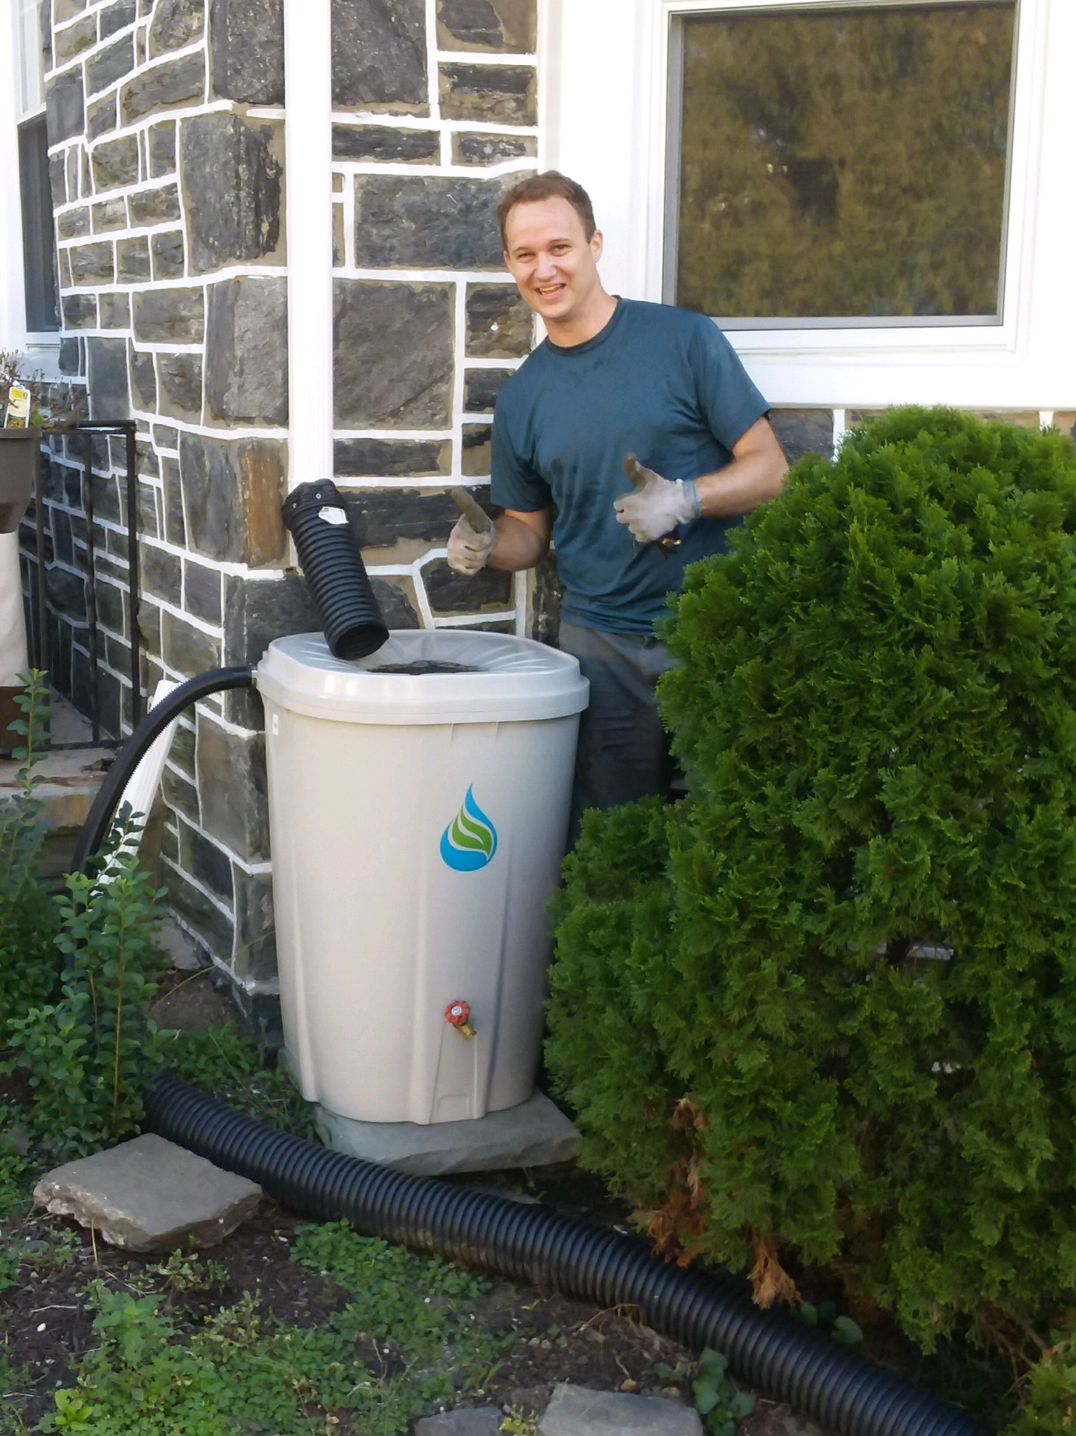
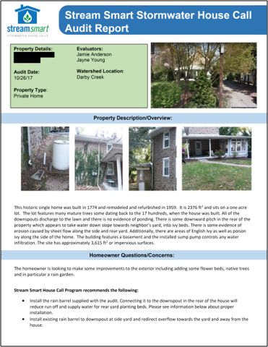
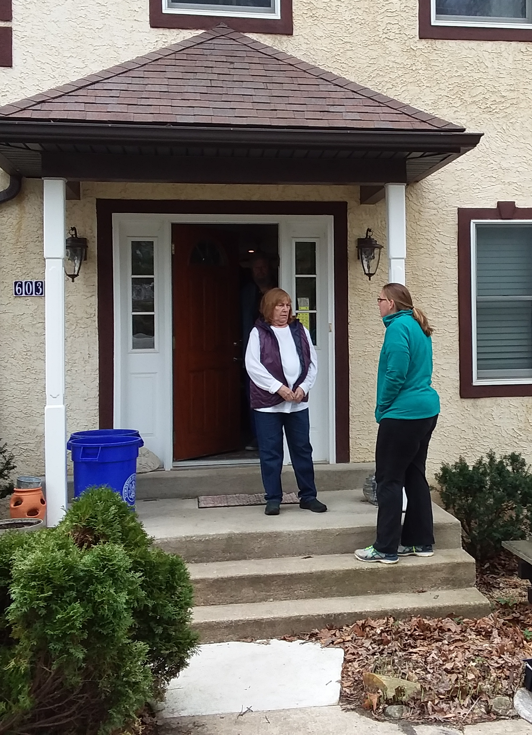
Engaging Individuals
Notes:
Each audit engages residents in a conversation regarding current maintenance practices and involves a walk around of the property to see how they currently manage stormwater.
We have found that most owners have a limited understanding of how stormwater flows on their properties.
Each property receives a detailed report outlining steps they can take to have a more creek friendly property.
Where possible and as funding permits, we provide or help install free or low cost GSI on properties.
Includes Rain Barrels, rain gardens, flow through planters, trees, native plants, gutter extenders, de-paving

Slide 16
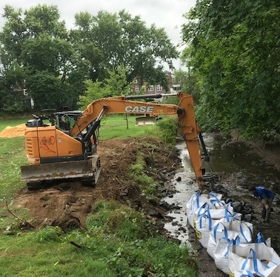
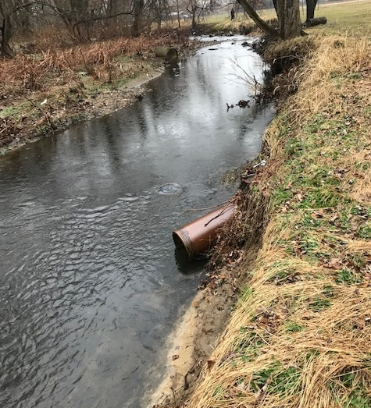
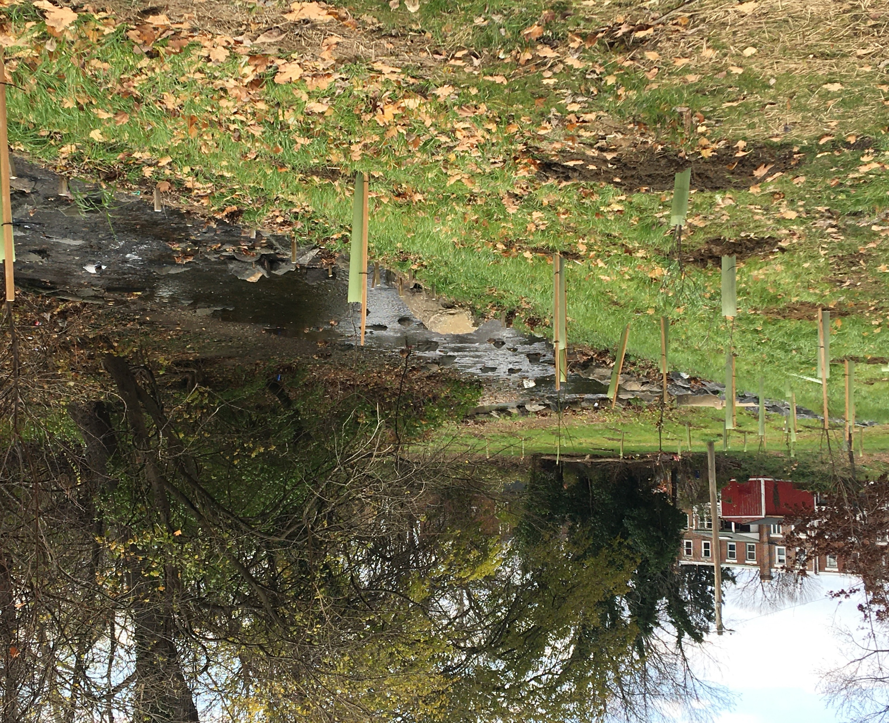
Drexel Gardens Park Restoration
Restore 440 linear feet of streambank
Create a riparian buffer
2 Bioswales
1 Rain Garden
Stream Monitoring Equipment
Notes:
Drexel Gardens is heavily used park owned by Upper Darby Township. Naylor’s Run flow right through the park.
stream experiences dangerous flashy flow conditions, streambank erosion, and high sediment loads.
Project would treat a large volume of water from the park and the surrounding neighborhood
High-visibility projects will provide important opportunities for education and outreach including to stakeholders, local government officials, and community members.

Slide 17
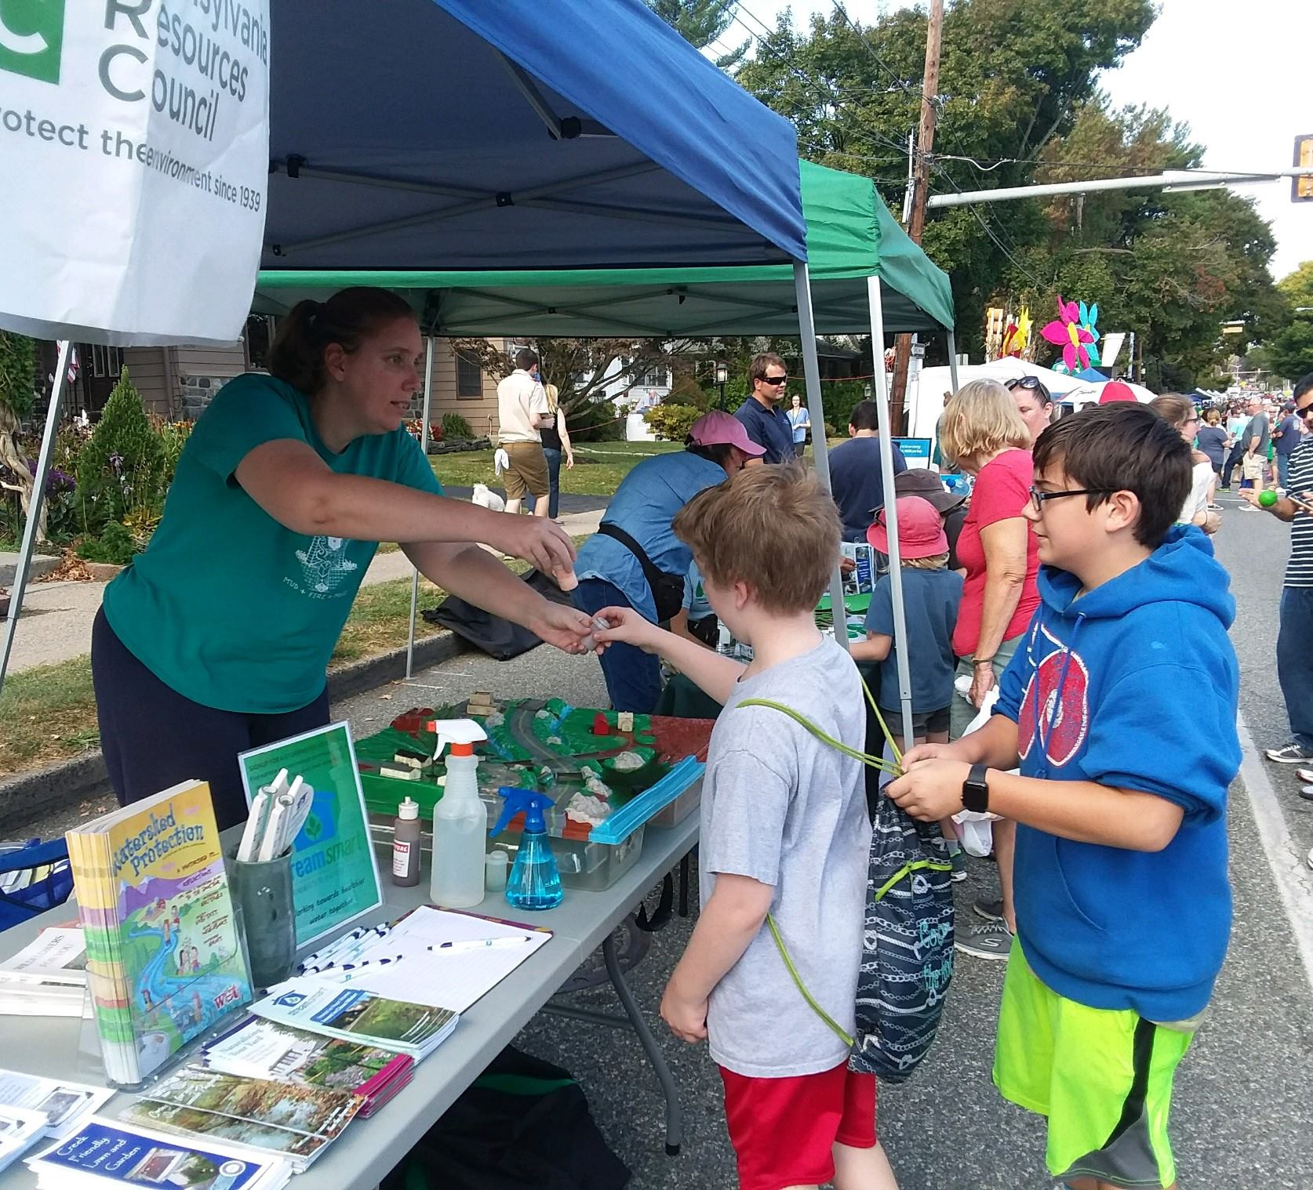
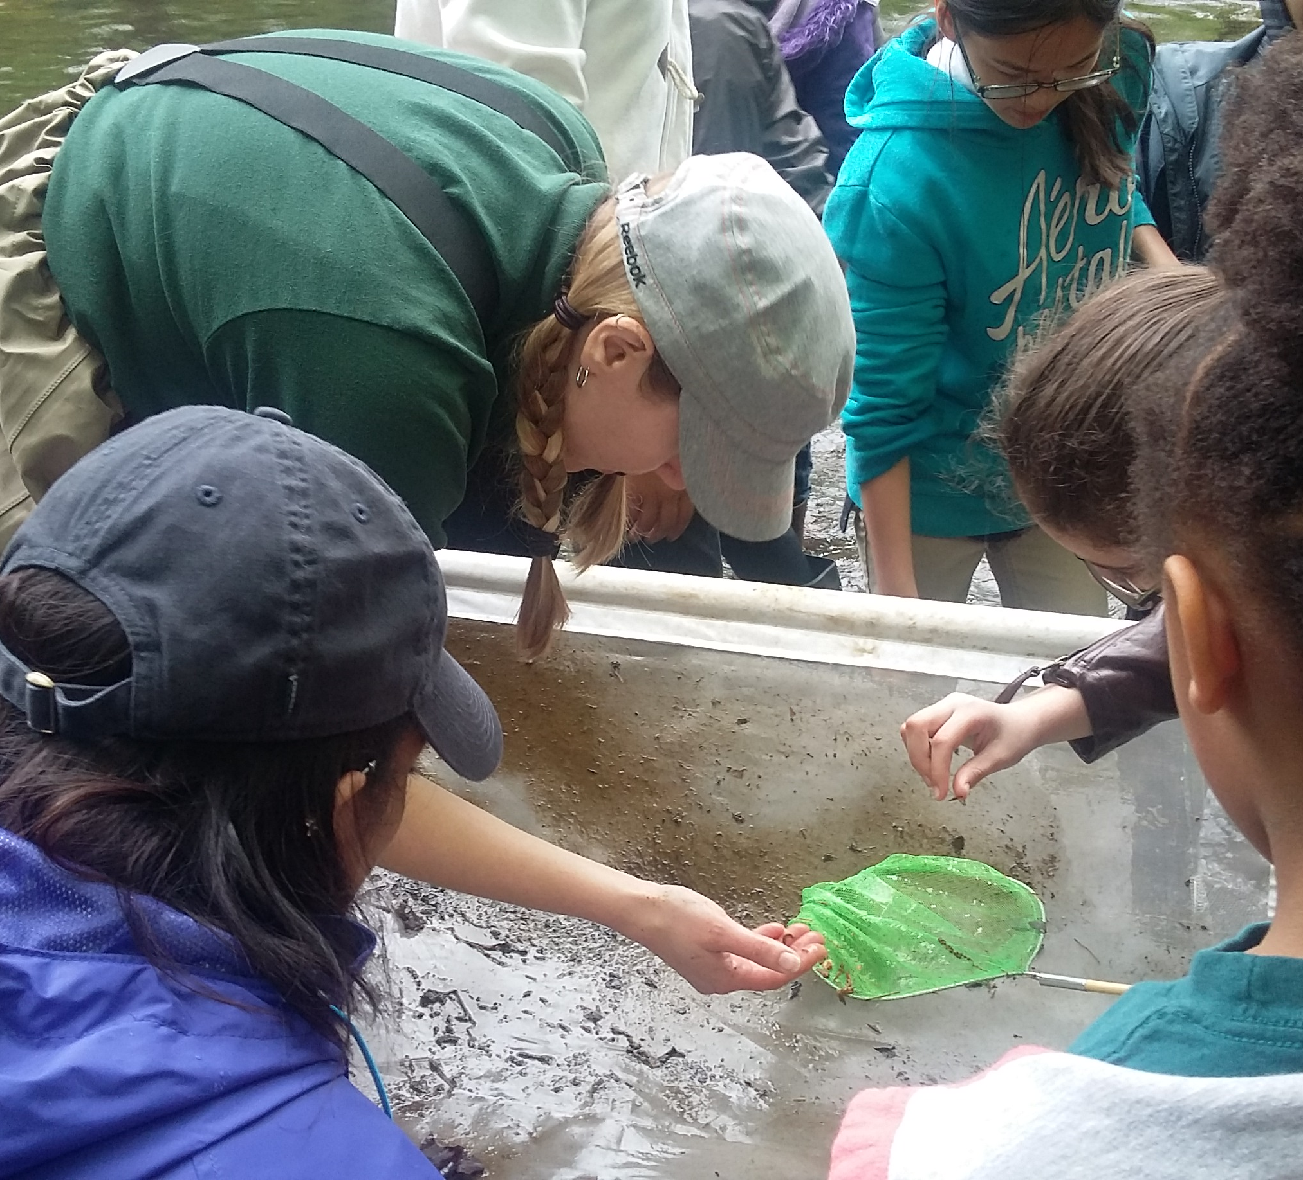
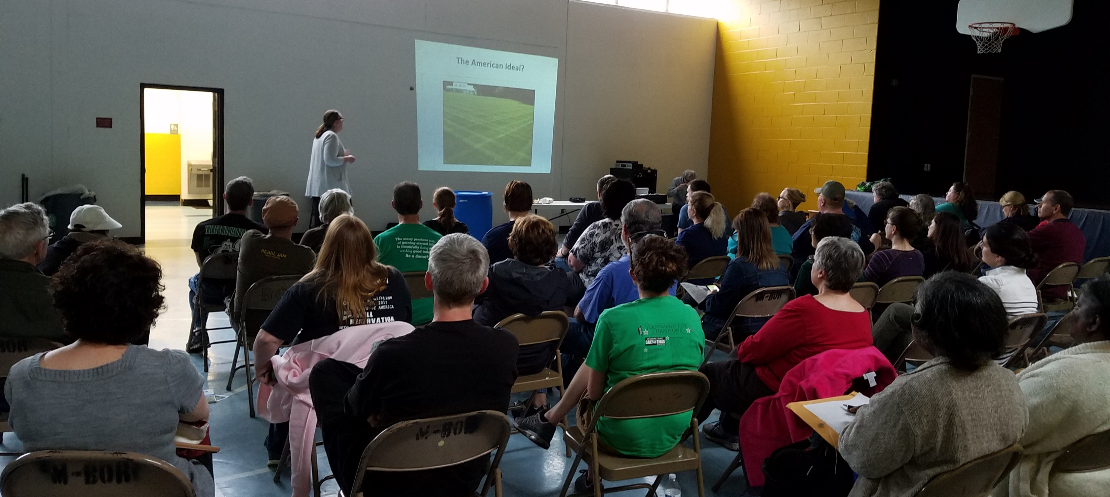
Educational Outreach
Stormwater Workshops
Rain Barrel Workshops
Rain Gardens Workshops
GSI Installation Trainings
Municipal Trainings
In-School Education
Stream Field Trips
Tabling Events
Notes:
Education and Outreach is a large part of the initiative.
Multiple workshops and events each year to educate about what is happening in our watershed and what we can be doing to help.
Workshops also serve as a recruiting tool for rain garden assessments, stream smart house calls, rain garden team members

Slide 18
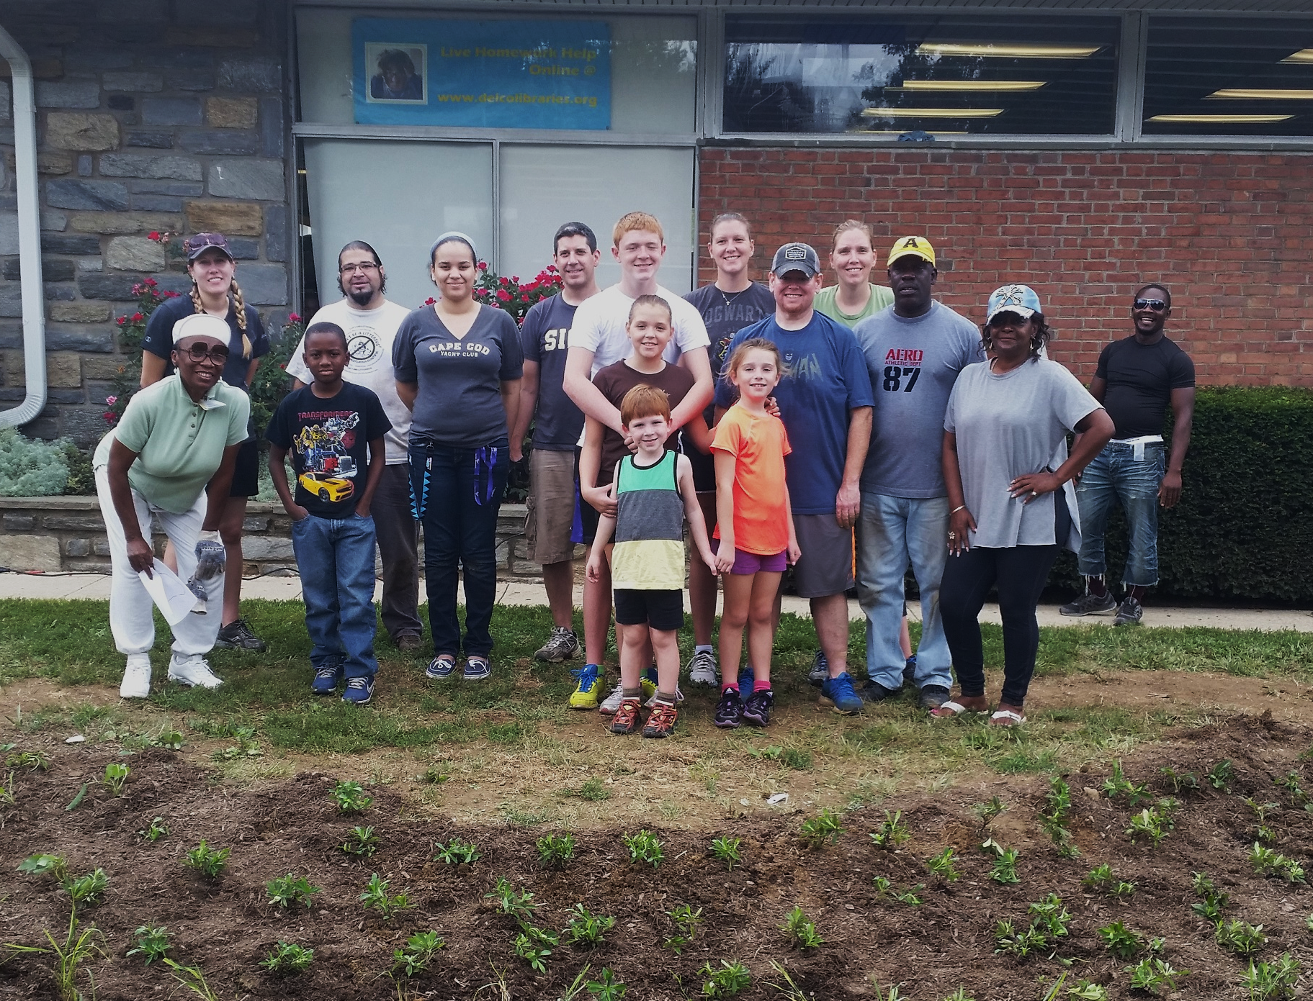
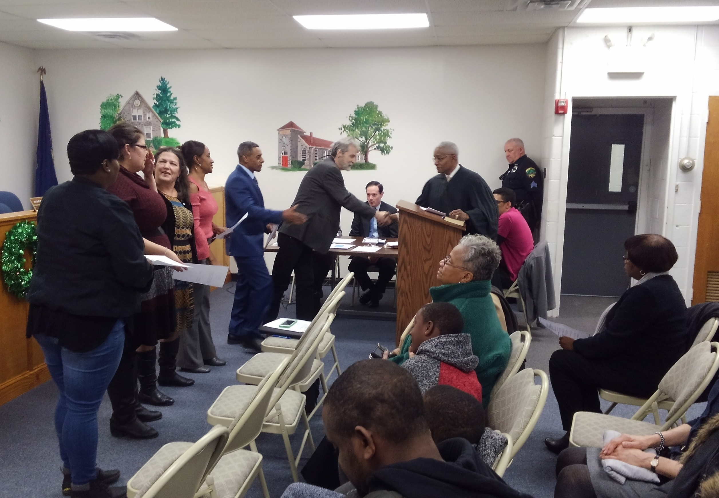
Creating Enthusiasm Among Residents & Officials
Notes:
These initiatives bring together local leaders and residents of all ages, building support for good watershed stewardship while helping to address MS4 requirements through deployment of small-scale, low-cost GSI installations, ultimately across a large number of properties.
With EDCSC’s multi-municipal approach to MS4 planning and implementation it fosters effective cooperation and leverages efficiencies to manage cost to taxpayers.

Slide 19
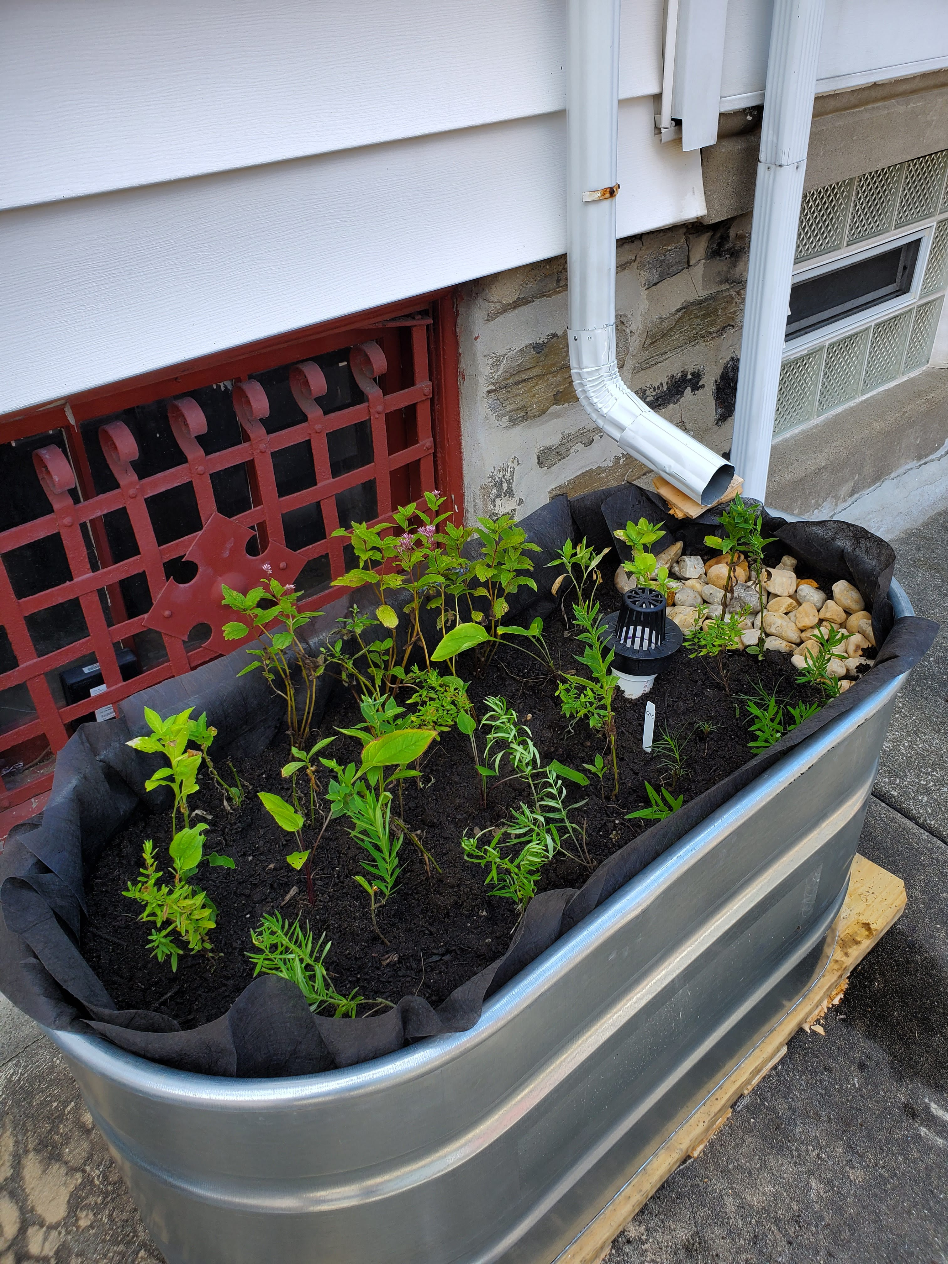
Outcomes to Date
50 Workshops
1600 rain barrels distributed
82 Private property rain gardens
16 Public property rain gardens
11 Flow through planters installed
300+ Stream Smart Audits
Nearly 1 acre of rain gardens created
2 Community rain garden teams developed
Expanded Stream Smart House Calls regionally
25,000 lbs of sediment reduction annually
Over 30,000,000 gallons of prevented annually
Notes:
Missing data from other partners, most of these numbers are even higher!
50 Workshops
1600 rain barrels distributed
82 Private property rain gardens
16 Public property rain gardens
11 Flow through planters installed
300+ Stream Smart Audits
Nearly 1 acre of rain gardens created
2 Community rain garden teams developed
Expanded Stream Smart House Calls regionally
25,000 lbs of sediment reduction annually
Over 30,000,000 gallons of prevented annually

Slide 20
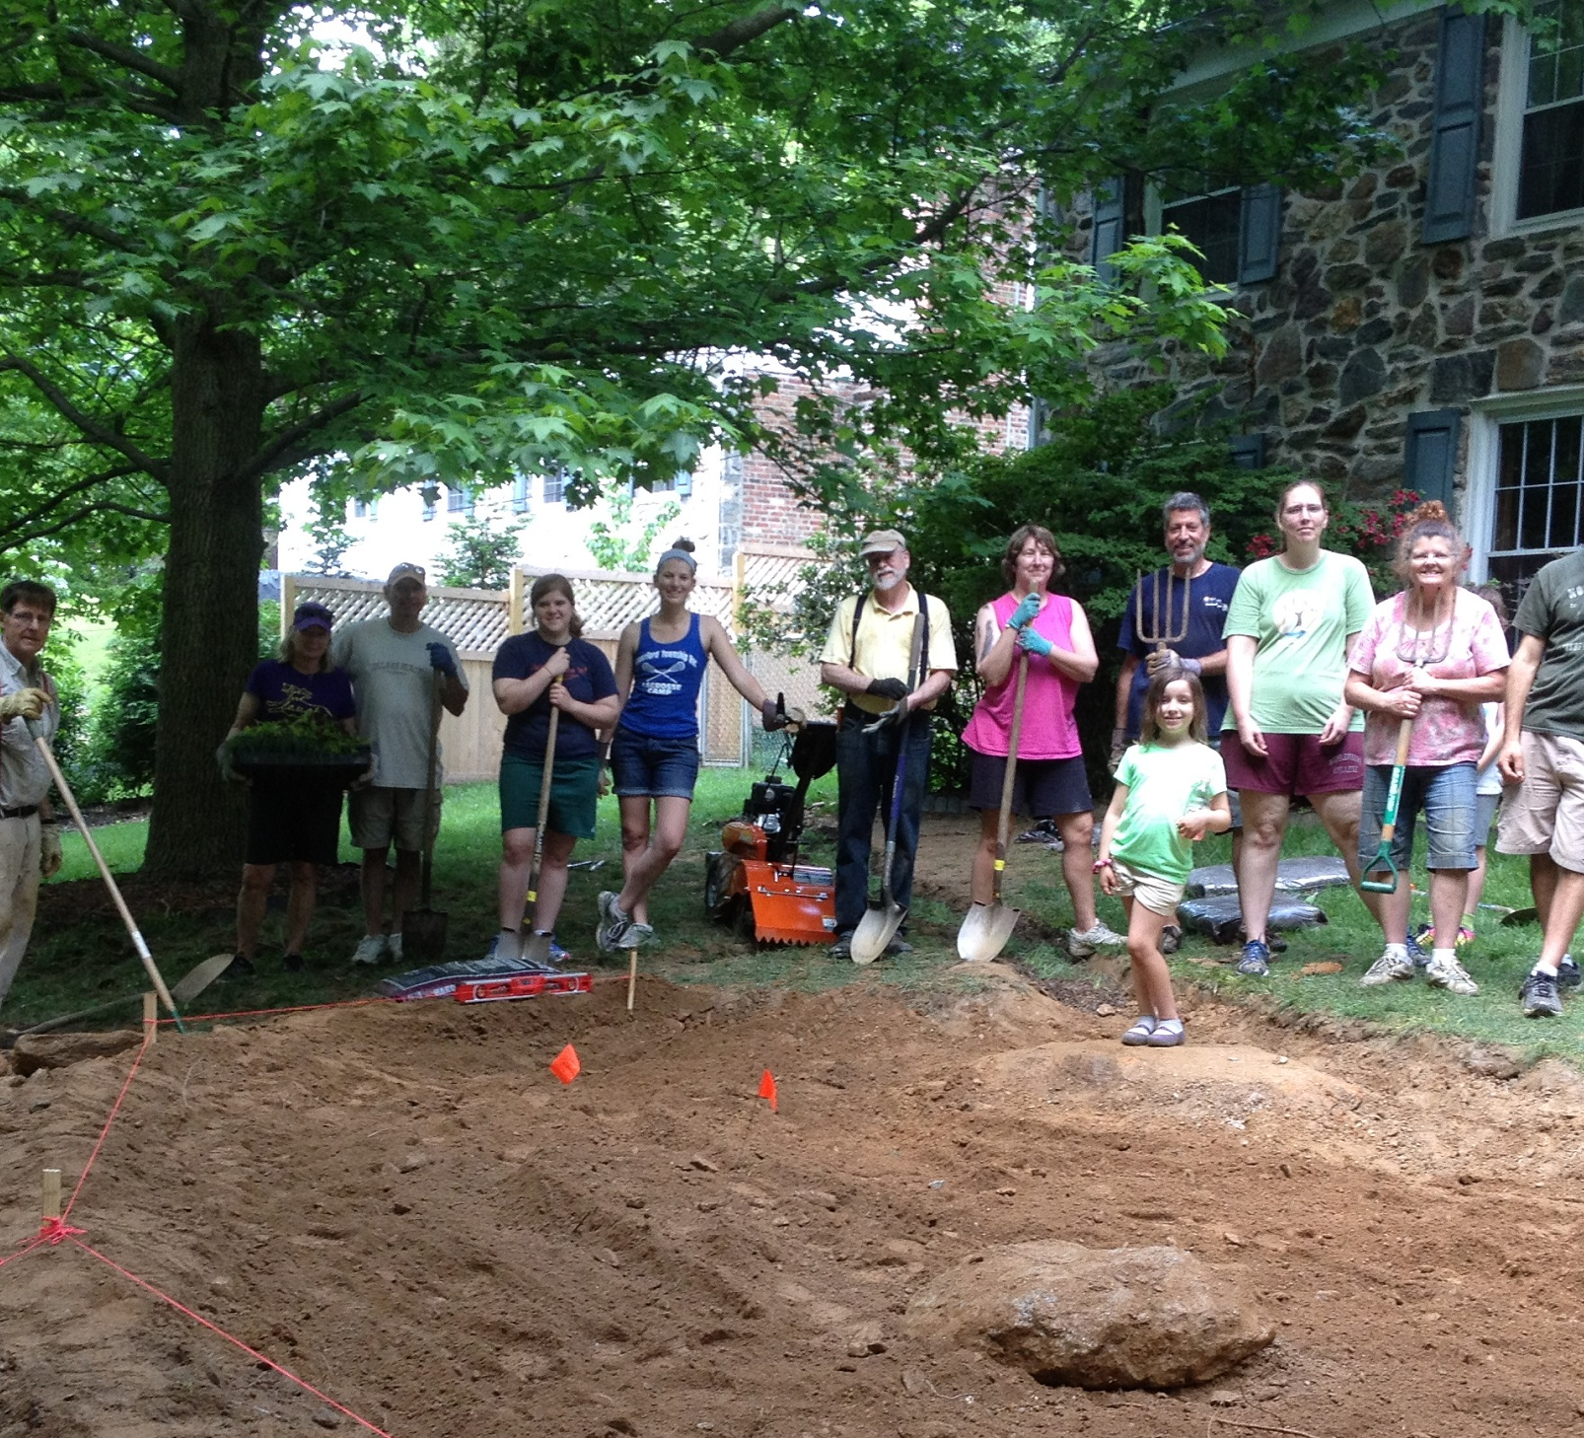
Next Steps
Build Capacity
Streamline Programs under Growing Greener Communities Umbrella
Create Apprenticeship Program
Rain Gardens in Eastwick
Create Educational Website
Notes:
- Build Capacity to Continue expand the program
- Streamline the different programs under Growing Greener Communities Umbrella
- Create Apprenticeship program train others rain gardens & GSI – create more community rain garden teams
- Rain Gardens in Eastwick section of Philadelphia
- Develop a Growing Greener Communities Website
The website will include instructional videos, guidance on training volunteers, assessing properties, infiltration testing, sizing gardens, plant selection, garden installation, and operation and maintenance. The goal is to have a website that provides a replicable model other organizations use to implement similar community-based rain garden or small scale GSI programs in other portions of the Delaware River watershed and beyond.
The website will also be an excellent resource for residents and other individuals interested in GSI and different landscaping techniques

Slide 21


Questions
Contact
Diana Andrejczak
andrejczak@prc.org
610-353-1555 ext. 2
Notes:
Thank you for joining our session today. We'd like to address any questions at this time.

