Slide 1

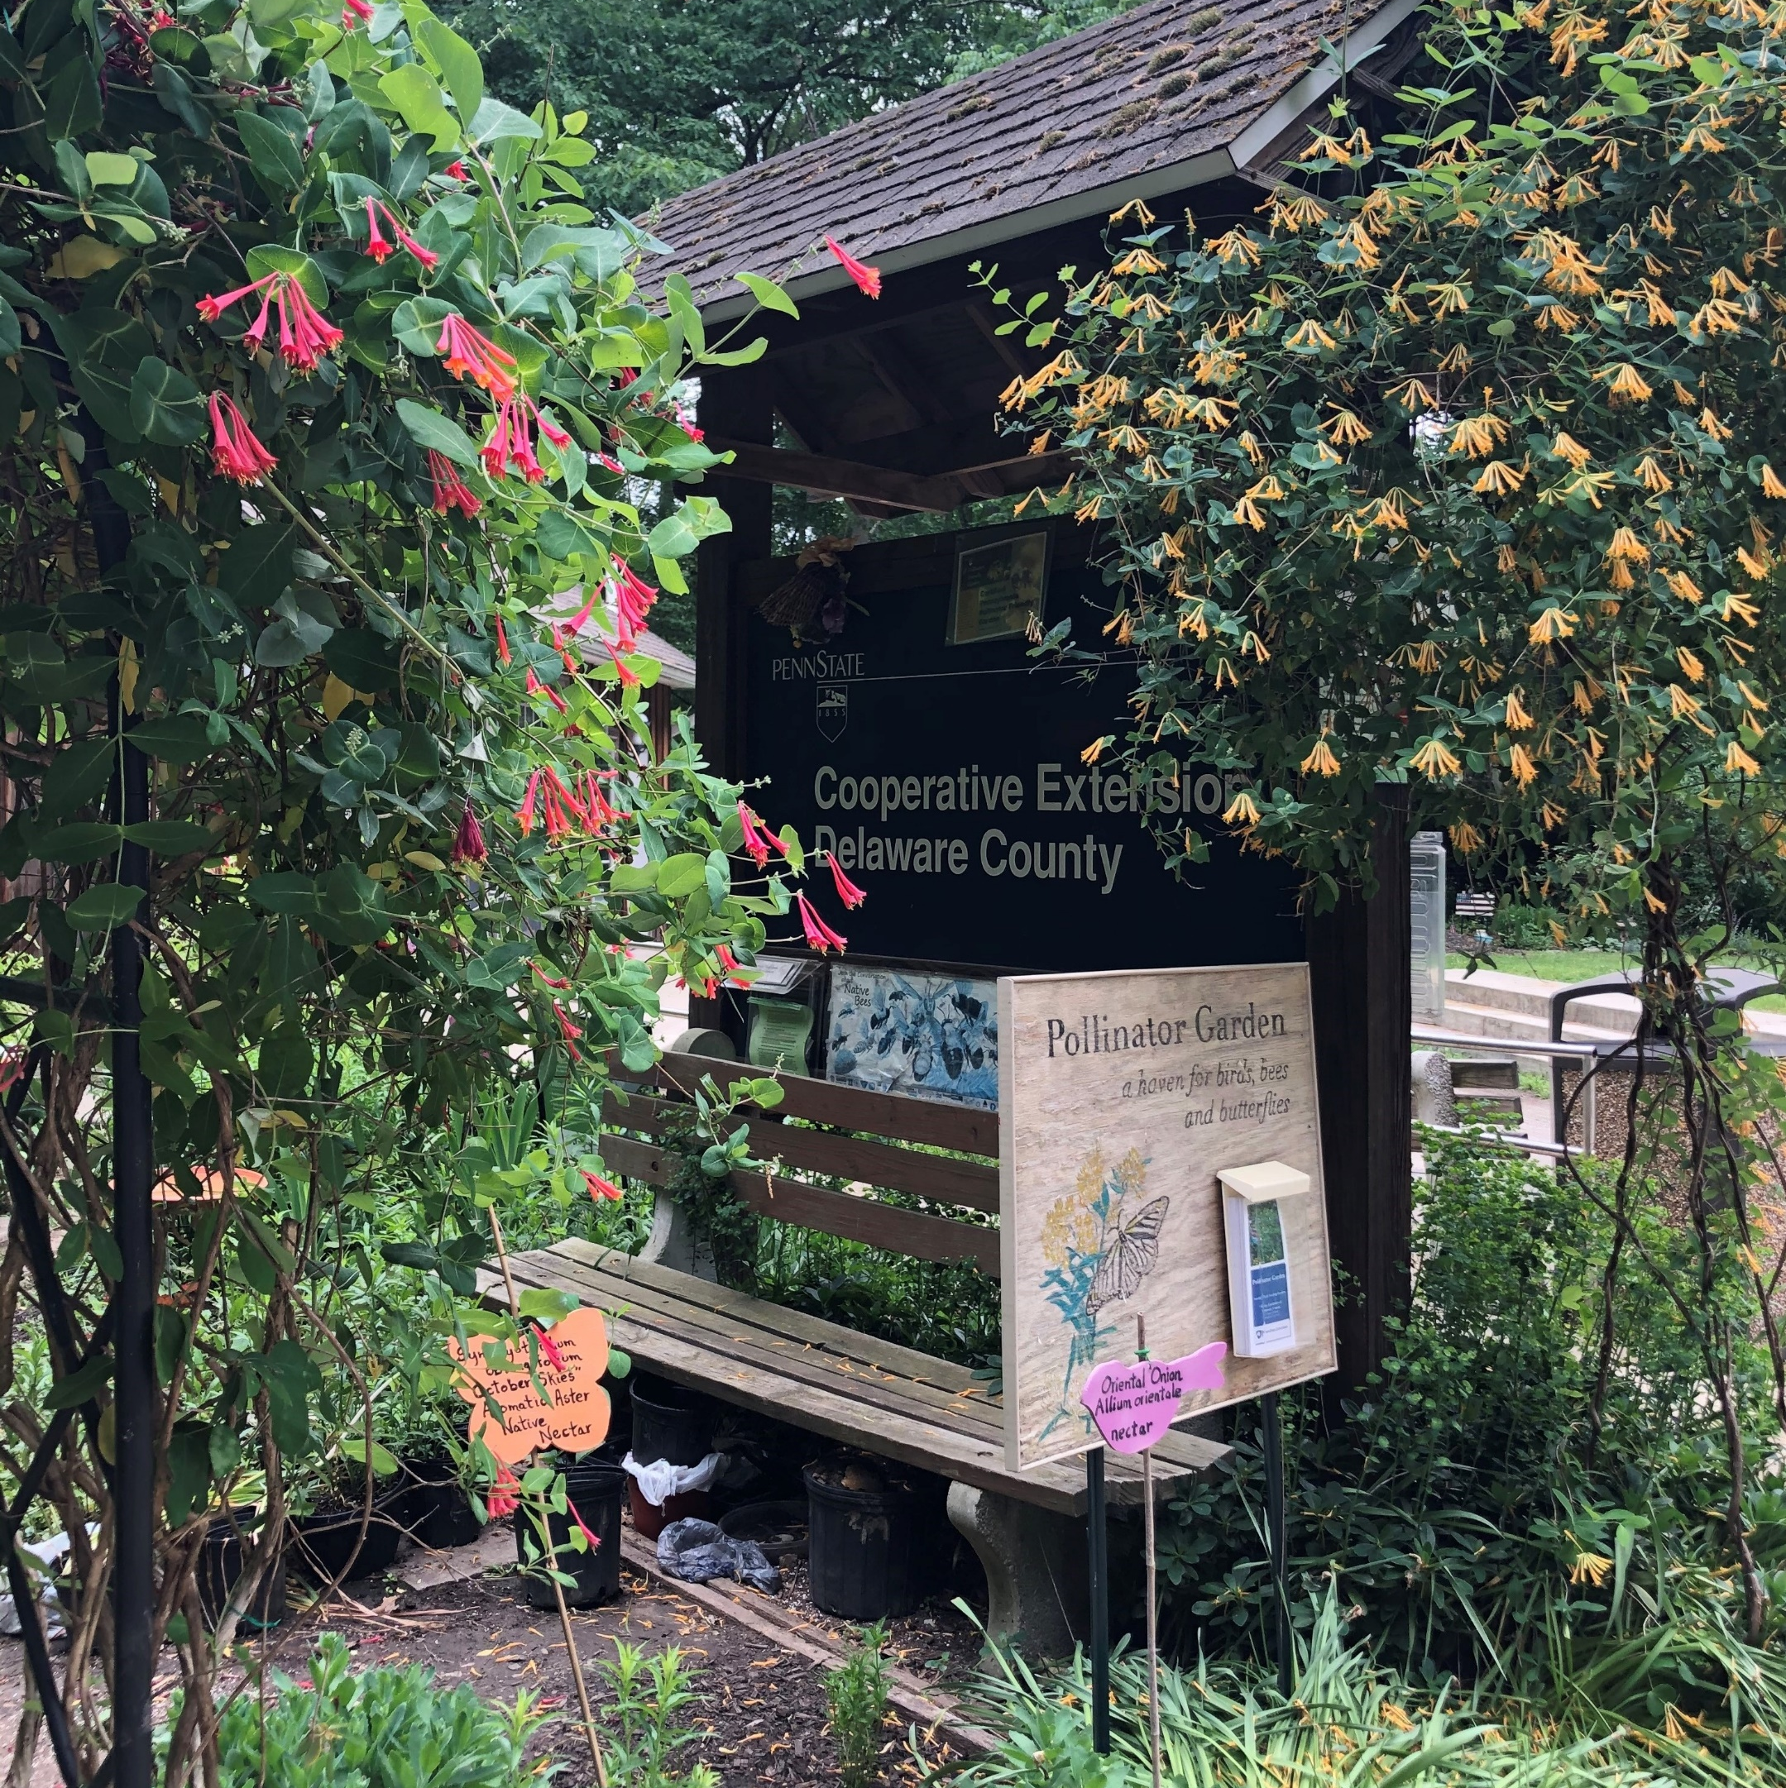

Pollinator Friendly Yards
Penn State Extension Master Gardeners of Delaware County
Smedley Park
20 Paper Mill Road
Springfield, PA 19064
Holly Thorpe, Coordinator
610-690-7669
hat5041@psu.edu
Notes:
My name is Holly Thorpe. I am the Master Gardener Coordinator in Delaware County. I will be introducing you to the master gardener program and our efforts to contribute to the county’s sustainability.

Slide 2
We believe that all people should have access to science-based education.
Notes:
Penn State Extension believes that…

Slide 3
What and who are Penn State Master Gardeners?
The Penn State Master Gardener volunteer program supports the outreach mission of Penn State Extension by utilizing unbiased research-based information to educate the public and our communities on best practices in sustainable horticulture and environmental stewardship.
Notes:
The Master Gardener program in Delaware County is made up of over 150 volunteers . Last year, despite the pandemic, our volunteers contributed nearly 9000 hours of volunteer time to helping promote sustainability. What do we do?

Slide 4
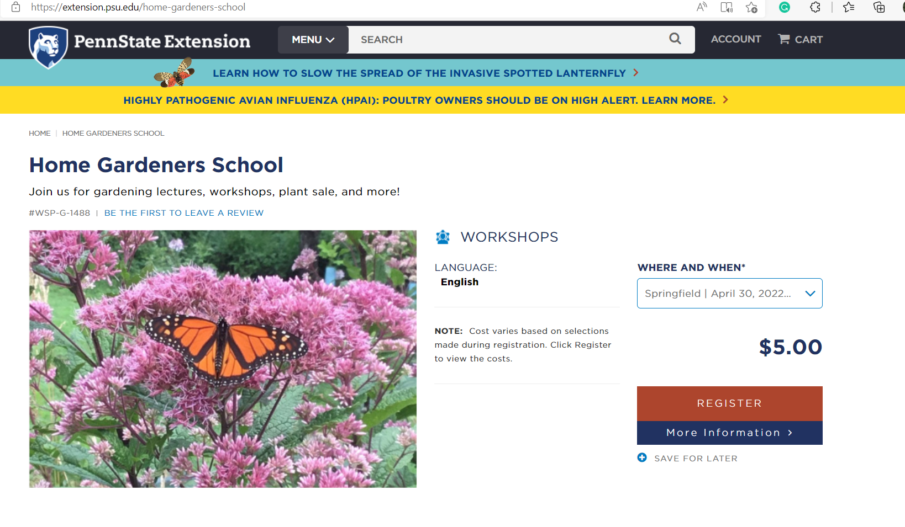
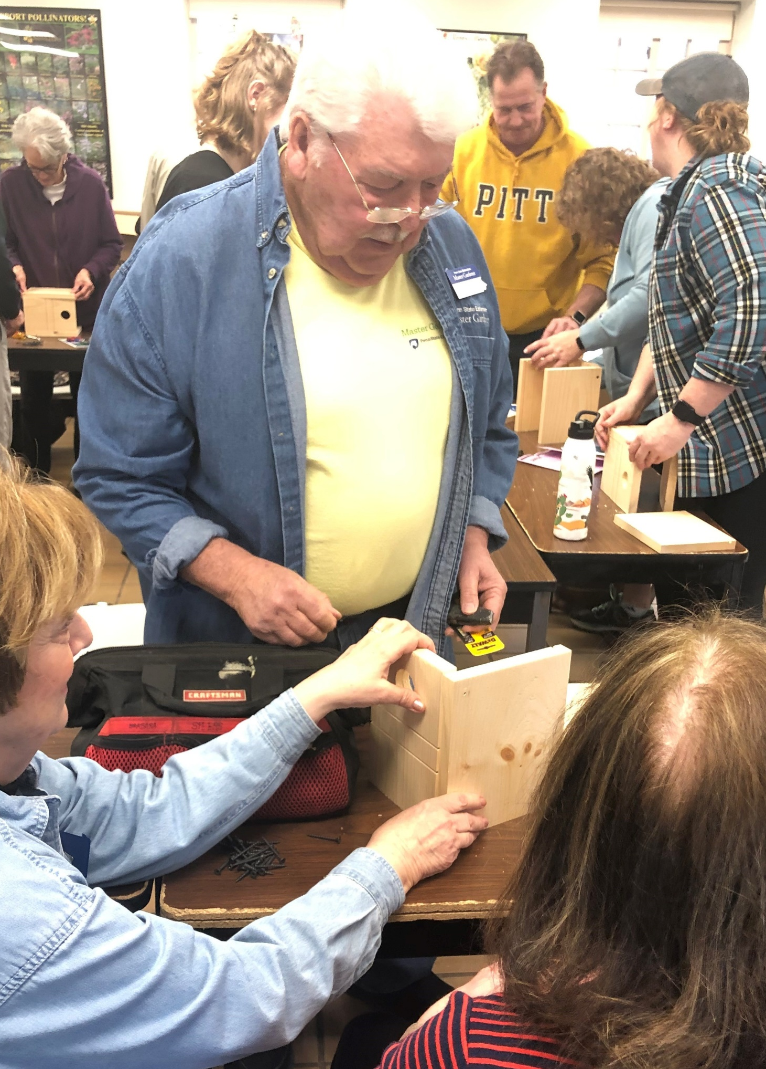
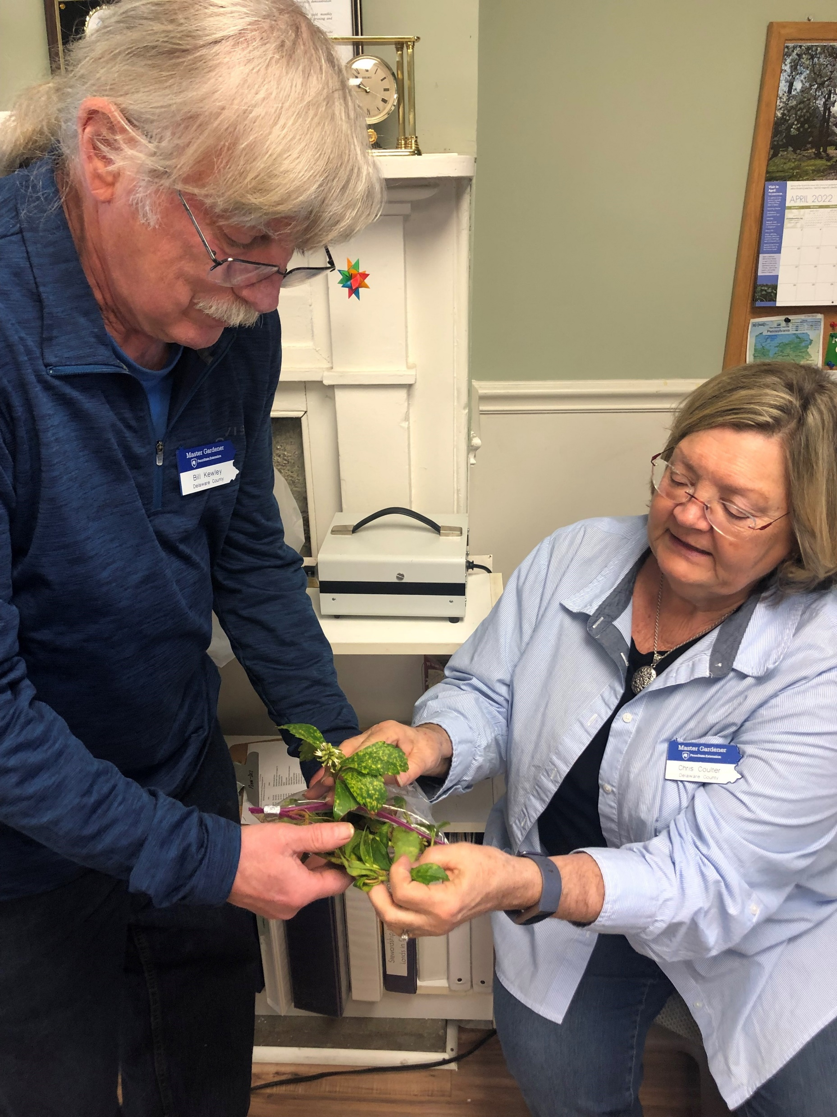
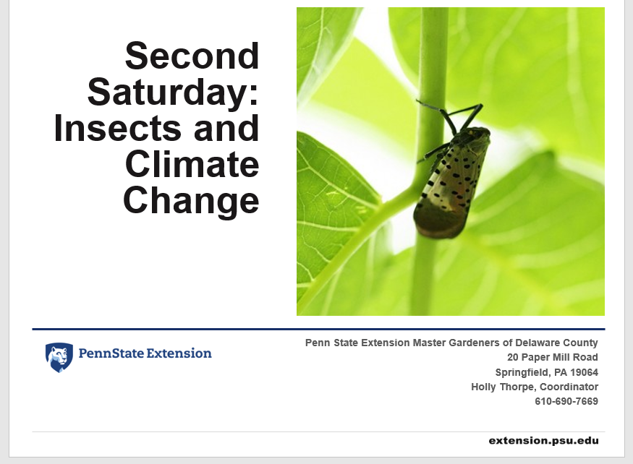
Garden Hotline
Speakers Bureau
Master Gardener Programs:
Notes:
17 volunteers staff the Garden Hotline on Tuesdays and Thursdays from 10-1. Last year they spent over 156 hours answering questions about garden planning, insects, weeds, plant identification, plant health and spotted lanternfly.
Our Speakers Bureau volunteers give Talks to local community groups, libraries and garden clubs. We staff information tables at events and host virtual Second Saturday presentations. This month we hosted Dr. Mark Boudreau who talked about insects and climate change. We host Spring and Fall garden symposiums. We are making preparations for next Saturday’s Home Gardeners School which features lectures by local gardening experts, workshops and a plant sale. We’ll be at Smedley Park from 9 to 2:30 on Saturday, April 30.

Slide 5
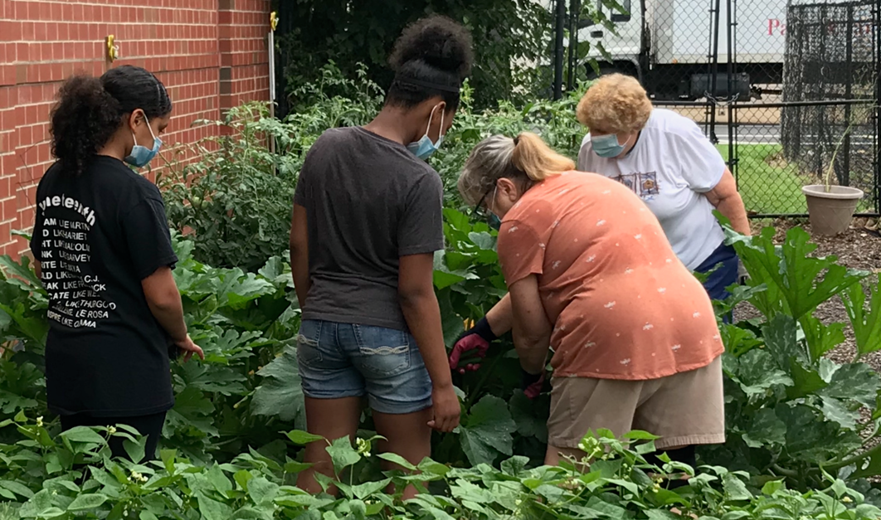
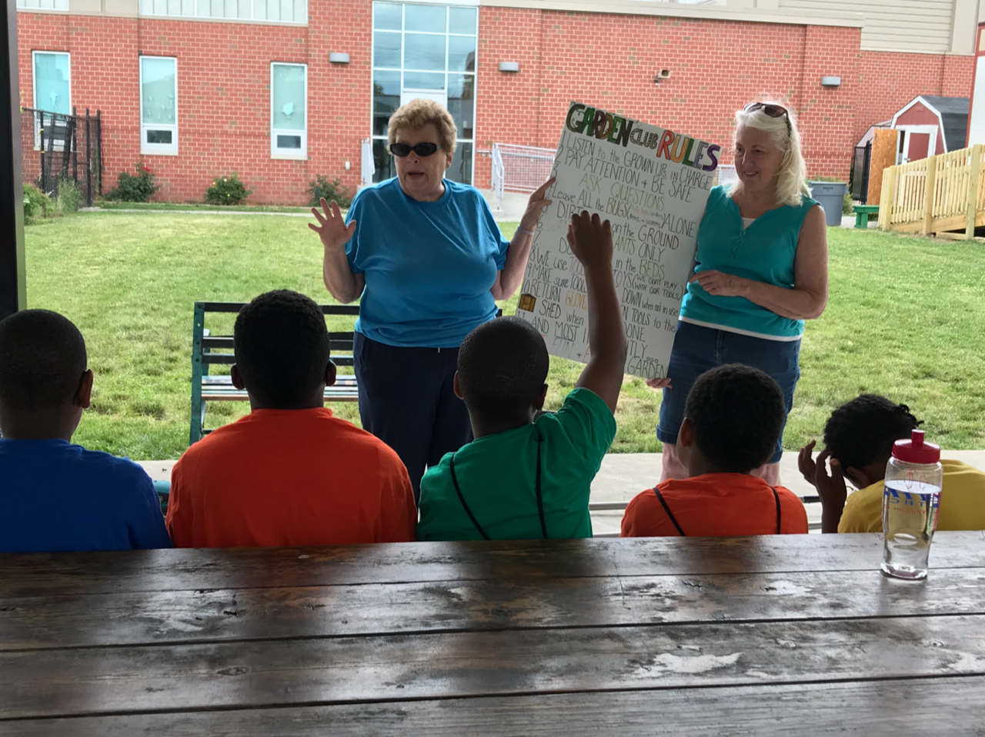
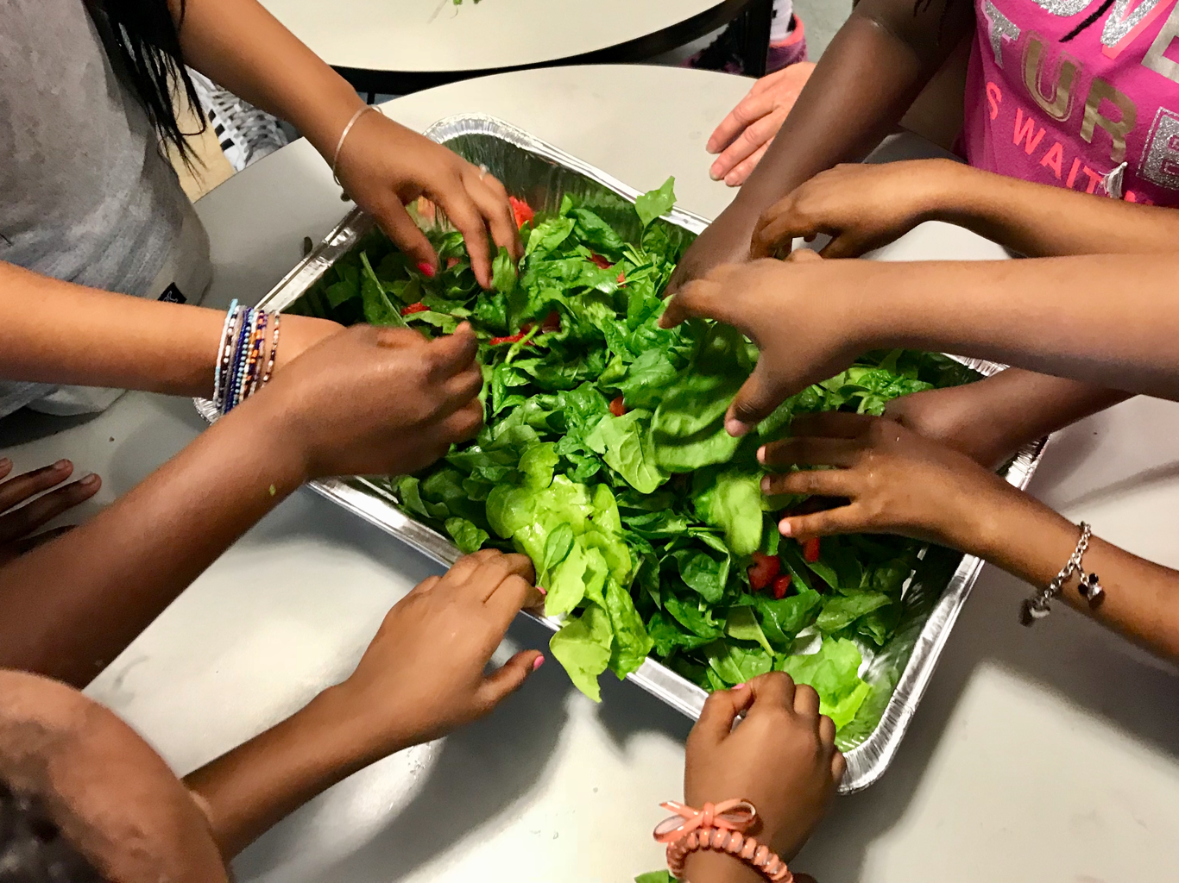
In the Community: Boys and Girls Club of Chester
Master Gardener Programs:
Notes:
Our volunteers plant and maintain 26 garden beds at the Boys and Girls Club of Chester. They teach the after school and summer camp children about gardening, nutrition and pollination. Nearly 2000 pounds of fresh produce was donated last year.

Slide 6
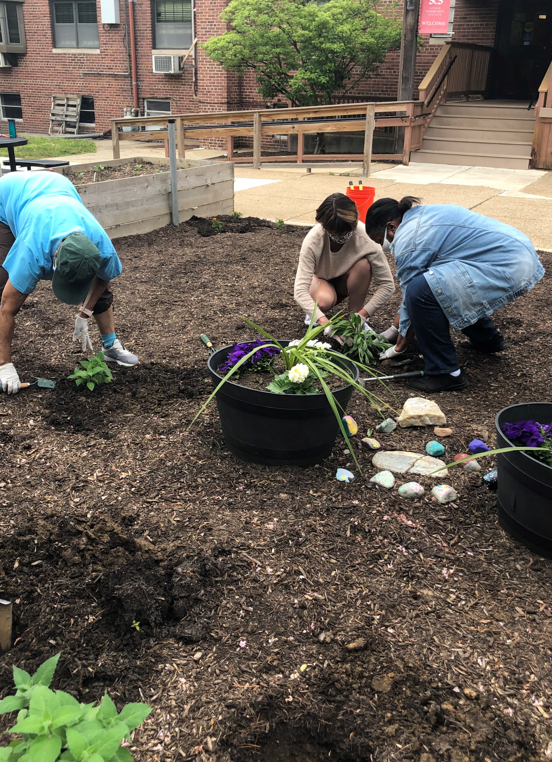
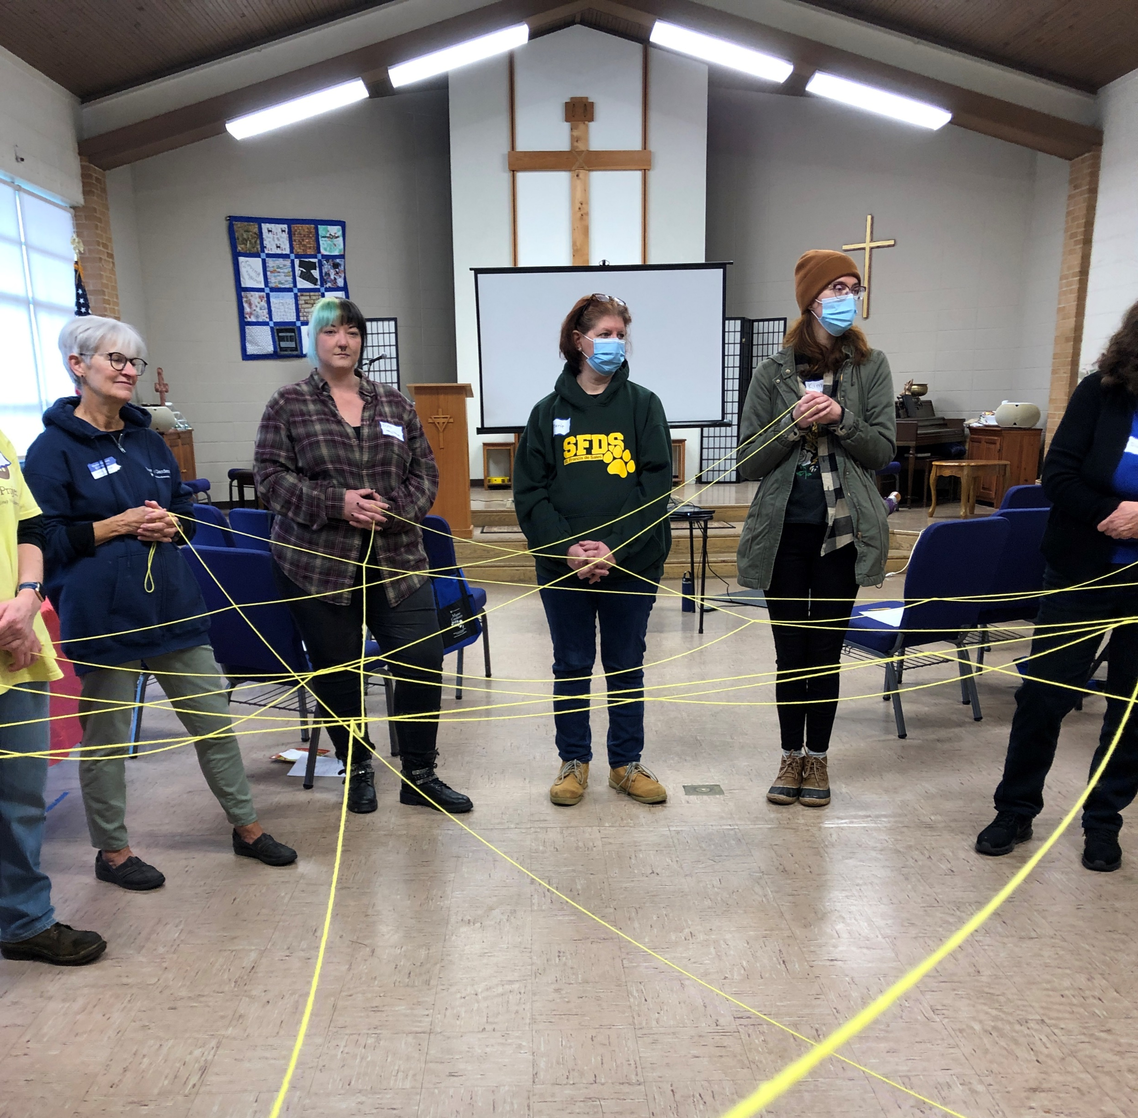
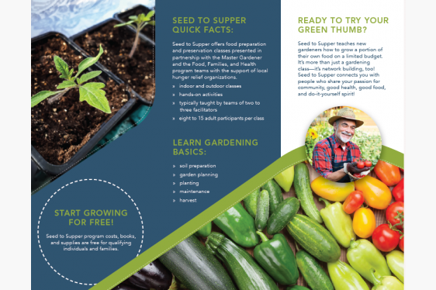
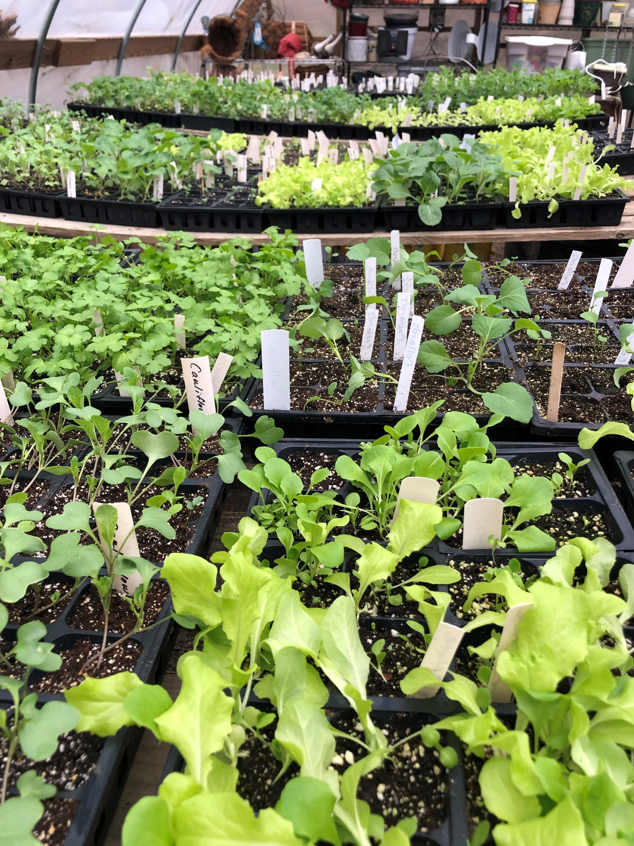
Seed to Supper and
Seed Starting
Master Gardener Programs:
Notes:
Our volunteers plant cool and warm season vegetables and donate them to local senior centers and organizations working with food insecure populations. We’ve donated plants to the gardens at Friendship Circle Senior Center, Chester Eastside Community Garden, Loaves and Fishes, the Brandywine Sustainable Garden at Penn State Brandywine and the DELCO Food Project. A new program that we are excited about is Seed to Supper. We are partnering with the DELCO Food Project to offer the new Program which teaches vegetable gardening basics to low-income gardeners. The course covers everything from preparing your soil, choosing plants, integrated pest management, harvesting and nutrition.

Slide 7
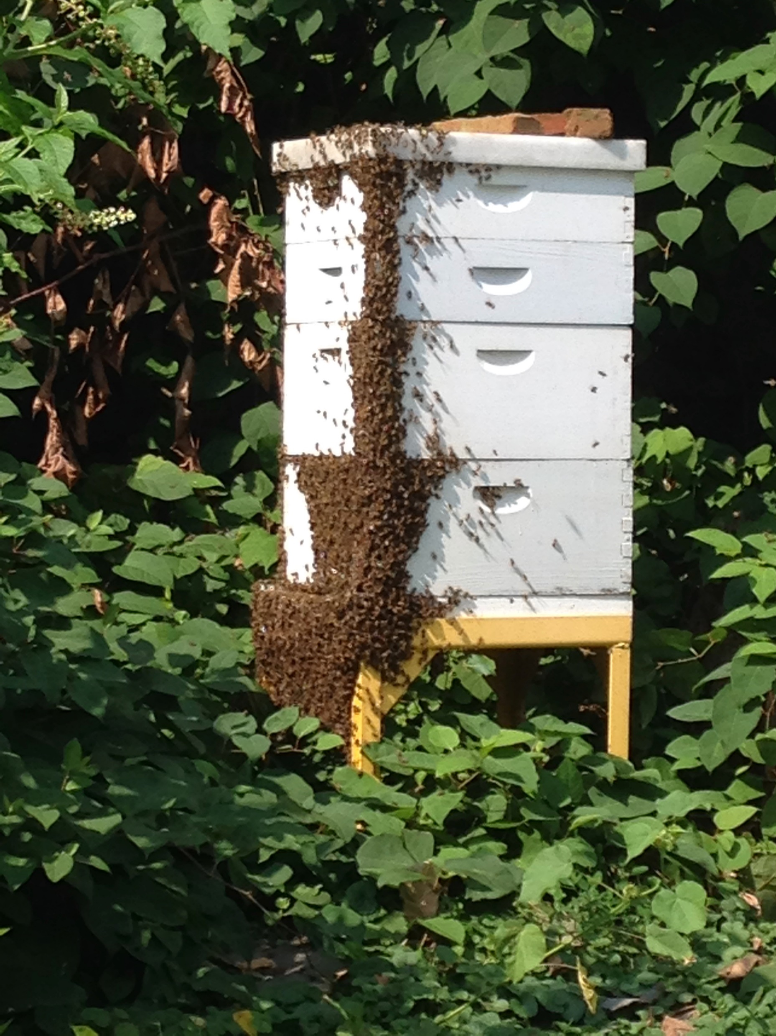

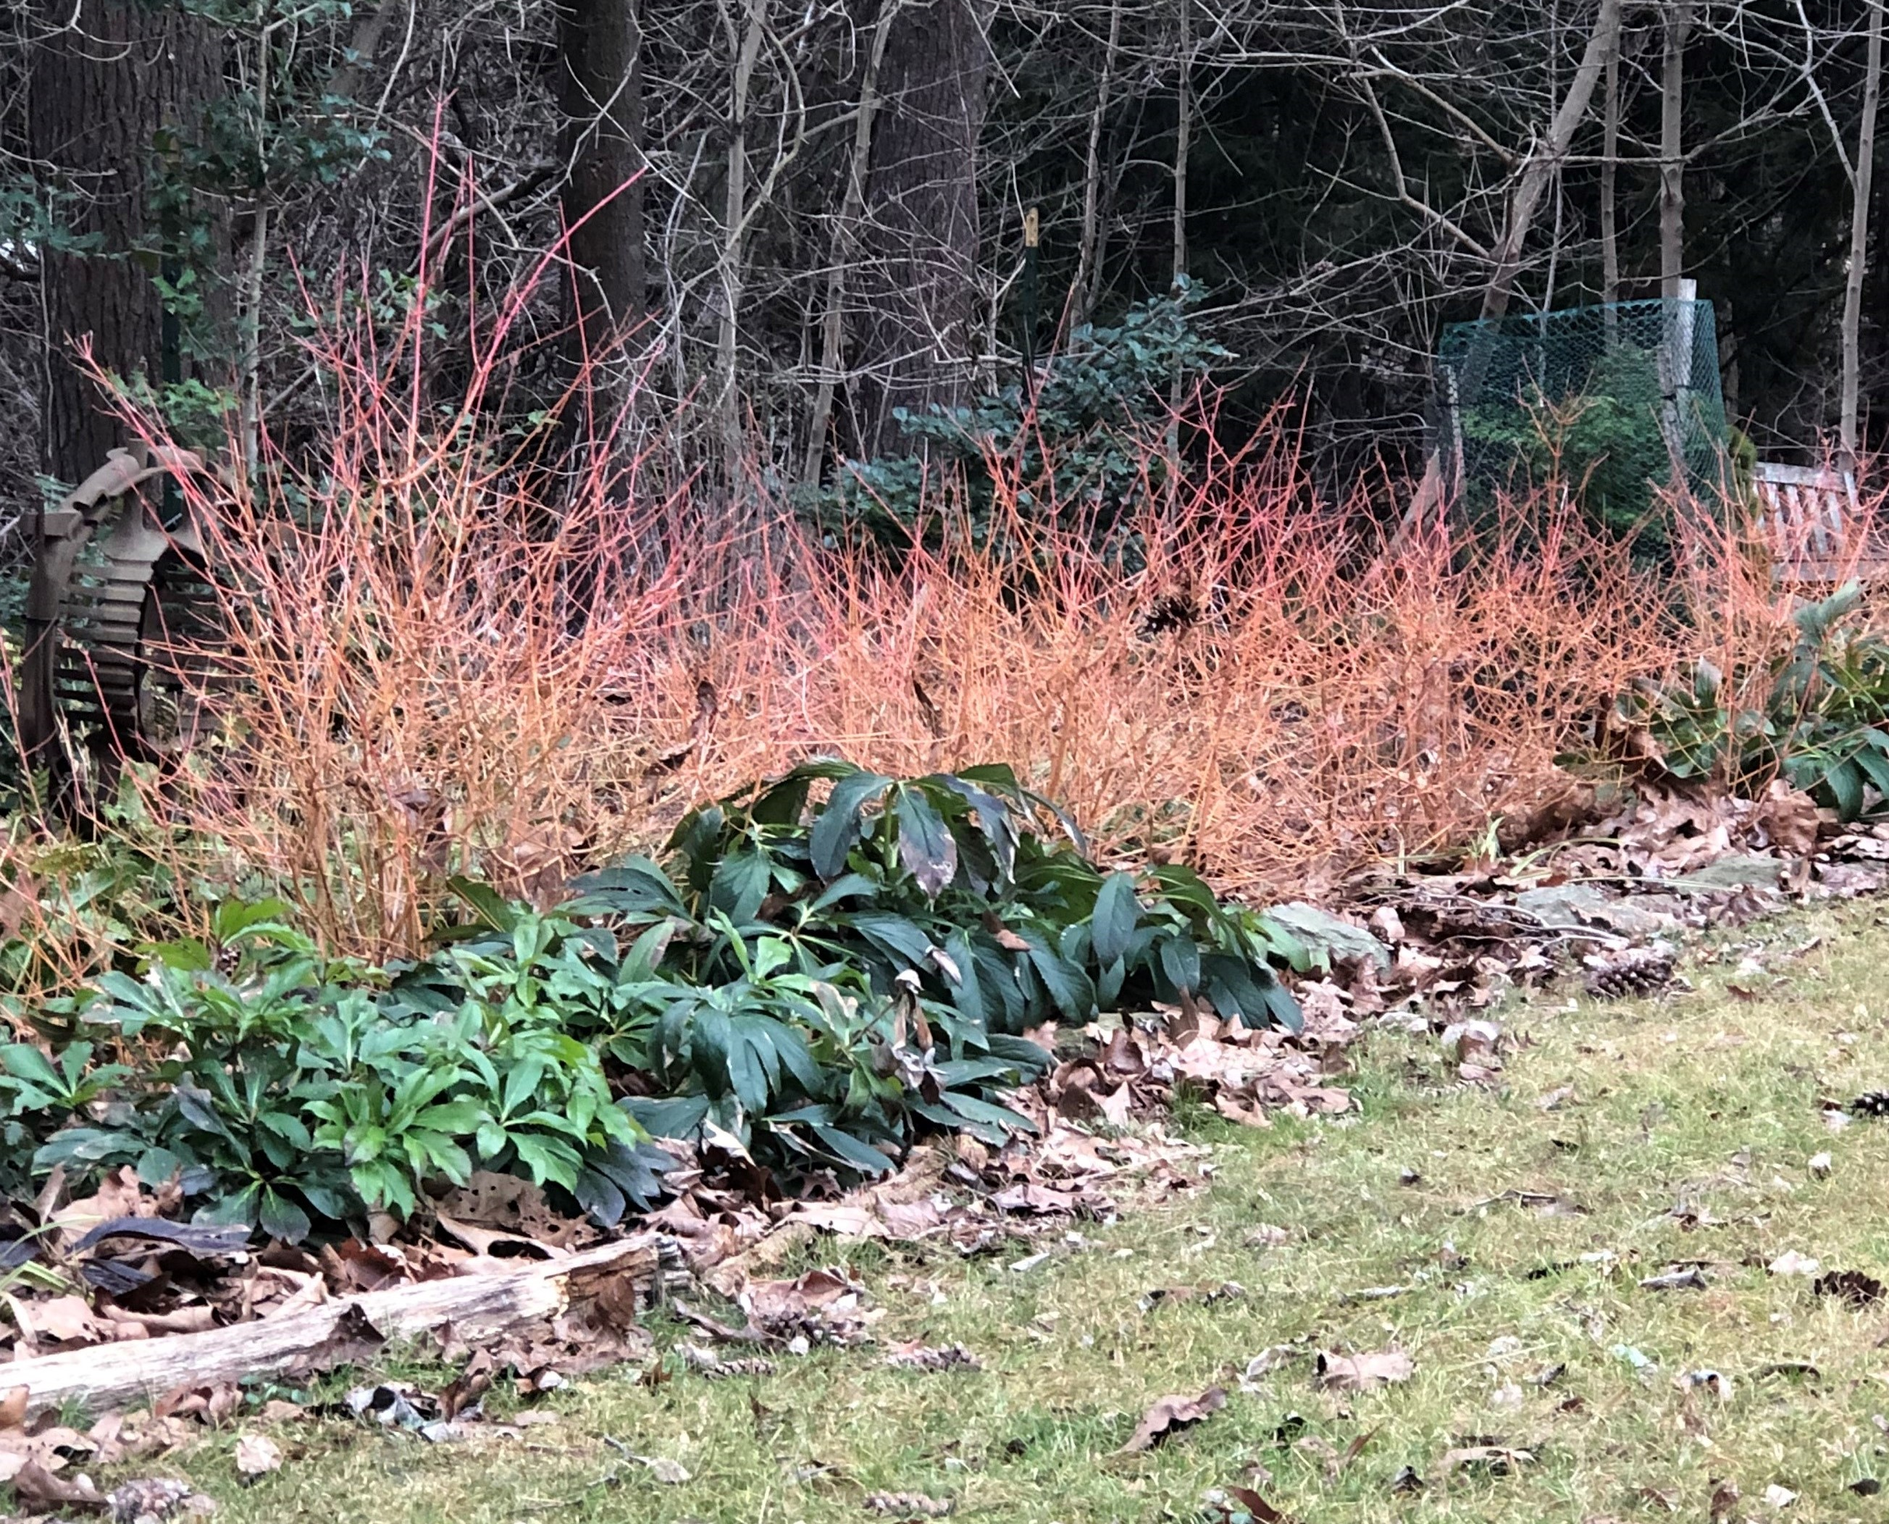
Teaching Gardens
Master Gardener Programs:
Notes:
We maintain demonstration gardens across the county in Smedley Park, The Grange in Havertown including maintaining the bee hives, Nitre Hall in Haverford Township, and the Brandywine Sustainable Garden at Penn State Brandywine.

Slide 8
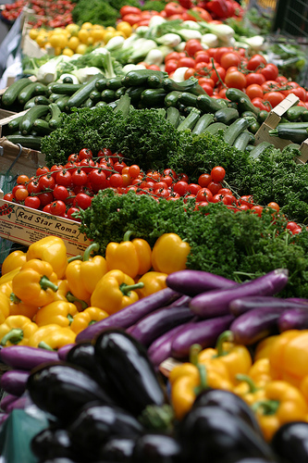
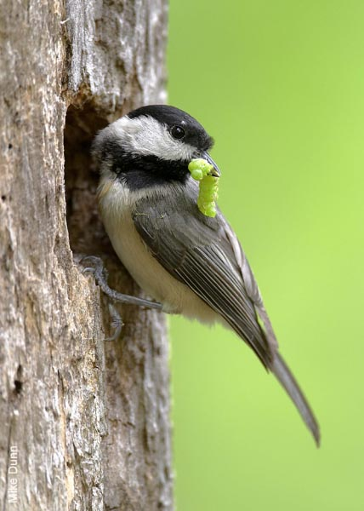
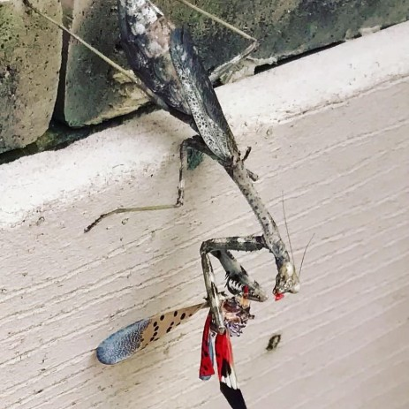
Education
Master Gardener Programs:
Why a Pollinator Friendly Yard?
1 of every 3 bites of food comes to us from pollinators
Birds and wildlife depend on the seeds and fruits of pollinated plants
Birds depend on caterpillars to feed their young
Predatory insects help manage pest populations
Image courtesy Heather O’Malley
Notes:
It is through our programs that we are able to teach Delaware County residents about sustainability through encouraging pollinator friendly yards. Many of us know about honeybees and their importance in growing vegetables. But we also stress the importance of all beneficial insects. Caterpillars are necessary to sustain bird populations and predatory insects are needed to keep pest insects in check.

Slide 9
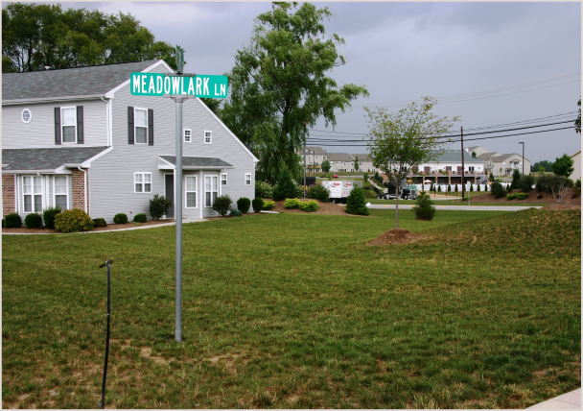
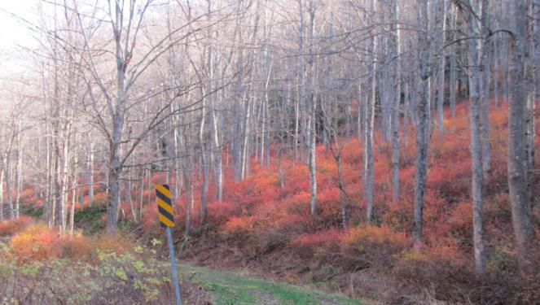
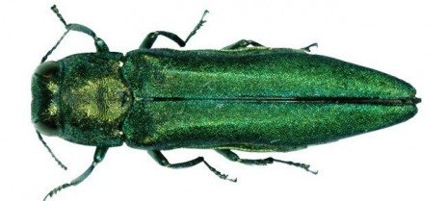
Pollinators are in trouble!
Habitat Loss and Fragmentation
Lack of plant diversity and nesting habitat in our yards
Natural pollinator habitat invaded by introduced species
Pathogens and diseases
Pesticide use
*Photos courtesy Penn State Extension
Notes:
Many suburban lawns are filled with turf grass. We plant ornamentals without regard for their invasive qualities: Bradford pear, Japanese barberry, and burning bush have escaped our yards and are proliferating in the wild. Emerald Ash Borer and Hemlock Wooly Adelgid have destroyed our native trees. Excessive pesticide use creates pesticide resistance.

Slide 10
Old Gardening Trend: Monocultures

Slide 11
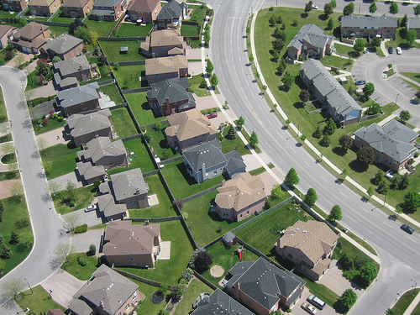
Notes:
This is what a typical neighborhood looks like.

Slide 12
New Gardening Trend: Biodiversity
Notes:
We want to teach the residents of Delaware County to think more about Biodiversity.

Slide 13
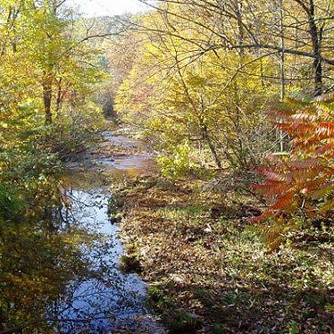
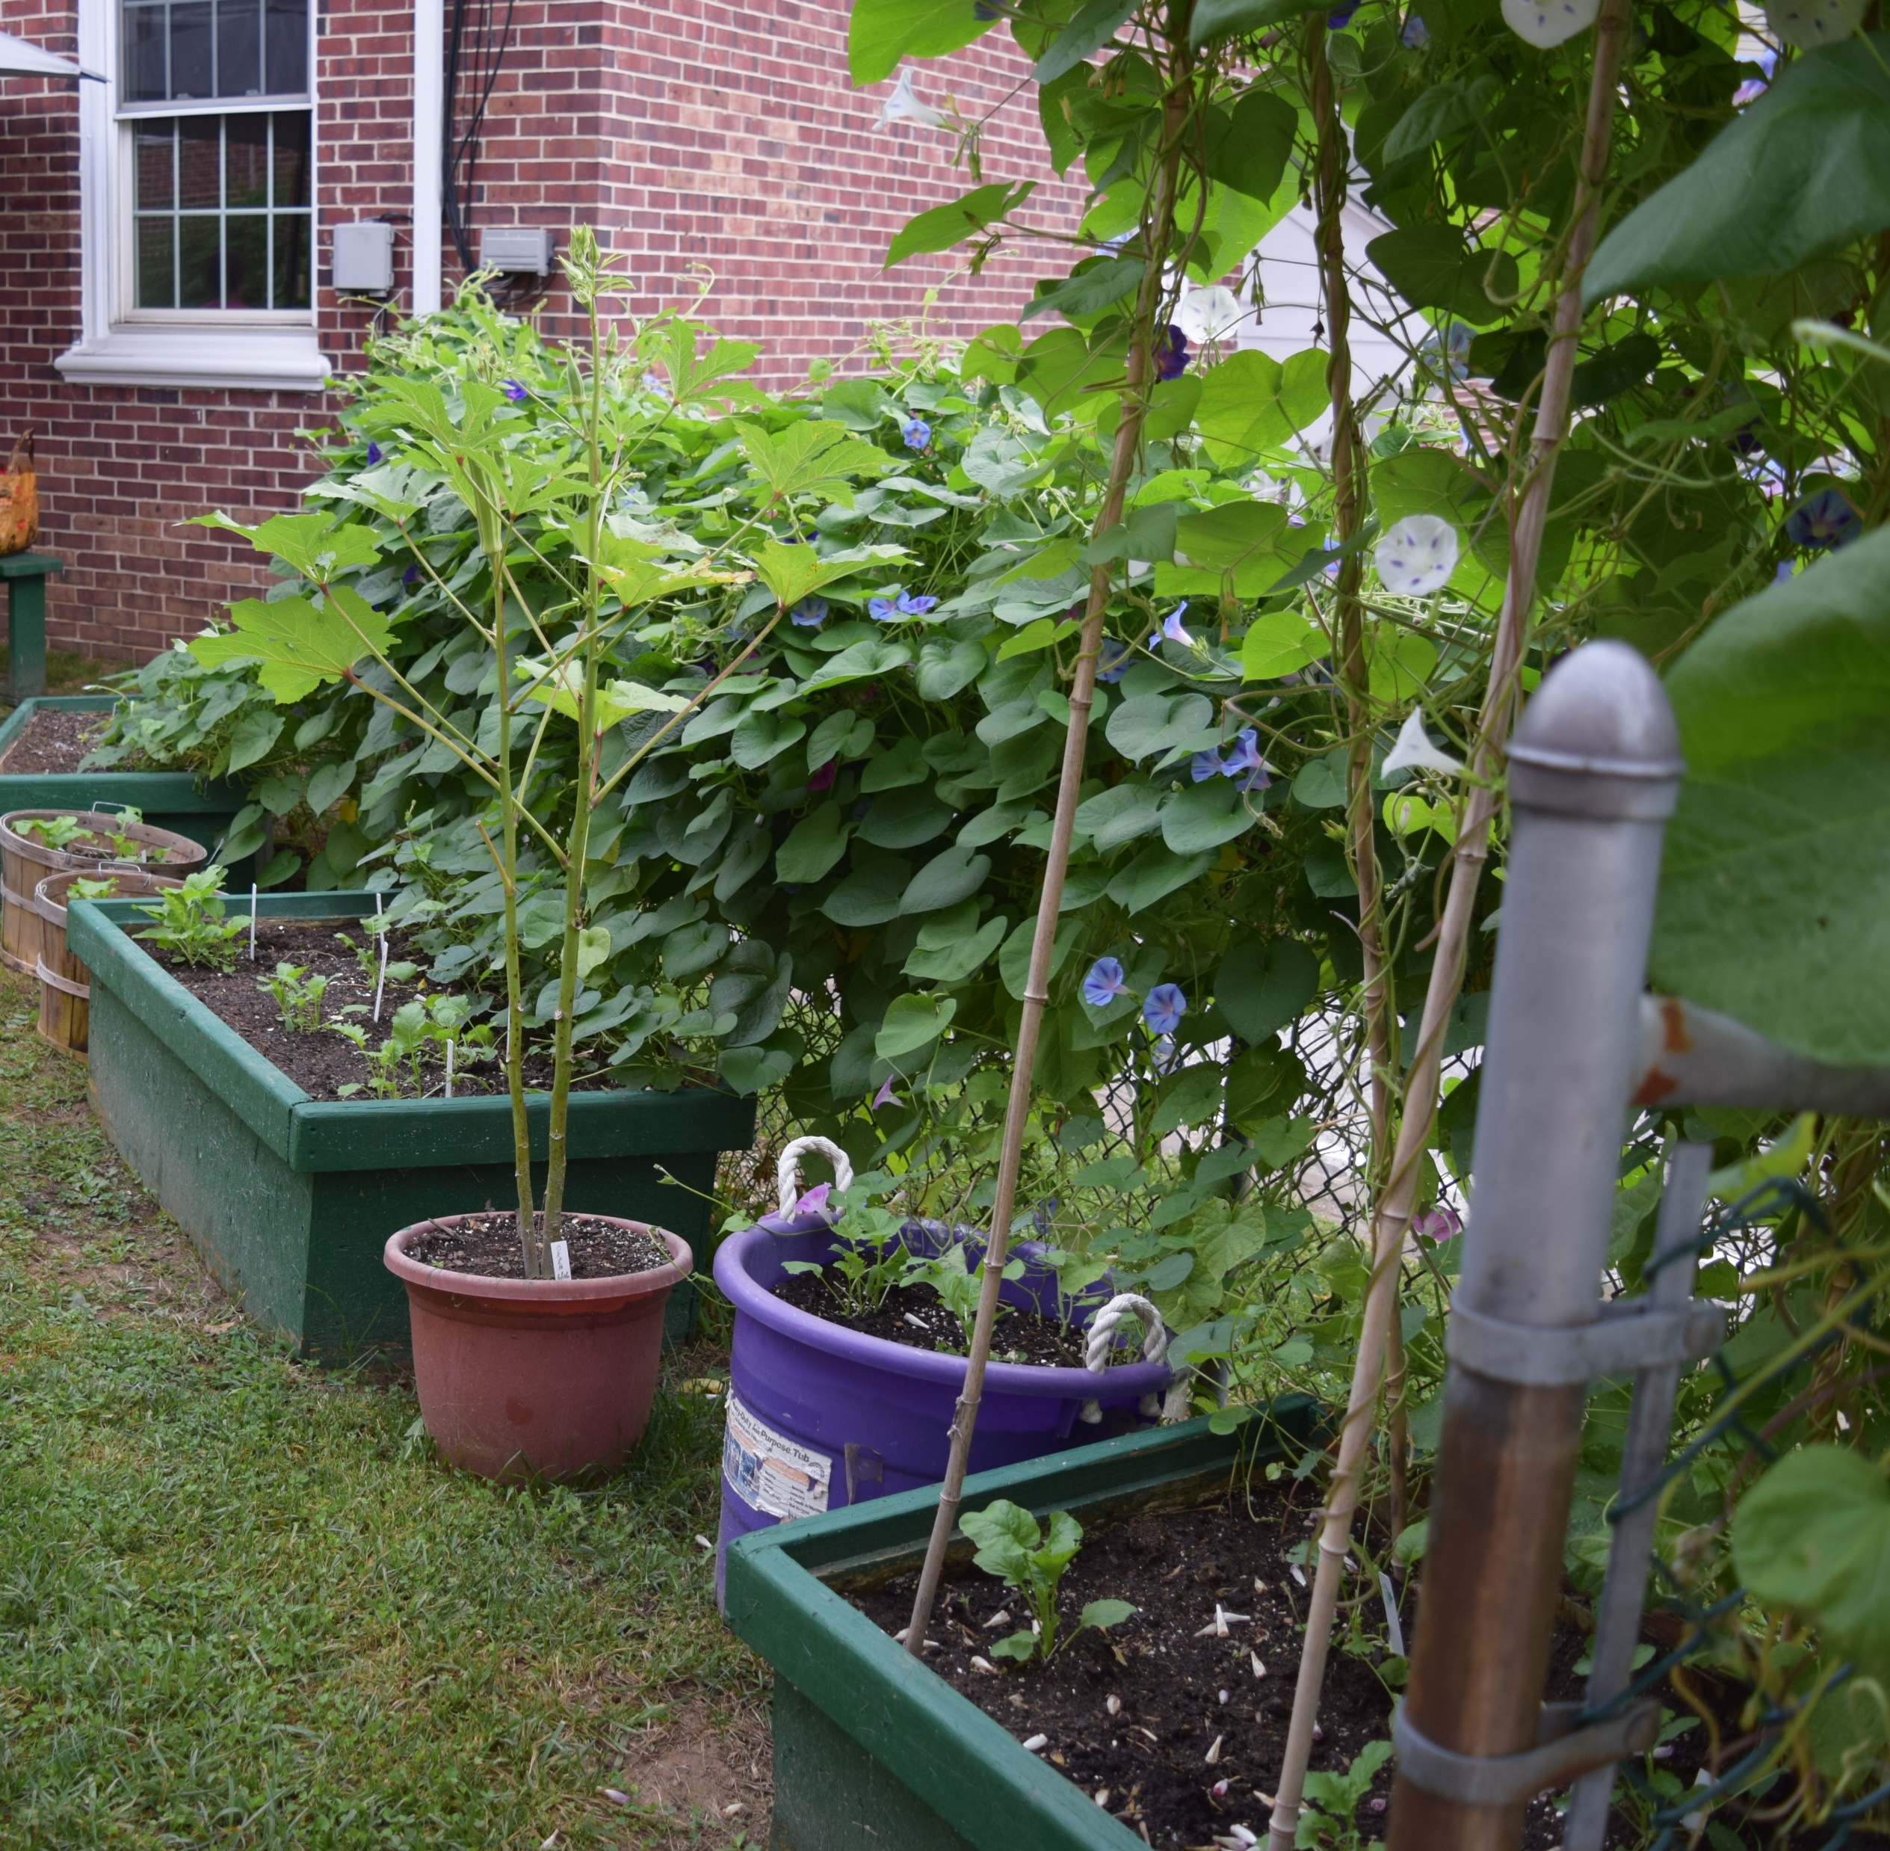
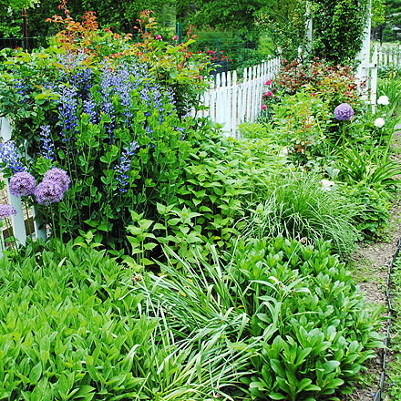
Gardeners can help reverse pollinator decline
Notes:
Gardeners can help reverse pollinator decline, learn how to create healthy soil and cut down on the use of pesticides.

Slide 14
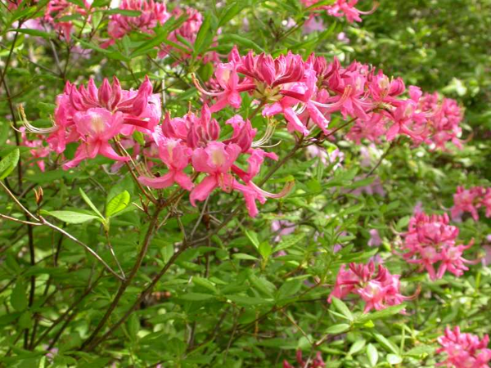
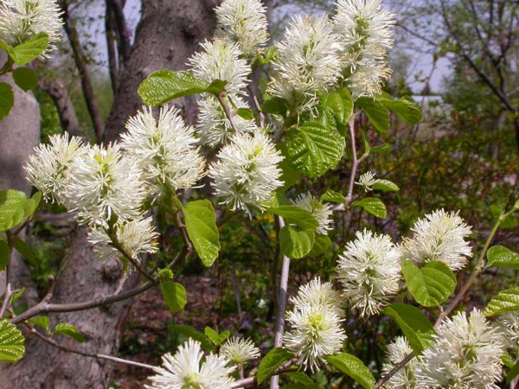
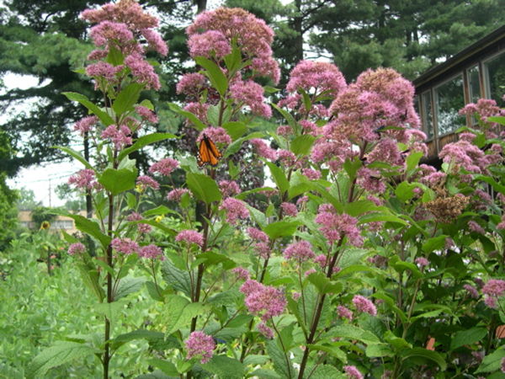
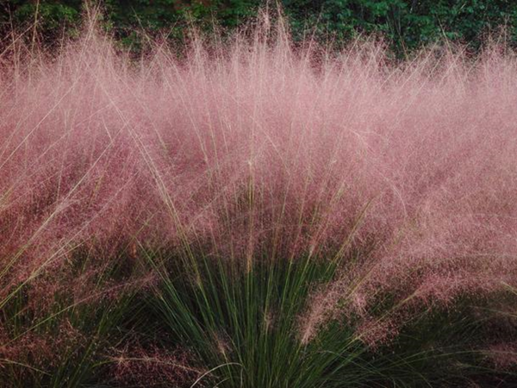
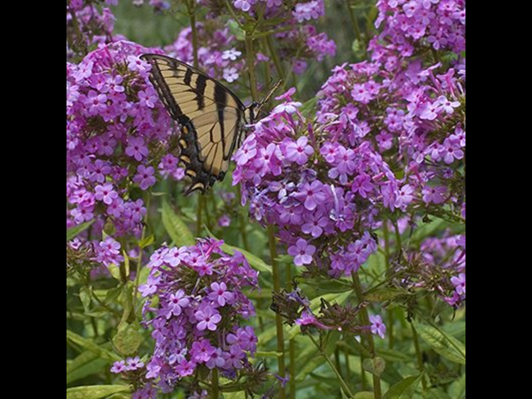
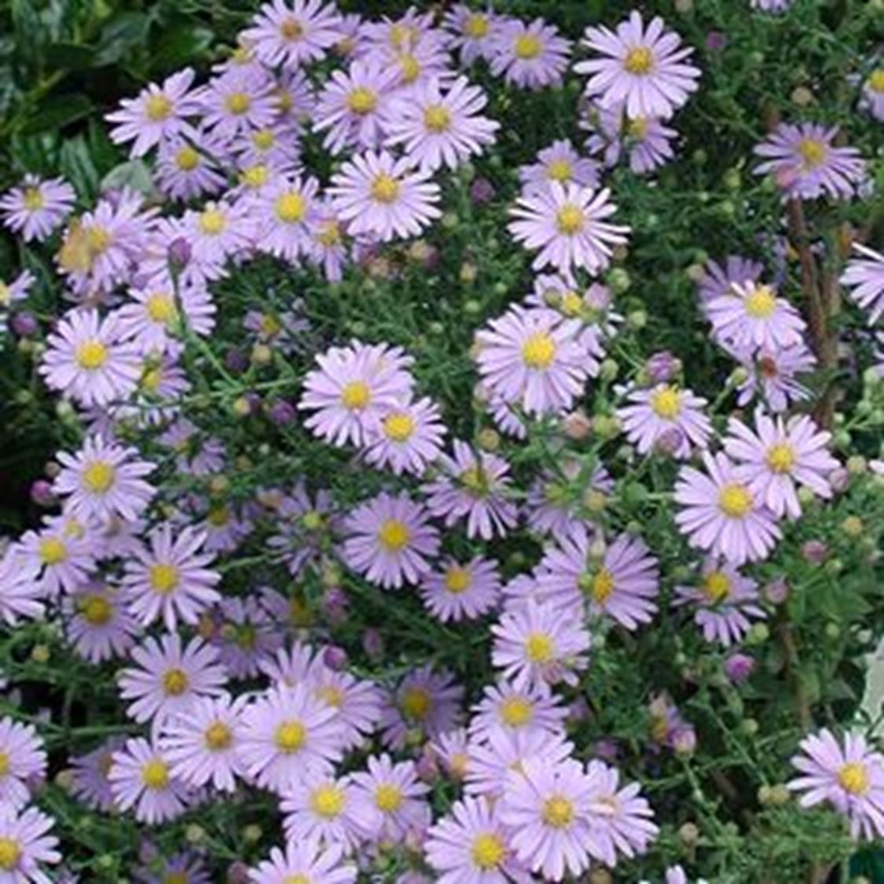
Include more Native Plants
Notes:
One of the best ways to do that is to plant native plants. In his book, Bringing Nature Home, Dr. Doug Tallamy from the University of Delaware encourages us to try to achieve a 70-30 % ratio of natives to non-natives. These plants are already adapted to our climate and have evolved with our native insects.

Slide 15
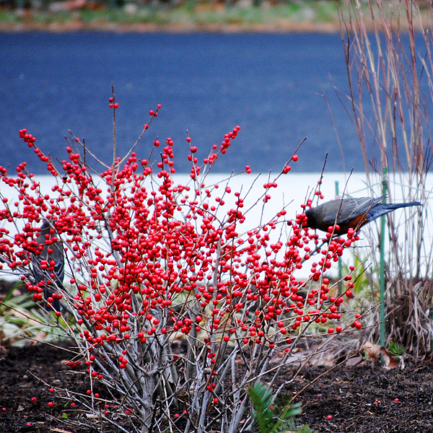
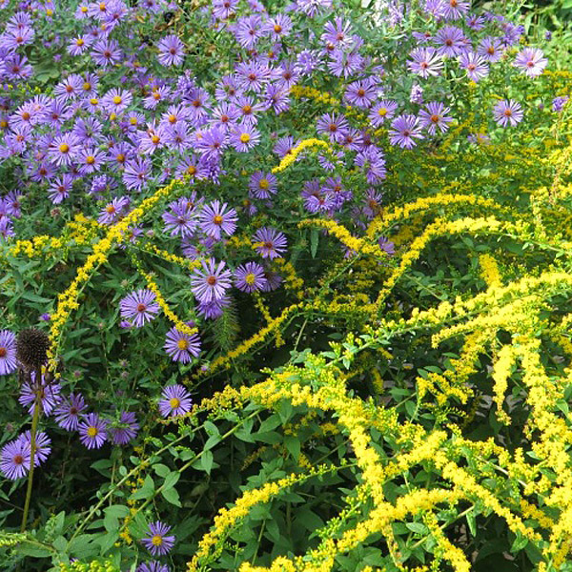
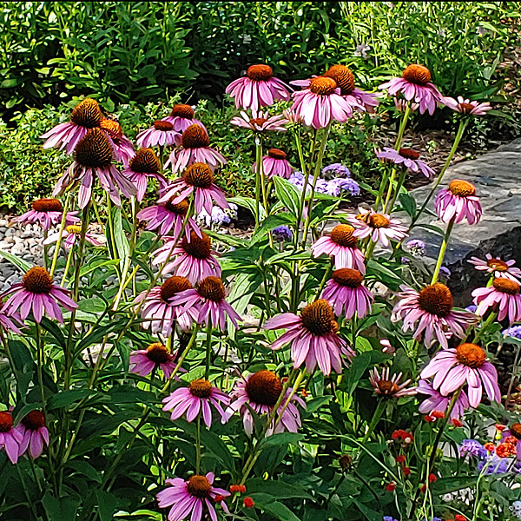
Provide food and nectar
Notes:
As you plan your gardens, you can also think about how it will support wildlife. Winterberries sustain birds through the late winter cold. Native plants provide nectar and food for our native birds, butterflies and insects.

Slide 16
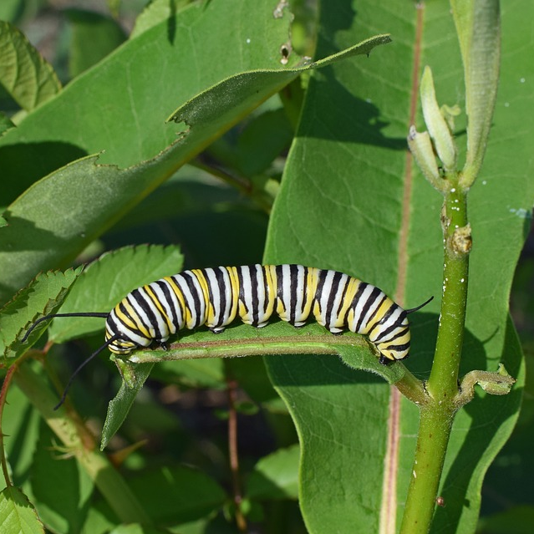
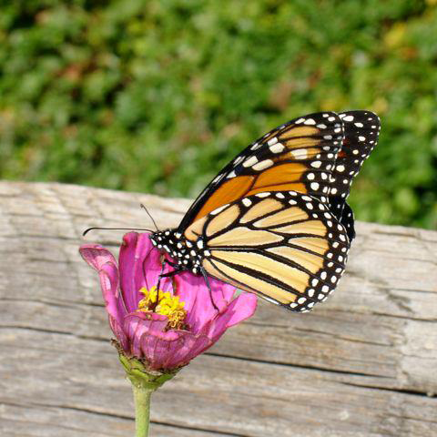
Consider all life stages
Notes:
Oftentimes we only think of providing nectar. It is just as important to provide food. Many insect larvae are specialists. Monarch butterfly larvae can only eat plants in the Asclepias family. Tiger Swallowtail larvae need ash, birch, sweetbay Magnolia and Tulip tree leaves to feed on.

Slide 17
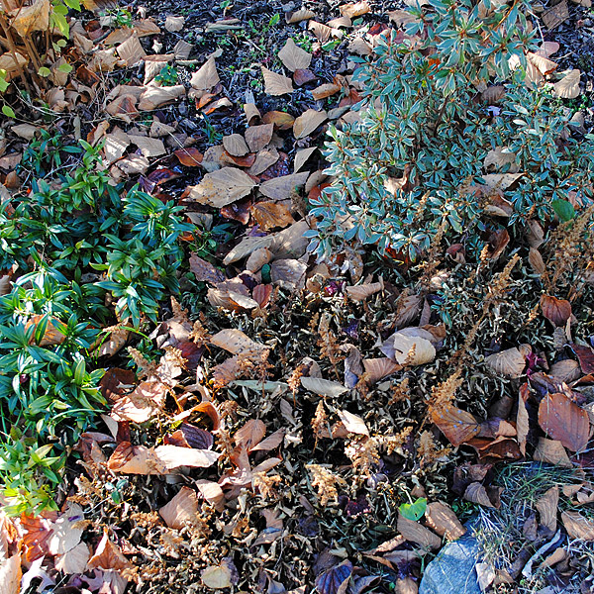
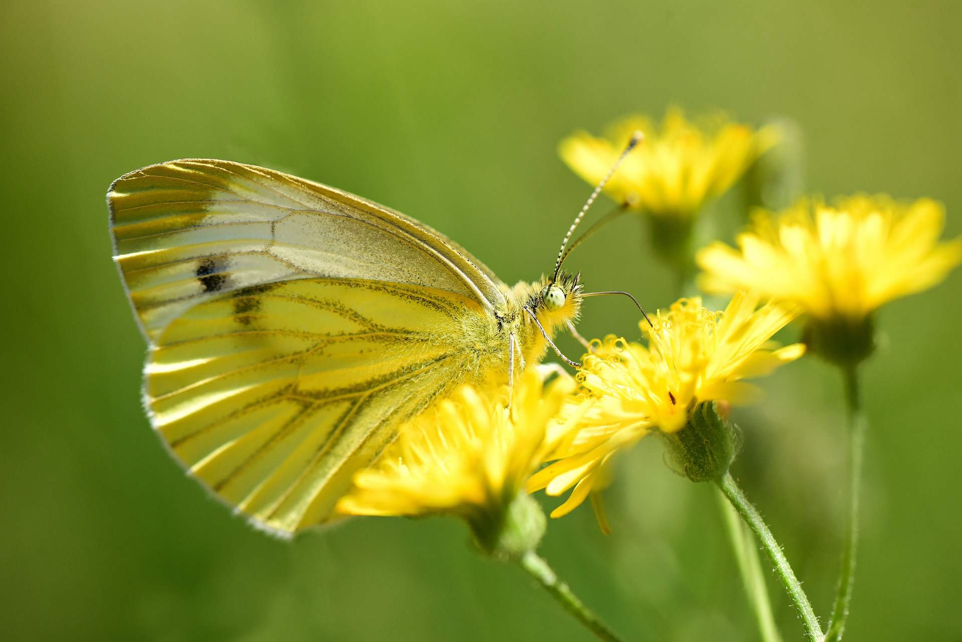
Don’t be too neat and tidy
Expect and tolerate some insect damage
Leave leaf litter in the fall
Delay spring garden clean-up
Photo courtesy MabelAmber at Pixabay
Notes:
Many beneficial insects overwinter in leaf litter and plant stems. Early pollinators need the pollen from dandelions and wild violets to support themselves before many other of our other garden plants bloom. If you are concerned about dandelions spreading, simply deadhead them before they turn to seed.

Slide 18

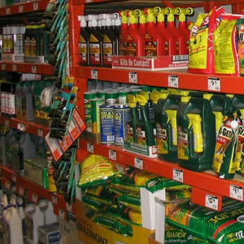
Reduce Pesticide Use
Choose plants for site conditions
Use good cultural practices
Use less harmful pesticides if possible
If pesticide use is necessary, apply when bees are not active (evening) and when plants are NOT in bloom
Notes:
You can reduce the use of pesticides by keeping your plants healthy. This is another reason to choose native plants. They are used to our cool springs and summer humidity. If insect populations are low, simply handpick them from your plants. If you must use pesticides, choose the least toxic means possible and talk with the master gardeners to understand the best time to treat the pest.

Slide 19
Consider Certifying your Garden!
http://ento.psu.edu/pollinators
Notes:
We encourage you to learn more about certifying your garden as a “Pollinator Friendly Garden”. Even if your garden isn’t ready, the guidelines provided will help guide you to achieving a more sustainable garden! The Master Gardeners are standing by ready to help you!

Slide 20
Questions?
Master Gardener Program - Master Gardener Program — Penn State Extension (psu.edu)
Master Gardeners of Delaware County - Delaware County Master Gardener Program — Penn State Extension (psu.edu)
Pollinator Garden Certification: Pollinator Garden Certification — Department of Entomology (psu.edu)
Garden Hotline: Delawaremg@psu.edu
Notes:
It’s been a pleasure joining you this afternoon. Please feel free to reach out to me with any questions.

