Slide 1



Rebecca Yurkovich
Sustainability and Resilience Manager
Francine Locke
Chief Sustainability Officer, Delaware County

Slide 2

SustainDelco:
A Sustainability Plan for Delaware County, PA
Presented by:
Francine Locke, Chief Sustainability Officer
Rebecca Yurkovich, Sustainability & Resilience Manager

Slide 3
At a Glance:
Delaware County, Pennsylvania
Population: 576,000 residents
Population Density: 3,138 residents per square mile – 2nd most densely populated county in Pennsylvania
Primarily urban and suburban neighborhoods
Located in southeastern Pennsylvania (PA) between the City of Philadelphia, PA and the City of Wilmington, Delaware (DE)
35% of residents identifying as Black (23%), Hispanic (5%), or Asian (7%)
Median household income of around $80,398
49 Municipalities

Slide 4

Delaware County Governance
5-Member Elected Delaware County Council
Executive Director, a County Council appointee
Home Rule Charter Administrative Code
Elected ROW
  Controller
  Register of Wills
  Sheriff
  District Attorney
  County Courts

Slide 5
Delaware County Sustainability Commission
Formed in 2020 by a resolution of Delaware County Council
Charged with providing reviews and recommendations to Delaware County Council and County departments
10 members of the public
7 members of County staff

Slide 6
First CSO and Office of Sustainability
Hired first CSO in January 2021
Charged with developing first County sustainability Plan
Overseeing 6 County Departments

Slide 7
New Organizational Structure
Chief Sustainability Officer
Parks and Recreation
Planning
Fleet Management
Facilities
Fleet
Conservation District
Asst Dir Sustainability Finance
Sustainability & Resilience Mgr
Data Analyst

Slide 8
Delaware County Office of Sustainability (DCOS)
Mission:
Make Delaware County and its operations more sustainable and resilient to the effects of climate change by:
  Examining government operations
  Engaging with the community
  Working with the new Sustainability Commission to develop a long-term Sustainability and Climate Action Plan.
Goals:
Create and implement County’s Sustainability Plan
Operationalize sustainability in six County Departments:
  Public Works
  Planning
  Facilities Mgmt
  Fleet/Motor Vehicle Mgmt
  Parks and Recreation
  Conservation District

Slide 9
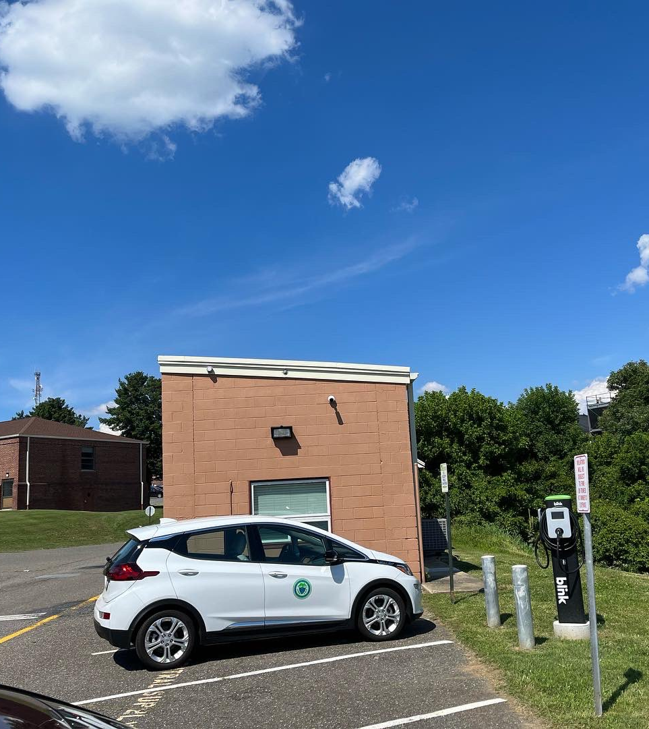
Sustainability Highlights since 2021
Completed a Facility Condition and Needs Assessment (FCNA) of over 60 County-owned properties for baseline data
Borrowed two historically significant capital loans to support Public Works’ CIP: $35 Million for 2022 and $40 Million for 2023
Established a Delaware County Property Assessed Clean Energy (C-PACE) Program
Received $600K, the largest alternative fuel incentive grant (AFIG) award in PA, to purchase 69 EVs and 22 dual charging stations
Significant Capital investments in Parks and Open Space and Municipality Greenways Grant Program
Acquired by Imminent Domain largest County Park 200+ acres
Completed a Local Climate Action Plan (LCAP) including an inventory of greenhouse gas emissions County-wide and for County operation

Slide 10
Delaware County’s 1st Sustainability Plan – SustainDelco’s Mission
To create a sustainable and resilient Delaware County that protects the most vulnerable residents from the impacts of climate change and supports a robust green economy while protecting and preserving natural resources.

Slide 11
Delaware County’s 1st Sustainability Plan
Summary of Public Engagement
Community Prioritization Survey
(December 2021)
Goal: Identify Priorities for Sustainability
Focus Area Subcommittees
(August 2022 – March 2023)
Goal: Identify Goals, Targets, and Actions
63 Hours of Active Meetings
Stakeholder Meetings
(October – December 2022)
Goal: Gain perspective on the responsibilities of other departments and organizations and identify mutual goals
Opportunities for partnership and implementation across variety of organizations
Open Houses
(March – April 2023)
Goal: Share Progress about the Sustainability Plan and gather feedback on the drafted material
3 In-person and 1 virtual
651 Participants
Findings: 75% - greatly concerned with Climate Change
Natural Resources, Climate Resiliency, and Zero Waste as priorities
89 Participants
Findings: 12 Goals, 18 subgoals, 29 Targets, and 248+ Actions
15+ Stakeholder Meetings
80+ Participants from 15 municipalities

Slide 12
Economic Sustainability
Education
Governance
Equity, Inclusion and Justice
Sustainability Plan Guiding Principles

Slide 13
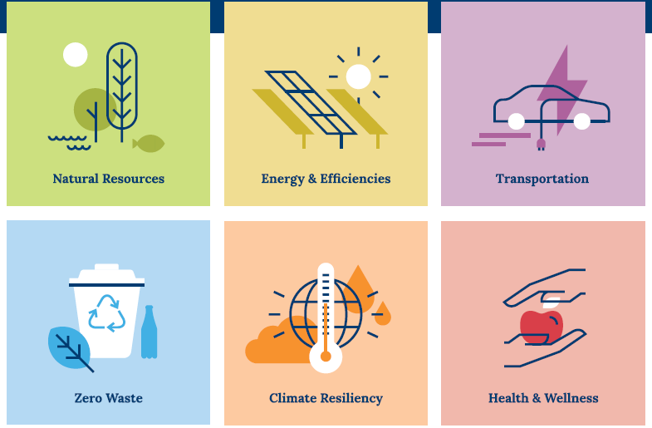
Six Focus Areas

Slide 14


Focus Area 1: Climate Resiliency
“To prepare Delaware County to adapt, withstand, and recover quickly from the effects of climate change.”
Sub-Categories
Goals
Natural Hazards
Economy
Infrastructure
To equip Delaware County to be more prepared to combat extreme weather events.
To grow and diversify the green economy.
To ensure infrastructure is properly constructed and maintained to withstand climate hazards through informed decisions by municipalities and residents.
Target: Increase the number of communities that adopt and implement resiliency practices to adapt to, prepare for, and respond to climate hazards
Target: Increase the number of green jobs/businesses in Delaware County by 5% over the next 5 years.
Target: Increase awareness and understanding of sustainable infrastructure by engaging all 49 municipalities and their residents over the next 5 years.

Slide 15


Focus Area 2: Natural Resources
“To protect, conserve, and restore natural resources in Delaware County.”
Sub-Categories
Goals
Targets: 1. Increase the number of acres of protected open space by 10% over 5 years. 2. Increase number of residents with access to open space within a half mile walk by 10% over the next 5 years.
Open Space
Tree Canopy & Plantings
Watershed Quality
To increase the amount of and accessibility to open space.
To increase Native Trees/Tree Canopy/Natural Plantings.
To improve the quality of watersheds throughout Delaware County.
Brownfields
To identify brownfields in Delaware County and increase remediation efforts.
Targets: 1. Increase the total tree canopy area by 10% over 5 years. 2. Remediate and enhance 250 acres with native plantings in Delaware County in the next 5 years.
Target: Install 25 BMPs across the County in the next 5 years.
Target: Complete a brownfields survey in all 49 Delaware County Municipalities over the next 5 years.

Slide 16
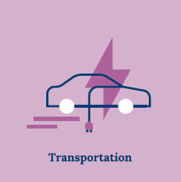
Focus Area 3: Transportation
“To increase accessibility to safe, active, and multimodal transportation as alternatives to single occupant motor vehicles.”
Sub-Categories
Goals
Target: Increase miles of sidewalk and trails by 5% over 5 years.
Walking Infrastructure
Biking Infrastructure
Transit Ridership
To increase walking as a form of active transportation in Delaware County.
To increase biking as a form of active transportation in Delaware County.
Increase transit ridership in Delaware County.
EVs and EV Infrastructure
To support access to and adoption of EVs and EV infrastructure.
Target: Increase miles of bike lanes, safe bike routes, and trails by 5% over 5 years.
Targets: 1. Increase transit ridership in Delaware County by 20% over 5 years.
2. Provide education in 100% of Delaware County municipalities on the benefits and availability biking, walking, and public transit over the next 5 years.
Targets: 1. Increase the number of public and county-owned charging stations by 50% over the next 5 years. 2. Increase the number of EV in Delaware County by 400% over the next 5 years. 3. Electrify 25% of the County fleet over the next 5 years.

Slide 17

Focus Area 4: Energy and Efficiencies
“Reduce water and energy consumption in buildings and properties in Delaware County and transition to combustion-free renewable energy.”
Sub-Categories
Goals
Targets: 1. Reduce energy consumption (EUI -- kBTU/Sqft) in County buildings by 20% over the next 5 years. 2. Reduce energy consumption (EUI -- kBTU/Sqft) in residential and commercial buildings by 20% over the next 5 years.
Energy
Water
Renewable Energy
To reduce energy consumption in Delaware County.
To reduce water consumption in Delaware County.
To increase availability and use of combustion-free locally-sourced renewable energy sources.
Emissions
Reduce emissions in Delaware County.
Targets: 1. Reduce water consumption in County buildings by 20% over the next 5 years. 2. Reduce water consumption in commercial and residential buildings by 20% over the next 5 years.
Targets: 1. Increase the availability and use of combustion-free locally-sourced renewable energy infrastructure in County Buildings by 10% over the next 5 years. 2. Increase the availability and use of combustion-free locally-sourced renewable energy infrastructure in residential, commercial, and industrial properties by 10% over the next 5 years.
Target: Reduce by 20% compared to the 2019 baseline over the next 5 years.

Slide 18
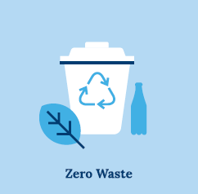
Focus Area 5: Zero Waste
“To achieve Zero Waste in Delaware County through.”
Sub-Categories
Goals
County Operations
Countywide
Emissions
Achieve Zero Waste in Delaware County Operations.
Achieve Zero Waste in Delaware County Communities.
Reduce emissions from waste.
Targets: 1. Achieve 50% diversion rate in County buildings in the next 5 years.
2. Reduce waste tonnage in County buildings by 60% over the next 5 years.
Targets: 1. Achieve 50% diversion in Delaware County Communities in the next five years.
2. Reduce waste tonnage in Delaware County Communities by 60% over the next 5 years.
Target: Reduce emissions by 20% from the 2019 baseline over the next 5 years.

Slide 19

Focus Area 6: Health & Wellness
“To create a safe and healthy environment to live, work, play and thrive.”
Sub-Categories
Goals
Target: Provide education in 100% of Delaware County municipalities to increase awareness and understanding of the impacts of air quality on health the next 5 years.
Air
Water
Food
To ensure just and equitable access to clean, clear, and healthy air.
To ensure just and equitable access to safe and affordable drinking water and water for recreation.
To ensure just and equitable access to healthy, nutritious, appealing, and locally grown food.
Overall Wellbeing
Improve the overall physical and mental health and well-being for all.
Target: Provide education in 100% of Delaware County municipalities about healthy hydration and the recreational use of water for health and wellness over the next 5 years.
Target: Increase the number of healthy food offerings in food insecure communities by 20% over 5 years.
Target: Adopt 100% Delaware County Health Department programs as they are developed over the next 5 years.

Slide 20

County Controls
Influences
Educates
County Operations
Facilities
Waste
Fleet
Technical Assistance
Model Plans
Resolutions
Model Ordinances
Partnerships
Schools
Businesses
Municipalities
Grants and Partnerships
County Capital and Operating Funds
Implementation Strategy
Fundraising with Fiscal Sponsorship by the Foundation for Delaware County

Slide 21
Next Steps
Final vote by Sustainability Commission to adopt the Plan.
Present the finalized Plan to County Council.
Launch Plan and Begin Fundraising Strategy with The Foundation for Delaware County.
Implement, Track, and Report out Annually

Slide 22
Thank you!
Francine Locke
Chief Sustainability Officer
Delaware County, PA
lockef@co.Delaware.pa.us
Rebecca Yurkovich
Sustainability and Resilience Manager
Delaware County, PA
yurkovichr@co.Delaware.pa.us
https://delcopa.gov/sustainability/.gov/sustainability

