Slide 1

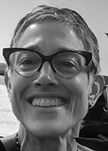
Melissa Muroff
Program Coordinator, Chester Partnership for Safe Neighborhoods, Chief, Environmental Crimes Unit

Slide 2
Chester Partnership for Safe Neighborhoods:
2023 Delaware county sustainability conference
Building partnerships to mitigate gun violence and illegal dumping in chester city

Slide 3
Sustainability and the Delaware county DA’s Office
DA Stollsteimer’s 2020 Smart on Crime Platform
Government ethics
Gun violence reduction
Criminal justice reform
Workers’ rights
Environmental protection
The Chester Partnership For Safe Neighborhoods
Countywide health + environmental protection

Slide 4
Chester Partnership for Safe Neighborhoods (CPSN)
The CPSN is funded by a two-year $2M Violence Intervention and Prevention (VIP) grant from the Pennsylvania Commission on Crime and Delinquency (PCCD), which was awarded to the Delaware County District Attorney’s Office on January 26, 2022.
Grant Objective: To reduce gun violence in the City of Chester.
Initiative of the Delaware County Office of the District Attorney

Slide 5



CPSN Grant – Funds Allocation
All CPSN programs are Chester-based.
50%
40%
10%
Gun violence prevention + community enrichment programs
Local aw enforcement support
Illegal Dumping Deterrence Program

Slide 6






CPSN - Gun Violence Prevention
Advancing the “health and wellness” goal of the delco sustainability and climate action plan

Slide 7
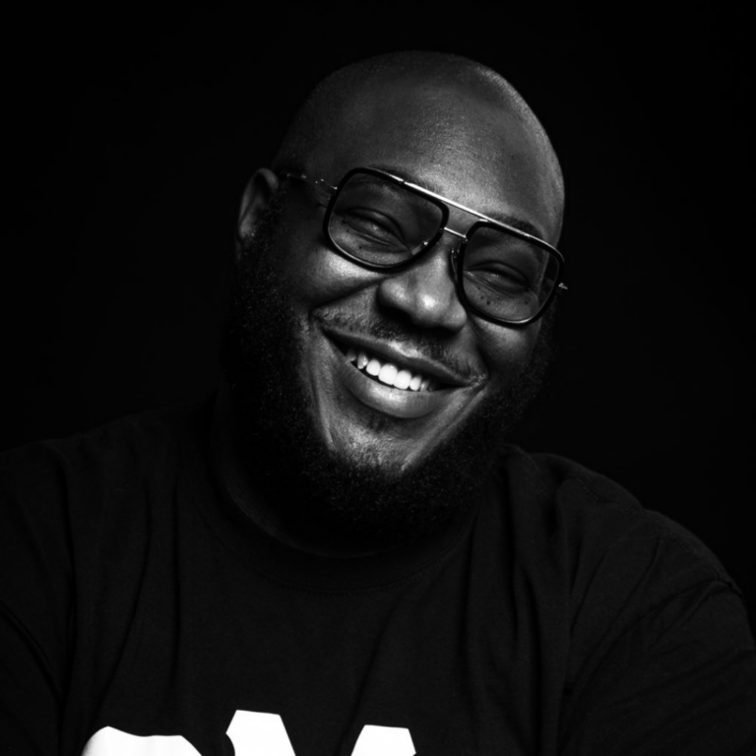
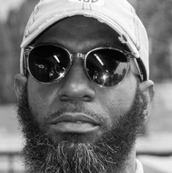
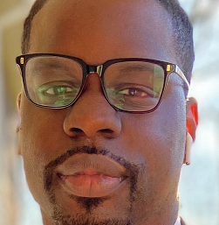
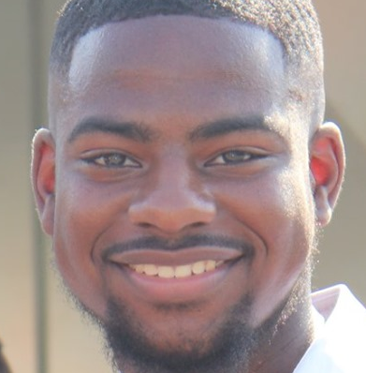

CPSN Gun Violence Prevention Outreach Team
“Uncle P”
“Geo”
LeBrian
Community Resource Specialist
CPSN Credible Messenger
CPSN Credible Messenger
“Nas”
“Coach Dawn Michelle”
CPSN Outreach Specialist
CPSN Outreach Specialist

Slide 8
CPSN - Gun Violence Prevention
Mission
Support Services
Special Programs
Building local partnerships to keep those at risk for gun violence alive, unhurt, and out of jail by providing mentoring and critical and timely help.
Education / job training / job placement
Psychological / trauma support
Emergency + temporary housing / utilities costs
Transportation
Food, clothing, childcare
Funeral costs
CPSN Bicycle Program
Fair Chance initiatives
Re-entry Ready programming
Youth + Community Events

Slide 9



CPSN – ILLEGAL DUMPING DETERRENCE PROGRAM
Advancing the “waste and resource management” goal of the delco sustainability and climate action plan

Slide 10
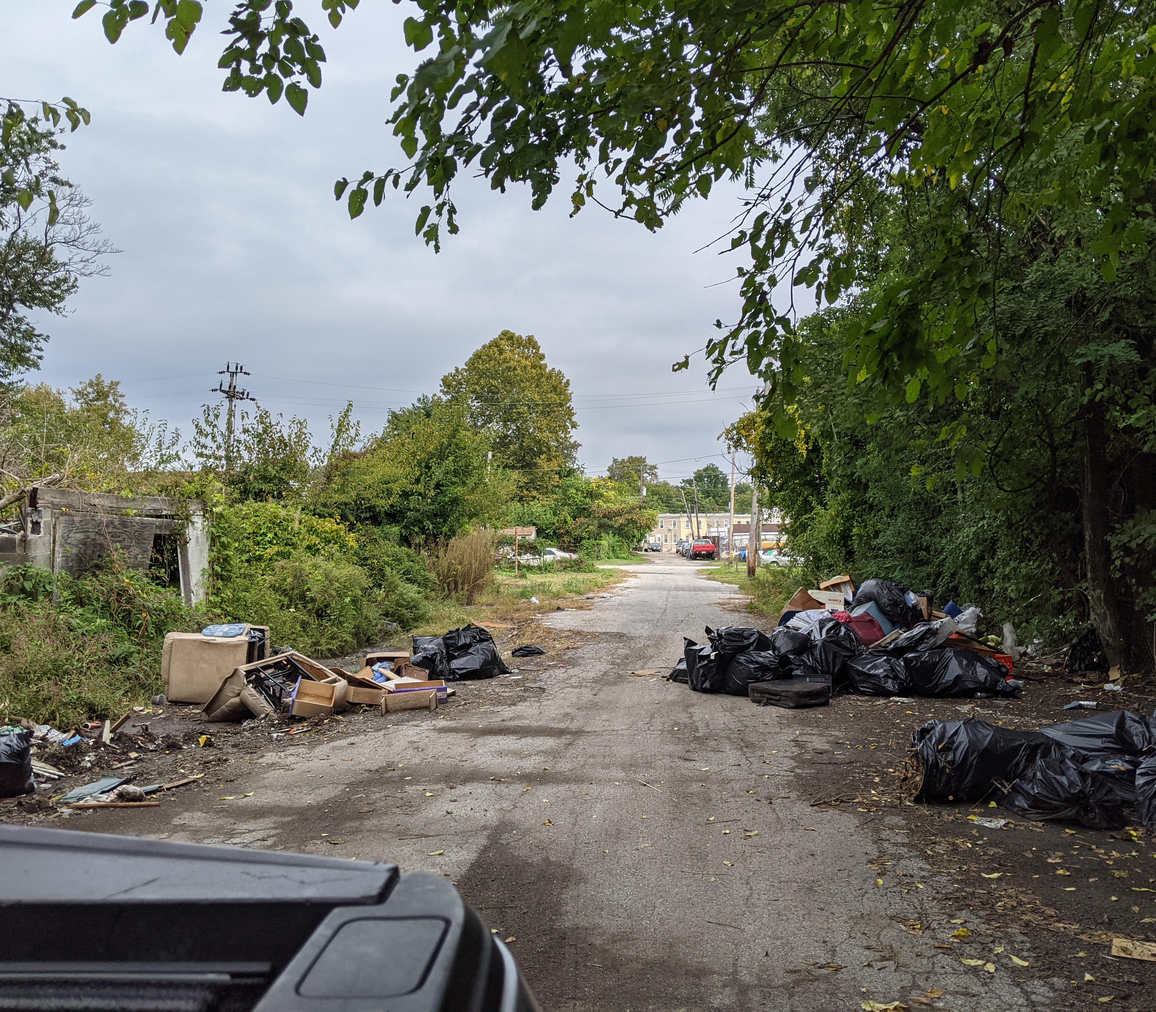
CPSN – Illegal Dumping Deterrence Program
Team + Stakeholders
Chester Office of the Mayor
Chester Dept. of Public Works
Chester Dept. of Licenses & Inspections
Chester Economic Development Authority
Chester Dept. of Planning
Chester City Engineer
Chester Police Dept.
Municipal District Judges
Delaware County DA’s Office

Slide 11
Other Advances in Sustainability
Through its Environmental Crimes Unit and Law Unit, the Delaware County DA’s Office has used its statutory authority to pursue settlements to address large scale environmental and public health impacts in Delaware County.
Delaware County DA’s Office

Slide 12
Office of the District Attorney - Commitment to Sustainability
PFAS Litigation
Mariner East Pipeline Investigation
Opioid Settlement
On May 17, 2021, the Delaware County DA’s Office filed a lawsuit against 3M, Chemours, DuPont, and other alleged manufactures of AFFF, for their role in the contamination of three Delaware County sites. This suit has been transferred to a large multidistrict litigation currently pending before the Federal South Carolina District Court.
The Delaware County DA’s Office actively supported the Attorney General’s Grand Jury investigation of the Mariner East Pipeline construction. As a result, Energy Transfer, L.P., the pipeline operator, was charged with and convicted of 48 criminal charges. The August 5, 2022 plea agreement includes a $10M payment to make the most damaged water sources safer.
In 2022, the Delaware County DA’s Office played a key role leading to the historic $65M opioid settlement with pharmaceutical distributors. As a result, the County is receiving annual payments of $3.5M for 18 years to support programs related to the impacts of opioid overuse and addiction.

Slide 13




Thank You
Melissa Muroff
484-214-7790
muroffm@co.Delaware.pa.us
#delcoda

