Slide 1

Getting the Most from the 2026 County Aid Program
January 28, 2026
February 3, 2026

Slide 2
Informational Session Agenda
Welcome and Introductions
County Aid Program Overview
  Program Requirements
  Key Dates for 2026
Common Questions and Pitfalls
Looking Forward to 2027
Session Participant Question and Answer

Slide 3
County Aid Program Overview
Objective
  To support maintenance of a safe and reliable transportation system
  Funds are to be used for the construction, maintenance, and repair of municipal roads and bridges
Eligible Applicants
  All 49 Delaware County municipalities
Eligible Projects
  PennDOT Publication No. 9 identifies program eligibility requirements
  Project must conform to Pub 9 to be considered eligible to receive County Aid allocation monies

Slide 4
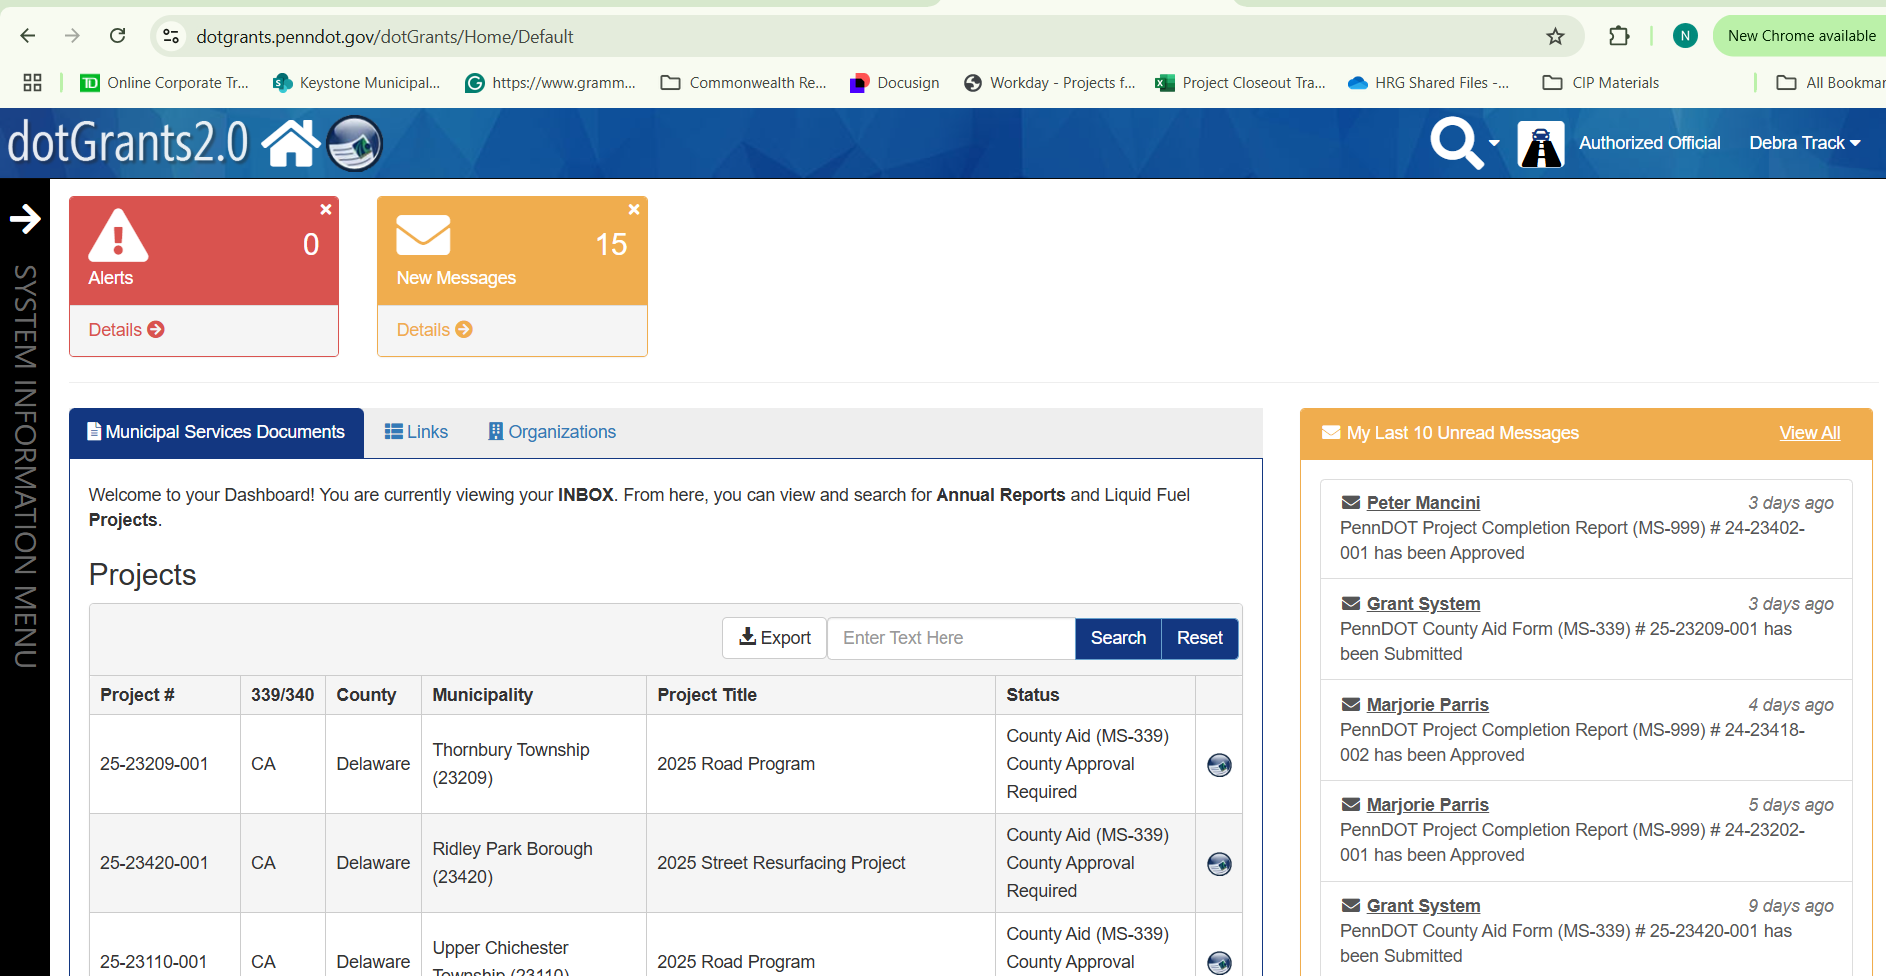
County Aid Program Requirements
County Aid projects are managed in dotGrants
  dotGrants is PennDOT’s online Grant Management System
  A free account is required
  A paper application will not be accepted
  A Municipal Official or Authorized 3rd party may create the County Aid Application
  dotGrants will automatically assign a project number when County Aid Application is initialized

Slide 5
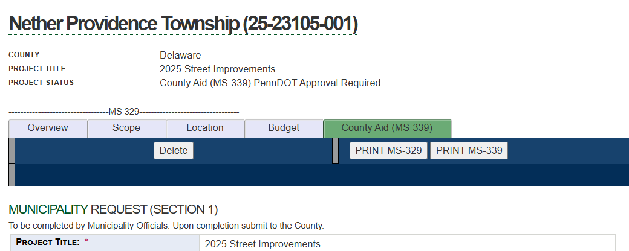
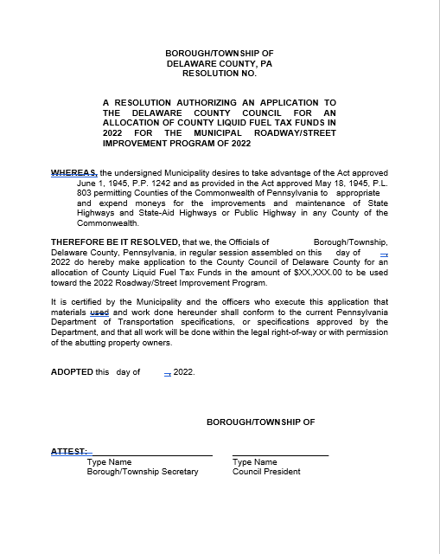
County Aid Program Requirements
County Aid Application must be created in dotGrants:
Complete Section 1 of the County Aid Application in dotGrants
  Project Scope of Work and title must identify type of work to be performed
  PennDOT will not accept “2026 Road Program”
Upload the dated, signed & attested Municipal Resolution for County Aid

Slide 6
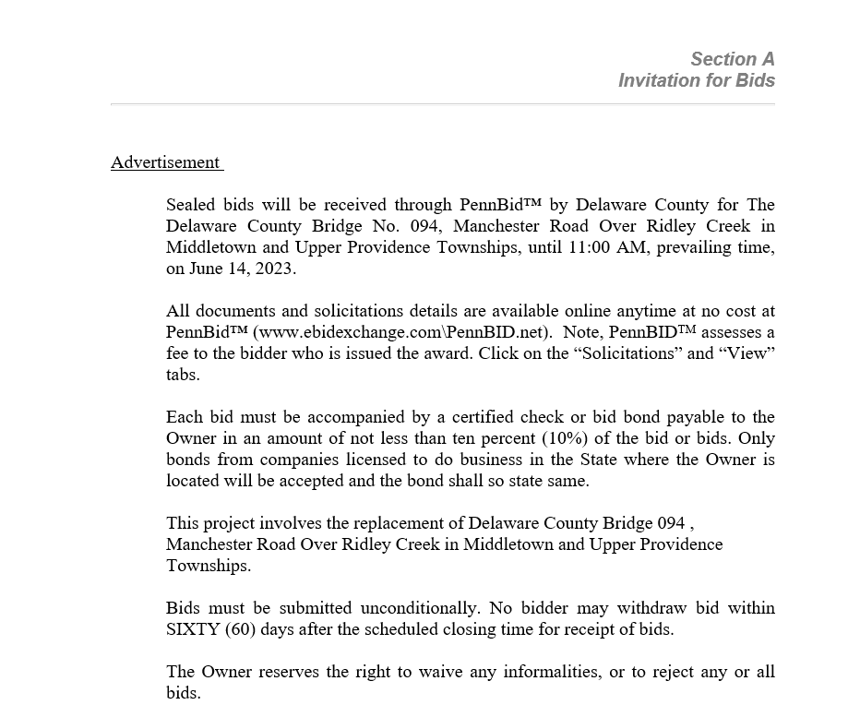

County Aid Program Requirements
PennDOT Municipal Services will create and approve the project after:
Project is advertised
Contract awarded to the lowest responsible bidder
Contract fully executed by all parties
Submission of all required documentation to Municipal Services Specialist for review

Slide 7
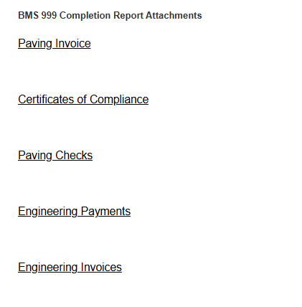
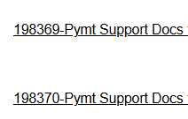
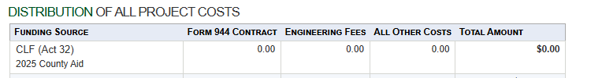
County Aid Program Requirements
Filing the Final MS-999 Project Completion Report:
All documents must be uploaded to dotGrants
Issue the COUNTY AID PAYMENT from the GENERAL FUND
Be sure to CLAIM County Aid on the MS-999. Do not leave the value for CLF ACT 32 blank.

Slide 8
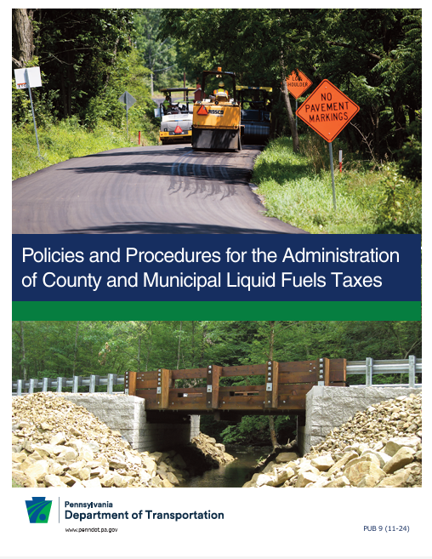
County Aid Program Requirements
  Allowable Expenditures per Publication 9
    Construction, reconstruction, maintenance, and repair of roads and bridges
      Paving Projects
      Bridge Maintenance
      Guide Rail Improvement
      Crack Sealing
    Culverts and drainage structures
    Costs associated with traffic signs and signals
    Street lighting [PECO Utility Invoices]
*Please verify project scope conforms to PennDOT Publication 9
*For assistance, please consult with PennDOT Municipal Services Specialist

Slide 9

2026 County Aid Program- Key Dates
  March 20 – Final date to notify of intent to accept 2026 County Aid allocation
    Failure to notify by this date results in forfeiture of 2026 funding
  June 30 – County Aid must be filed in dotGrants & Project Advertised
    Failure to file by this date results in forfeiture of 2026 funding
  September 30 – County Aid project must be substantially complete
  November 27 – Last day to file Project Completion Report in dotGrants
    Project Completion Report is Form MS-999
    It is filed in dotGrants
    All data and supporting documents must be included in the report
    Failure to file FINAL MS-999 by this date results in forfeiture of 2026 funding
**A complete calendar of Key Dates is provided in the Appendix**
This Photo by Unknown Author is licensed under CC BY-SA-NC

Slide 10
Common Pitfalls Associated with County Aid

Slide 11
Non-payment of County Aid #1
Issue County Aid invoices are paid from the Municipal Liquid Fuels account. | Solution All County Aid-related invoices must be paid from the General Fund. Funds may not be commingled.

Slide 12
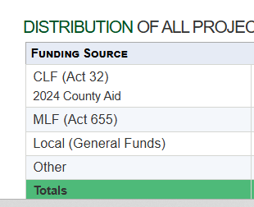
Non-payment of County Aid #2
Issue MS-999 Project Completion Report does not claim CLF (ACT 32) in the Distribution of All Project Costs table | Solution Identify Source as CLF (ACT 32) and enter the approved allocation value in the Total Amount field.

Slide 13
Non-payment of County Aid #3
Issue Filing a Partial MS-999 Project Completion Report. | Solution File a FINAL Project Completion Report [MS-999] and all required documentation within the allowable deadline. PARTIAL Project Completion Reports [MS-999] are ineligible for County Aid.

Slide 14
Non-payment of County Aid #4
Issue Claiming County Aid allocations after the project year closes. | Solution File FINAL MS-999 Completion Report by the November 27th due date Failure to do so will result in forfeiture of 2026 County Aid allocation

Slide 15
Common Questions about County Aid

Slide 16
Common Questions about County Aid
May I request a dollar value greater than identified in the County Aid Allocation Letter?
No, funding is carefully budgeted each year to enable all municipalities to participate at the funding level offered. The value in each allocation letter is the maximum available to each municipality for the calendar year.

Slide 17
Common Questions about County Aid
Is my project eligible?
The County of Delaware does not determine project eligibility. Please refer to PennDOT Publication No 9 for eligible and ineligible expenditures. If you have questions or need clarification, PennDOT Municipal Services is a terrific resource. PennDOT Municipal Services reviews all project applications for compliance.
Only PennDOT is authorized to approve a County Aid project.

Slide 18
Common Questions about County Aid
Why is my County Aid not being paid?
This is a great question!
      The project was not approved by PennDOT
      The Project Completion Form [MS-999] did not claim County Aid
      Only a PARTIAL MS-999 Project Completion Report was filed by the due date
      The FINAL MS-999 Project Completion Report was not filed timely
      Invoices to be covered by County Aid must be paid from the General Fund account
      Invoices to be covered by County Aid may not be paid from the Liquid Fuels account

Slide 19
Common Questions about County Aid
May I pay for engineering services using County Aid?
  Do not pay for engineering services using County Aid monies.
  PennDOT recommends issuing the first check to the Contractor using the entirety of the County Aid allocation. This payment is to be paid from the General Fund.

Slide 20
Common Questions about County Aid
Must I file my FINAL Project Completion Report [MS-999] before the end of the project year?
  The FINAL Project Completion Report milestone date is November 27, 2026
  Final PennDOT approval will not be granted until the FINAL MS-999 Project Completion Report is filled out in its entirety, and all required documents are uploaded into dotGrants.
  Modifications Required by PennDOT must be addressed timely.
  Please upload all documents and resolve any modifications within two [2] months to avoid forfeiture of funding.
  Filing a PARTIAL Project Completion Report [MS-999] does not preserve funding beyond 12/31.

Slide 21
Common Questions about County Aid
What happens if a Municipality misses the November 27th milestone date?
  Missed milestone dates will result in forfeiture of County Aid monies. Please plan accordingly.
  If we do not hear from you and the deadline is missed, funding will be forfeited.
  Communication is key.

Slide 22
Common Questions about County Aid
What if PennDOT grants a project extension?
  PennDOT extensions are separate and apart from the County Aid requirements. PennDOT extensions are not an extension of County Aid funding availability.
  Allocations not claimed in the calendar year are forfeited.

Slide 23
Thank you for attending!
Question & Answer

Slide 24
APPENDIX

Slide 25
2026 County Aid Key Dates
2026 | MILESTONE
January 28 | Mandatory Information Session #1 for 2026 Program
February 3 | Mandatory Information Session #2 for 2026 Program
March 20 | Notification of Acceptance of allocation
June 30 | Project filed in dotGrants & Project must be advertised
September 30 | Project must be substantially complete
October 31 | All work complete and final invoice from Contractor paid
November 27 | Final Payment to Contractor issued and all final documents for dotGrants provided to PennDOT
December 31 | Program Completion by County

Slide 26
County Aid Resources
PennDOT Municipal Services, District 06
  Marjorie Parris, Municipal Services Supervisor
  mparris@pa.gov
dotGrants: PennDOT Online Grant Management System
  https://www.dotgrants.penndot.gov/dotGrants/welcome/index
Publication 9: Policies and Procedures for Administration of County and Municipal Liquid Fuels Taxes
  https://www.dot.state.pa.us/public/PubsForms/Publications/PUB%20369.pdf

Slide 29
Contact Us
Program Administrator: Delaware County Public Works Department
  Director of Public Works – Danielle Floyd – FloydD@co.delaware.pa.us
  Capital Finance Manager – Debra Track – TrackDE@co.delaware.pa.us
Program Facilitator: Herbert, Rowland, & Grubic, Inc.
  Program Manager – Eric Kaufman – ekaufman@hrg-inc.com
Technical Support: PennDOT Municipal Services
  Municipal Services Supervisor – Marjorie Parris – mparris@pa.gov
https://delcopa.gov/departments/publicworks.html
610-891-6021

