Slide 1
Conscious Connections Inc.
Matthew Williams

Slide 2
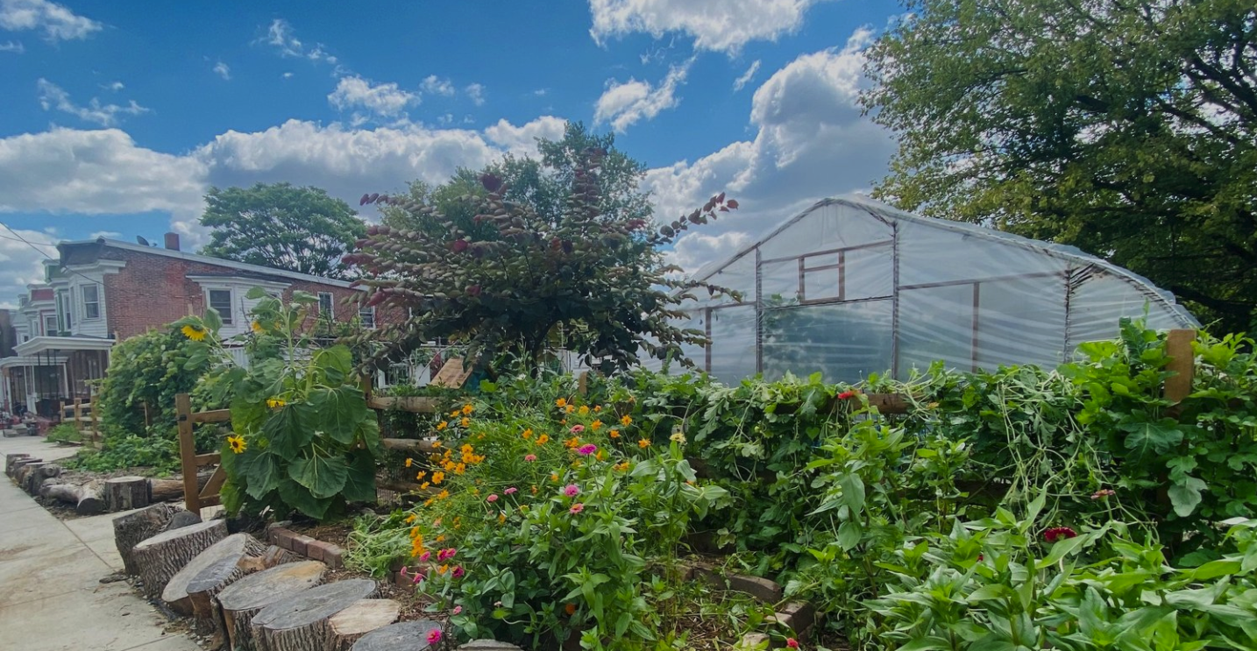
Our Mission
Conscious Connections, Inc. (CCI) is a nonprofit organization that provides educational programming and operates an urban farm located in Wilmington, Delaware.
We are passionate about serving our community by providing opportunities for learning and programs aimed at combating food insecurity and increasing the access to fresh food.
Through our community outreach efforts, a safe place for youth has been created where we nurture creativity, ingenuity, and self empowerment.

Slide 3
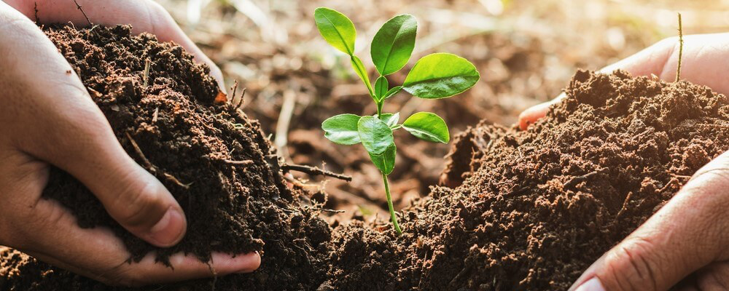
Climate Resilience and Urban Gardening
Some of the approaches used at Conscious Connections Inc:
Green space
Soil remediation
Youth environmental education

Slide 4
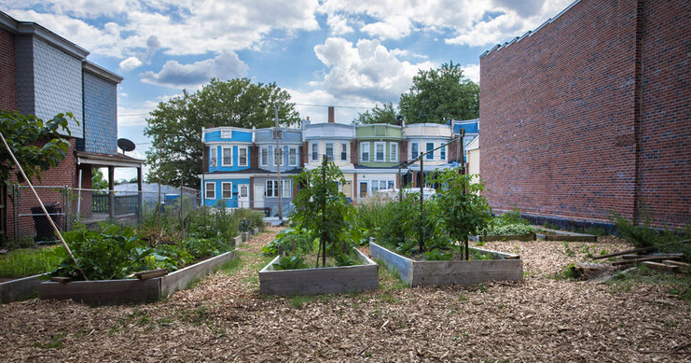
Urban Farming
Urban farming is the practice of cultivating, processing, and distributing food in urban areas.
Urban Farming creates an abundance of food for people in need by planting gardens on unused land and space while increasing diversity, educating the community and providing an environmentally sustainable system to enhance communities.
Benefits:
Economic
Environmental
Social and cultural
Education
Health, nutrition, and food accessibility
Notes:
Matthew to discuss the specific type of urban farming that is going on in Wilmington.
https://www.conserve-energy-future.com/types-and-benefits-urban-agriculture.php
Economic
Job opportunities
Increases value of the land
Environmental
Improve urban environment quality - biodiversity, improve air quality
Reduction of carbon footprint- requires less industrial chemicals (organic)- less emissions from transportation mediums
Crop preservation/crop development
Social and cultural
Community participation and unity
Maintaining cultures
Education
Training and development / creativity and innovation
Health, nutrition, and food accessibility
Creates urban food security
Availability of fresh produce
Keeping community healthy

Slide 5
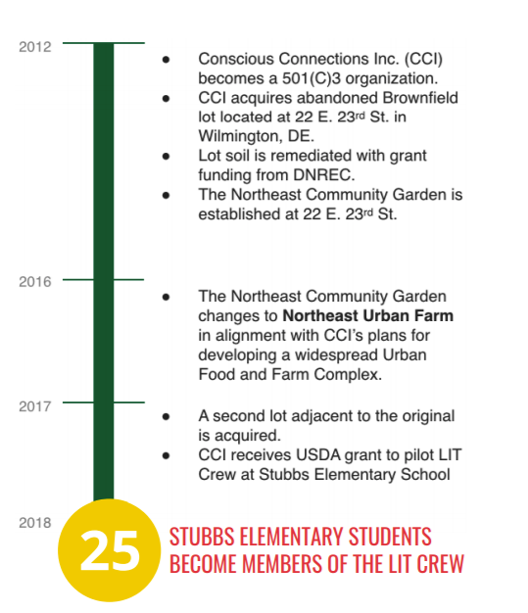
Our History
2018 - Today
Urban Farmer training sight
Herb Garden
Fruit Forest

Slide 6
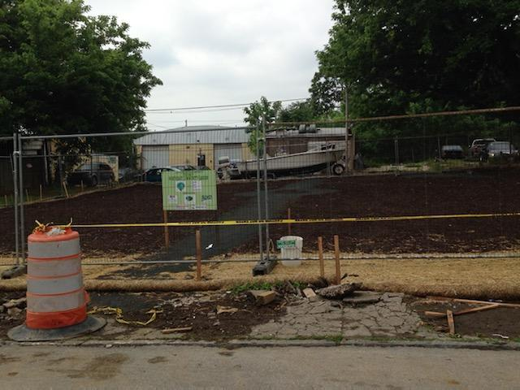
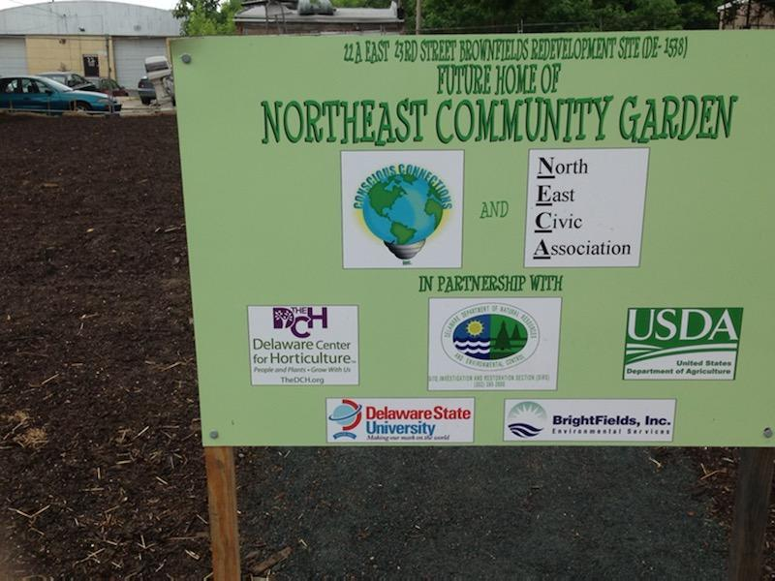
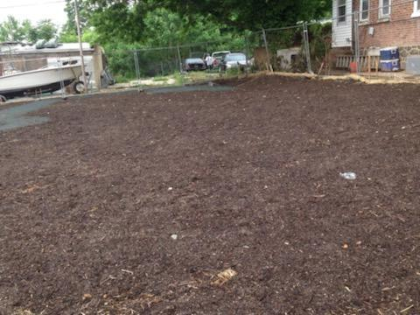
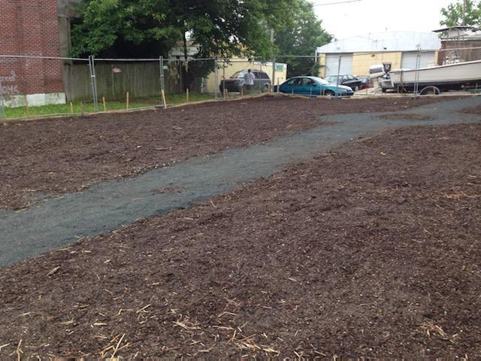
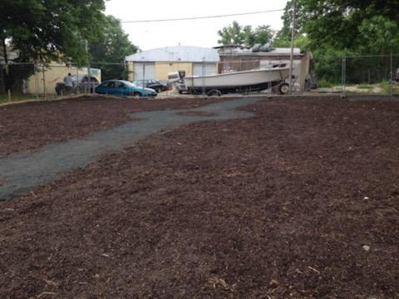
10 Years Ago

Slide 7
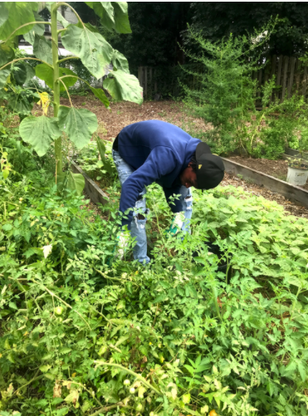
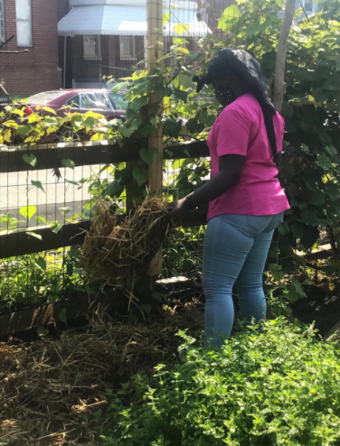
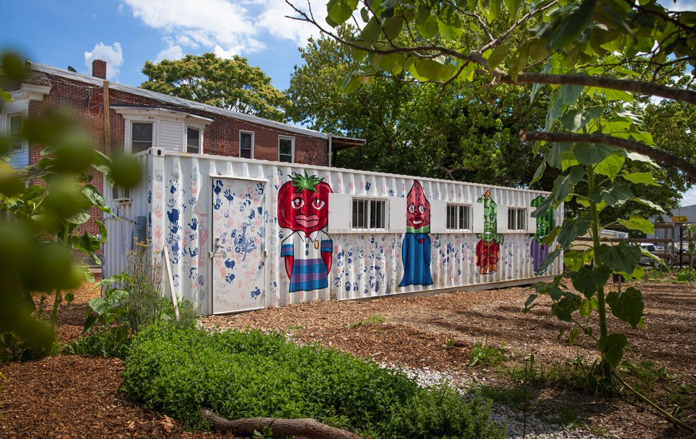
Today

Slide 8
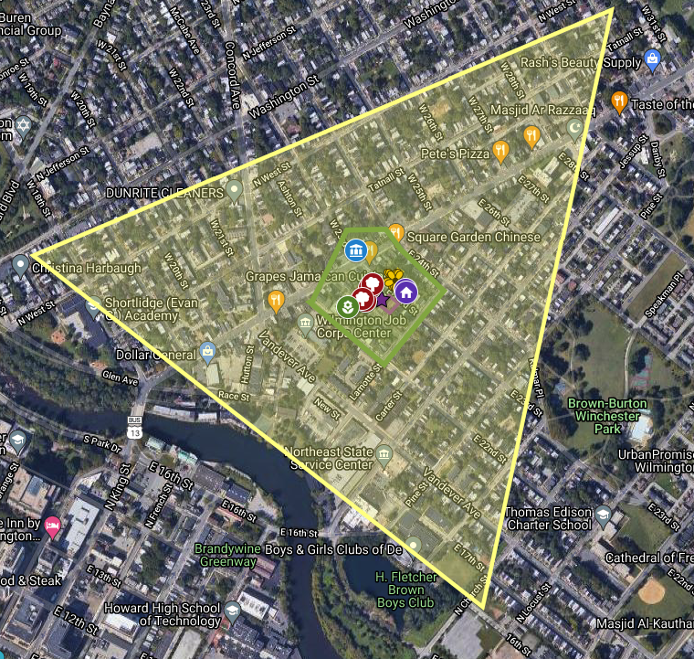
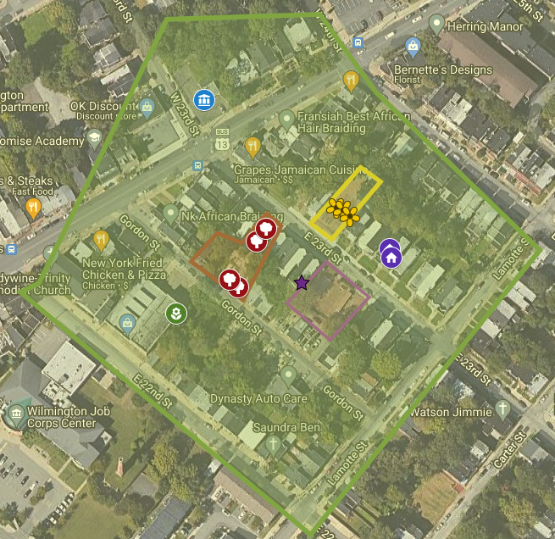
Impact Zone
Headquarters and Main Farm Sight (A)
Farm Sight (B)
Fruit Forrest (C)

Slide 9
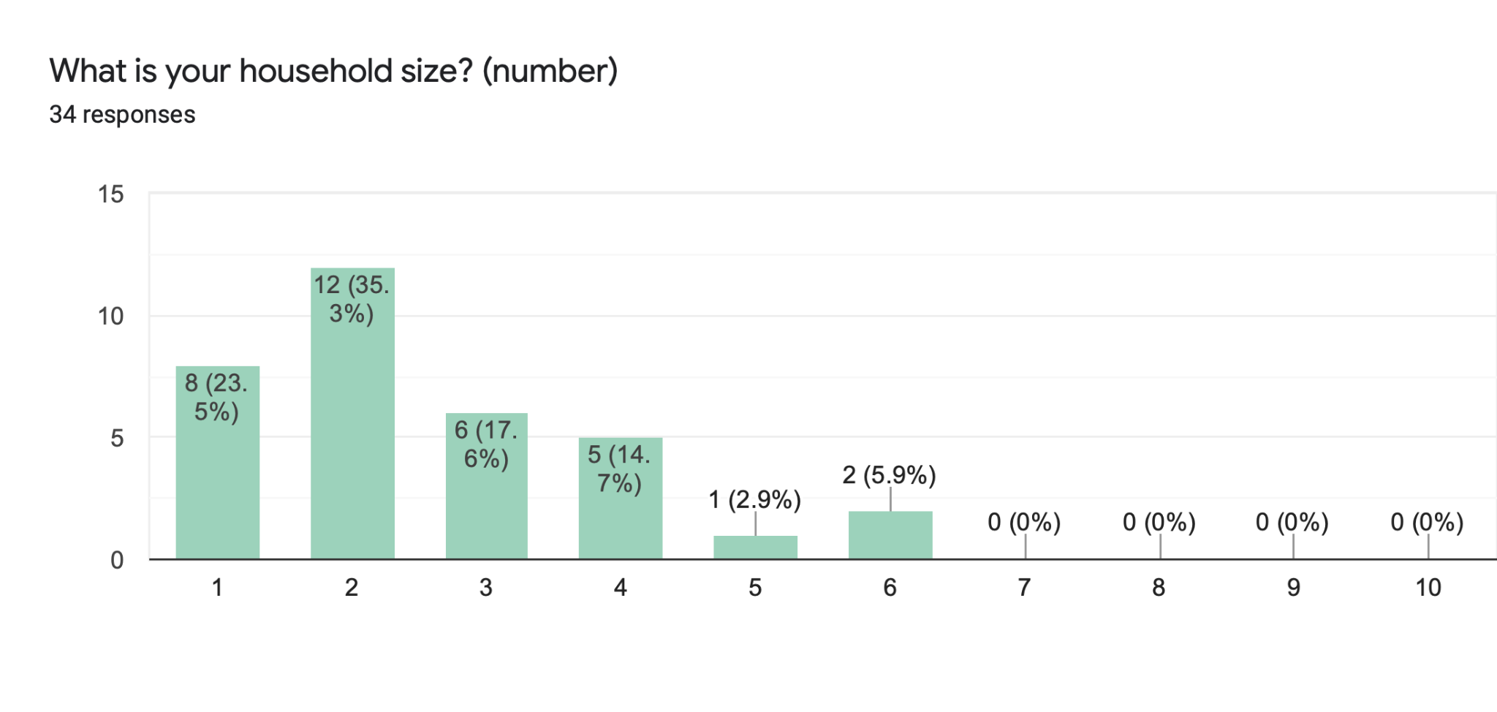
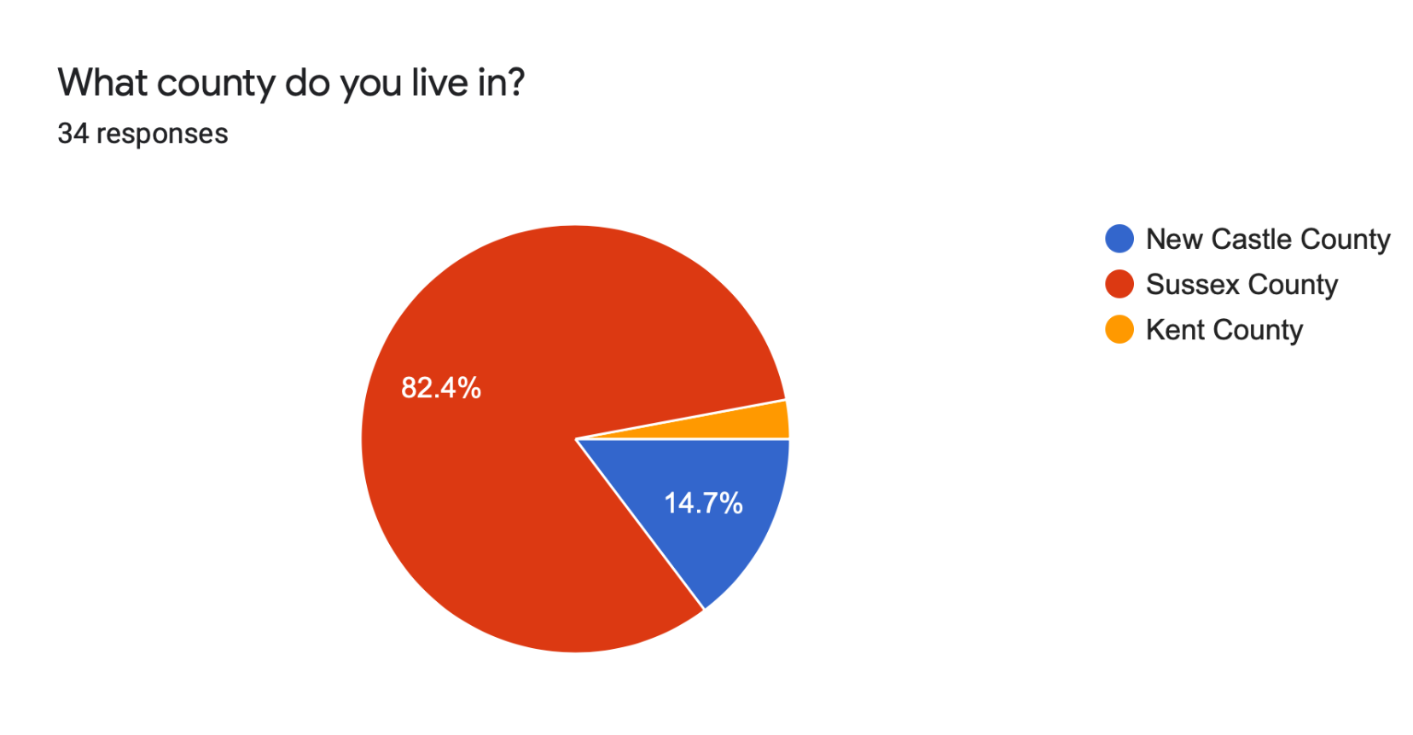
Community Demographics
Based on April FTC Sign-Ups:

Slide 10
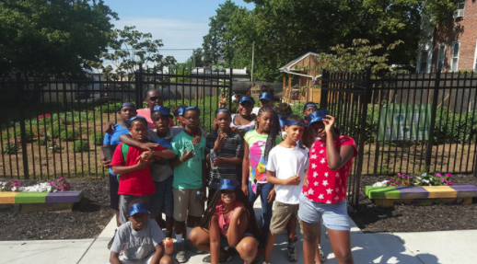
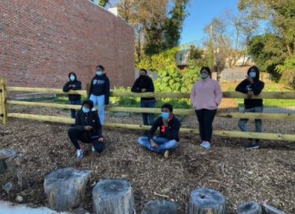
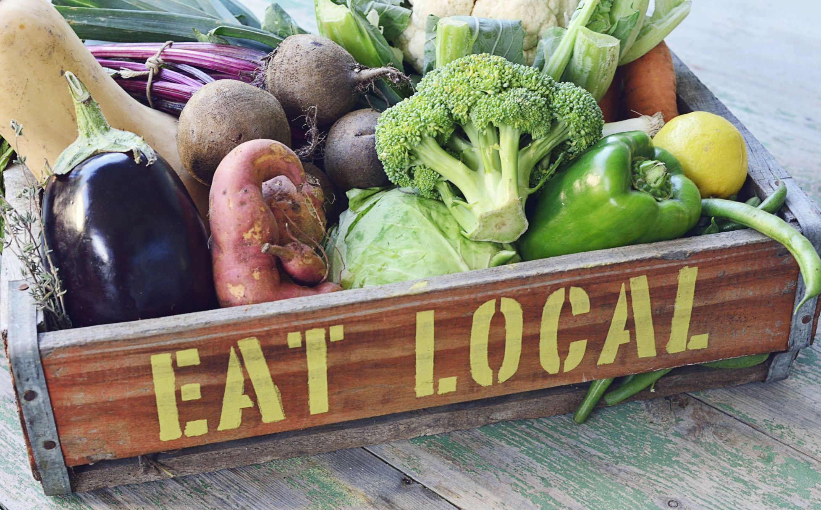
Programs
L.I.T Crew
Wilmington Evolution
Feed the Community
Delaware Farm Fresh

Slide 11
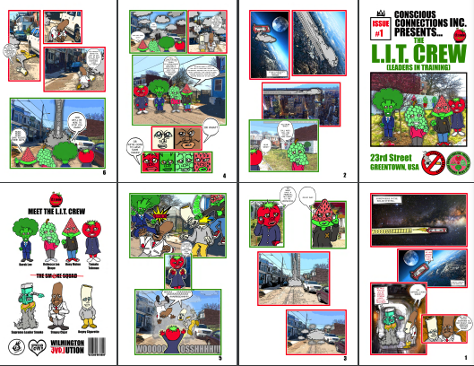
LIT Crew (Leaders in Training)
L.I.T. Crew members receive education and exposure in the arts and agriculture.
Members participate in activities at the urban farm and translate that knowledge into real world scenarios via their own production of a comic book series!

Slide 12
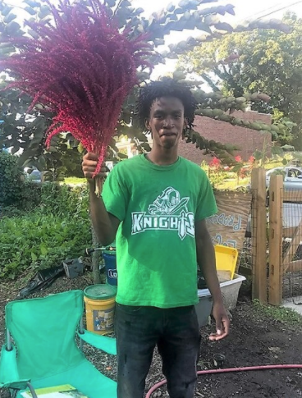
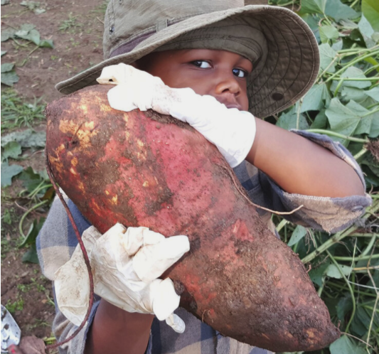
Youth Community Impact
At Conscious Connections, we offer a variety of community-based programs for the youth. We believe EDUCATION + EXPOSURE = ECONOMIC OPPORTUNITY.
L.I.T. Crew members receive education and exposure with activities at the urban farm through the Junior Master Gardeners™ curriculum in preparation for work in agriculture, landscaping, maintenance, and more.

Slide 13
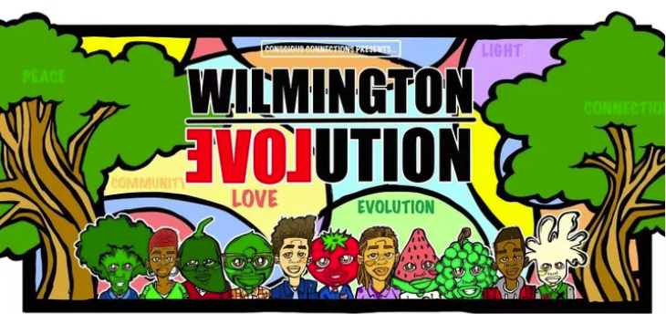
Wilmington Evolution
Wilmington Evolution
A concept and movement aimed at connecting Wilmington community members by creating a network of individuals who want to positively impact their local community through neighborhood beautification, increasing access to healthy food, and providing opportunities for workforce development.
Wilmington Evolution is an extension of Conscious Connections, Inc. and our mission.
We aim to transform our city by demonstrating and modeling community engagement practices that are more purposeful, equitable, and transparent. We believe that we are stronger when we work together and showing LOVE for our city will help EVOLVE it into a safer place with more opportunity for both personal and economic growth.

Slide 14
Feed the Community! (FTC)
Increase access to fresh produce and increase healthy food consumption in communities that have limited access
Donation of fresh produce to a family living in these circumstances will help to combat food insecurity and increase healthy food options
Wilmington and Seaford, DE
In addition to providing fresh fruits and vegetables, we aim to meet the needs of our community based on their food interests

Slide 15
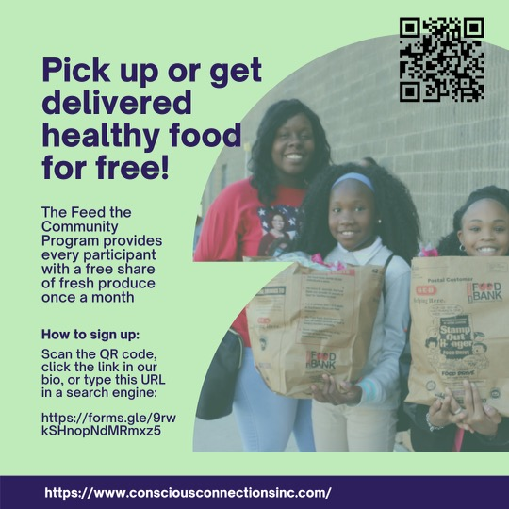
FTC Sign-ups to date
November - 40
December - 15
January - 21
February - 20
March - 50
April - 25
Total sign-ups - 171

Slide 16
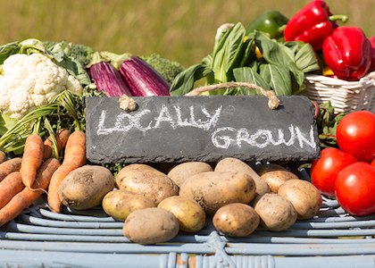
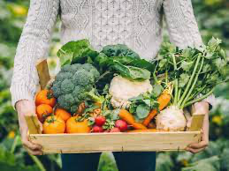
Delaware Farm Fresh (DEFF)
DEFF is a food facilitation cooperative working to combat food insecurity while improving the distribution of locally grown and produced food in the State of Delaware.
DEFF will provide and manage a web-based platform and delivery service for Delaware farmers that will allow them to market and sell their locally grown and curated products to retail customers, restaurants, and other businesses and institutions.
Two aggregation and distributions sites in the State of Delaware – one in Sussex County and the other in Wilmington.
DEFF supports the small farmer, builds a local food system, and strengthens the community!
Notes:
Goals and Objectives
Increase the access to fresh food
Reduce the cost of locally grown produce
Reduce food waste
Enable small to medium sized farms to access a wider range of customers
Distribute high-quality and locally produced products directly from the farmer to consumer within a 2-to-3-day turnaround time

Slide 17
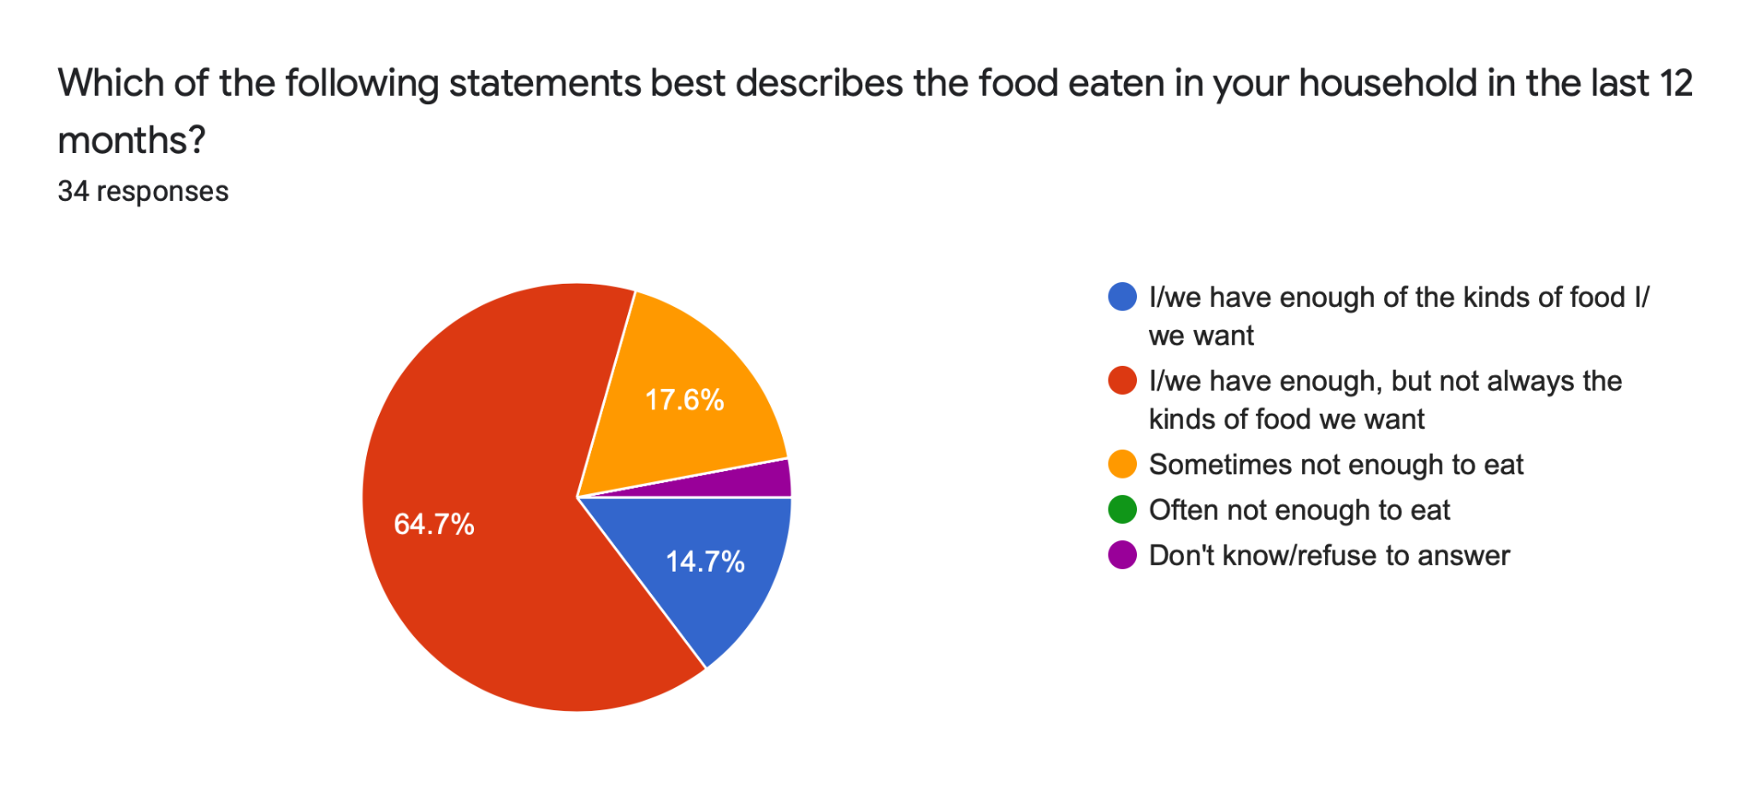
Community Needs
64.7% of participants state their household has enough food, but not always the kinds of food that they want
17.6% of the participants state that they sometimes do not have enough to eat
Only 14.7% of the participants have enough of the foods that they want

Slide 18
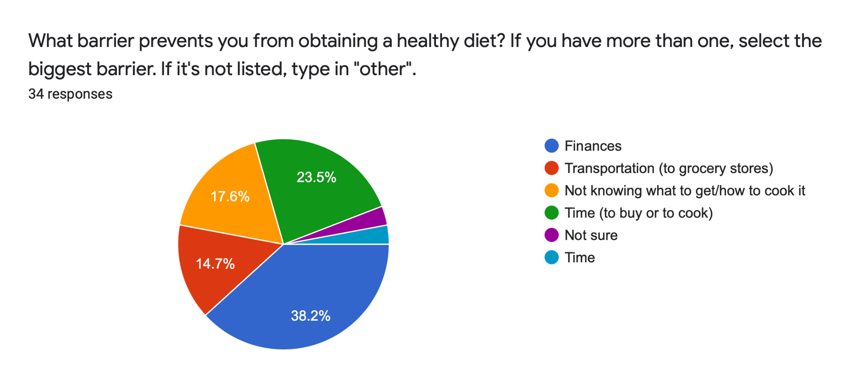
Community Needs
Participants state that the program addresses these barriers through:
Accessibility of fresh/healthy food
Costs of food/gas (very high since pandemic)- supplements income
Ability to make healthy meals for family
Delivery- don’t need to worry about transportation
Based on April FTC Sign-ups:

Slide 19
Responses to Program
Responses to “If you have used this program before, how has this program impacted you/your family?”
“Help me and my family out alot with not being able to get to the store like that.”
“It puts extra food on our table”
“Helps fill in the gaps of food I can't afford”
“I enjoy the program”
“Saved money”
“Easy access to healthy foods”
“This is a great program”
“I will be eating healthier”
“It’s been amazing, collard greens were provided one time and I made them for a veggie for dinner one night, my kids wanted sweet potato fried with the sweet potatoes provided, than the fresh green beans was another great fresh veggie to add to the meal the kids loved.”

Slide 20
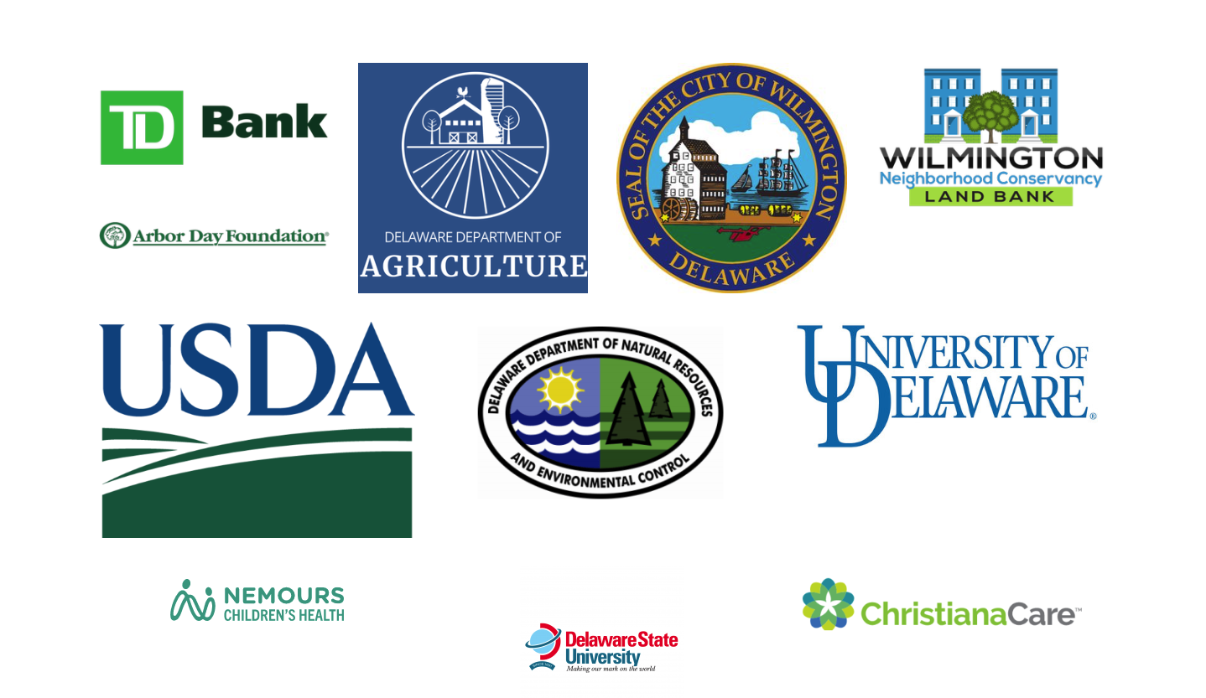
Partners and Sponsors
TD Bank
Delaware Department of Agriculture
City of WIlmington (Seal of the City of Wilmington, Delaware)
Wilmington Neighborhood Conservancy Land Bank
Arbor Day Foundation
USDA
Delaware Department of Natural Resources
and Environmental Control
University of Delaware
Nemours Children’s Health
Delaware State University
Christiana Care
Metropolitan WIlmington Urban League
Delaware Center for Homeless Veterans
BrightFields Inc - Environmental Services
Northeast Civic Association
Challenge Program

Slide 21
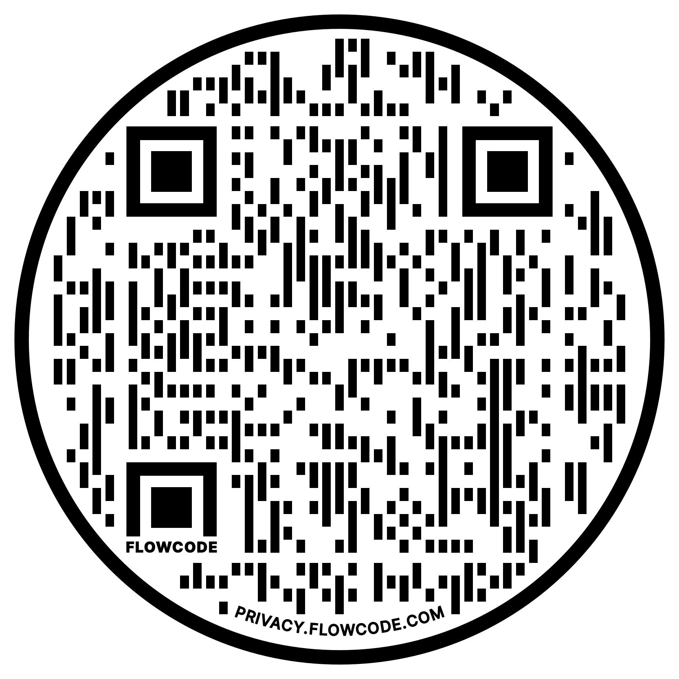
How you can help!
You can contribute in any way that you are comfortable with!
We need you on our team to have a true impact on the community
contributing time to support our mission
money to help us grow
energy to bring awareness to our fundraising events
Contact information
Farm Address: 22 East 23rd Street, Wilmington, DE 19802
Mailing Address: 802 West 29th Street, Wilmington, DE 19802
Phone: (302) 402-5150
Email: info@consciousconnectionsinc.com
Instagram and Facebook: @cciurbanfarm
Scan this QR code with your mobile device to donate to Conscious Connections Inc!

