Slide 1


Dr. Adelina Voutchkova-Kostal
Director of Sustainable Development at the American Chemical Society

Slide 2
GREEN AND SUSTAINABLE CHEMISTRY
Adelina Voutchkova
Director | Sustainable Development

Slide 3
Green and Sustainable Chemistry
American Chemical Society
Adelina Voutchkova
Director, Sustainable Development
Assoc. Professor, George Washington University

Slide 4
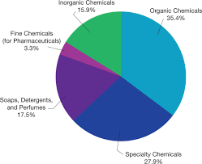
Everything is a chemical
Chemicals are related to:
TYPES OF CHEMICALS
Food
Transportation
Communication
Information Technology
Economy
Notes:
Opportunities for contributions from academia to the sustainable development of developing world
Note: Engage the public from the beginning – ask them to name everything that is/is not a chemical.
Answers may vary. Bottom line of this exercise is that everything is a chemical or has been touched by a chemical.
Make a transition to different areas.

Slide 5
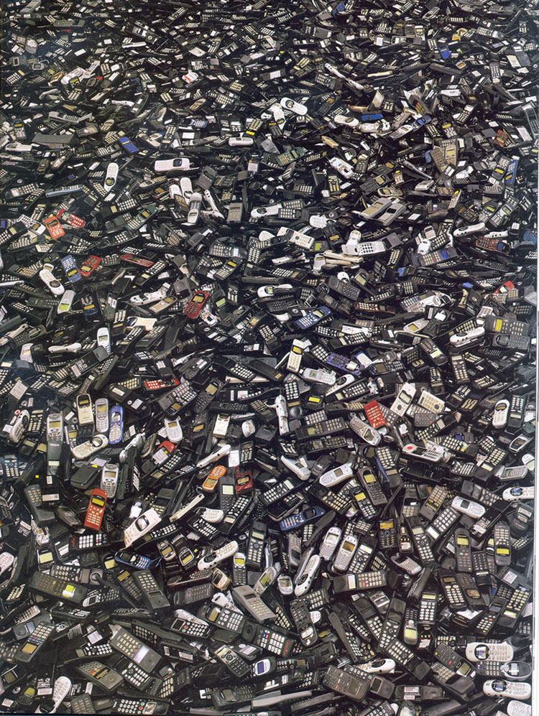

Slide 6
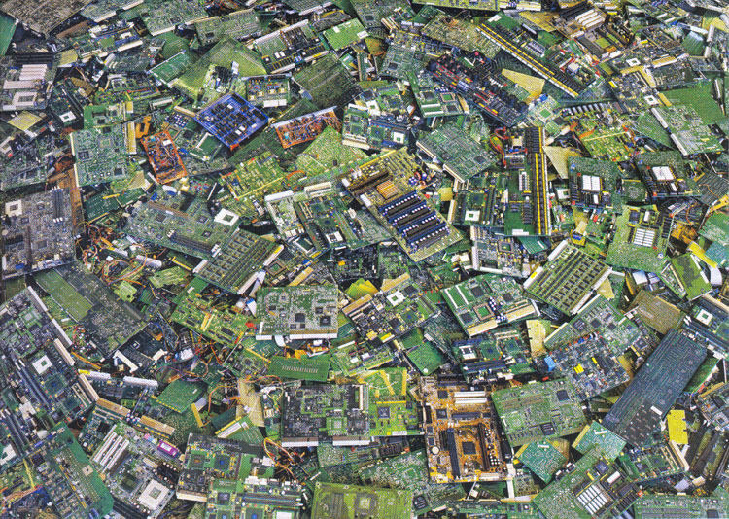

Slide 7
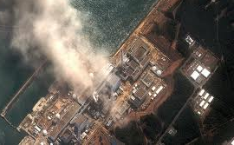
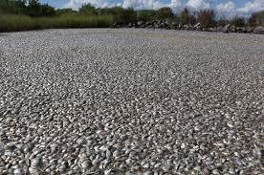
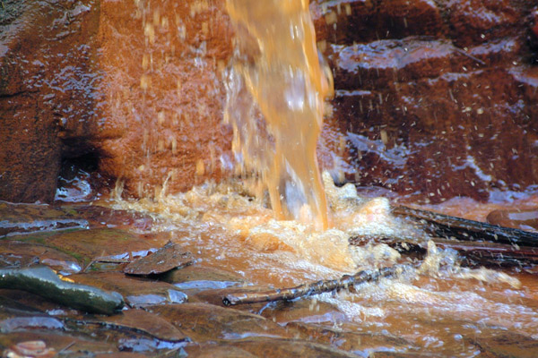
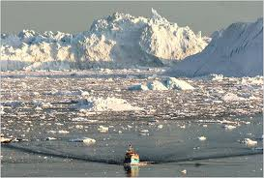
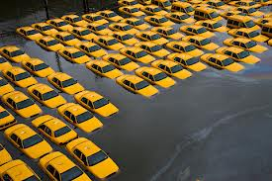
Environmental Impacts of Chemical Industry
3.93 billion lbs. of toxic chemicals were released directly to air, land, and water in 2010, 16% increase from 2009.
US EPA TRI
Fukushima Nuclear Power Plant 2011
Exposure controls can and do fail
Plaquemines Parish, LA
Levels of chemicals in fish rivers are high enough to cause massive fish kills
Severe weather systems and rising sea levels are providing palpable indicators of climate change
Notes:
What motivates us?

Slide 8
Climate Change
Concerns for climate chaos, oceanic temperature, stratospheric chemistry, and global distillation can be addressed through the development and implementation of green chemistry technologies

Slide 9
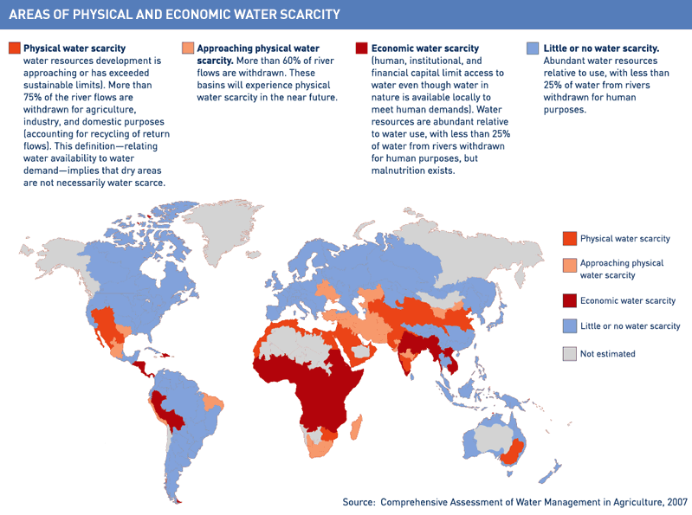
Water Scarcity
Two major sources of disruption of the hydrological cycle are warming produced by climate change and features of the "built environment" that induce more runoff.
Notes:
Two major sources of disruption of the hydrological cycle are warming produced by climate change and features of the "built environment" that induce more runoff.
When climate change results in hotter, more arid surface conditions it prevents both infiltration needed for replenishment of deep reserves and reduces the surface water available for immediate uses such as agriculture or filling reservoirs for drinking water.
Changes in the built environment, such as the creation of mass concentrations of "hardscape" - asphalt and concrete - as well as the destruction of watershed timberlands, marshes, and wetlands, ease the path for more rapid runoff such that more rainfall end up going straight to the sea.

Slide 10
Growing Energy Consumption
Energy use has approximately doubled in the past 30 years
Majority of the energy generated today is from non-renewable sources that damage the environment
Energy production depletes our resources, pollutes rivers and air
Notes:
Energy consumption of growing due to our lifestyle and the new technological demands.

Slide 11
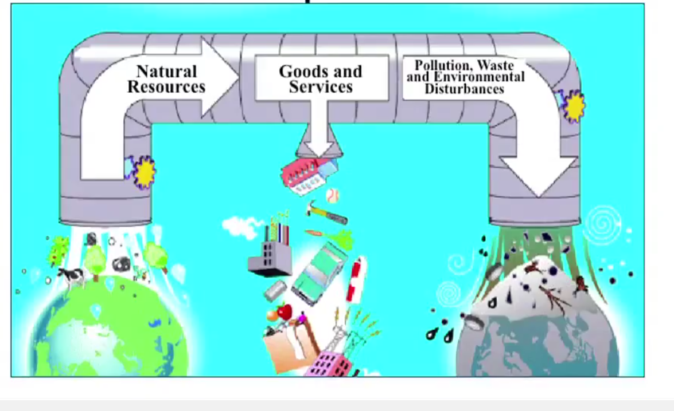
RESOURCE DEPLETION

Slide 12
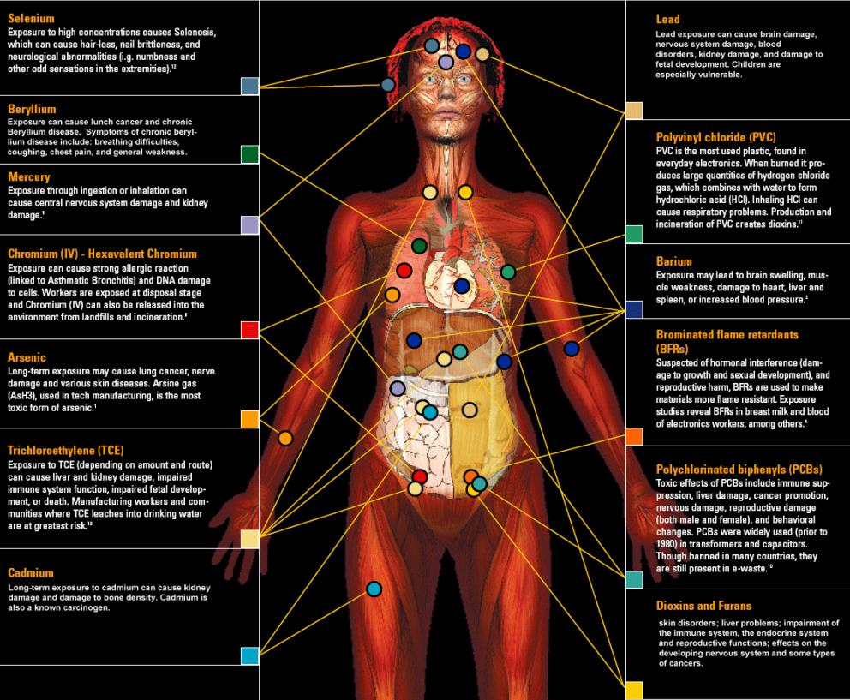
Effect of Commodity Chemicals on Human Health
148 chemicals in the body as determined by CDC study
Of the chemicals found:
  76 cause cancer in humans or animals,
  94 are toxic to the brain and nervous system, and
  79 cause birth defects or abnormal development.
The dangers of exposure to these chemicals in combination has never been studied.

Slide 13
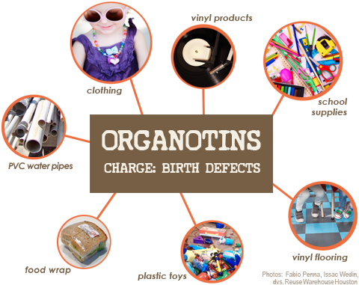
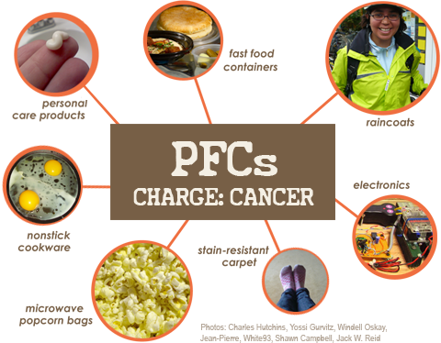
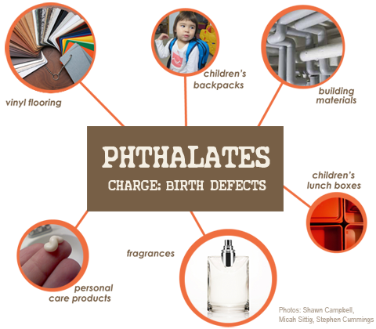
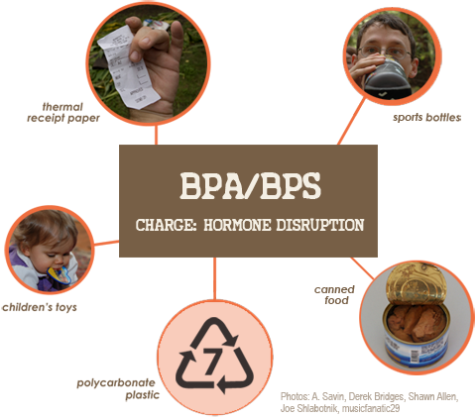
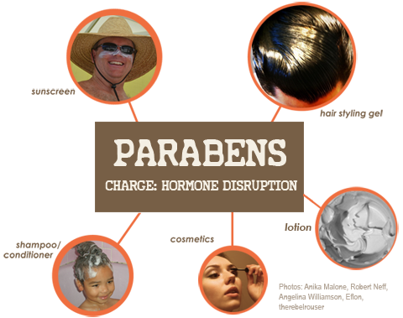
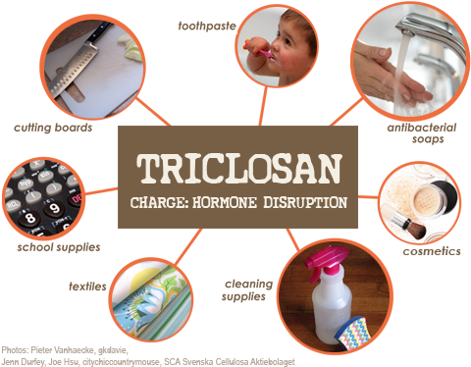
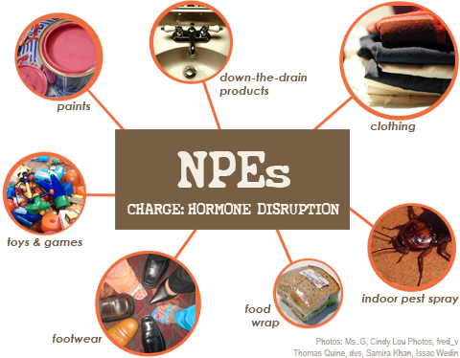
Notes:
Organotin biocides, pesticides, PVC, obesity, immune damage: birth defects
Nonylphenol ethoxylates: household cleaners, drain cleaners, paints; ED, repro, birth defects, extreme aq tox
Triclosan: removed by FDA as a result of association with ED
Pesticides: kill bees, associated with Alziemers
Flame retardants: endocrine disruption
Preservatives in personal care products
Tricolosan: pesticide is found in products like toothpaste and cosmetics; endocrine disruption, learning disabilities, infertility
PFCs: stain-resistance, water-resistance; cancer, kidney disease
We can't escape them: even chemicals that are no longer manufactured are out there for good (eg PCBs) These chemicals migrate through the ecosystem through air/water and via global supply chains à 95% of Americans have synthetic chemicals used to make plastics and cosmetics in their blood (CDC).

Slide 14
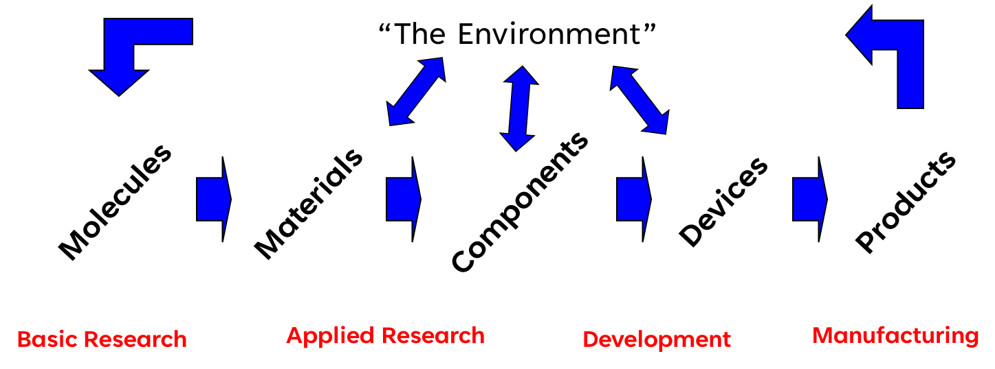
Where do products come from?
SOCIAL IMPLICATIONS
Economics
Performance

Slide 15
WASTE PREVENTION HEIRARCHY
Reduction at source
Re-use
Recovery, recycle
Disposal without energy recovery
Energy recovery
Increasing sustainability impact

Slide 16
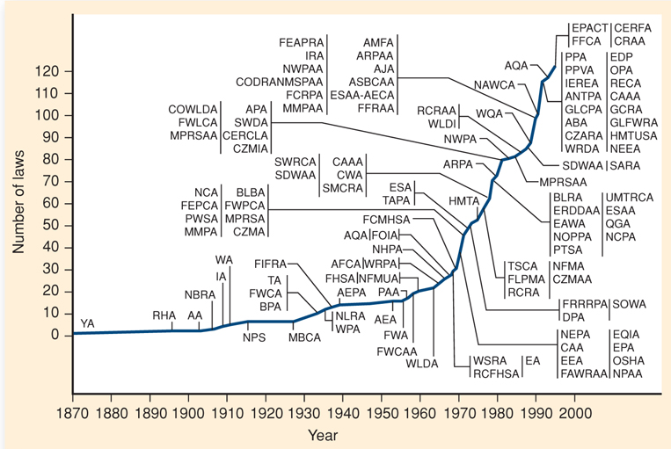
Environmental Regulation Growth
“The total federal budget outlays for regulatory compliance activities have almost doubled in the past 13 years, from $13.7 billion in 1990 to $26.9 billion in 2003 in real terms.”
“total of $281 billion in 2008”
“The total burden…is $160 billion on manufacturers alone.”
J. A. Cusumano, New Technology for the Environment, Chemtech, 1992, 22(8), 482–489
P. T. Anastas, Meeting the Challenges of Sustainability through Green Chemistry, Journal of Green Chemistry, 2003, 5(2), G29-G34.
Notes:
The govt cost of managing regulatory programs; do not include private sector costs
Compliance includes environemntal, economic, workplace and tax; but env compliance is at least 50%

Slide 17
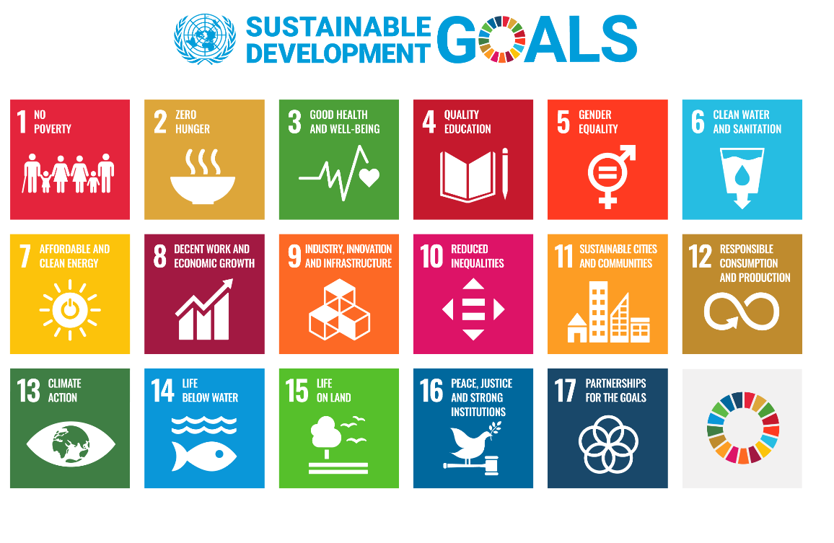
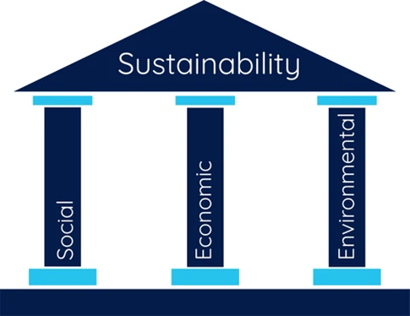
Addressing the UN Sustainable Development Goals Through Chemistry
A unified call for action by all countries to promote prosperity while protecting the planet

Slide 18
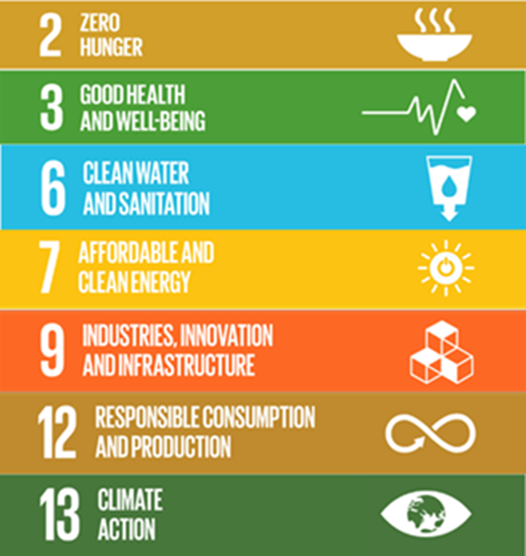
Addressing the UN Sustainable Development Goals Through Chemistry
Chemistry is central to solving these global challenges, and more!

Slide 19
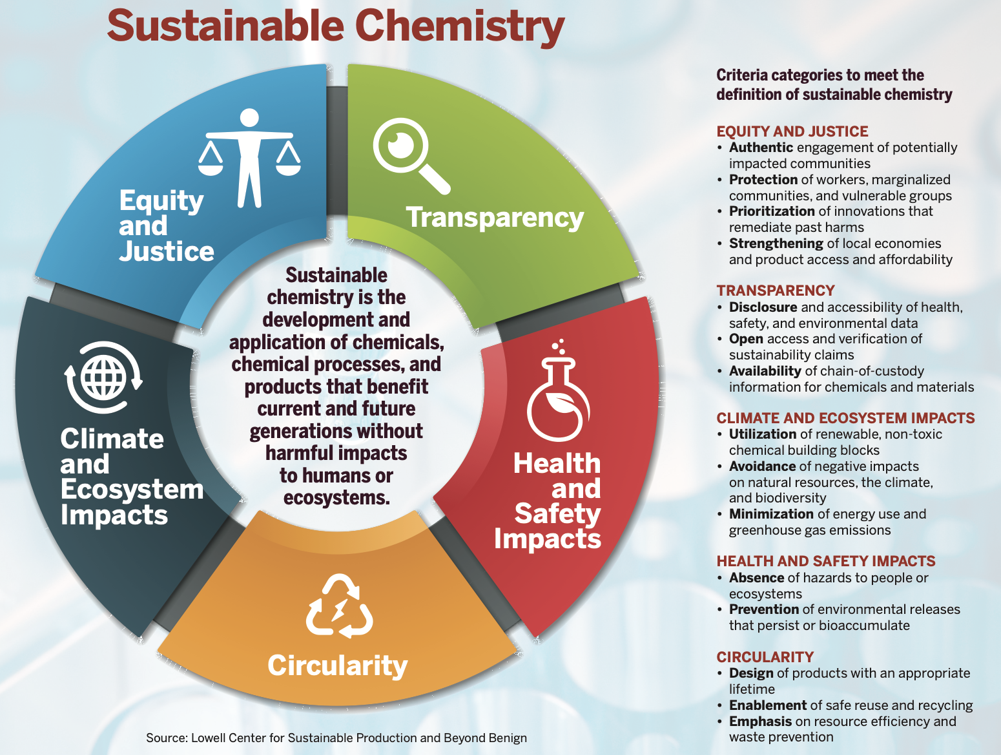

Slide 20

WHOSE PROBLEM IS IT?
I make self-driving cars. Sure they can kill passengers, but that’s okay because other designers are working on safe cars.

Slide 21

WHOSE PROBLEM IS IT?
WHOSE PROBLEM IS IT?
WHOSE PROBLEM IS IT?
WHOSE PROBLEM IS IT?
I make fancy food, but sometimes it makes people sick. It’s okay though, because other chefs are working on non-toxic meals!

Slide 22
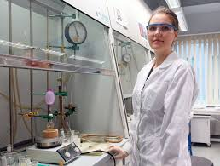
WHOSE PROBLEM IS IT?
I make new compounds for commercial applications. Sure they are toxic and bad for the environment, but It’s okay though, because other chemists are working on “green” chemistry.

Slide 23
Proactive Approach: Green Chemistry
Green chemistry &
Sustainable Development
Environmental performance
Risk
Management
Compliance
Economic performance
The design of chemical products and processes that reduce or eliminate the use and generation of hazardous substances
Anastas, P. and Warner, W. Green Chemistry: Theory and Practice, Oxford University Press: New York, 1998.
Notes:
“Do what today others won’t, so tomorrow, you can do what others can’t.” ~ Brian Rogers Loop
I am not free if my freedom is predicated on reacting to my past. Kenny Loggins
Hazard must be recognized as a design flaw
Circumstantial: Use, Exposure, Handling, Treatment, Protection, Recycling, Costly
Intrinsic
Molecular design for reduced toxicity
Reduced ability to manifest hazard
Inherent safety from accidents or terrorism
Increased potential profitability

Slide 24
Proactive Approach
Green chemistry &
Sustainable Development
Environmental performance
Risk
Management
Compliance
Economic performance
The design of chemical products and processes that reduce or eliminate the use and generation of hazardous substances
Anastas, P. and Warner, W. Green Chemistry: Theory and Practice, Oxford University Press: New York, 1998.
Notes:
“Do what today others won’t, so tomorrow, you can do what others can’t.” ~ Brian Rogers Loop
I am not free if my freedom is predicated on reacting to my past. Kenny Loggins
Hazard must be recognized as a design flaw
Circumstantial: Use, Exposure, Handling, Treatment, Protection, Recycling, Costly
Intrinsic
Molecular design for reduced toxicity
Reduced ability to manifest hazard
Inherent safety from accidents or terrorism
Increased potential profitability

Slide 25
Principles of Green Chemistry
Chemistry & Engineering
Toxicology & Biochemistry
CHEMICAL DESIGN
Design safer chemicals and products
Design chemicals and products to degrade after use
Minimize the potential for accidents
Ecology & Env. Science
Anastas, P. and Warner, W. Green Chemistry: Theory and Practice, Oxford University Press: New York, 1998.
Notes:
Chemical synthesis: emphasis on efficacy and performance.
Little or no training of synthetic chemists in toxicology.
With little understanding of mechanistic toxicology, the main focus of environmental and human health protection
With little understanding of mechanistic toxicology, the main focus of environmental and human health protection by regulatory agencies was on exposure prevention
As understanding evolved in toxicology SAR data was primarily used to evaluate toxicity of chemicals, but these considerations were not generally incorporated into novel chemical design.
Mechanistic toxicology and molecular modeling began to become more well-developed.
Green Chemistry, Twelve Principles Framework – 1990’s

Slide 26
Principles of Green Chemistry
the design of chemical products and processes that minimize the use or generation of hazardous substances.
PRODUCTION PROCESS DESIGN
CHEMICAL DESIGN
Prevent waste
Design less hazardous chemical syntheses
Use renewable feedstocks
Use catalysts over stoichiometric reagents
Avoid chemical derivatives
Maximize atom economy
Use safer solvents and reaction conditions
Increase energy efficiency
Design safer chemicals and products
Design chemicals and products to degrade after use
Minimize the potential for accidents
Anastas, P. and Warner, W. Green Chemistry: Theory and Practice, Oxford University Press: New York, 1998.
Notes:
Both research efforts are inspired by the ideals of green (sustainable) chemistry, which is the is the design of chemical products and processes that minimize the use or generation of hazardous substances.

Slide 27
Sustainable Development
Sustainable Chemistry
Green Chemistry
HOW? Policy, Remediation, Exposure controls,
Water purification, Recycling, Green Chemistry
HOW? How can chemistry to used to innovate such that it leads to sustainable chemistry and development?

Slide 28

FOCUS ON DESIGN
FUNCTION
HEALTH
ENVIRONMENT
Notes:
The moment a chemist puts pencil to paper, he/she is making determinations about the human health and environmental impacts associated with the chemicals used in or generated from the manufacture, processing, use, and disposal of chemical products.

Slide 29
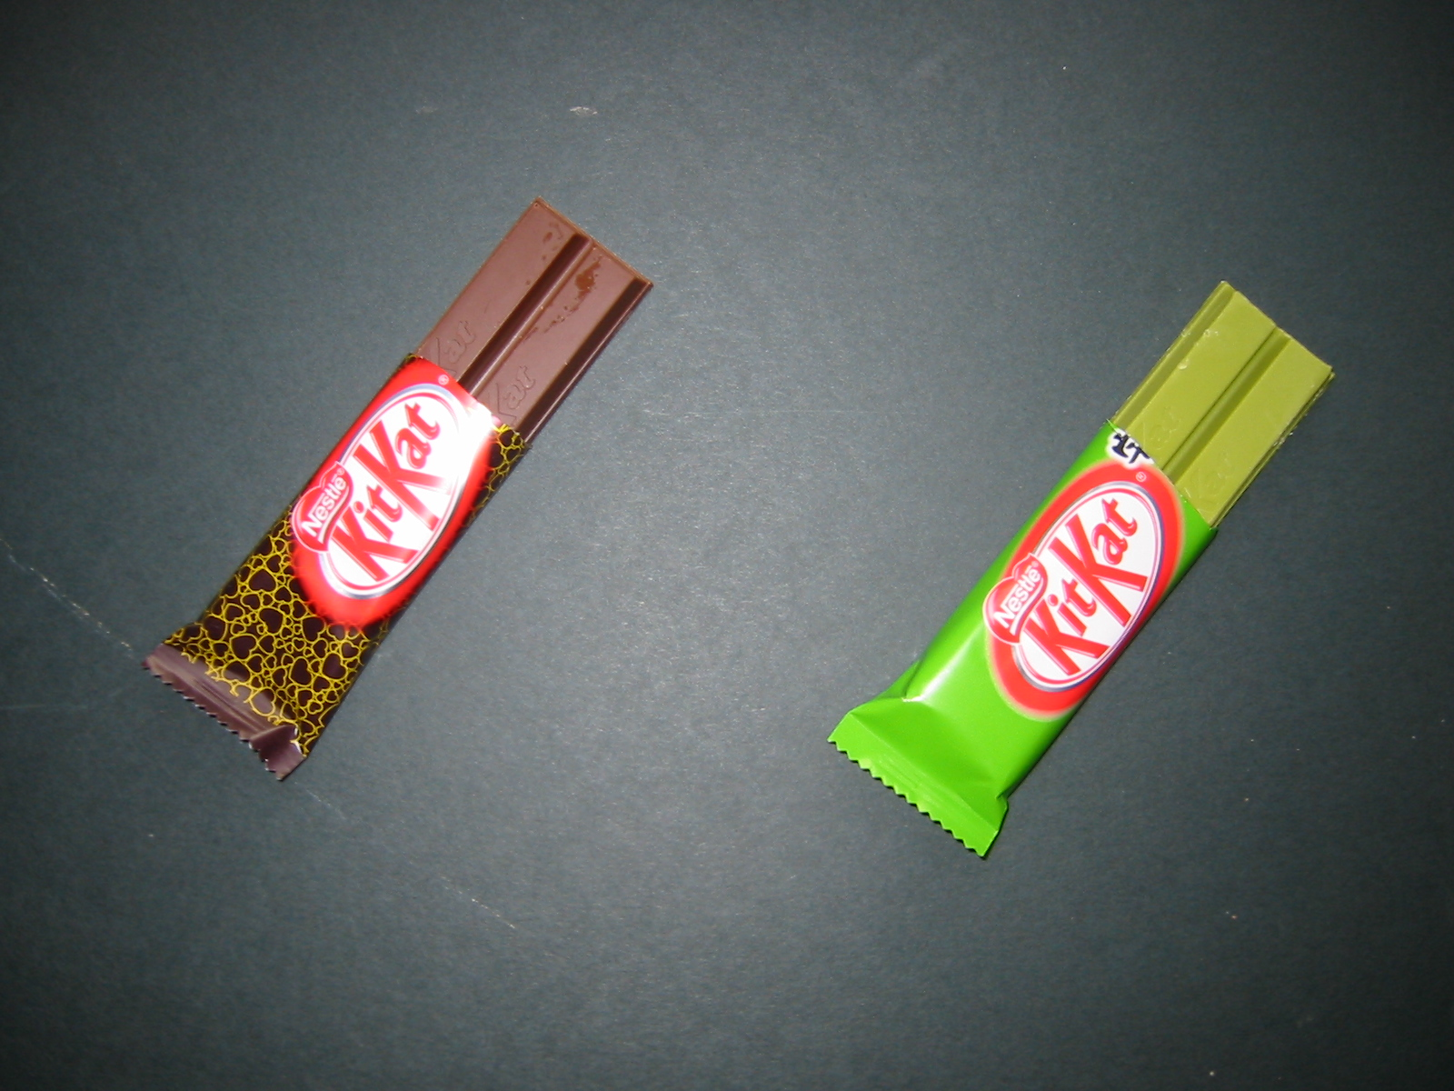
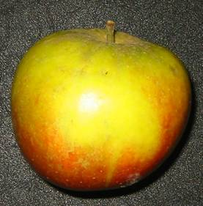
GReEN CHEMISTRY
NOT GREENER
BETTER

Slide 30


TOOLBOX MODEL
Traditional processes
Green processes

Slide 31

We NEED MORE and DIFFERENT people inventing materials.
DIVERSITY
PURPOSE
SCIENCE LITERACY

Slide 32

ACS Green Chemistry Institute
Catalyzing green chemistry and engineering to promote sustainability, prosperity, and equity across the global chemistry enterprise.
Strategic Areas
Advancing Science
Advocating for Education
Accelerating Industry
Facilitating Equity
American Chemical Society

Slide 33
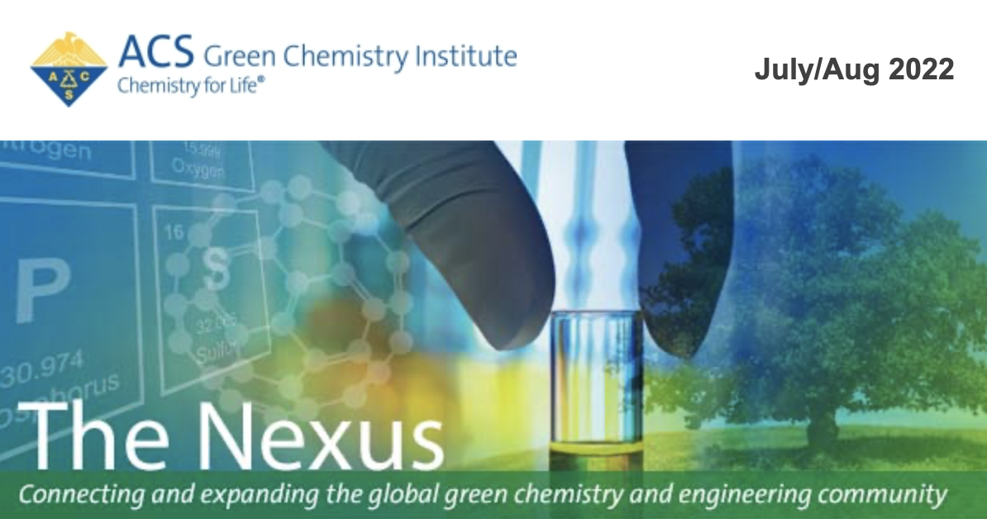
Green Chemistry Institute
Science
Advancing green and sustainable research and innovation.
  Identifying innovation and funding gaps
  Guiding and facilitating research towards knowledge gaps
  Facilitating translation to industry
  Communicating and advocating for green chemistry research
  Celebrating and disseminating success stories
Notes:
Goal 1: Engage researchers, industry decision makers, and other stakeholders to incorporate sustainability into the practice and use of chemistry.
Goal 2: Equip ACS leaders and members, and other advocates to be influential voices about policies in sustainable chemistry via development and dissemination of appropriate tools for the relevant audiences.
Goal 3: Engage networks of chemists and stakeholders to advance sustainability education and communication.

Slide 34
Green Chemistry Institute
Education
Advancing chemistry-focused education in green and sustainable chemistry.
  Facilitate adoption of green chemistry and sustainability across the curriculum
  Promoting grassroots adoption of green chemistry in industry via professional training
  Provide strategic advice and best practices for universities
Notes:
Goal 1: Engage researchers, industry decision makers, and other stakeholders to incorporate sustainability into the practice and use of chemistry.
Goal 2: Equip ACS leaders and members, and other advocates to be influential voices about policies in sustainable chemistry via development and dissemination of appropriate tools for the relevant audiences.
Goal 3: Engage networks of chemists and stakeholders to advance sustainability education and communication.

Slide 35
Green Chemistry Institute
Industry
Accelerate industrial adoption of green chemistry and engineering
  Convene industry groups to collaborate, set goals and benchmarks towards sustainability goals through Roundtables
  Accelerate chemistry startups targeting sustainability
  Provide mechanism to match industry innovation needs/gaps to research products and expertise
Notes:
Goal 1: Engage researchers, industry decision makers, and other stakeholders to incorporate sustainability into the practice and use of chemistry.
Goal 2: Equip ACS leaders and members, and other advocates to be influential voices about policies in sustainable chemistry via development and dissemination of appropriate tools for the relevant audiences.
Goal 3: Engage networks of chemists and stakeholders to advance sustainability education and communication.

Slide 36
Green Chemistry Institute
Equity
Facilitate equitable adoption of green chemistry, engineering and sustainability practices worldwide
  Identify and help minimize/remove barriers to adoption of green chemistry practices in underdeveloped economies.
  Connect researchers from underdeveloped countries to resources and facilities across the world to help accelerate development of locally-appropriate technologies.
  Support the development of “local” green chemical processes, i.e. ones that are specifically tailored to resources, needs and challenges of communities and regions.
Notes:
Goal 1: Engage researchers, industry decision makers, and other stakeholders to incorporate sustainability into the practice and use of chemistry.
Goal 2: Equip ACS leaders and members, and other advocates to be influential voices about policies in sustainable chemistry via development and dissemination of appropriate tools for the relevant audiences.
Goal 3: Engage networks of chemists and stakeholders to advance sustainability education and communication.

Slide 37

Thank you
Adelina Voutchkova
gci@acs.org
https://www.acs.org/greenchemistry

